Slide 1

AI231108-03
CSSM Concept Green Book
G2 – outline proposal concept
CCSDS Teleconference
04 April 2024
Marcin Gnat, DLR/GSOC

Slide 2
Intro
The “Extensible Space Communication Cross Support – Service Management – Concept” Green Book (G1) has been released in 2014 (we have 10 years anniversary ☺)
Many concepts of the concept book are not completely valid anymore, some of the contents belong conceptually rather to the Functional Resource Model
Large portions of the book include enterprise models and considerations, which however do not make things clear enough, rather the opposite is the case.
This presentation tries to show the proposed new outline and contents of the G2 release. The main objective: streamline the G2, make it shorter and more comprehensive.

Slide 3
Naming
The “Extensible Space Communication Cross Support – Service Management – Concept” is a title which was made many years ago in expectation to cover for very large portion of the Service Management world.
Proposal:
  Change the title to “Extensible Cross Support Service Management Concept”
  Generally remove SCCS as term/acronym and replace it with CSSM
  Do not use CSSS term anymore (Cross Support Service System). It makes text reading hard, it’s barely explained and it’s completely not used in any of our blue/magenta books.

Slide 4
Outline (1/3)
1 INTRODUCTION
1.1 PURPOSE OF THIS REPORT
1.2 BACKGROUND
1.3 SCOPE
1.4 APPROACH
1.5 DOCUMENT ORGANIZATION
1.6 DEFINITIONS
1.7 REFERENCES
2 CONCEPT OVERVIEW
2.1 WHAT IS THE EXTENSIBLE SPACE COMMUNICATION CROSS SUPPORT SERVICE MANAGEMENT CONCEPT?
2.2 SCCS SERVICE MANAGEMENT ENTERPRISE MODEL
2.3 INFORMATION ENTITIES
2.4 EXTENSIBILITY OF SCCS SM INFORMATION ENTITIES
2.5 MANAGEMENT SERVICES
2.6 ROADMAP
3 SCCS SERVICE MANAGEMENT ENTERPRISE MODEL
3.1 GENERAL
3.2 ORGANIZATIONAL DOMAINS IN THE SCCS SM ENTERPRISE MODEL
3.3 FUNCTIONAL VIEW
3.4 PHYSICAL VIEW
1 INTRODUCTION
1.1 PURPOSE OF THIS REPORT
1.2 BACKGROUND
1.3 SCOPE
1.4 APPROACH
1.5 DOCUMENT ORGANIZATION
1.6 DEFINITIONS
1.7 REFERENCES
2 CONCEPT OVERVIEW
2.1 WHAT IS THE EXTENSIBLE CROSS SUPPORT SERVICE MANAGEMENT?
2.2 CONTEXT AND LIFECYCLE OF CSSM
2.3 INFORMATION ENTITIES
2.4 EXTENSIBILITY OF CSSM INFORMATION ENTITIES
2.5 MANAGEMENT SERVICES
2.6 DEPENDANCY ON FUNTIONAL RESOURCE MODEL

Slide 5
Outline (2/3)
4 SCCS MISSION SUPPORT LIFECYCLE
4.1 GENERAL
4.2 SERVICE CATALOG CONSULTATION
4.3 SERVICE AGREEMENT DEVELOPMENT
4.4 SERVICE AGREEMENT PERIOD
5 INFORMATION ENTITIES
5.1 GENERAL
5.2 SERVICE CATALOG
5.3 PLANNING REQUEST
5.4 PROVISIONAL PLAN
5.5 SERVICE AGREEMENT
5.6 CONFIGURATION PROFILE
5.7 COMMUNICATIONS GEOMETRY
5.8 SUSTAINABLE DATA RATES & VOLUME ESTIMATES
5.9 RADIO FREQUENCY INTERFERENCE
5.10 RESOURCE CONFLICTS
5.11 COST ESTIMATES
5.12 SPACE LINK EVENT SEQUENCE
5.13 RESOURCE AVAILABILITY INFORMATION
5.14 TRAJECTORY PREDICTION SEGMENT
5.15 SERVICE PACKAGE REQUEST
5.16 SERVICE PACKAGE
5.17 SCHEDULE OF SERVICES
5.18 SERVICE PACKAGE EXECUTION EVENT NOTIFICATION
5.19 ACCOUNTING REPORT
5.20 INFORMATION ENTITY CROSS-REFERENCING FRAMEWORK
3 CSSM MISSION SUPPORT LIFECYCLE
3.1 GENERAL
3.2 SERVICE CATALOG CONSULTATION
3.3 SERVICE AGREEMENT DEVELOPMENT
3.4 SERVICE AGREEMENT PERIOD
4 CSSM INFORMATION ENTITIES
4.1 GENERAL
4.2 SERVICE CATALOG
4.3 PLANNING INFORMATION REQUEST
4.4 COMMS PLANING INFORMATION
4.5 SERVICE AGREEMENT
4.6 CONFIGURATION PROFILE
4.7 …
4.8 …
4.9 …
4.10 …
4.11 …
4.12 SPACE LINK EVENT SEQUENCE
4.13 RESOURCE AVAILABILITY INFORMATION
4.14 …
4.15 SERVICE PACKAGE REQUEST
4.16 SERVICE PACKAGE
4.17 SCHEDULE OF SERVICES
4.18 …
4.19 ACCOUNTING REPORT
4.20 …
5 ANCILLARY INFORMATION ENTITIES
5.1 SICF
5.2 DDOR PATTERN
5.3 TRAJECTORY INFORMATION (ODM)

Slide 6
Outline (3/3)
6 EXTENSIBILITY OF SCCS SM INFORMATION ENTITIES
6.1 CONCEPTS OF INFORMATION ENTITY EXTENSIBILITY
6.2 EXTENSIBILITY OF THE SERVICE AGREEMENT AND CONFIGURATION PROFILE INFORMATION ENTITIES
6.3 EXTENSIBILITY OF THE SERVICE PACKAGE REQUEST AND
SERVICE PACKAGE INFORMATION ENTITIES
6.4 EXTENSIBILITY OF PLANNING DATA INFORMATION ENTITIES
7 MANAGEMENT SERVICES
7.1 GENERAL
7.2 SCCS SM INFORMATION ENTITIES IN PROVIDER-SPECIFIC MANAGEMENT SERVICES
7.3 EXTENSIBLE SCCS MANAGEMENT SERVICES
8 ROADMAP
8.1 OVERVIEW
8.2 DELIVERABLES
ANNEX A ACRONYMS AND ABBREVIATIONS
ANNEX B COMPARISON OF THE SCCS SM ENTERPRISE MODEL TO THE CROSS SUPPORT REFERENCE MODEL, PART 1: SPACE LINK EXTENSION
ANNEX C SYSML SCCS SERVICE MANAGEMENT ENTERPRISE MODEL
ANNEX D SOLAR SYSTEM INTERNETWORK ENTERPRISE MODEL
ANNEX E SERVICE COMPONENTS AND FUNCTIONAL RESOURCE
TYPES USED BY THE EXAMPLE AOS AND TELECOMMAND MISSIONS
6 EXTENSIBILITY OF CSSM INFORMATION ENTITIES
6.1 CONCEPTS OF INFORMATION ENTITY EXTENSIBILITY
6.2 EXTENSIBILITY OF THE SERVICE AGREEMENT AND CONFIGURATION PROFILE INFORMATION ENTITIES
6.3 EXTENSIBILITY OF THE SERVICE PACKAGE REQUEST AND
SERVICE PACKAGE INFORMATION ENTITIES
6.4 EXTENSIBILITY OF PLANNING DATA INFORMATION ENTITIES
7 MANAGEMENT SERVICES
7.1 GENERAL
7.2 CSSM INFORMATION ENTITIES IN PROVIDER-SPECIFIC MANAGEMENT SERVICES
7.3 EXTENSIBLE CSSM MANAGEMENT SERVICES
8 ROADMAP
8.1 OVERVIEW
8.2 DELIVERABLES
ANNEX A ACRONYMS AND ABBREVIATIONS
ANNEX B SANA/GITHUB CONSIDERATIONS (???)
ANNEX C CLOUD COMPUTING AND SSI CONSIDERATIONS (???)

Slide 7
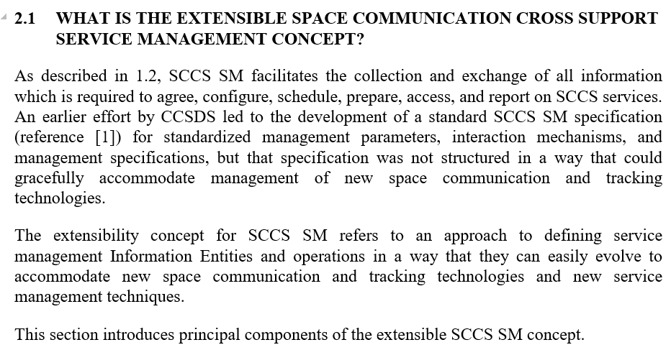
Details
Chapter 2
Chapter 2.1
Okay as such, needs just rework to bring it up to date

Slide 8
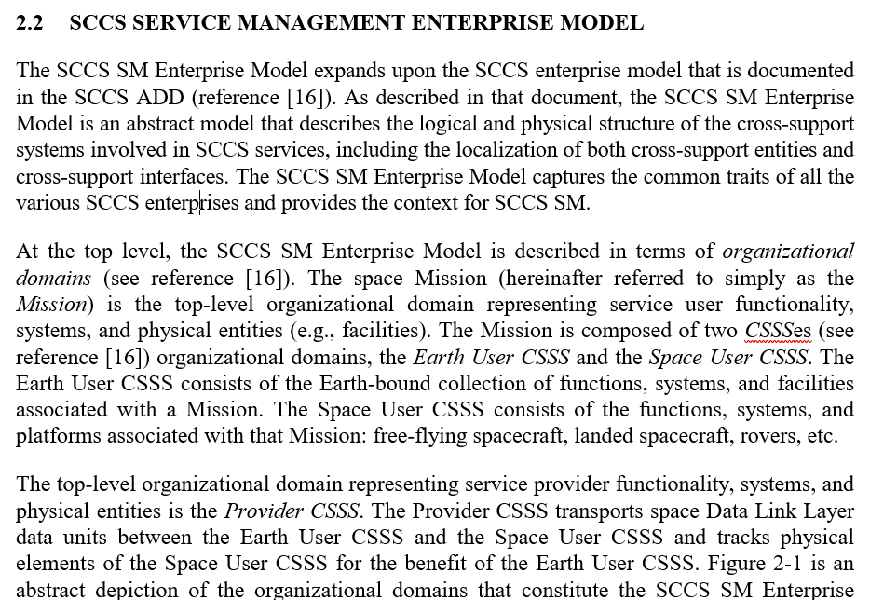
Details
Chapter 2
Chapter 2.2
Scrap these things and belonging text. Replace it with some more to the bottom explanation of “yes, there is a service provider and service user, and they want to schedule things”

Slide 9
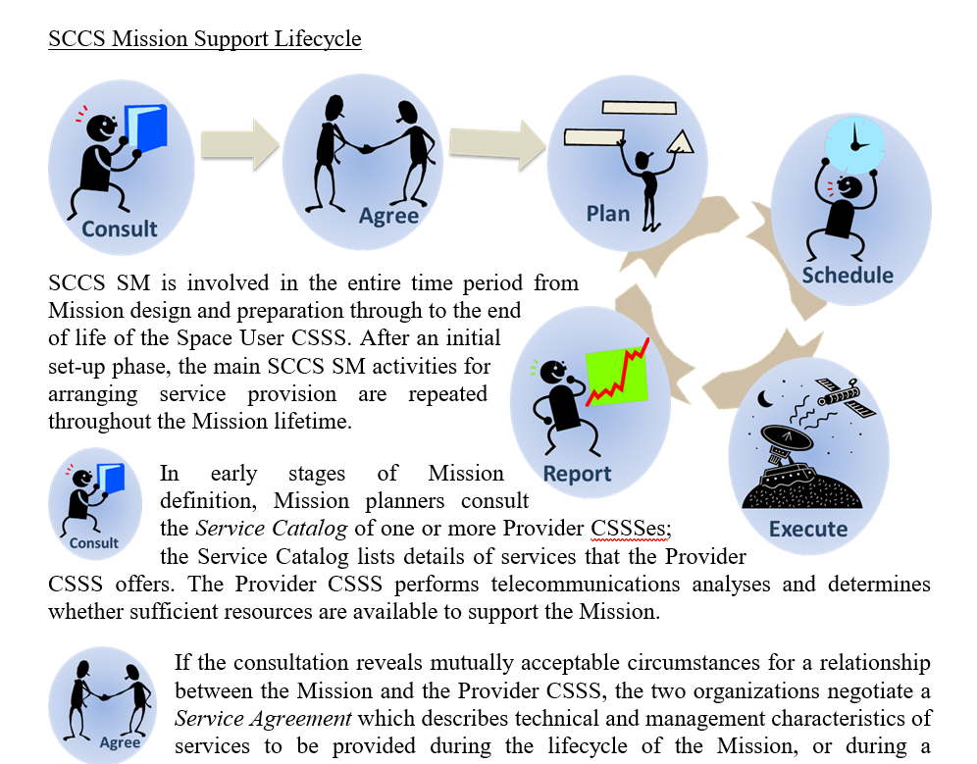
Details
Chapter 2
Chapter 2.2
Keep this, just maybe slightly reworking/updating. Alternatively move it to CSSM MISSION SUPPORT LIFECYCLE chapter.

Slide 10
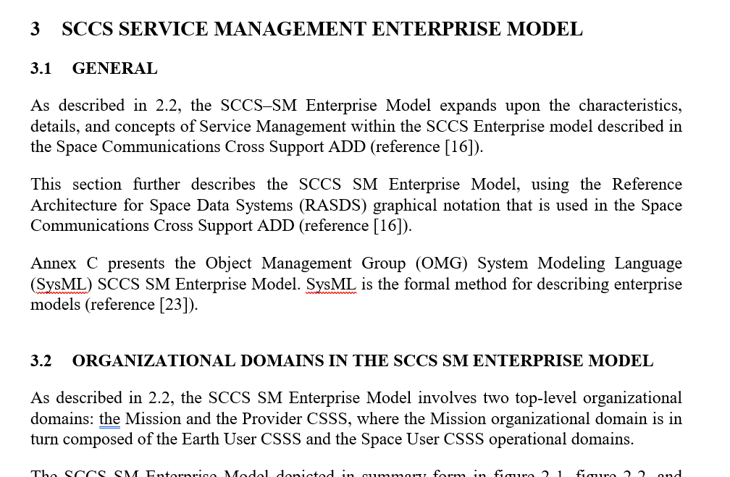
Details
Chapter 3
Scrap this altogether. Nobody is going to read this, yet understand.

Slide 11
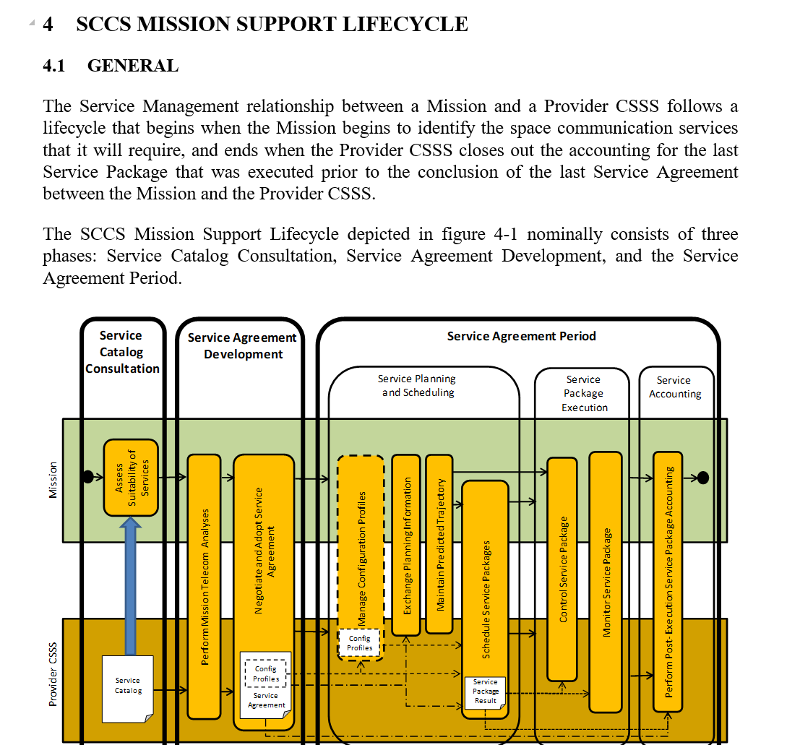
Details
Chapter 4
Keep it, just some review / updates needed. Chapter renumbered to 3.

Slide 12
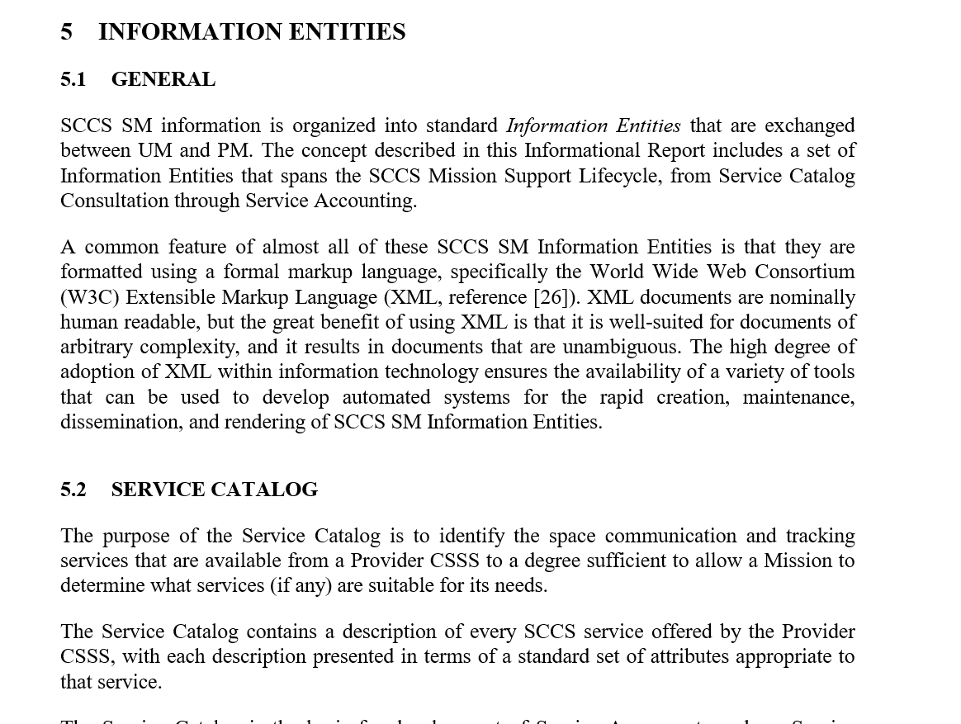
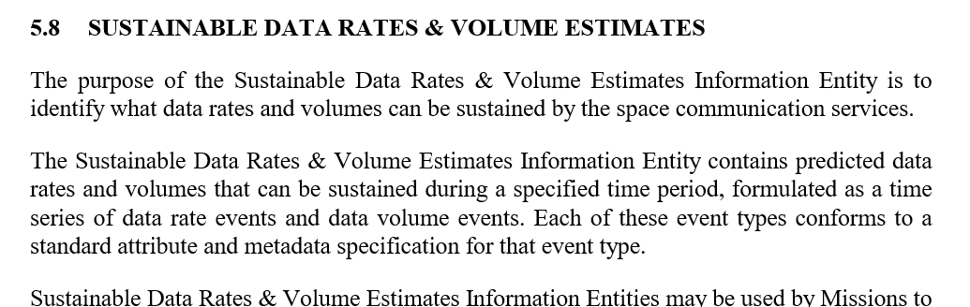
Details
Chapter 5
Keep it in general. Chapter renumbered to 4.
Remove (in my opinion) obsolete subsections on:
Comms Geometry (it goes into CPIF anyway)
Sustainable Data Rates / Volumes
RFI
Resource Conflicts
Cost Estimates
Trajectory Prediction Segment (see next page as well)
Service Package Execution Event Notification (will be covered by Management Services)
Cross-Referencing Framework → does not fit here really, and questionable if we shall keep it at all (Annex??? TBD)
Rename chapters of:
Planning Request → Planning Information Request (more precise)
Provisional Plan → Comms Planing Information (CPIF, more precise, includes Comms Geometry stuff)
Resource Availabiltiy Information → name can stay, content needs to fit the Antenna Free Time of SSF

Slide 13
Details
Chapter 5 (new)
Add new chapter including “ancillary” information entities, which should be named here, as they are used by CSSM:
ODM (TLE, OEM, etc…)
DDOR Patterns
SICF

Slide 14
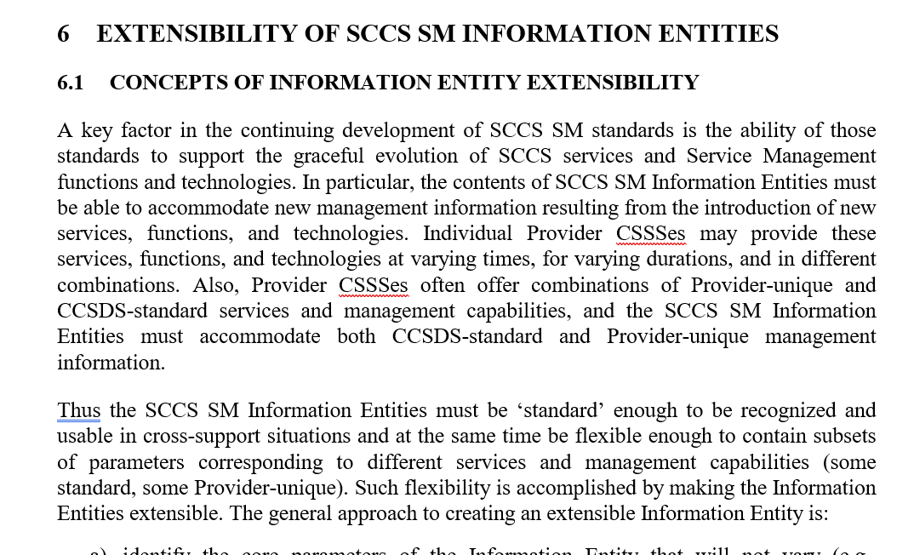
Details
Chapter 6
Keep it in general. Needs significant rework to show specific aspects of:
Additional, custom schemas which can be used
modResParm
Relation/mechanism to the FRM schemas for individual Functional Resources
Explanation why we have AED and CDE magenta books, and what’s inside
Get rid of deeper explanations on Abstract Service Components (this is a domain of FRM itself) – chapter 6.2.2, 6.2.3, 6.2.4

Slide 15
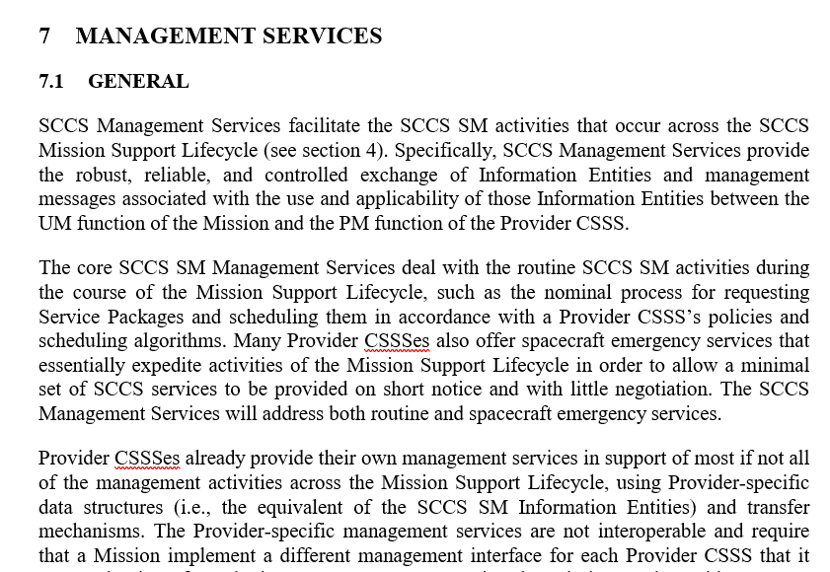
Details
Chapter 7
Keep it in general. The chapter is currently very short and probably we could write something more to that (something in direction actual services, REST, etc… in essence what has been until now discussed in etrms of development of SMASH)

Slide 16
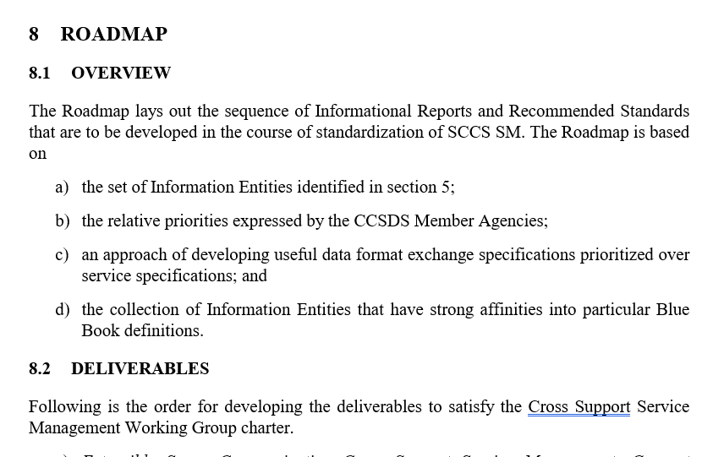
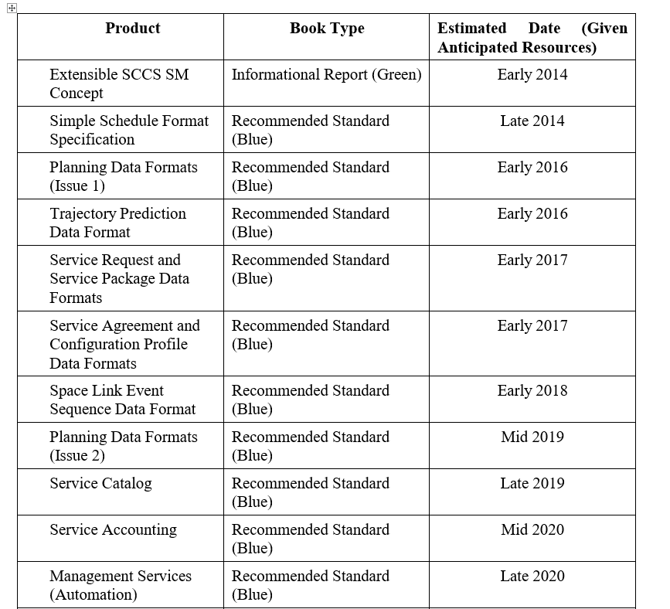

Details
Chapter 8
For the moment I left it here, but maybe we do not need it anyway. In case we do, we should significantly update it.

Slide 17
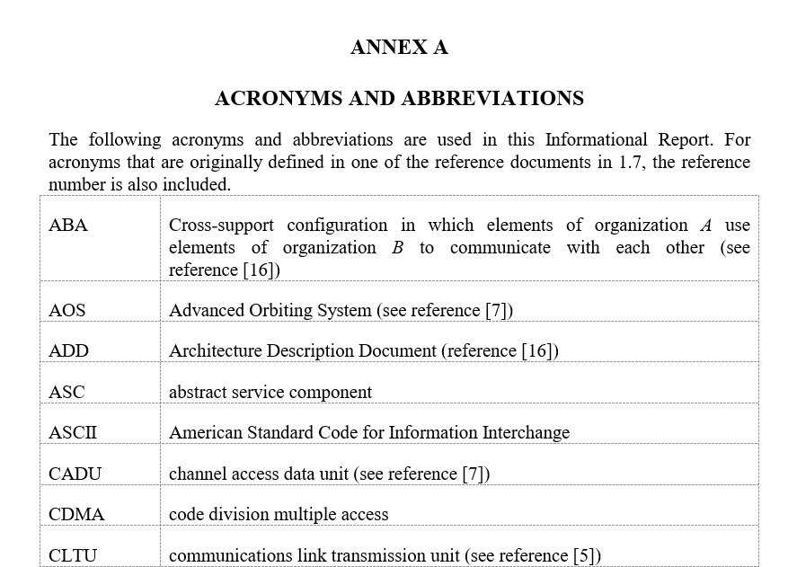
Details
Annex A
Ok, maybe needs an update.

Slide 18
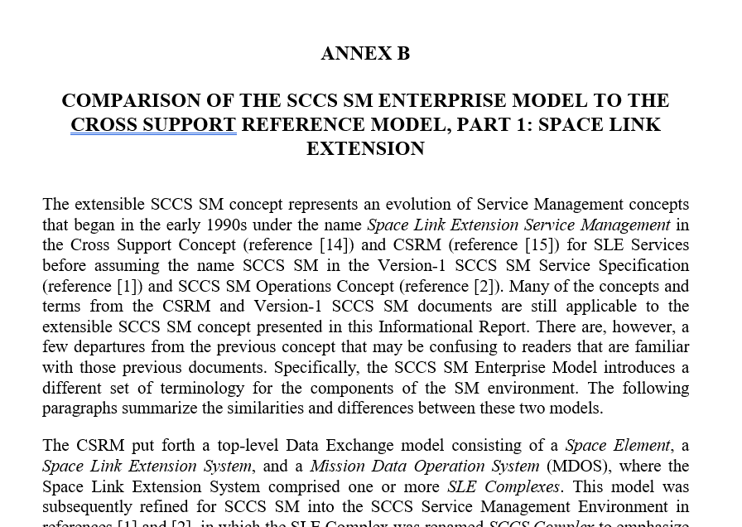
Details
Annex B
Not clear to me, what it is trying to say. Propose to delete it.

Slide 19
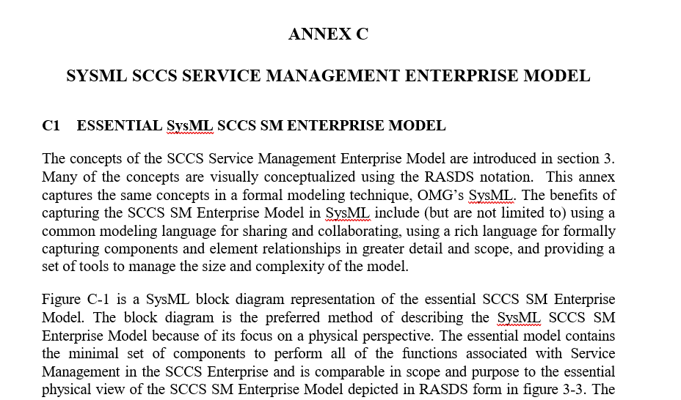
Details
Annex C
Yikes! Delete it….

Slide 20
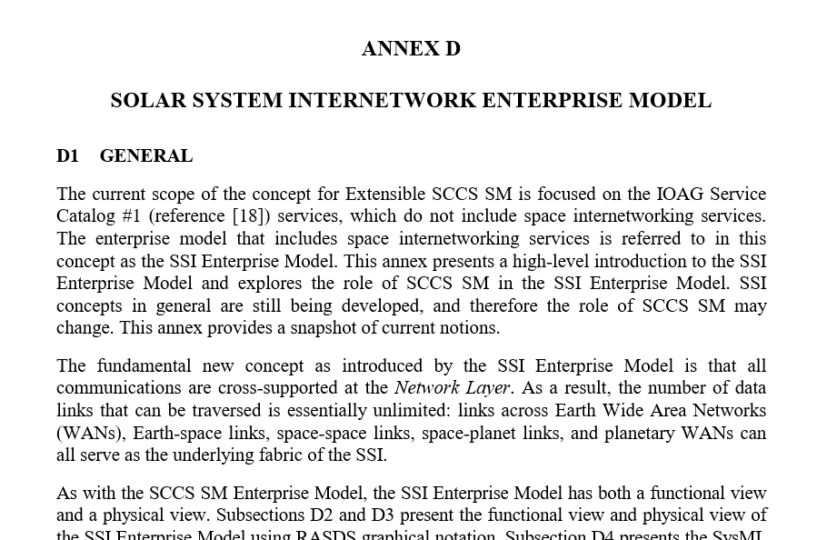
Details
Annex D
And here we have DTN….
Seems to me way too complicated to put it in Annex (=nobody cares) and principal question if we want to tackle on ABBA and other SSI things at all. Proposal to delete.

Slide 21
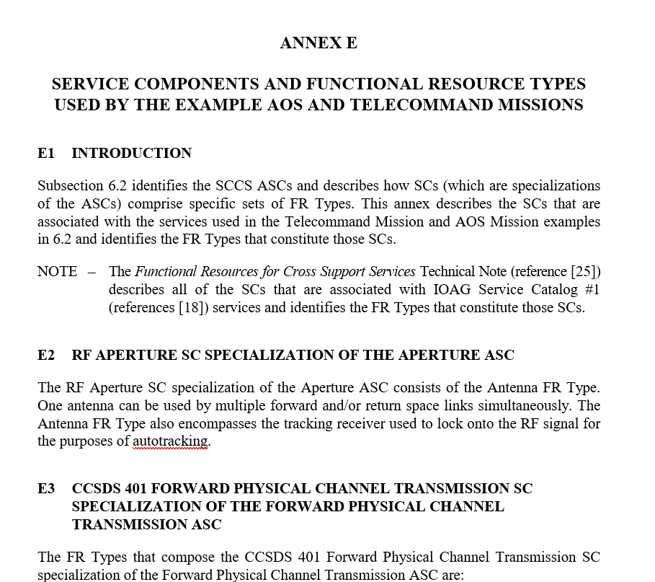
Details
Annex E
Not clear to me, what it is trying to say. Propose to delete it.

