Slide 1

SEA SM & Configuration Model Analysis
Review of FRM, EDS, Component,
Protocol, ICS, & MIB relationships
Presenter: P. Shames
Updated 19 Jan 2022

Slide 2
SEA FRM & EDS Model Comparison
This FRM & EDS model comparison documents how various abstract and concrete systems architecture elements relate :
  Functional Resource Model (FRM): a formalized abstract model of functional resources (i.e. “abstract components”) that are tied to specific protocol behaviors; the model abstractly describes interfaces and behaviors, and several FRs may be assembled to describe “as implemented” components. The FRM also formalizes the definition of control elements and parameters inside Functional Resources so that they may be monitored and controlled.
  Electronic Data Sheet (EDS): a formalized description of the interfaces and exposed behaviors (at those interfaces) of actual, realized components (hardware or software). The EDS is an interoperable specification that may be embedded in, or somehow associated with, an realized component that implements one of more protocols or other behaviors. An EDS might potentially be used to formalize a MIB description, which is often abstract, but this is not required.
  Component: a fully realized element of a system that implements one or more protocols or other system or application functions. This may be implemented using hardware, software, firmware or some combination of these techniques. The interfaces and behavior of a realized component may be described by an EDS. The abstract Functional Resources that a Component implements internally might be defined by one or more FRs, but this is unspecified at present. The Component may expose, or not, aspects of one or more protocol MIBs at a management interface.

Slide 3
SEA FRM & EDS Model Comparison
  Protocols: concrete on the wire PDUs and protocol entity behaviors, abstract Service Access Point (SAP), abstract MIB, and PICS (ideally). Protocols must be unambiguous specifications and capable of interoperability.
  Implementation Conformance Specification (ICS): a table of all the mandatory and optional requirements met by a specific protocol implementation, a filled out instance of a PICS.
  Management Information Base (MIB): an abstract list of the parameters that control protocol implementation behavior; may, or may not, be realized inside the implementation or at an exposed implementation interface. A MIB is not itself an interoperable element, but the controlling parameters in both implemented protocol peers must be matched for interoperability to take place.
These different types of model elements may be used in developing architecture descriptions of different systems.
  Abstract systems elements and their transformation into concrete (fully realized) systems elements
  Concrete elements assembled to create views of implemented (or in design) space systems, ground systems, launch systems, operational systems
  These elements are also used to construct network views, deployment views, service views, management views, etc
  Other views, data and control, deployments, and domain boundaries will use specific instances of these elements shown from different viewpoints

Slide 4
Concepts are transformed into Realizations
Conceptual View
Realized View
Std defines a protocol, PDUs, behavior & abstract SAPs
FRM typically references one or more Protocol specs
EDS(es) define concrete Component interfaces & behavior
EDS
TC S&CC
protocol
FRM
Protocol includes a PICS pro forma and often an abstract MIB
MIB
TC S&CC
protocol
EDS may be used to document actual MIB
FRM identifies one or more abstract Functional Resources (FR).
PICS
Component implements one or more protocols
agent
TC PLOP, Sync
and Channel
Encoding
TC PLOP, Sync
and Channel
Encoding
FRM
Design
Transformation
FRM may define parameters for monitor and/or control.
ICS documents implemented Protocol features
ICS
Conceptual views define abstract system elements, make reference to various standards, and parts of them, but make no references to actual implementations nor allocations of functions to Nodes. Protocol specs (plus PICS & MIB), and FRM, may be used to document different aspects of the conceptual design.
Realized views define concrete Components and define their interfaces and exposed behavior at these interfaces. They document how Components have implemented various standards (in HW/SW), and define allocations of functions to Nodes. EDS, a filled out ICS for the implementation, and FRM may be used to document the Component.

Slide 5
Conceptual Model Relationship Diagram
Standard describes
protocol features,
PDUs, behavior,
and possibly SAPs
Each FR
references
a standard
FRM
FRM describes
Abstract element
behaviors, abstract
I/Fs & connectivity
FRM
App
protocol
FRM
Abstract
Peer
Component
Abstract
Component
App Protocol
Sub-Element
App
PDU
App Protocol
Peer Interaction
Protocol describes PDU
& protocol behavior that
must be implemented
Link
Sub-Element
MIB (part of standard)
describes abstract
Protocol controls
Link
PDU
Link Protocol
Peer Interaction
Coding & RFM
Sub-Element
C&S / RFM Protocol
Peer Interaction
C&S / RFM
PDU
PICS
PICS (part of standard)
describes required /
optional protocol features
Logical
Interaction

Slide 6
Concrete Component Relationship Diagram
FRM
FRM describes element behaviors, and parameters for monitor and/or control.
EDS
EDS describes interfaces
& behavior of whole (or parts)
Real Component
FRM
FRM
Real
Component
Real Peer
Component
App Protocol
Sub-Element
App
PDU
App Protocol
Peer Interaction
Protocol describes PDU
& protocol behavior that
element must implement
Link
Sub-Element
MIB describes abstract Protocol controls (may be documented by EDS)
Link
PDU
Link Protocol
Peer Interaction
Coding & RFM
Sub-Element
C&S / RFM Protocol
Peer Interaction
C&S / RFM
PDU
ICS
ICS describes
protocol features
as Implemented
Physical
Interaction

Slide 7
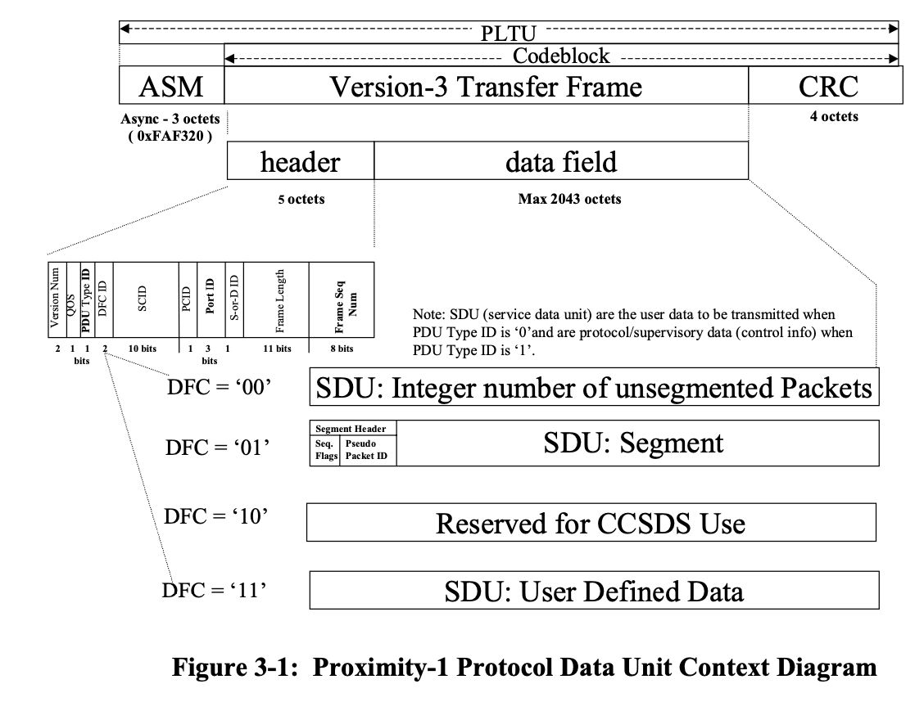
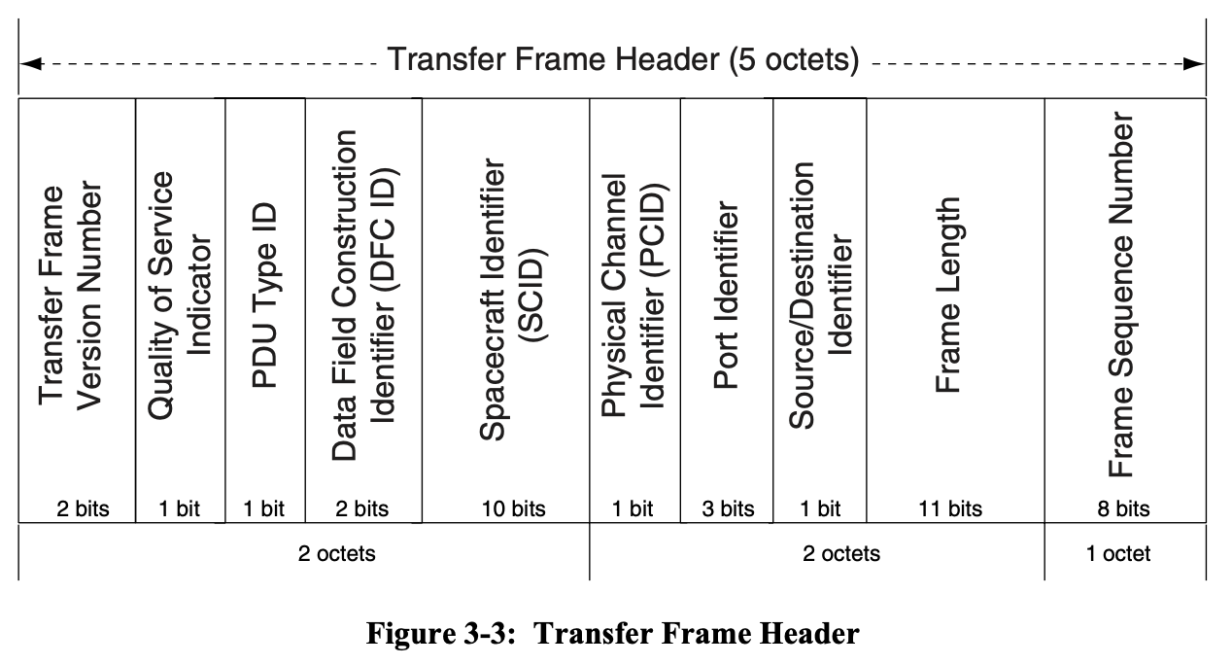
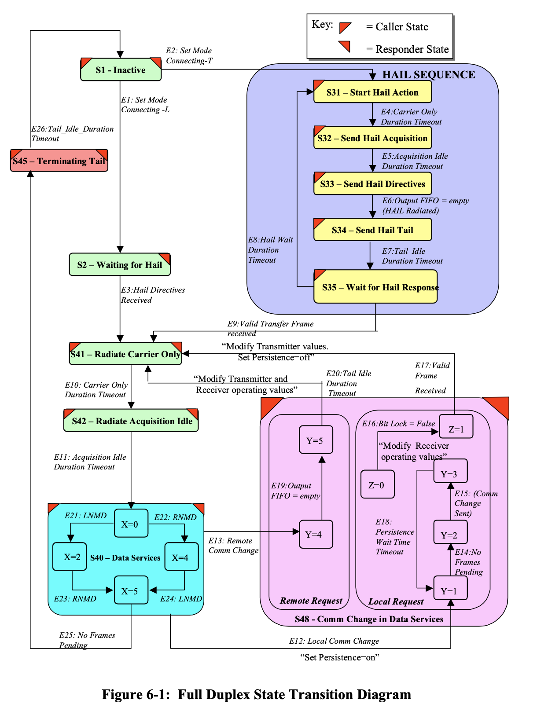
Protocol: PDU, Layered Model, and Protocol Behavior
Prox-1 Example, CCSDS 211.0-B-4
  Protocols:
  Defined by concrete on the wire PDUs and protocol entity behaviors, abstract Service Access Point (SAP), abstract MIB, and PICS pro forma (ideally).
  Protocols must be unambiguous and capable of interoperability.
  A single Functional Resource (FR) will usually relate to only one such CCSDS standard.
  Some FR, such as “Aperture”, do not relate to a standard at all

Slide 8
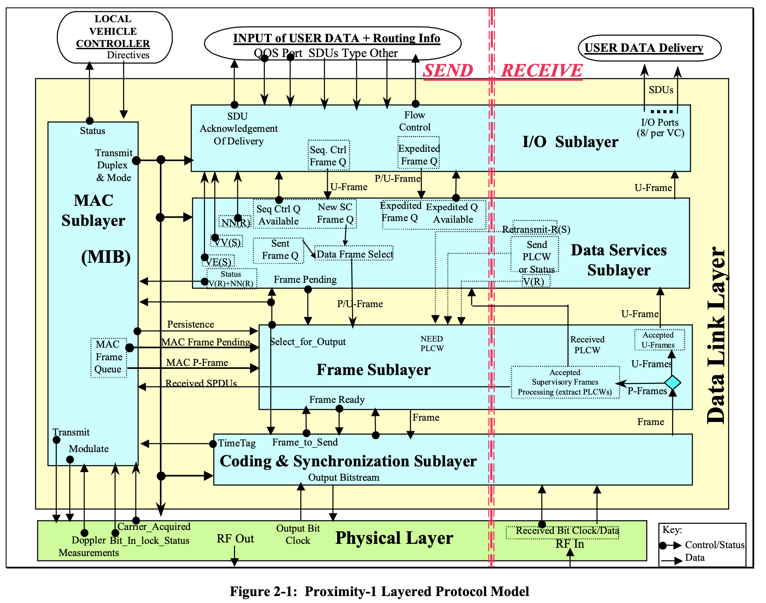
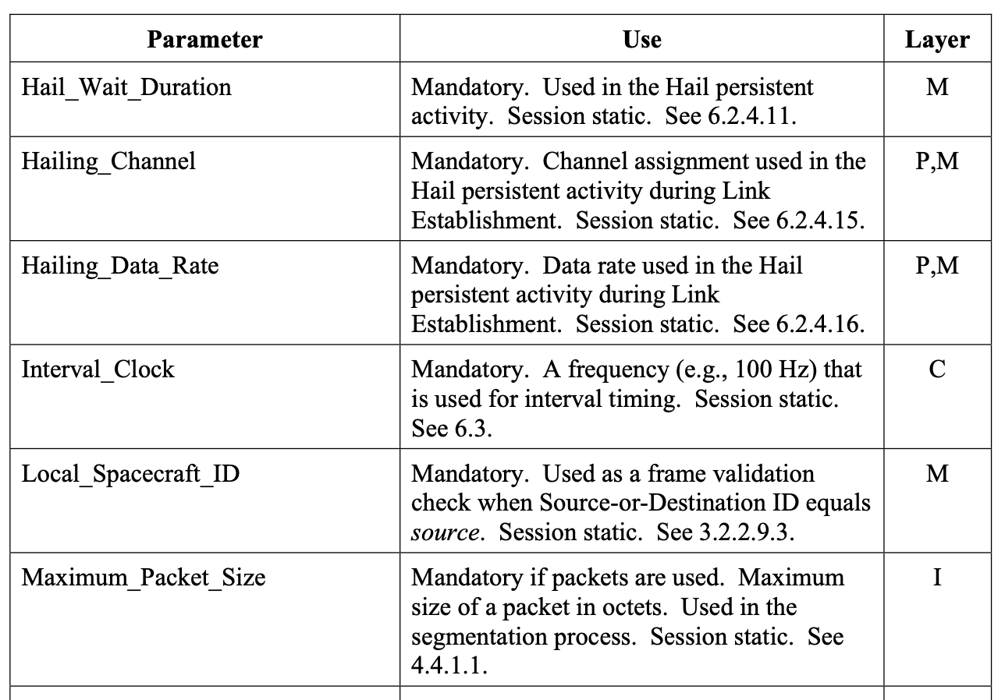
Protocol: Protocol Implementation Conformance Statement (PICS), Management Information Base (MIB)
Prox-1 Example, CCSDS 211.0-B-4
  Protocols:
  Most protocol stacks, like this Prox-1 version, are actually composed of several layers.
  Prox-1 defines its own frame, data services, coding and synch, and physical layers, other protocol specs may share layers.
  Prox-1 defines its own Media Access Control (MAC) sublayer and an associated abstract Management Information Base (MIB) that defines the controllable parameters used to configure the implemented protocol entity.
  The MIB, and the protocol ”service access points” are all defined as abstract, not concrete, entities
  When this protocol is implemented in a Component, the interfaces of that Component may be described by an Electronic Data Sheet (EDS) as shown in “dotted lines”.
The implemented interface of a “Radio” component may be defined by an EDS.
  A filled out PICS template, for a specific implementation of a protocol, is an ICS, and it specifies which mandatory and/or options features were actually implemented.

Slide 9
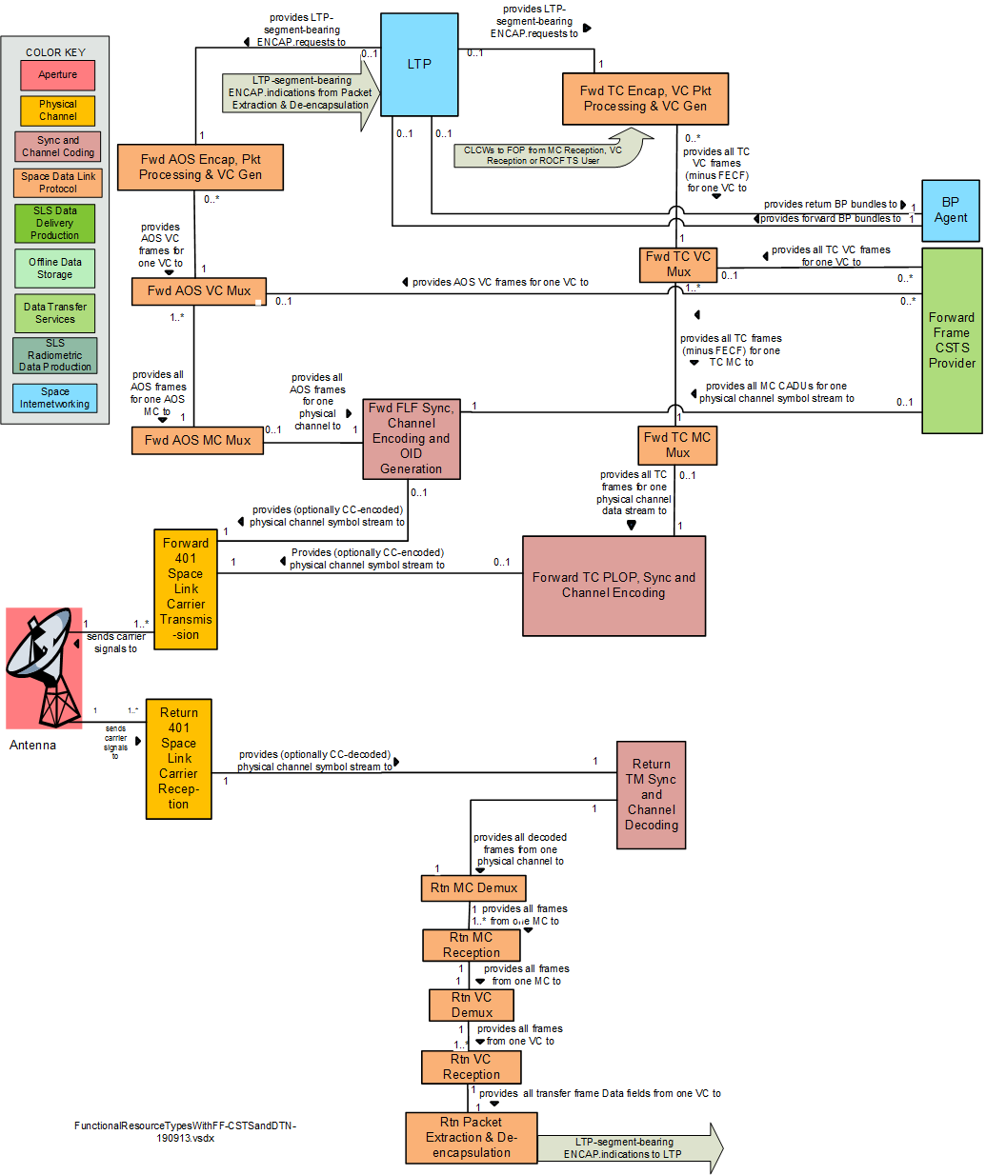
Functional Resource Model (FRM)
  Functional Resource Model (FRM):
  Each FR (colored box on this diagram) typically corresponds to a single CCSDS protocol or service document (or part thereof).
  A formalized abstract model of functional resources (i.e. “abstract components”) that implement specific protocol behaviors;
  The model describes abstract interfaces and behaviors, and the allowed ways that these FRs may be assembled (as shown) to describe “as implemented” components.
  The FRM formalizes the definition of control elements inside Functional Resources so that they may be monitored and controlled.
  The set of FRM’s is created and managed in a toolchain that can export XML (and other forms)
  FRM is intended to define functions in an Earth Space Link Terminal (ESLT), otherwise known as a ground station / complex, but they can be extended to define all protocol functions in any end-to-end element.
  A single realized Component, such as a “Radio” may implement more than one FR, as shown in “dotted lines”.
A “Radio” component implementing a set of FRs.

Slide 10
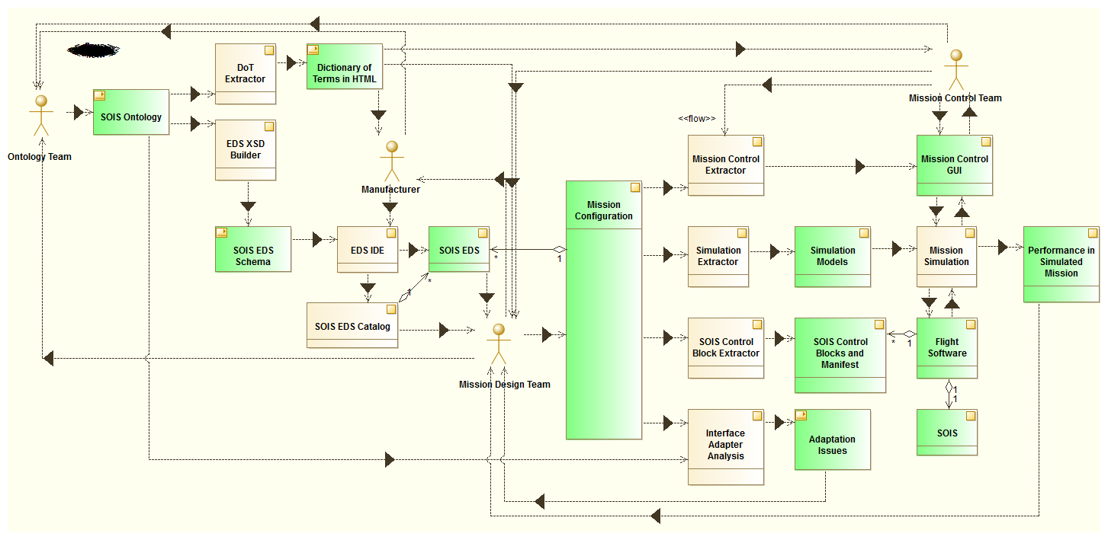
Electronic Data Sheet (EDS)
Example from CCSDS 371.0-G-1
  EDS:
  EDS has published a formalized Dictionary of Terms (DoT) and Component description framework to accurately define Devices, services, interfaces, behaviors, and [future] deployment configurations.
  The EDS descriptions may be ingested into tool chains to automatically generate specifications that can be used to generate software, APIs, and simulations.
Onboard System Functions
Applications
Model
Application Support Functions
Device Service
SO Electronic Data Sheet
specifies
Queues, Buffers
FlowIds
Software Bus
references
Subnet Functions
Dictionary of Terms
Management Services
references
references
Bus command
schedule
EDS tool chains
Deployment Description
specifies
Bus Controller
DIO
1553
describes
Device
Updated 2020 May 28
  Protocol Functional Resources (FR) could be adapted to document internal functions within the Component (Device in this diagram).
  Protocols are implemented within these Components

Slide 11
FRM used to describe abstract ESLT Functions
  FRM:
  FRM defines the Abstract Functional Resources needed to implement end-to-end data flows in planned systems.
  Each FR is tied to a specific Protocol specification (or parts of it), or other elements like Aperture.
  Each FR provides abstract descriptions of the functions and data that flows across interfaces for data, monitor, control, and management for the elements that implement communications functionality in a deployed system.
  The abstract parameters that are associated with each element are defined for Monitor Data (MD) and Service Control (SC) services, and eventually, for configuration by Service Management (SM).
  CSTS services are externally connect to these some of these functions and control parameters, and provide access to the different implementation interfaces for monitor data and service control.
ESLT
Provision Management (PM)
(UM)
Earth User CSSS
Element Management (EM)
agent
SC-CSTS
Provider
(frames)
Directives
SC-CSTS
MUE
agent
Parameters
and Events
MD-CSTS
Provider
(frames)
MD-CSTS
MUE
Space
Link to
Space User
Node
agent
agent
agent
agent
agent
agent
Antenna
CCSDS 401 Space
Link Carrier
Transmission
TC PLOP, Sync
and Channel
Encoding
TC MC
Multiplexing
TC VC
Multiplexing
FF-CSTS
Provider
(frames)
Frames
FF-CSTS
MUE
Earth Space Link Terminal
space link/transfer service data
UM/PM Service Management interface
PM/EM interface
Line Legend:
Functional resource-based interactions between EM and FRs
Functional resource-based interactions among FRs

Slide 12
EDS could be used to describe Concrete ESLT Cross Support Elements
  FRM & EDS:
  FRM defines the Abstract Functional Resources needed to implement end-to-end data flows in planned systems.
  Different concrete components may implement one or more FRs.
  Each concrete component has real interfaces that may be described by an EDS .
  An EDS could be used to describe the actual data that flows across control and management interfaces for the concrete elements that implement communications functionality in a deployed system.
  Components may have separate input, output, and management interfaces, each with a separate EDS.
  The parameters that are associated with each element may be made accessible via agents that interface to SM configuration, SC control, and MD monitoring services.
Provision Management (PM)
(UM)
Element Management (EM)
Earth User CSSS
agent
SC-CSTS
Provider
(frames)
Directives
SC-CSTS
MUE
agent
Parameters
and Events
MD-CSTS
Provider
(frames)
MD-CSTS
MUE
Space
Link to
Space User
Node
agent
agent
agent
agent
agent
agent
Antenna
CCSDS 401 Space
Link Carrier
Transmission
TC PLOP, Sync
and Channel
Encoding
TC MC
Multiplexing
TC VC
Multiplexing
FF-CSTS
Provider
(frames)
Frames
FF-CSTS
MUE
Earth Space Link Terminal
Electronic Data Sheet (EDS) – one per component interface
space link/transfer service data
UM/PM Service Management interface
PM/EM interface
Line Legend:
Functional resource-based interactions between EM and FRs
Functional resource-based interactions among FRs

Slide 13
Using a Proxy Agent to control different Concrete ESLT Elements
  Proxy Agent:
  Different concrete Components may implement one or more FRs.
  Each concrete Component has a native interface that may be described by an EDS.
  Each Component may have separate & unique management interfaces, each with a separate EDS.
  A Proxy Agent Management element may be used to provide a single common management interface protocol for Element Management, MD and SC purposes.
  EDS may be used to describe the unique component interfaces and the Proxy Agent interfaces.
Provision Management (PM)
(UM)
Element Management (EM)
Earth User CSSS
Proxy Agent Management
agent
proxy
agent
proxy
agent
proxy
agent
proxy
agent
proxy
agent
SC-CSTS
Provider
(frames)
Directives
SC-CSTS
MUE
agent
Parameters
and Events
MD-CSTS
Provider
(frames)
MD-CSTS
MUE
Space
Link to
Space User
Node
agent
agent
agent
agent
agent
agent
Antenna
CCSDS 401 Space
Link Carrier
Transmission
TC PLOP, Sync
and Channel
Encoding
TC MC
Multiplexing
TC VC
Multiplexing
FF-CSTS
Provider
(frames)
Frames
FF-CSTS
MUE
Earth Space Link Terminal
Electronic Data Sheet (EDS) – one per component interface
space link/transfer service data
UM/PM Service Management interface
PM/EM interface
Line Legend:
Functional resource-based interactions between EM and FRs
Functional resource-based interactions among FRs

Slide 14
FRM could be used to describe abstract Spacecraft Comm Subsystem Elements
  FRM:
  FRM defines the Abstract Functional Resources needed to implement end-to-end data flows in planned ESLT systems.
  Each FR is tied to a specific Protocol specification (or parts of it).
  Each FR could be modified to provide abstract descriptions of the data that flows across interfaces for data, monitor, control, and management for spacecraft elements that implement the functionality in a deployed spacecraft comm system.
  The abstract parameters that are associated with each element could be modified for comm subsystem (Management) configuration, comm control (Control), and S/C monitor (Monitor) interfaces.
  Abstract interfaces may be defined connect to these elements and provide access to an abstract spacecraft implementation framework.
Spacecraft
Spacecraft
Control
Systems
Comm Subsystem Management (CSM)
Comm
SS
Process
Control
Directives
Spacecraft
Comm
Control
agent
Parameters
and Events
Monitor
Process
Spacecraft
Monitor
Space
Link to
ESLT
Node
agent
agent
agent
agent
agent
agent
Antenna
CCSDS 401 Space
Link Carrier
Transmission
TC PLOP, Sync
and Channel
Encoding
TC MC
Multiplexing
TC VC
Multiplexing
Frame Data
Process
Frames
Frame
Date
Sources
Spacecraft
space link/transfer service data
UM/PM Service Management interface
PM/EM interface
Line Legend:
Functional resource-based interactions between EM and FRs
Functional resource-based interactions among FRs

Slide 15
EDS & FRM could be used to describe Concrete Spacecraft Comm Subsystem Elements
  FRM & EDS:
  FRM defines the Abstract Functional Resources needed to implement end-to-end data flows in planned systems.
  Each FR could be modified to provide abstract descriptions of the data that flows across interfaces for data, monitor, control, and management interfaces for the spacecraft elements that implement communications functionality in a deployed system.
  Different concrete S/C components may implement one or more FRs.
  Each concrete component has real interfaces that may be described by an EDS .
  An EDS describes the actual data that flows across control and management interfaces for the concrete elements that implement the functionality in a deployed system.
  Components may have separate input, output, and management interfaces, each with a separate EDS.
  The parameters that are associated with each Component are defined for comm subsystem (Management) configuration, comm control (Control), and S/C monitor (Monitor) interfaces.
Spacecraft
Spacecraft
Control
Systems
Comm Subsystem Management (CSM)
Comm
SS
Process
Control
Directives
Spacecraft
Comm
Control
agent
Parameters
and Events
Monitor
Process
Spacecraft
Monitor
Space
Link to
ESLT
Node
agent
agent
agent
agent
agent
agent
Antenna
CCSDS 401 Space
Link Carrier
Transmission
TC PLOP, Sync
and Channel
Encoding
TC MC
Multiplexing
TC VC
Multiplexing
Frame Data
Process
Frames
Frame
Date
Sources
Spacecraft
Electronic Data Sheet (EDS) – one per component interface
space link/transfer service data
UM/PM Service Management interface
PM/EM interface
Line Legend:
Functional resource-based interactions between EM and FRs
Functional resource-based interactions among FRs

Slide 16
Some Final Comments - FRM
Functional Resources (FR) and the FR Model (FRM) were defined specifically by the CSS to abstractly document the FRs in a cross support system, and (initially) to provide a basis for standardized monitor data parameter names, which then grew into a DoT for configuratoin parameters, control directive parameters, etc.
The FRs are tied to protocols (or other functional elements), and they document abstract behaviors, connectivity, and parameters for reference by CSS Service Management (configuration, planning, scheduling) and for MD-CSTS and SC-CSTS monitor & control purposes.
They are largely about abstract, low level, systems elements and configurations absent real implementation details.
FRs were intended only for use in CSS / ESLT, but they are fundamentally an abstract model of elements that implement protocols, and could be re-defined, with some “polarity adjustments” *, to describe the protocol aspects of abstract systems elements anywhere protocols are implemented, in flight or on the ground.
* polarity adjustments = sending elements on ground need receiving elements on-board

Slide 17
Some Final Comments - EDS
Electronic Data Sheets (EDS) and the Dictionary of Terms (DoT) were defined specifically in SOIS to concretely document the interfaces and behaviors of components in on-board systems.
The EDS are tied to real Components (which may be implemented either by hardware or software) and their interfaces, they document concrete interface behaviors, and concretely document parameters, data structures, and interfaces for use by SOIS implementors and toolchains.
They are largely about concrete systems elements and real implementation details.
EDS were intended only for use in SOIS on-board systems, but they are a model of the interfaces of components that implement protocols, and could be used, with some “polarity adjustments”* anywhere components and their interfaces are defined, either in flight or on the ground.
* polarity adjustments = sending elements on ground need receiving elements on-board

Slide 18
“Normalization” of FRM & EDS
These two different approaches do overlap, to some extent, in terms of the elements that they reference: standards, the abstract and concrete elements that implement these standards, the interfaces of the components, the composition of these components, their behaviors, and how they may be combined and managed.
Normalization of these two overlapping, but somewhat distinct, views could be approached by:
  Adopting identical data and protocol names / terms where appropriate (integrating different DoT sets)
  Adopting common means of describing interfaces and protocol elements (MIB, PICS, other), but with abstract / concrete distinctions
  Adopting common means of describing behaviors
  Adopting common means of describing compositions (of abstract or concrete elements)
  Or, not doing anything …
And then there is the whole SIS Asynchronous Management Architecture (AMA) [I-D.birrane-dtn-ama] and AMA Application Data Model [I-D.birrane-dtn-adm-03] and how those relate to these …

