Slide 1

AI 231108-02 follow up
Providing gap information via CPIF
CSS SM Teleconference
2024-01-31
Marcin Gnat, DLR/GSOC

Slide 2
Introduction
The „gap priovision“ showed up during SSF review session during Fall meetings 2023.
The freindly request came from JPL, asking if specific kind of information could be provided in respectively updated SSF.
I (Marcin) argued, the SSF will get too confusing and proposed the solution provided over CPIF firmat (without any changes required)
Next page shows more commented JPL gaps scenario

Slide 3
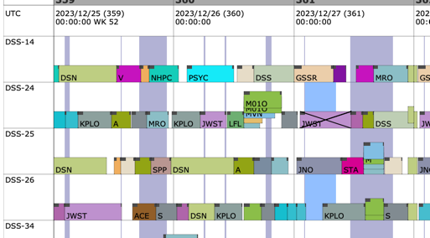
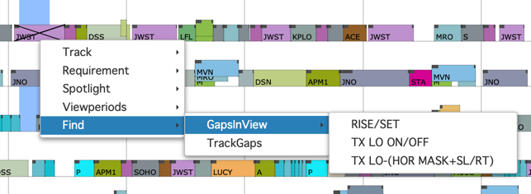
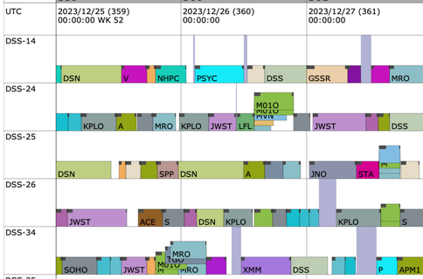
Gaps as provided by JPL
Gaps between passes (of a specific mission)
Gaps in view (specific mission and mask)
A user can select a mission (here JWST again) and a mask (or logical mask), and then display when there are gaps in the schedule (unused antenna time) in which JWST is in view. In the lower picture, the grayish vertical bands show these times in this example schedule.
Full schedule, and the grayish vertical bands are simply the times when there is no JWST tracking, i.e. outside any beginning-of-track to end-of-track on any antenna. For many missions, extended gaps are not permitted, and a quick assessment of the duration of any tracking gaps is useful.

Slide 4
Discussion
Obviously the requested “gap analysis” is kind of “mission centric” or “user oriented” service, whereas SSF (or generally CSSM) is ground station centric (or “provider oriented”).
  SMWG may consider if provision of data formats and services for mission specific analysis is in scope of the WG and the CSSM
As understood from the example provided from JPL, there are actually two different products desired:
  1. Full schedule showing explicitly no-tracking times of selected spacecraft (ignoring any other constraints) (see next page for visual example and further questions)
  2. Gaps in schedule, showing overlap where selected spacecraft is in view and the respective ground antennas are “unused”. (see further page for respective example and further questions)
Depending on answers to the questions, the usage of CPIF, SSF or combination of both may be considered (see last pages for respective CPIF and SSF examples with tweaks allowing for “gap analysis”).
General issue with gap analysis is, that it ultimately makes sense if all of the antennas are taken into account. The SSF/CPIF are delivered however by individual providers, thus their potential “gap analysis” will only apply to respective provider antennas. Thus the mission/user still needs to consolidate the “gaps analyses” from different providers.

Slide 5
Full schedule with mission non-tracking gaps (NOTRACK)
The gaps show overall times where there is no S/C#1 tracking
The reason for “non-tracking” is unimportant
Shown example would result in three start/stop time combinations, with some meta data explaining this being valid for Antennas 1 through 5.
Result could be provided as CPIF or SSF, both with some tweaks though
Requires provider to perform the analysis of its complete network wrt “non-tracking” of the specific S/C
Issues:
  The request for SSF or CPIF can be done either for individual sites/antennas or “everything” when omitting ApertureLocation class (not a real issue, rather observation)
  The SSF or CPIF are provided only for antennas of single provider
  Generally problematic to provide some “overall network times” which are not bound to specific antenna with CPIF or SSF (both formats kind of are based on relevance to a specific aperture). In case of SSF it is obligatory, in CPIF can be omitted.
Questions:
  Does the “gap analysis” shall provide all the schedule information and the gaps in one file?

Slide 6
Full schedule with mission non-tracking gaps (NOTRACK)
Questions:
  Does the “gap analysis” shall provide all the schedule information and the gaps in one file?
    If “YES” the only option would be to use SSF. Needed multiple tweaks:
      Allowing for provision of aperture unbounded “ScheduledActivity” (either make these attributes optional or allow usage there of “ALL”)
      Add new “ServiceType” to the enumeration (analogue to “UNUSED”), for example “NOT-TRACKED”
      The “user” parameter needs to be set to affected S/C.
      The SSF needs to have mixed “normal” schedule and the gaps information in one file (as different ScheduledPackages) – schema-side it is possible, from the logical point of view it was not intended/desired until now
      Gaps can be provided as individual “ScheduledActivity” in one ScheduledPackage, omitting the ScheduledPackageRef.
      The SMURF request for Simple Schedule needs new type (“NOT-TRACKED” or “SIM_SCH_NOTRACK”)
      User gets all of the information from single provider in one file
    If “NO”, preferred option would be to use CPIF for provision of mission/spacecraft not-tracking gaps
      Provided as “AdditionalEvent”, defined with AbstractParameter (alternatively define complete new Event Type DefinedEvent – needs rework of CPIF!)
      Small extra extension schema needed, defining new Additional Event.
      Omitting the ApertureLocation (valid for all provider network)
      The SMURF request for Comms Planning would need a new type for planningInfoType (actually in CDE), like “MISSION_NOTRACK”
      User/Mission needs to request the SSF with “normal” schedule and the CPIF with “gaps”

Slide 7
non-tracking gaps (NOTRACK) – CPIF example
GapExtensionEvent.xsd
<?xml version="1.0" encoding="UTF-8" standalone="no"?>
<xsd:schema xmlns="urn:ccsds:schema:cssm" xmlns:xsd="http://www.w3.org/2001/XMLSchema" targetNamespace="urn:ccsds:schema:cssm" elementFormDefault="qualified" attributeFormDefault="unqualified">
<xsd:include schemaLocation="902x02p01TC1-CPIF.xsd"/>
<!--********************************************************************************************************************** -->
<!-- GAP Extension Definitions -->
<!--********************************************************************************************************************** -->
<xsd:element name="userMissionGapStartEvent" type="SrvMgtAbstractAdditionalEventType" substitutionGroup="srvMgtAbstractAdditionalEvent"/>
<xsd:element name="userMissionGapEndEvent" type="SrvMgtAbstractAdditionalEventType" substitutionGroup="srvMgtAbstractAdditionalEvent"/>
</xsd:schema>
Example1.xml
<?xml version="1.0" encoding="UTF-8"?>
<!--Sample XML file generated by XMLSpy v2013 (x64) (http://www.altova.com)-->
<commsPlanningInfo xsi:schemaLocation="urn:ccsds:schema:cssm GapExtensionEvent.xsd" xmlns="urn:ccsds:schema:cssm" xmlns:xsi="http://www.w3.org/2001/XMLSchema-instance">
<commsPlanningInfoHeader originatingOrganization="DLR" generationTime="0000-000T00:00:00" version="2" commsPlanningInfoStatus="OPERATIONAL">
<planningInfoTypeList>
<planningInfoType>MISSION_NOTRACK</planningInfoType>
</planningInfoTypeList>
</commsPlanningInfoHeader>
<commsPlanningInfoData>
<userMissionGapStartEvent type="GAP" user="JWST" description="Non-tracking gap start time" identifier="NT_1a">
<srvMgtEventTime epochTimeSystem="UTC" absoluteTime="0000-000T00:00:00"/>
</userMissionGapStartEvent>
<userMissionGapEndEvent type="GAP" user="JWST" description="Non-tracking gap end time" identifier="NT_1b">
<srvMgtEventTime epochTimeSystem="UTC" absoluteTime="0000-001T11:30:00"/>
</userMissionGapEndEvent>
<userMissionGapStartEvent type="GAP" user="JWST" description="Non-tracking gap start time" identifier="NT_2a">
<srvMgtEventTime epochTimeSystem="UTC" absoluteTime="0000-002T01:00:00"/>
</userMissionGapStartEvent>
<userMissionGapEndEvent type="GAP" user="JWST" description="Non-tracking gap end time" identifier="NT_2b">
<srvMgtEventTime epochTimeSystem="UTC" absoluteTime="0000-002T03:00:00"/>
</userMissionGapEndEvent>
</commsPlanningInfoData>
</commsPlanningInfo>

Slide 8
non-tracking gaps (NOTRACK) – SSF example
Example3.xml
<?xml version="1.0" encoding="UTF-8"?>
<!--Sample XML file generated by XMLSpy v2013 (x64) (http://www.altova.com)-->
<simpleSchedule xsi:schemaLocation="urn:ccsds:schema:cssm 902x01p11-SSF.xsd" xmlns="urn:ccsds:schema:cssm" xmlns:xsi="http://www.w3.org/2001/XMLSchema-instance">
<simpleScheduleHeader originatingOrganization="DLR" generationTime="0000-000T00:00:00" version="2" status="OTHER" inclusionType="OVERLAP_INCLUSION"/>
<scheduledPackage scheduledPackageId="ID_1" user="JWST" comment="boked pass">
...
</scheduledPackage>
<scheduledPackage scheduledPackageId="ID_2" user="MEX" comment="boked pass">
...
</scheduledPackage>
…
<scheduledPackage scheduledPackageId="ID_77" user="JWST" comment="Not-tracked gaps">
<scheduledActivity scheduledActivityId="NT1" activityStatus="TENTATIVE" beginningOfTrack="0000-000T00:00:00" endOfTrack="0000-001T11:30:00">
<serviceInfo serviceType="NOT-TRACKED" frequencyBand="OTHER"/>
</scheduledActivity>
<scheduledActivity scheduledActivityId="NT1" activityStatus="TENTATIVE" beginningOfTrack="0000-002T01:00:00" endOfTrack="0000-002T03:00:00">
<serviceInfo serviceType="NOT-TRACKED" frequencyBand="OTHER"/>
</scheduledActivity>
</scheduledPackage>
</simpleSchedule>

Slide 9
Overlap of mission in view and antenna unused time (GAP)
The gaps show times of overlapping antenna free times and S/C#1 being in visibility (see also questions below)
Antenna 5 has no visibility at all
“The Local Gaps” are blocks where S/C#1 is visible on the specific antenna, and antenna is free, but the S/C#1 is actually being tracked by another antenna already.
Result could be provided as CPIF or SSF, both with some tweaks though
Requires provider to perform the analysis of its complete network, inclusively visibility analysis.
Issues:
  The request for SSF or CPIF can be done either for individual sites/antennas or “everything” when omitting ApertureLocation class (not a real issue, rather observation)
  The SSF or CPIF are provided only for antennas of single provider

Slide 10
Overlap of mission in view and antenna unused time (GAP)
Questions:
  Does the “gap analysis” shall provide all the schedule information and the gaps in one file?
    If “YES” the only option would be to use SSF. Needed multiple tweaks:
      The gaps would be provided per aperture (ApertureLocation must be used)
      Add new “ServiceType” to the enumeration (analogue to “UNUSED”), for example “GAP” or “TRACKING-GAP”
      The “user” parameter needs to be set to affected S/C.
      The SSF needs to have mixed “normal” schedule and the gaps information in one file (as different ScheduledPackages) – schema-side it is possible, from the logical point of view it was not intended/desired until now
      Gaps can be provided as individual “ScheduledActivity” in one ScheduledPackage, omitting the ScheduledPackageRef.
      The SMURF request for Simple Schedule needs new type (“GAP” or “SIM_SCH_GAP”)
      User gets all of the information from single provider in one file
    If “NO”, preferred option would be to use CPIF for provision of mission/spacecraft and antenna unused gaps
      Provided as “AdditionalEvent”, defined with AbstractParameter (alternatively define complete new Event Type DefinedEvent – needs rework of CPIF!)
      Small extra extension schema needed, defining new Additional Event.
      The ApertureLocation must be used
      The SMURF request for Comms Planning would need a new type for planningInfoType (actually in CDE), like “MISSION_GAP”
      User/Mission needs to request the SSF with “normal” schedule and the CPIF with “gaps”
  Should the “local gaps” be included or not?
    “Local gaps” are the free times of the antenna, where s/c is in visibility, as seen from the individual antenna perspective only (means, same time there may be another actual tracking pass on another antenna in parallel)
    “Overall gap” is the antenna free time, where the s/c is in visibility and there is no other tracking happening in parallel (requires information about other antennas / the schedule)

Slide 11
mission in view and antenna unused time
CPIF example
GapExtensionEvent.xsd identical as before
Example2.xml
<?xml version="1.0" encoding="UTF-8"?>
<!--Sample XML file generated by XMLSpy v2013 (x64) (http://www.altova.com)-->
<commsPlanningInfo xsi:schemaLocation="urn:ccsds:schema:cssm GapExtensionEvent.xsd" xmlns="urn:ccsds:schema:cssm" xmlns:xsi="http://www.w3.org/2001/XMLSchema-instance">
<commsPlanningInfoHeader originatingOrganization="DLR" generationTime="0000-000T00:00:00" version="2" commsPlanningInfoStatus="OPERATIONAL">
<planningInfoTypeList>
<planningInfoType>MISSION_GAP</planningInfoType>
</planningInfoTypeList>
</commsPlanningInfoHeader>
<commsPlanningInfoData>
<userMissionGapStartEvent type="GAP" user="JWST" description="Station unused and spacecraft in view start time" identifier="OUV_1a">
<srvMgtEventTime epochTimeSystem="UTC" absoluteTime="0000-005T12:30:00"/>
<apertureReference siteRef="Station1" apertureRef="Antenna1"/>
</userMissionGapStartEvent>
<userMissionGapEndEvent type="GAP" user="JWST" description="Station unused and spacecraft in view end time" identifier="OUV_1b">
<srvMgtEventTime epochTimeSystem="UTC" absoluteTime="0000-005T13:30:00"/>
<apertureReference siteRef="Station1" apertureRef="Antenna1"/>
</userMissionGapEndEvent>
<userMissionGapStartEvent type="GAP" user="JWST" description="Station unused and spacecraft in view start time" identifier="OUV_2a">
<srvMgtEventTime epochTimeSystem="UTC" absoluteTime="0000-007T01:00:00"/>
<apertureReference siteRef="Station2" apertureRef="Antenna2"/>
</userMissionGapStartEvent>
<userMissionGapEndEvent type="GAP" user="JWST" description="Station unused and spacecraft in view end time" identifier="OUV_2b">
<srvMgtEventTime epochTimeSystem="UTC" absoluteTime="0000-007T03:00:00"/>
<apertureReference siteRef="Station2" apertureRef="Antenna2"/>
</userMissionGapEndEvent>
</commsPlanningInfoData>
</commsPlanningInfo>

Slide 12
mission in view and antenna unused time
SSF example
Example4.xml
<?xml version="1.0" encoding="UTF-8"?>
<!--Sample XML file generated by XMLSpy v2013 (x64) (http://www.altova.com)-->
<simpleSchedule xsi:schemaLocation="urn:ccsds:schema:cssm 902x01p11-SSF.xsd" xmlns="urn:ccsds:schema:cssm" xmlns:xsi="http://www.w3.org/2001/XMLSchema-instance">
<simpleScheduleHeader originatingOrganization="DLR" generationTime="0000-000T00:00:00" version="2" status="OTHER" inclusionType="OVERLAP_INCLUSION"/>
<scheduledPackage scheduledPackageId="ID_1" user="JWST" comment="boked pass">
...
</scheduledPackage>
<scheduledPackage scheduledPackageId="ID_2" user="MEX" comment="boked pass">
...
</scheduledPackage>
<scheduledPackage scheduledPackageId="ID_77" user="JWST" comment="Unused antenna and spacecraft in view gaps">
<scheduledActivity scheduledActivityId="NT1" activityStatus="AVAILABLE" beginningOfTrack="0000-005T12:30:00" endOfTrack="0000-005T13:30:00" siteRef="Station1" apertureRef="Antenna1">
<serviceInfo serviceType="TRACKING-GAP" frequencyBand="OTHER"/>
</scheduledActivity>
<scheduledActivity scheduledActivityId="NT2" activityStatus="AVAILABLE" beginningOfTrack="0000-007T01:00:00" endOfTrack="0000-007T03:00:00" siteRef="Station2" apertureRef="Antenna2">
<serviceInfo serviceType="TRACKING-GAP" frequencyBand="OTHER"/>
</scheduledActivity>
</scheduledPackage>
</simpleSchedule>

Slide 13
Summary
Gap analysis is possible to provide (assuming the provider offers such a service!!!):
  With CPIF:
    without significant changes (only planning type in CDE needs to be added)
    Only gap information is provided (schedule itself needs to be retrieved separately)
  With SSF:
    With significant changes to SSF and SMURF
General question of the role of the service/antenna provider and the CSSM needs to be answered

Slide 14
BACKUP

Slide 15
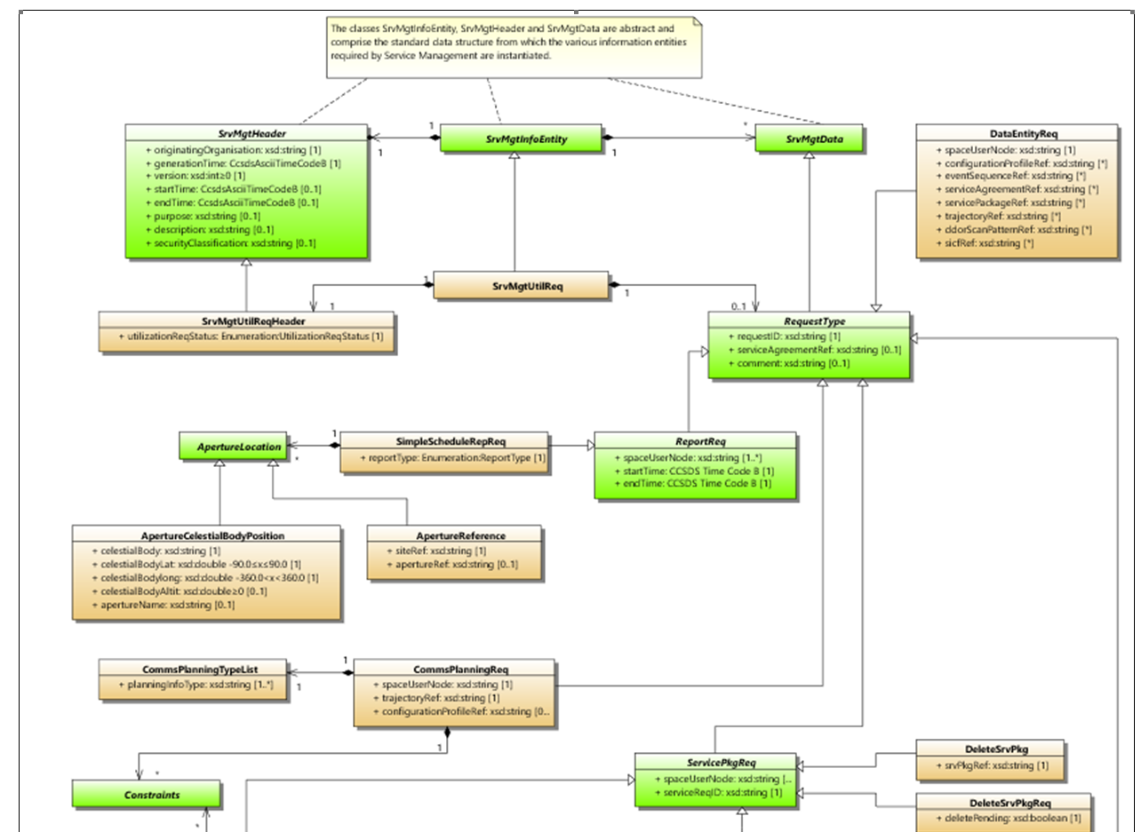
Backup SMURF

Slide 16
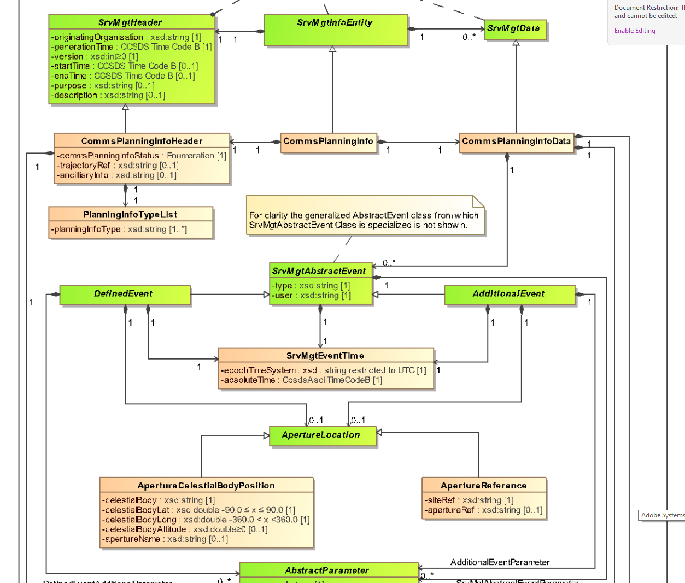
Backup SMURF

Slide 17
Backup SMURF

