Slide 1
Service Agreement
Proposal Service Agreement parameters - update
CCSDS Teleconference 2024
30 January 2024
Marcin Gnat, DLR/GSOC

Slide 2
Intro
Inputs delivered until now from DLR, UKSA, NASA NSN and JAXA
This collection shall provide initial set of parameters which would be included in general section of Service Agreement (additionally to the Config Profiles), constituting kind of meta-information set.
The XSD schema for this part shall be relatively simple (grouping classes with individual parameters inside, most of which will be optional).
UPDATE 2024-01-18: altered, moved or deleted parameters according to discussions during Fall Meetings 2023.

Slide 3
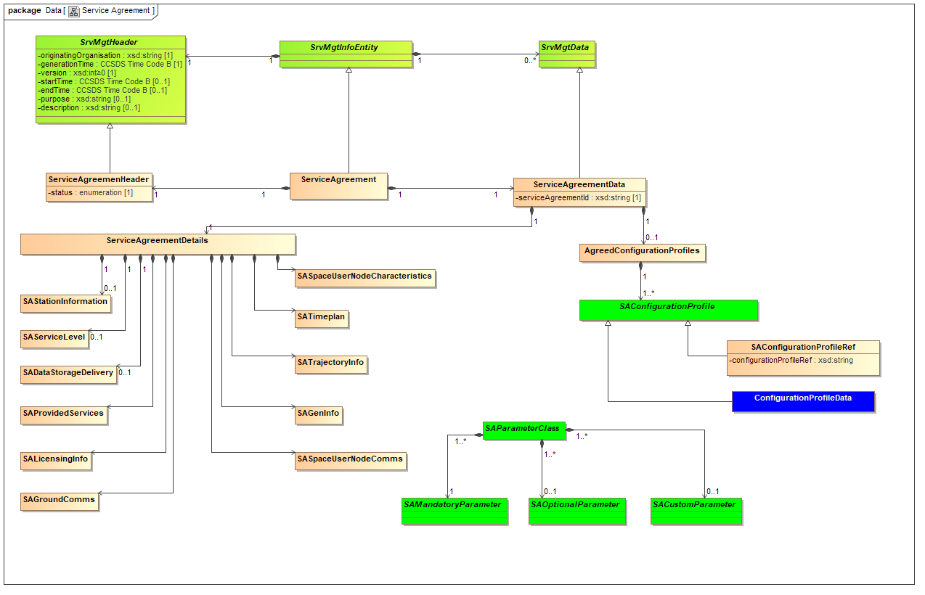
Intro

Slide 4
Parameter Groups in SA
Following parameter groups have been identified and will be respectively used for groping the parameters in the XML/XSD:
General Information (SAGeneralInformation)
Key Mission Dates (SAKeyMissionDates)
Trajectory Info (SATrajectoryInfo)
Level of Service (SAServiceLevel)
Provided Services (SAProvidedServices)
Data Storage and Delivery (SADataStorageDelivery)
Ground Comms (SAGroundComms)

Slide 5
Selection of Parameters for SA
Parameter Name | Provider Agency User Agency
Group | General Information
Datatype | String
Example | <providerAgency name=“Goonhilly Earth Station Ltd”/>, <userAgency name=“Deutsches Zentrum für Luft- und Raumfahrt e.V.”/>
Description | More legal/contractual relevant provider organization name, may not be same as “originating organization” in the XML, which may be i.e. just “GSOC”.
Comments | Confirmed

Slide 6
Selection of Parameters for SA
Parameter Name | Provider Contacts User Contacts
Group | General Information
Datatype | Complex
Example | <providerContacts> <contactPerson name=“Max Mustermann” role=“Project Manager” email=“max.mustermann@dlr.de” phone=“0049 8153 00000”> </providerContacts>
Description | List with service agreement relevant contact persons / positions.
Comments | Confirmed

Slide 7
Selection of Parameters for SA
Parameter Name | Supported Spacecraft
Group | General Information
Datatype | Complex
Example | <supportedSpacecraft> <supSpacecraft name=“Integral” acronym=“IGL”/> <supSpacecraft name=“MarsExpress” acronym=“MEX”/> </supportedSpacecraft>
Description | List with supported spacecraft.
Comments | Check SANA correspondence

Slide 8
Selection of Parameters for SA
Parameter Name | Mission Description
Group | General Information
Datatype | String with reference
Example | <missionDescription text=“This mission is supposed to discover undiscovered discoveries in the universe. It uses multiple discoverer class spacecraft which perform discoveries.” docRef=“additionalMissionDescritpionDoc.pdf”/>
Description | Concise text block with a mission description which may help provider to better assess the project needs.
Comments | Confirmed

Slide 9
Selection of Parameters for SA
Parameter Name | Spacecraft Characteristcs
Group | General Information
Datatype | ref
Example | <spacecraftCharacteristics ref=“documentReference” name=“S2G ICD”/>
Description | Reference to spacecraft description or space to ground ICD document
Comments | Confirmed.

Slide 10
Selection of Parameters for SA
Parameter Name | Agreed Provider Apertures
Group | General Information
Datatype | complex
Example | <agreedProviderApertures> <apertureDetails site=“WHM” aperture=“S67” priority=“1” type=“ground” usagePhase=“routine”/> </agreedProviderApertures>
Description | List of agreed apertures to be used in the frame of Service Agreement. Type may be enum with (ground,relay,space,orbiter,moon,etc…)? Check if we need to have space and gound apertures for Provider???
Comments | Confirmed.

Slide 11
Selection of Parameters for SA
Parameter Name | Agreed User Apertures
Group | General Information
Datatype | complex
Example | <agreedUserApertures> <apertureDetails userSpaceNode=“MEX” aperture=“MEX-LGA1” priority=“1” type=“space” usagePhase=“routine”/> </agreedUserApertures>
Description | List of agreed apertures to be used in the frame of Service Agreement. Type may be enum with (ground,relay,space,orbiter,moon,etc…)? Check if we need to have space and gound apertures for User???
Comments | Confirmed.

Slide 12
Selection of Parameters for SA
Parameter Name | Service Agreement Support Start Service Agreement Support Stop
Group | KeyMissionDates
Datatype | date
Example | <srvAgrSupportStart date=“2023-300T00:00:00” /> <srvAgrSupportStop date=“2024-300T00:00:00” />
Description | date on which the service agreement support period starts or ends.
Comments | Confirmed

Slide 13
Selection of Parameters for SA
Parameter Name | Phases
Group | KeyMissionDates
Datatype | complex
Example | <missionPhases> <phaseDetails id=“TC1” description=“Data Flow Test” startDate=“2023-310T00:00:00” endDate=“2023-312T00:00:00” type=“test”> <involvedResource type=“aperture” ref=“WHM1”/> <involvedResource type=“noc” ref=“GSOC”/> </phaseDetails> </missionPhases>
Description | date on which the service agreement support period starts or ends.
Comments | Confirmed. System Freeze will be used as additional Phase type (i.e. “freeze”)

Slide 14
Selection of Parameters for SA
Parameter Name | Launch Windows
Group | KeyMissionDates
Datatype | complex
Example | <launchWindows> <launchWindow id=“LW1” startTime=“2024-056T00:00:00” endTime=“2024-056T02:00:00” default=“true”/> <launchWindow id=“LW2” startTime=“2024-057T01:00:00” endTime=“2024-056T03:00:00”/> <launchWindow id=“LW3” startTime=“2024-058T03:00:00” endTime=“2024-056T03:01:00”/> </launchWindows>
Description | List of possible planned launch date and time
Comments | Confirmed.

Slide 15
Selection of Parameters for SA
Parameter Name | Trajectory Format
Group | Trajectory Information
Datatype | enum
Example | <trajectoryFormat type=“OEM” format=“XML”/>
Description | OEM Text, OEM XML, TLE, STDM, etc… Exchange formats are indicated.
Comments | Confirmed

Slide 16
Selection of Parameters for SA
Parameter Name | Trajectory / Orbit Type
Group | Trajectory Information
Datatype | enum
Example | <trajectoryType type=“LEO” />
Description | LEO, GEO, Lunar orbit, deep space etc.
Comments | Confirmed

Slide 17
Selection of Parameters for SA
Parameter Name | Trajectory Description
Group | Trajectory Information
Datatype | string
Example | <trajectoryDescription text=“This trajectory has an eccentricity of …. And is stretching between apogee of …. And perigee of…. LTAN is …..” />
Description | description of orbit like inclination, periodicity, etc…
Comments | Confirmed

Slide 18
Selection of Parameters for SA
Parameter Name | Service List
Group | Provided Services
Datatype | complex
Example | <serviceList> <serviceDetails type=“TELEMETRY” freqBand=“S” provisionType=“online”> <transferService type=“RAF”/> <transferService type=“RCF”/> </serviceDetails> </serviceList>
Description | service list, with each item listing a service (like TELEMETRY, TELECOMMAND, RANGING) with possibly some additional information (like frequency band or specification like RAF; CLTU) this could look like: - TELEMETRY(S-Band, online, SLE(RAF, RCF, ROCF))
Comments | Confirmed

Slide 19
Selection of Parameters for SA
Parameter Name | Tracking Configuration
Group | Provided Services
Datatype | String
Example | <trackingConfiguration type=“MSPA”/>
Description | MSPA, multiple spacecraft per aperture considerations, TDM (time divisiion multiplex)
Comments | Confirmed

Slide 20
Selection of Parameters for SA
Parameter Name | Product Retention Time
Group | Data Storage and Delivery
Datatype | Integer + string
Example | <productRetentionTime type=“TMData” name=“housekeeping telemetry” retentionTime=“30000”/>
Description | how long the data shall remain available for pickup/delivery, in seconds
Comments | Confirmed

Slide 21
Selection of Parameters for SA
Parameter Name | Product Storage Volume
Group | Data Storage and Delivery
Datatype | Integer + string
Example | <productStorage type=“TMData” name=“housekeeping telemetry” volume=“100”/>
Description | Required/assigned product storage volume in GB
Comments | Confirmed

Slide 22
Selection of Parameters for SA
Parameter Name | Comms Bandwidth
Group | Ground Comms
Datatype | Integer + string
Example | <commsBandwidth identifier=“primeLine” value=“20” />
Description | Required/assigned comms bandwidth for real-time communications (SLE). IN Megabit per second (Mbps)
Comments | Confirmed

Slide 23
Selection of Parameters for SA
Parameter Name | Command Latency
Group | Ground Comms
Datatype | Float + text
Example | <cmdLatency value=“5.5” referredTo=“delivery at SLE provider”/>
Description | Required/actual comms command latency in milliseconds.
Comments | Confirmed

Slide 24
Selection of Parameters for SA
Parameter Name | Redundancy
Group | Ground Comms
Datatype | string
Example | <redundancy text=“Required full redundant comms loop with identical bandwidth running over separate provider circuit” />
Description | express the need for the redundncy, at which levell, etc…
Comments | Confirmed

Slide 25
Selection of Parameters for SA
Parameter Name | Frequency of Contacts
Group | Level of Service
Datatype | string
Example | <frequencyOfContacts text=“3 contacts per day of duration 10 to 30 minutes” phaseRef=“routine”/>
Description | Expresses the usage of passes in general manner e.g. 3 contacts per day of duration 10 to 30 minutes.
Comments | Confirmed

Slide 26
Selection of Parameters for SA
Parameter Name | Cost of Service
Group | Level of Service
Datatype | String (alternative cost int, currency enum €,$, unit enum hour,pass,month, type enum routine,emergency,leop)
Example | <costOfService text=“300€ per hour for routine support” /> Alternative <costOfService cost=“300” currency=“€” unit=“hour” type=“routine”/>
Description | £x per hour, £y per contact, £z monthly etc. (commercially sensitive)
Comments | TBC

Slide 27
Selection of Parameters for SA
Parameter Name | Success Criteria
Group | Level of Service
Datatype | complex
Example | <successCriteria id=“SCrit1” value=“50” unit=“percent” criteria=“good frames” evaluationPeriod=“pass” />
Description | e.g. >50% dataflow during pass
Comments | Confirmed

Slide 28
Selection of Parameters for SA
Parameter Name | Availability
Group | Level of Service
Datatype | integer
Example | <availability value=“10” unit=“hours”/>
Description | MTTR (Mean Time To Restore)? Required/agreed reliability? In hours.
Comments | Confirmed

Slide 29
Selection of Parameters for SA
Parameter Name | Ancillary Services
Group | Level of Service
Datatype | string
Example | <ancillaryServices text=“Encryption required according to….”/>
Description | free text allowing to provide some additional requirements for ancillary services (hosting, encryption, etc..)
Comments | Confirmed

Slide 30
Selection of Parameters for SA
Parameter Name | Product delivery timing
Group | Level of Service
Datatype | string
Example | <productDeliveryTiming text=“tracking data must be delivered latest 20 minutes after pass”/>
Description | timing information on delivery expectations for different services / products, like "tracking data must be delivered latest 20 minutes after pass"
Comments | Confirmed

Slide 31
Selection of Parameters for SA
Parameter Name | Provided Service Levels
Group | Level of Service
Datatype | complex
Example | <providedServiceLevels> <serviceLevel name=“LEOP” definition=“engineering support during pass, data flow test executed before, on call support” priority=“1”/> </providedServiceLevels>
Description | definition of service levels (like routine support, LEOP, emergency, etc… )
Comments | Confirmed

Slide 32
Selection of Parameters for SA
Parameter Name | Support Periods
Group | Level of Service
Datatype | complex
Example | <supportPeriods> <supportPeriod id=“SupPer1” description=“early mission phase” minHours=“10” maxHours=“200” minSupportTime=“600” serviceLevel=“routine” pass, data flow test executed before, on call support” priority=“1” periodStartTime=“2024-010T00:00:00” periodStopTime=“2024-020T00:00.00” typicalSupportCount=“10” typicalSupportUnit=“hours” typicalSupportPeriod=“week” /> </supportPeriods>
Description | maybe something smart how we can provide information in blocks (i.e. period 1, 10 hours per week, period 2, 5 hours per month, period 3, etcc….) with additional information on priority or required service level (see "provided Servcie Levels), minimum hours per period, maximum hours per period, minimum pass length (seconds)
Comments | Possible confusion with Mission Plan (SA period, system Freeze, etc..). In essence overlapping with SMURF enhanced constraints (we may reuse the definition from there maybe?) TBC

Slide 33
Backup

