Slide 1
Service Agreement and Configuration Profile
Data Formats Blue Book
→ third outline approach ←
CCSDS Spring Meetings 2019
07 May 2019
Marcin Gnat, DLR/GSOC

Slide 2
General thoughts
Service Agreement
The Service Agreement shall contain (possibly) all Configuration Profiles...
...plus some general „meta-information“

Slide 3
General thoughts
Configuration Profile
We had a choice to produce a standard covering all universal possibilities (risking not to finish the book ever, and landing at highly abstract document being difficult to comprehend),
Or we could take an advantage of the “cookie cutter” concept, and trying to focus our efforts on “few” mostly used service / configuration profiles.
Unfortunately the later idea leads to relatively large number of pre-baked services, each including on top high number of parameters.
Making this leads us to following threats:
Large Blue Book (large BB = nobody reads it)
Multiple services are hard to keep up in sync and up to date
Keeping the parameter lists up-to-date and in sync with SANA seems to be a challenge
Projects/Agencies would need to go the way either to comply fully to BB or leave the CCDSD conform Configuration Profiles out.

Slide 4
General thoughts
Configuration Profile cd’
Let’s now consider the following:
Keep the specific parameters out of the Blue Book and reference to SANA
Question: does SANA group the parameters by the Functional Resource Component Type?
Combine both worlds of allowing practically every possible configuration and service → lets users to define virtually every possible combination in borders of the Functional Resource Model

Slide 5
General thoughts
Configuration Profile cd’
Keep basic cookie cutters for predefined services → lets users to pick predefined Functional Resource Component combinations and leaves them the decision to fill it with respective parameters according to SANA
Parameters may be freely defined bilaterally (disregarding SANA completely → good for initial implementations!)
Parameters from SANA may be selected (i.e. if the bilateral agreement assumes some specific values for things, they may be omitted altogether → responsibility of User and Provider!)
The parameters from SANA being used full scale
The way of parameter usage may be defined in meta-part of Service Agreement (i.e. “fullSana”, “partialSana”, “custom”).
One disadvantage (but maybe we can live with that): No explicit validation of specific cookie cutter Configuration Profile against XSD.

Slide 6
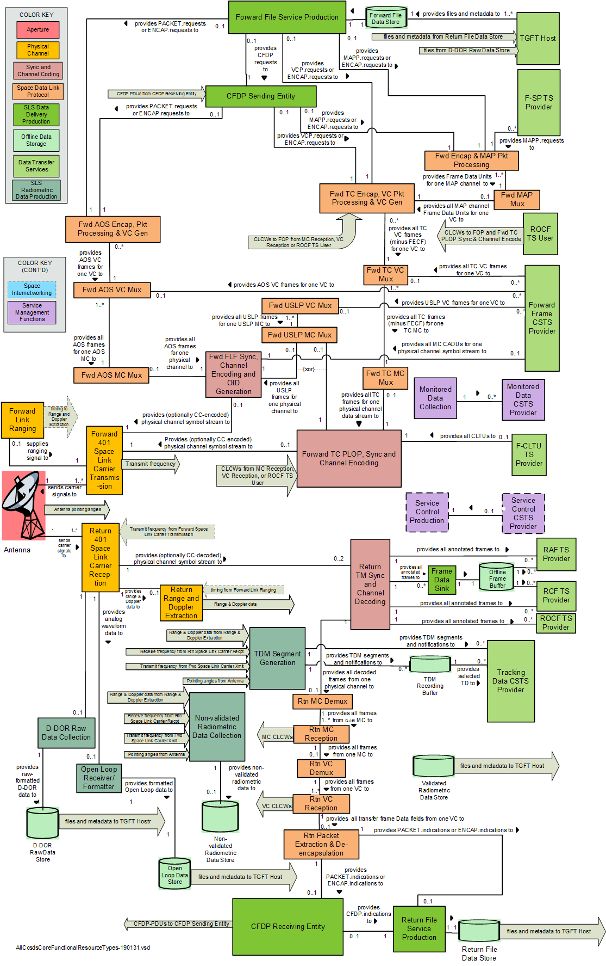
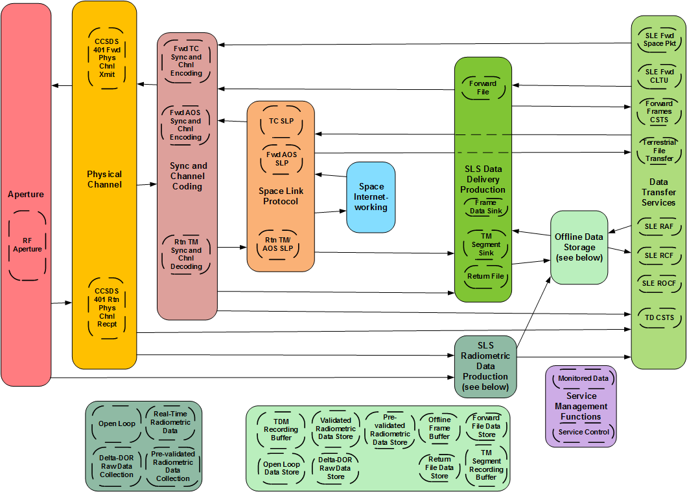
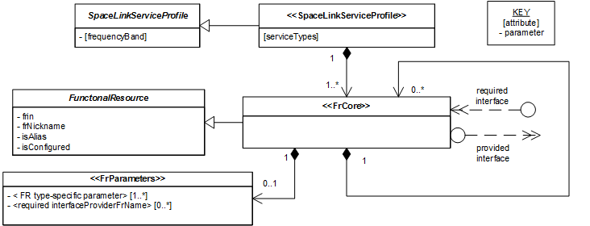
Mix ingredients…
You remember these pictures
© John™ ?

Slide 7
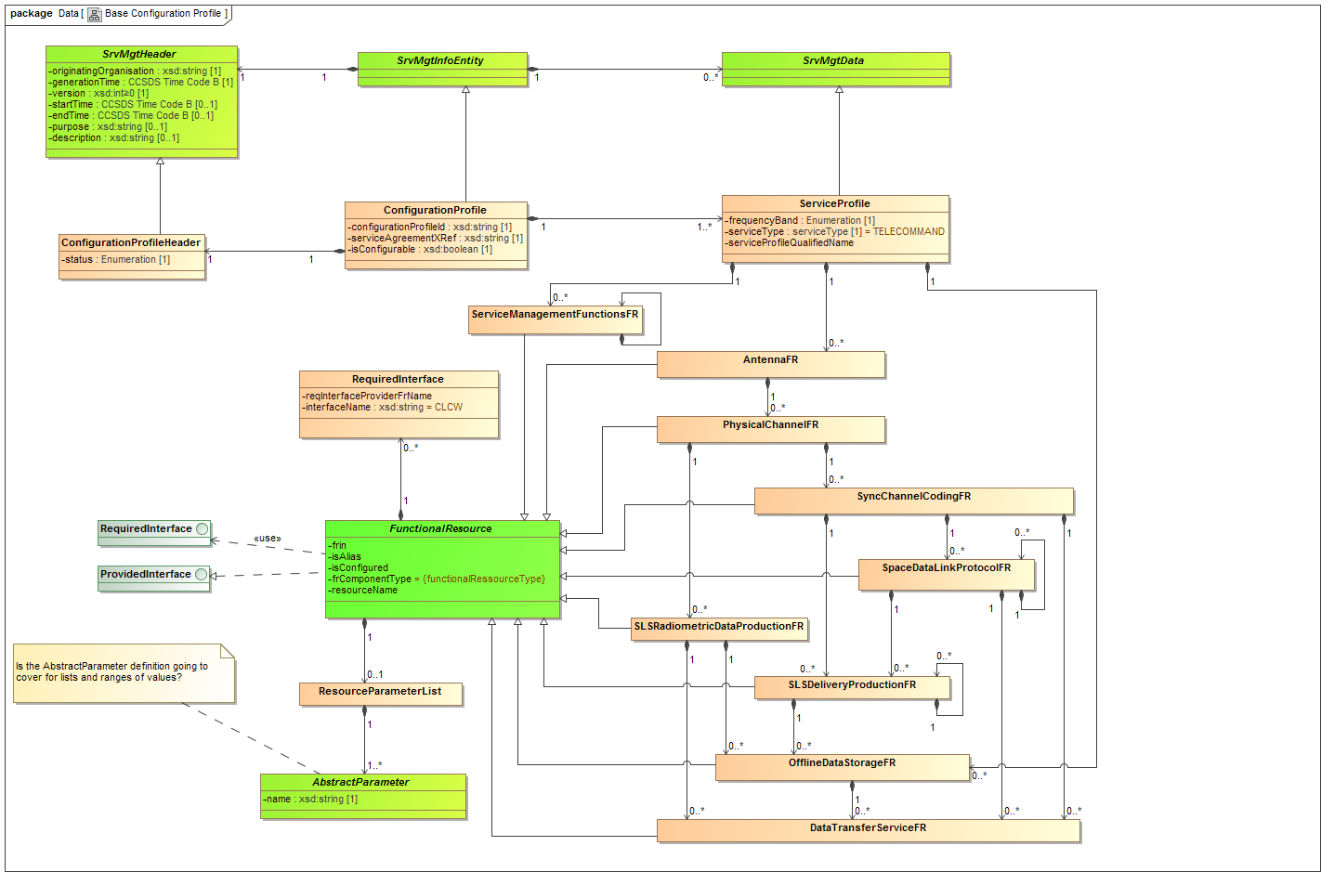
… and we are done.

Slide 8
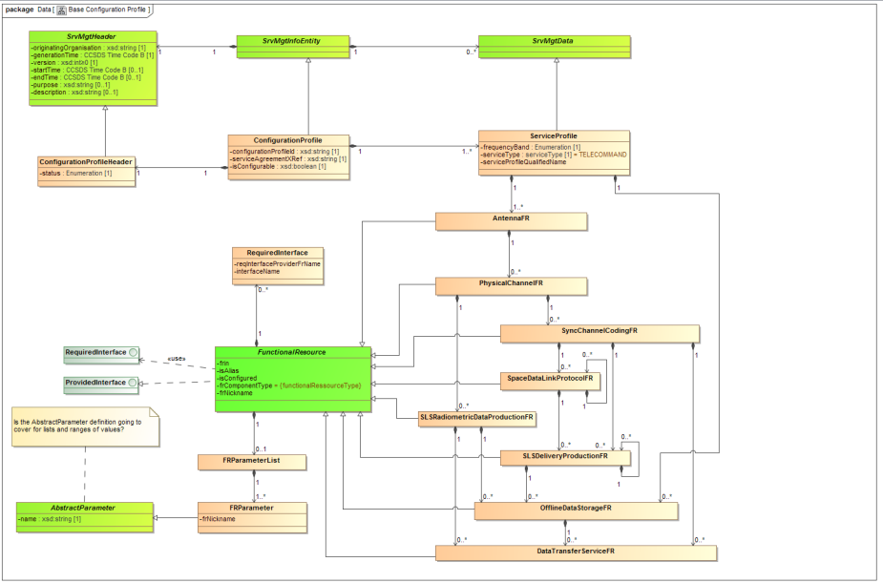
Configuration Profile - Comments
The UML model follows in principle the structure of Functional Ressource Groups
Possible combinations cover for all resonable Functional Resource based Service Profiles (hopefully)
Also in case of non-SANA bilaterally agreed configuration, the main model of Functional Resouce Groups is valid
To consider is the definition of the parameter. In the current version – to simplify things – the FRParameter (specialization of AbstractParameter ) is used. However this does not cover for Configuration Profiles containing lists of values or ranges → likely way to define things in Service Agreement.
We can define SACP BB
own definition of FRParameter
Or we can take advantage of such
definition in in Common
Data Entities Book

Slide 9
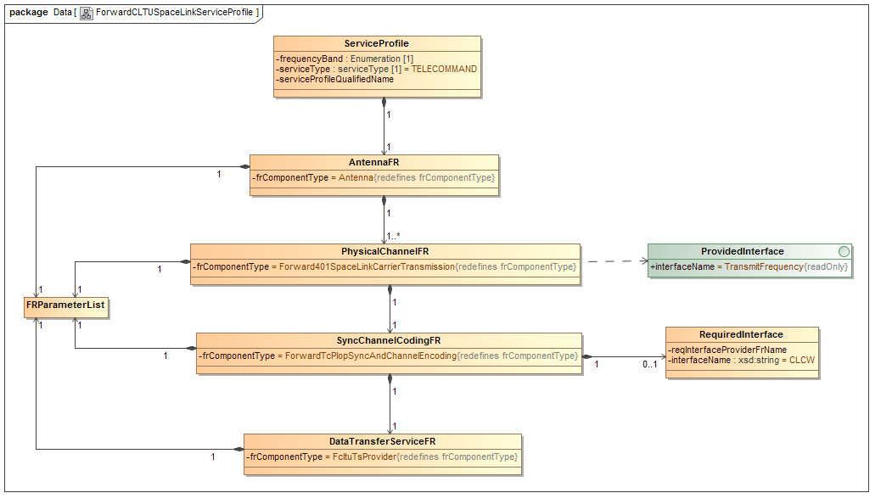
Example Cookie Cutters for Predefined Services

Slide 10
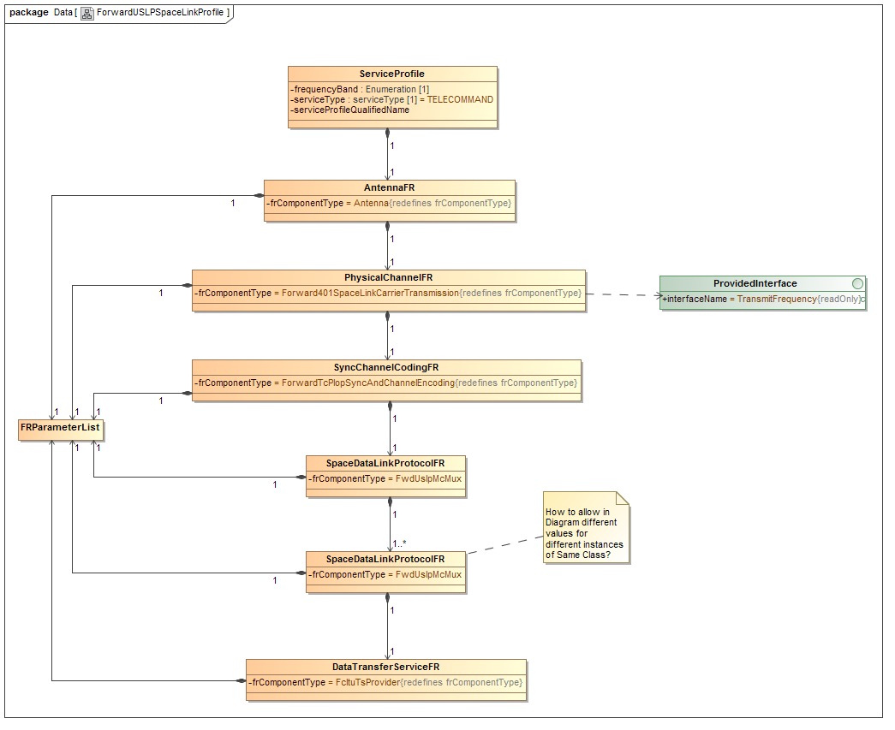
Example Cookie Cutters for Predefined Services

Slide 11
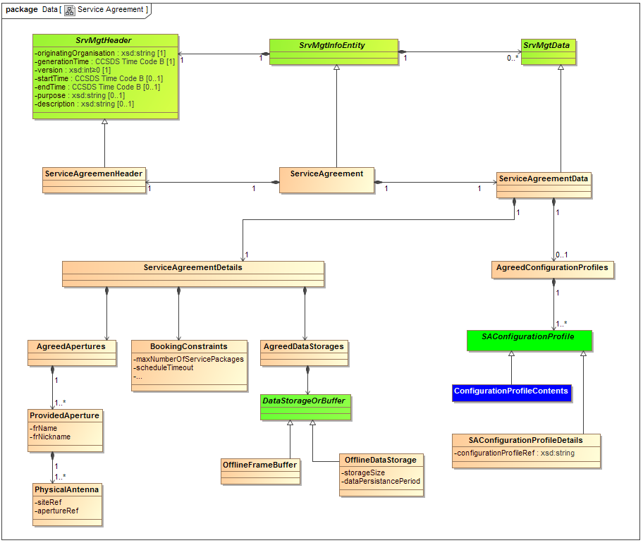
… and Service Agreement

Slide 12
Service Agreement - Comments
Generally the Service Agreement would be divided into two sections (represented by classes AgreedConfigurationProfiles and ServiceAgreementDetails)
AgreedConfigurationProfiles is a simple containment of actual ConfigurationProfiles
ServiceAgreementDetails shall comply what we called till now meta information or Service Agreement persistent information
Currently containing three subsections for AgreedApertures, BookingConstraints and AgreedDataStorages
Could be extended if needed
What actually happens, when we substantially change one of Configuration Profiles? Does it mean, the SA is invalid anymore? Or just “changed” as well?
How are we going to treat the change of Configuration Profile from „service agreement defined configuration profile with ranges and lists“ to the instance of Configuration Profile for actual use (with fixed values)?
(1) One possibility is to let users overwrite parameter values while instatiating via Service Package Request (Parameter respecification)
Out of the box
Does not need any additional control mechanisms
Will however require respecification for EACH single SP Request (a lot of redundancy in many cases and definitely annoying) → eventually a requirement to agency implementations to cover for that

Slide 13
Service Agreement - Comments
(2) Another possibility is to allow definition of another CP flavor.
For instance introducing an additional high level parameter for CP like „isConfigurable“.
In that scenario, the CP‘s defined in SA with lists and/or ranges would get the boolean false value for isConfigurable. CP‘s being able to be instantiated would get value true.
This would lead however inevitably to an effect, that CP‘s in SA would not be actually CP‘s anymore. Potential validation issues (CP vs SA) and question what we than understand as CP (is this the „thing“ in SA or the „configurable“ one? Which one is meant by SMURF for example?)
(3) Yet another possibility is to keep things defined in SA only to Service Profiles. The CP would be than a instantiation (and eventually combination) of specific Service Profiles. While instantiating, Service Profiles would get defined values.
Seems to be elegant
Issue: how to keep the agreed Service Profile combinations and maybe interactions between Service Profiles? Do we need it? Is it an issue at all?
Eventually implications on actual Configuration Profile definition

Slide 14
Service Agreement - Comments
The „meta-parameters“ we can use as inital list also the contents (partially at least) of chapter 5 from old proposed Service Catalog and Service Agreement white book.
The Service Agreement parameters are grouped into the following logical blocks:
Mission Registration
User and provider agency contact details (address, phones?)
Service Agreement timescale (covered by Service Management Header?)
Services to be provided (part of Config Profiles?)
Reference documents (do we need that?)
Testing required (what do we put here?)
Pricing (do we want this?)
Service Options and Constraints (SICF’s here?)
Spacecraft Communication Interfaces
Forward space link parameters (does it fit within CP itself, or should it stay extra? Some of stuff will be covered by ranges/lists in CP’s)
Return space link parameters (see above)
Service Management Operational Constraints
Configuration Profile parameters (not needed as CP’s are now integral part of SA itself, thus implicitly defined)
Trajectory Prediction parameters (we may need that)
Service Package parameters (this is what I called booking constraints)
Service Agreement parameters (?)
Service Monitoring and Reporting (?)

Slide 15
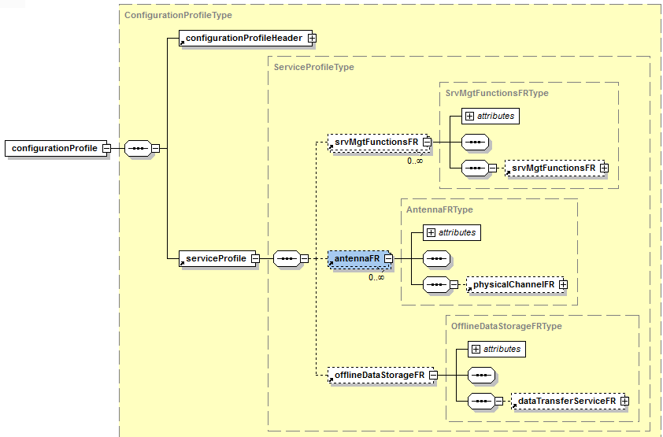
Schema example

Slide 16
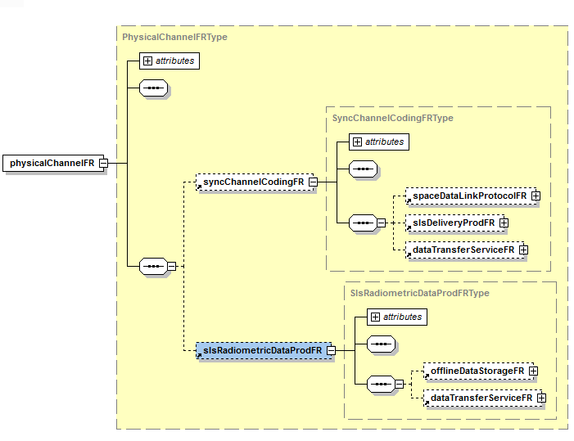
Schema example

Slide 17
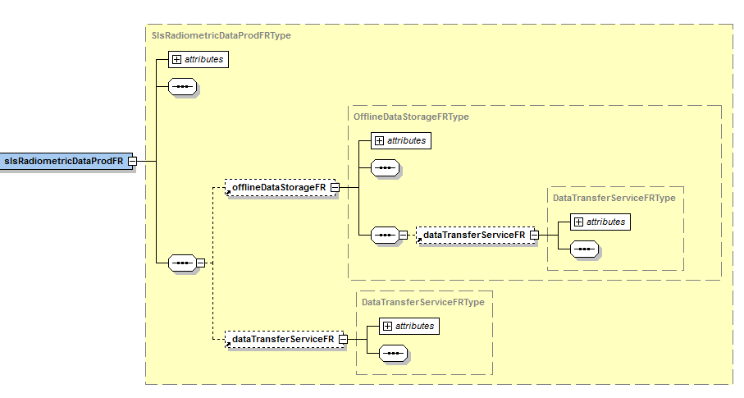
Schema example

Slide 18
Proposed Book Outline
Introduction (blah...)
Overview (another blah...)
Service Agreement
Overview with UML diagram
Schema diagrams?
Description of classes (classical)
General considerations on Service Agreement (here I want to put some information on lifecycle, status, state machine, etc…)
Considerations on containment of CP within SA (here I want to describe how the SA contains Configuration Profiles, things with ranges and lists of values, etc…)
Configuration profile
4.1. Geneneral infos (blah…)
4.2. Mapping of Functional Resources to Predefined Services (more or less what Erik proposed)
4.3 Basic definition of CP (including UML diagram, Schemas?, considerations on construction of configuration profiles out of cookie cutters and with help of SANA registry of Functional Resources)
4.3.x Considerations on allowed combinations of Service Profiles (here comes the stuff on how actually the Services are allowed to interact)
4.4. Forward Communication SL Service Profiles (all pre-baked Forward Services)
4.5. Return Communication SL Service Profiles
4.6. Radiometric SL Service Profiles
4.7. Service Management Functions Service Profiles
4.8. Combined Configuration Profiles (here come definitions of CPs with multiple Service Profiles, like TC and TM with CLCW stuff)

Slide 19
Reference Table for matching of Standard Services to Functional Resource Types

Slide 20
Summary
The current rough outline includes:
The internetworking services configuration missing
Schema is now only as „proof of concept“. In final version I will prepare multiple schema files – as the Configuration Profile and the Service Agreement eventually will share the Service Profile (or so, depending what we decide on previous considerations)
The table proposed by Erik is transposed, under assumption that number of Functional Resources is larger than currently offered count of Service Profiles

