Slide 1
Progress towards integration of Event Sequence and FRM
Partial response for AI 2018-0412-19:
“Indicate the directives from the FR model that occur at various state transitions in the event sequence.”
E. Barkley
NASA/JPL
09 July 2018

Slide 2
Contents
(Quick) run through of the state transitions (from an information modelling point of view) for forward carrier, command, and ranging services
Only at this time – return carrier and services pending
Semantics for event sequence states vs information available in current FRM
“Current” = information I could find in candidate SANA registry -- https://sanaregistry.org/r/functional_resources
Identification of FRM resources (kind of) re sequencing state machine transition edges

Slide 3
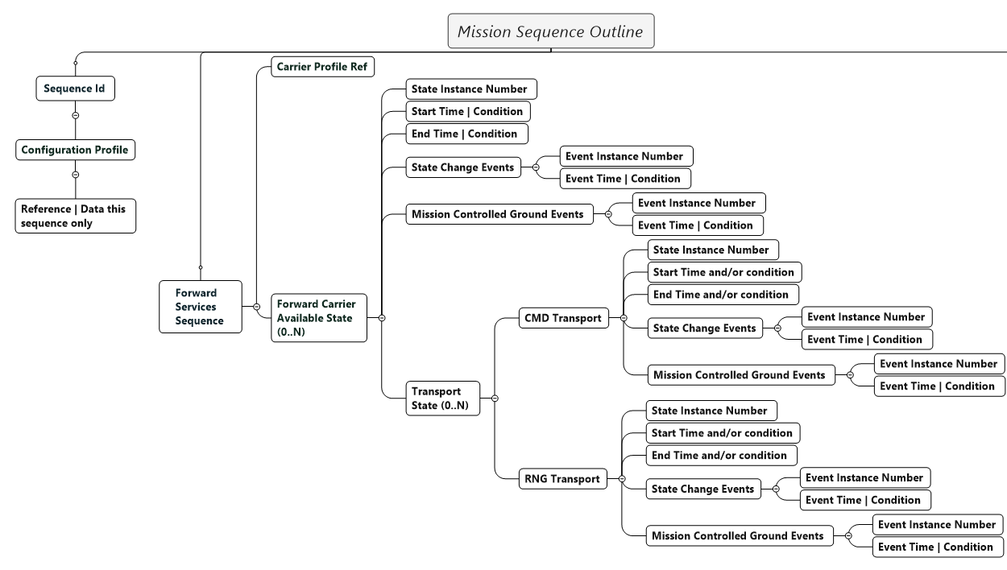

Slide 11
FR Details: Antenna (all assumed to be managed by the provider – no “commands” involved)
OID | Name | Classification | Transition Edge? | Comment
1.3.112.4.4.2.1.1.1.1.1 | antId | Monitor | No
1.3.112.4.4.2.1.1.1.2.1 | antProdStat | Monitor | No
1.3.112.4.4.2.1.1.1.3.1 | antActualAzimuth | Monitor | No
1.3.112.4.4.2.1.1.1.4.1 | antActualElevation | Monitor | No
1.3.112.4.4.2.1.1.1.5.1 | antCommandedAzimuth | Monitor | No
1.3.112.4.4.2.1.1.1.6.1 | antCommandedElevation | Monitor | No
1.3.112.4.4.2.1.1.1.7.1 | antControlledAzimuth | Monitor | No
1.3.112.4.4.2.1.1.1.8.1 | antControlledElevation | Monitor | No
1.3.112.4.4.2.1.1.1.9.1 | antControlledAzimuthRate | Monitor | No
1.3.112.4.4.2.1.1.1.10.1 | antControlledElevationRate | Monitor | No
1.3.112.4.4.2.1.1.1.11.1 | antAzimuthError | Monitor | No
1.3.112.4.4.2.1.1.1.12.1 | antElevationError | Monitor | No
1.3.112.4.4.2.1.1.1.13.1 | antPointingMode | Monitor | No
1.3.112.4.4.2.1.1.1.14.1 | antTrackingRxLockStat | Monitor | No
1.3.112.4.4.2.1.1.1.15.1 | antTrackingRxMode | Monitor | No
1.3.112.4.4.2.1.1.1.16.1 | antTrackingRxInpLevel | Monitor | No
1.3.112.4.4.2.1.1.1.17.1 | antTrackingRxLoopBwdth | Monitor | No
1.3.112.4.4.2.1.1.1.18.1 | antMeanWindSpeed | Monitor | No
1.3.112.4.4.2.1.1.1.19.1 | antPeakWindSpeed | Monitor | No
1.3.112.4.4.2.1.1.1.20.1 | antWindDirection | Monitor | No
1.3.112.4.4.2.1.1.1.21.1 | antAccumulatedPrecipitation | Monitor | No
1.3.112.4.4.2.1.1.1.22.1 | antPrecipitationRate | Monitor | No
1.3.112.4.4.2.1.1.1.23.1 | antRelativeHumidity | Monitor | No
1.3.112.4.4.2.1.1.1.24.1 | antAtmosphericPressure | Monitor | No
1.3.112.4.4.2.1.1.1.25.1 | antAmbientTemperature | Monitor | No
1.3.112.4.4.2.1.1.2.1.1 | antProdStatChange | Monitor | No
1.3.112.4.4.2.1.1.2.2.1 | antTrackingRxLoL | Monitor | No
1.3.112.4.4.2.1.1.2.3.1 | antWindSpeedWarning | Monitor | No
1.3.112.4.4.2.1.1.3.1.1 | antSetContrParams | Directive | No | HBPAN*
Semantics:
Start time
Spacecraft Forward Carrier start (time), SFC_{s,} = the time at which the spacecraft can first expect to receive a tuned-in carrier
Provider Forward Carrier start, PFC_{s} = SFC_{s,} - OWLT (One Way Light Time)
End time
Spacecraft Forward Carrier start time, SFC_{e,} = the time at which the spacecraft can last expect to receive a tuned-in carrier
Provider Forward Carrier end, PFC_{e} = SFC_{e,} - OWLT
Implied Semantics/Requirements on Service Provider:
The antenna microwave settings and associated electronics have been configured for the proper frequency, etc
Antenna is on point and tracking
Sufficient time has gone into warming the transmitter up
The tune-in sweep pattern has been executed to coincide properly (maybe just slightly in advance) with PFC_{e}
Summary of FRs Involved
*Handled by Provider as Needed

Slide 12
FR Details: Fwd401SpaceLinkCarrierXmit
OID | Name | Class | Transition Edge? | Comment
1.3.112.4.4.2.1.2.1.1.1 | fwd401CarrierXmitProdStat | M | N
1.3.112.4.4.2.1.2.1.2.1 | fwd401CarrierXmitStat | M | N
1.3.112.4.4.2.1.2.1.3.1 | fwd401CarrierXmitEirp | M | N
1.3.112.4.4.2.1.2.1.4.1 | fwd401CarrierXmitPolarization | M | N
1.3.112.4.4.2.1.2.1.5.1 | fwd401CarrierXmitActualCarrierFrequ | M | N
1.3.112.4.4.2.1.2.1.6.1 | fwd401CarrierXmitContrNominalCarrierFrequ | M | N
1.3.112.4.4.2.1.2.1.7.1 | fwd401CarrierXmitMod | M | N
1.3.112.4.4.2.1.2.1.8.1 | fwd401CarrierXmitSymbolStreamModType | M | N
1.3.112.4.4.2.1.2.1.9.1 | fwd401CarrierXmitSymbolStreamModIndex | M | N
1.3.112.4.4.2.1.2.1.10.1 | fwd401CarrierXmitRngModIndex | M | N
1.3.112.4.4.2.1.2.1.11.1 | fwd401CarrierXmitSweepProcStat | M | N
1.3.112.4.4.2.1.2.1.12.1 | fwd401CarrierXmitSweepProfile | M | N
1.3.112.4.4.2.1.2.1.13.1 | fwd401CarrierXmitSubcarrierFrequ | M | N
1.3.112.4.4.2.1.2.1.14.1 | fwd401CarrierXmitSubcarrierMod | M | N
1.3.112.4.4.2.1.2.1.15.1 | fwd401CarrierXmitSubcarrierFrequCoherency | M | N
1.3.112.4.4.2.1.2.1.16.1 | fwd401CarrierXmitSymbolClock | M | N
1.3.112.4.4.2.1.2.1.17.1 | fwd401CarrierXmitBasebandWaveform | M | N
1.3.112.4.4.2.1.2.2.1.1 | fwd401CarrierXmitProdStatChange | E | N
1.3.112.4.4.2.1.2.3.1.1 | fwd401CarrierXmitSetContrParams | D | ? | HBPAN
Semantics:
Start time
Spacecraft Forward Carrier start (time), SFC_{s,} = the time at which the spacecraft can first expect to receive a tuned-in carrier
Provider Forward Carrier start, PFC_{s} = SFC_{s,} - OWLT (One Way Light Time)
End time
Spacecraft Forward Carrier start time, SFC_{e,} = the time at which the spacecraft can last expect to receive a tuned-in carrier
Provider Forward Carrier end, PFC_{e} = SFC_{e,} - OWLT
Implied Semantics/Requirements on Service Provider:
The antenna microwave settings and associated electronics have been configured for the proper frequency, etc
Antenna is on point and tracking
Sufficient time has gone into warming the transmitter up
The tune-in sweep pattern has been executed to coincide properly (maybe just slightly in advance) with PFC_{e}
Summary of FRs Involved

Slide 13
1.3.112.4.4.2.1.2.3.1.1
fwd401CarrierXmitSetContrParams
--Details are TBD in the FRM
-From event sequence perspective:
Ramping of the forward carrier on|off
Transfer between up-linking ground stations
Forward Spacelink Available
CMD Data Transport
1.3.112.4.4.2.1.2.3.1.1
fwd401CarrierXmitSetContrParams
--Details are TBD in the FRM
--From event sequence perspective:
Configuration has been set at start of contact
Antenna is tracking
Transmitter has been warmed up
Tune-in sweep pattern has been completed
1.3.112.4.4.2.1.2.3.1.1
fwd401CarrierXmitSetContrParams
--Details are TBD in the FRM
-From event sequence perspective:
Transmitter is turned off (or
power shunted to water load)
RNG Data Transport

Slide 14
Forward Spacelink Available
1.3.112.4.4.2.1.2.3.1.1
fwd401CarrierXmitSetContrParams
--Details are TBD in the FRM
--From event sequence perspective:
Modulation Index
Modulation Type
Bit Rate
Subcarrier Frequency
Note: FRM does have:
1.3.112.4.4.2.1.2.1.9.1 fwd401CarrierXmitSymbolStreamModIndex
1.3.112.4.4.2.1.2.1.13.1 fwd401CarrierXmitSubcarrierFrequ
1.3.112.4.4.2.1.2.1.17.1 fwd401CarrierXmitBasebandWaveform
as monitor parameters
CMD Data Transport
1.3.112.4.4.2.1.2.3.1.1
fwd401CarrierXmitSetContrParams
--Details are TBD in the FRM
--From event sequence perspective:
CMD Modulation set to ON
Subcarrier modulation set to ON (if applicable)
Note: FRM does have:
1.3.112.4.4.2.1.2.1.7.1 fwd401CarrierXmitMod
1.3.112.4.4.2.1.2.1.14.1 fwd401CarrierXmitSubcarrierMod
as monitor parameters
1.3.112.4.4.2.1.2.3.1.1
fwd401CarrierXmitSetContrParams
--Details are TBD in the FRM
--From event sequence perspective:
Subcarrier Modulation set to OFF (if applicable)
CMD Modulation set to OFF
1.3.112.4.4.2.1.3.3.1.1 fwdLinkRngSetContrParams
--Details are TBD in FRM
-From event sequence perspective:
1) Modulation Index
Note: FRM does have:
1.3.112.4.4.2.1.2.1.10.1fwd401CarrierXmitRngModIndex
as monitor parameter; also note that this is a different group than FwdLinkRng (i.e, 1.3.112.4.4.2.1.2 vs 1.3.112.4.4.2.1.3)
1.3.112.4.4.2.1.3
FwdLinkRng
--Details are TBD in the FRM
--From event sequence perspective:
RNG Modulation set to ON
Tone Generation or PN Chip cycle started
Note: FRM does have:
1.3.112.4.4.2.1.3.1.1.1 fwdLinkRngMod
1.3.112.4.4.2.1.3.1.5.1 fwdLinkRngPnChipRate
and
1.3.112.4.4.2.1.2.1.10.1 fwd401CarrierXmitRngModIndex
as monitor parameters
RNG Data Transport
1.3.112.4.4.2.1.3
FwdLinkRng
--Details are TBD in the FRM
--From event sequence perspective:
Tone Generation or PN Chip cycle halted
RNG Modulation set to OFF

Slide 15
Conclusions so far…
The FRM tends to collect the control aspect for a functional group in generic “xxxxxxContrParms” element
In contrast to monitor data items, which tends to hint at what the various directives for “ContrParms” might look like
The event sequence state model assumes that all FRs in relation to the Antenna/Aperture are handled – i.e. these are the equivalent of a “large” set of directives that go into the initial transition into a forward carrier available state
I believe this is appropriate from a services point of view – not interested in controlling equipment, rather state the desired services and their transitions to be seen on a carrier
In theory there appear to be some good candidates from the FRM that match up with the transition edges
Exact identification does not seem possible at this time
Options for going forward
Work on defining all control directives that “make sense”
Work on defining control directives that are associated with event sequence transistions
This might be a good first step for SC-CSTS

