Slide 1
Trajectory Prediction Discussion
CCSDS CSSM Working Group Meeting
2 June 2015
Jessica Reinert
NASA/GRC

Slide 2
Trajectory Prediction – Service Management Header
Purpose and description are optional and not used in this case
 | TRAJECTORY PREDICTION SEGMENT | Info Entity Specific Notes
srvMgtMessageType (m) | y
originatingOrganization (m) [keeps as defined] [indictes provenenance of origniator -- even if just the warpping function] | y ? (perhaps conflict with NDM) | Creator of the TrajectoryPredictionInformation (wrapper)
generationTime (m) | y ? (perhaps conflict with NDM) | Generation time for the wrapper
status (m) [info entity specific] | y ? (perhaps conflict with NDM) | New, modified (perhaps add others later)
version (m) [info entity specific] | y ? (perhaps conflict with NDM) | Re-use description for standard header
startTime (m) [change to optional -- info entity specific] | y but payload has timestamps | Action for follow-up discussion
endTime [change to optional -- info entity specific] | y but paload has timestamps | Action for follow-up discussion

Slide 3
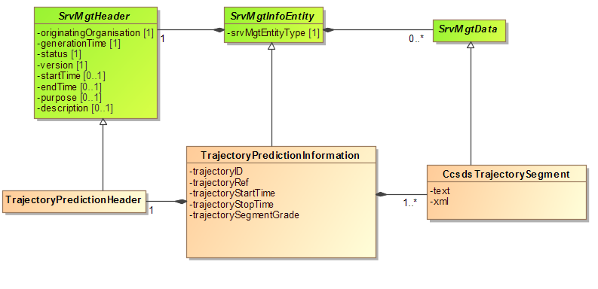
Trajectory Prediction – Service Management Header
Originally left trajectoryStartTime and trajectoryStopTime as different from startTime and stopTime, I think this is not what was intended from prior discussion because B1 SCCS-SM has only one time pair. Any disagreement?
Multiplicity between TrajectoryPredictionInformation and CcsdsTrajectorySegment, 1…1 or 1…*?
Notes:
John’s thoughts
If the Trajectory Prediction info entity uses the SvcMgtHeader, SrvMgtInfoEntity, and SrvMgtData stereotype as you have shown in the diagram, then there is the possibility of zero to multiple CcsdsTrajectorySegments being contained by one TP Info Entity. That’s not consistent with the B1 SCCS-SM definition of a TP “invocation”, which contains exactly one TP Segment. That may just have been an inadvertent application of the Info Entity stereotype, or you and the WG may have deliberately decided to change the concept and semantics from those of the B1 TP (again, I’m invoking Pietras Standard Apology here).
a. If it is indeed the case that it was just an inadvertent application of the Info Entity stereotype and the intention is to match the scope of the B1 SCCS-SM TP, then the class diagram (in addition to adding the SvcMgtHeader (empty?) subclass) should have a second cardinality, “1..1” declaration on the containment line between TrajectoryPredictionInformation and CcsdsTrajectorySegment. That would indicate that the general 0..* relationship between SvcMgtHeader and SrvMgtData is constrained to 1..1 for TP.
b. However, if you do intend that a single TP Info Entity can contain multiple trajectory segments, then the semantics have to be revisited. E.g., what do startTime and endTime in the SvcMgtHeader and/or trajectoryStartTime and trajectoryStopTime mean with respect to a set of trajectory segments, when in B1 trajectoryStartTime and trajectoryStopTime are defined in terms of a single trajectory segment? I won’t try to consider all the questions that this raises, on the chance (hope?) that case (a) above applies.

Slide 4
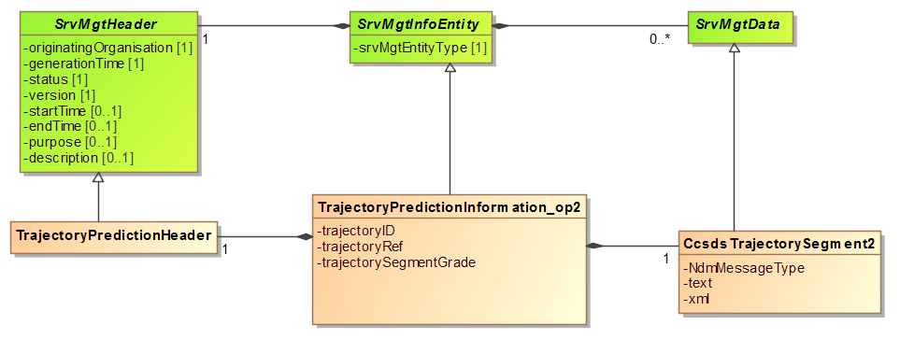
Trajectory Prediction – CcsdsTrajectorySegment
Changes from previous diagram
Multiplicity between TrajectoryPredictionInformation and CcsdsTrajectorySegment, 1…1
Removed duplicative start/stop times
Attempted to apply John’s thoughts about defining normative classes in a different way than previously proposed (see next slide).
Notes:
John’s thoughts
In your diagram, the CcsdsTrajectorySegment class is shown with two parameters, text and xml. These of course are really parameters of this class but just descriptors of the contents of classes that will be derived from CcsdsTrajectorySegment. I would (a) italicize CcsdsTrajectorySegment to indicate that it is a purely abstract class that is incapable of being used without being extended, (b) delete the text and xml “parameters” and (c) insert a comment box attached to the CcsdsTrajectorySegment class, stating that concrete subclasses of the CcsdsTrajectorySegment class must be defined. I’ve been thinking a little more about what we said in last week’s telecon about just making this type of declaration and leaving it up to using organizations to figure out how to create the specific subclasses. I’m now thinking that while that is true in the general case, in the specific case of CCSDS-standard formats (i.e., those defined in the ODM and XML Nav Blue Books) we might want to do a bit more, e.g., a normative annex that specifies the subclasses for those specific cases. We’re going to have to define such concrete subclasses in any case in order to do the prototyping, so we might as well make it normative while we’re at it and save everyone else that wants to use CCSDS standards the time and trouble of creating their own derived classes that may be incompatible with each other. Let me think about more about this and try to come up with a reasonable approach.

Slide 5
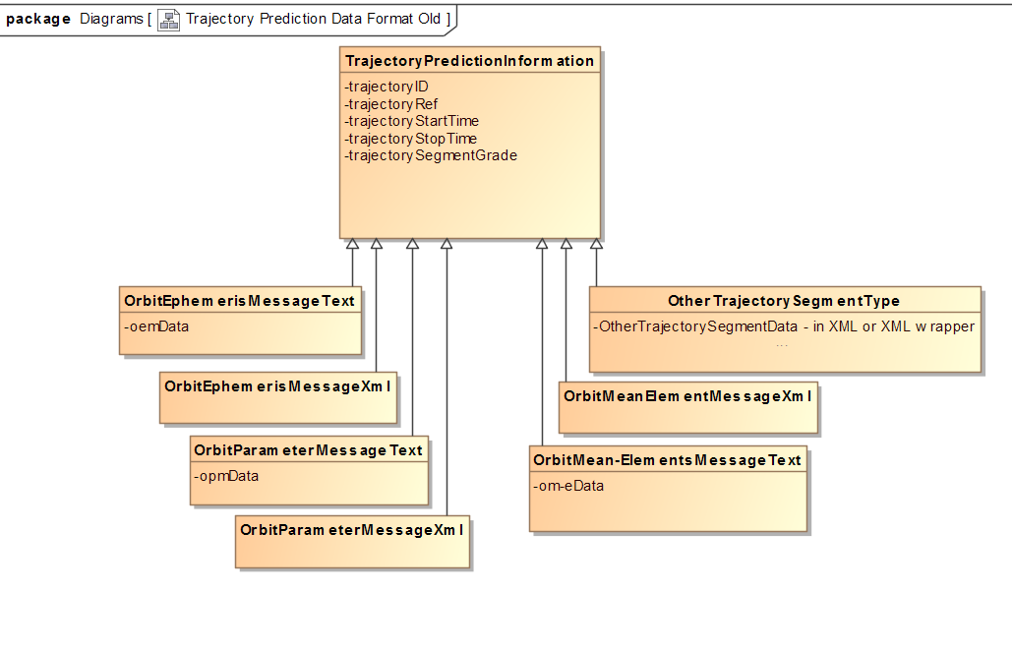
Trajectory Prediction – CcsdsTrajectorySegment
Previously proposed way to define normative classes
John do you have a new proposal?

