Slide 1
CSSM Pasadena Meetings
Brief Summary
(Full summary in the works)
13 Apr 2015

Slide 2
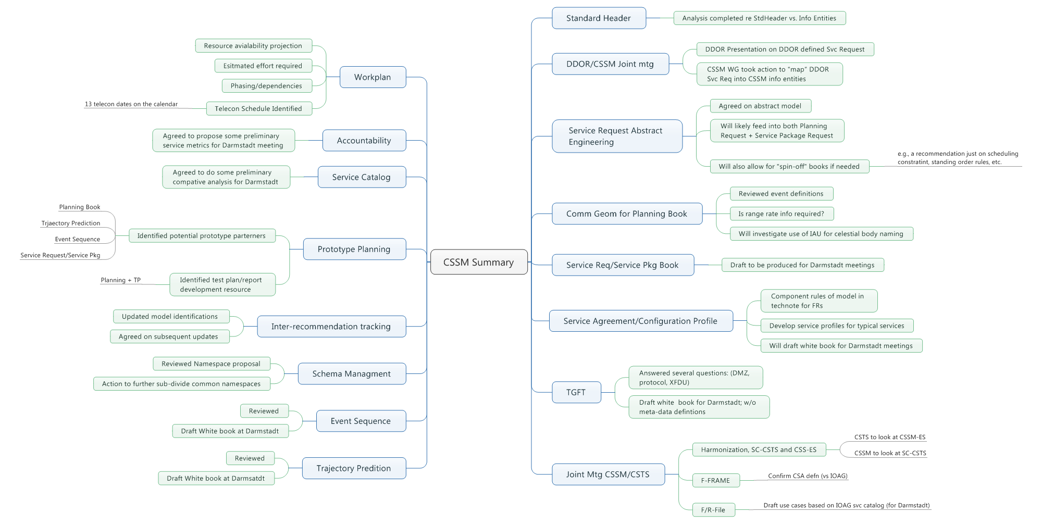

Slide 3
