Slide 1
TC/SLDP GB Comparison
Can the TC GB be Retired?

Slide 2
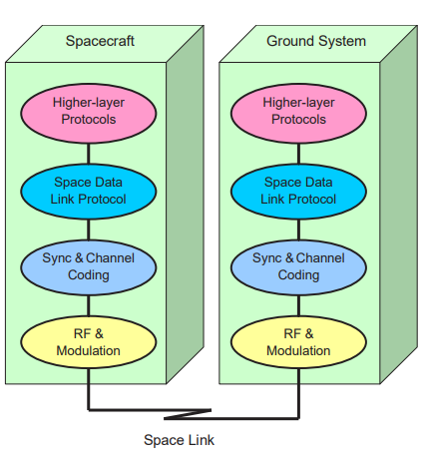
Space Data Link Protocols – Summary of Concept and Rationale
Outlines rationale for TC, TM, and AOS as well as general services that each provides.
Section 2: Provides a description of layer architecture for Data Link Later and below, whilst abstracting the rest
Section 3: Services available to each protocol for reliability, transfer timing, transfer frames, and packets
Section 4: Concepts of addressing/multiplexing, retransmission using COP-1, and transfer of packets using all 3 protocols.

Slide 3
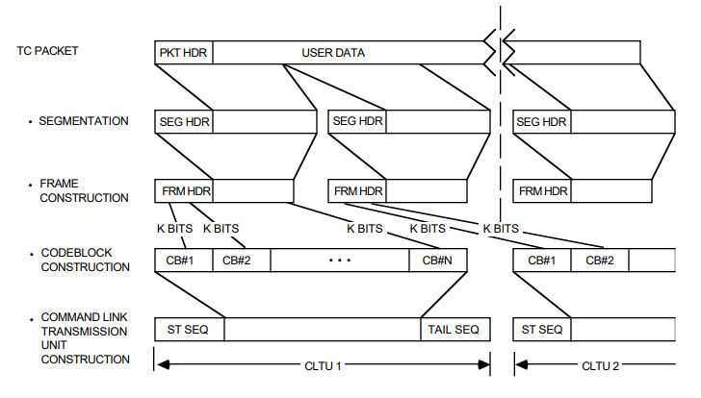
Telecommand – Summary of Concept and Rationale
Section 2: Outlines entire telecommand system from Application Layer to Physical Layer, and the 3 functional groups of the TC service. Very high-level description of services at each layer. Outline of TM/TC relationship. Description of data structures from packetization down to construction of CLTUs
Section 3: Services for each functional group and layer contained within

Slide 4
How do they Compare?
SDLP GB | TC GB
Services oriented | Technical, layer oriented
Covers TC/TM/AOS | Just includes TC
Focused on DLL + PL | Covers entire network stack
Different levels of information depending on role of reader | Presents reader with services for full stack with diagrams outlining I/Os for each

Slide 5
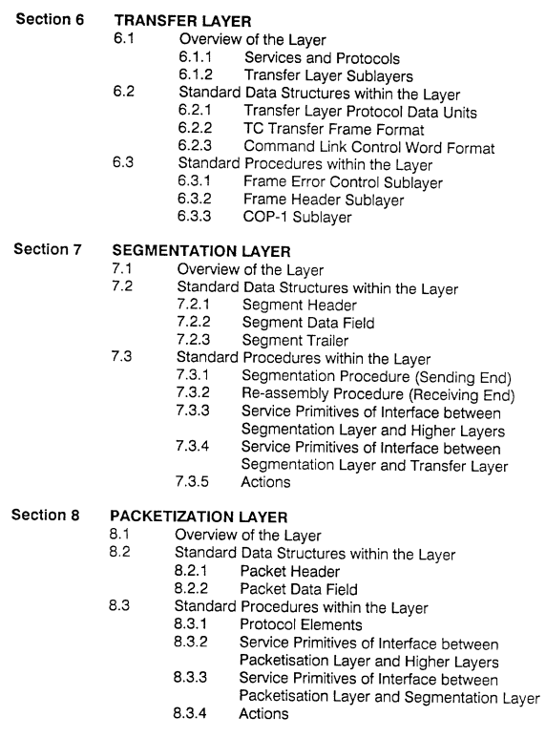
Issues with TC GB
The TC GB refers to series of non-OSI network layers, which will be misleading
The above was likely derived from ESA PSS document on Packet Telecommand Standards
Newer versions of the TC Blue Book don’t refer to this, which puts the validity of the TC GB in question

Slide 6
So, can we retire the TC GB?
Not because of the SDLP GB at least…

