Slide 1
Path Forward towards SPP Revision
Greg Kazz/Gian Paolo Calzolari
April 13, 2018
SLS-SLP WG
Gaithersburg, MD USA

Slide 2
#1 SPP has dual functionality which is currently not clearly defined
It’s first role is that of an application layer data structure using the APID as the (source or destination) data identifier, depending on direction of flow.
It’s second role is that of a shim protocol that encapsulates application layer PDUs into frames for transfer across the CCSDS data link layer.
The shim function is defined in the CCSDS Encapsulation Service.
Note that both roles can occur in any given system design and that the associated APIDs must be managed in APID space.
This dual functionality of SPP will be documented in the revised SPP BB and in OSCP GB.
We will examine if any parts of the retired Packet Telemetry Services (CCSDS 103.0-B-2-S) are still applicable as well as draft SPP Green Book (CCSDS 130.3-G-0.4).

Slide 3
Location of SPP/EPP
Upper Layers Protocols
Other
LTP
CFDP
Space Packet Users APIDs
0..2039
1st role = application layer data structure
2nd role = shim protocol that encapsulates application layer PDUs
ENCAPSULATION.request
(SPP) PACKET.request
PVN?
PACKET.request /
OCTET_STREAM.request

Slide 4
#2 Expunge Routing from SPP
We need to expunge any mention of the term “routing/route” in SPP since this function is really carried out by true network protocols e.g., IP or DTN.
Do we also need the appropriate replacement of “routing/route” in SPP as well as the term, “subnetwork” ?
Proposal is to substitute the word, “forwarding” for “routing/route”
Proposal is to substitute the word, “Space Link or SDLP” for ”subnetwork”

Slide 5
Occurrences of ‘Routing/Route’ in SPP
2.1.2 (Protocol Features) - The major function performed by this protocol is the routing forwarding of application data.
2.1.2 Routing The Space Data Link Protocol SAP address information (i.e., mapping from Path IDs to subnetwork addresses) is provided to the Space Packet Protocol entities by management.
2.1.2 At the source and intermediate systems, the Space Packet Protocol entity examines the Path ID of incoming Space Packets and routes them through appropriate subnetworks using the mechanisms provided by the subnetworks. ** This requirement is out of scope for SPP. **
2.3.1 (General Functions) - routing forwarding of protocol data units through a series of underlying subnetworks space links;
2.4.1 (Services assumed from Subnetworks Space Data Link Protocols) - addressing and routing forwarding capability in the subnetwork to be used for establishing LDPs within the SDLPs;
5.3 (Routing Parameters)
Subnetwork Identifier of the next Space Packet Protocol entity in the LDP
Subnetwork Address of the next Space Packet Protocol entity in the LDP
APID Qualifier of the LDP (if used)

Slide 6
#3 Logical Data Path
“The path from the source user application to the destination user application(s) through the subnetwork(s) is called a Logical Data Path (LDP).”
Proposal - Abandon the LDP and leave an informative historical note in the document, because in SPP path is nebulous, est. by mgmt. and is not interoperable.
Answer: ?
X
SDLPs
SDLPs
X
GPC: subnetworks… to be renamed
“space links” and 2 figures to be updated.

Slide 7
#4 Path ID
2.1.3 Addressing - A Path ID consists of an Application Process Identifier (APID) and an optional APID Qualifier.
Proposal – SPP currently does not define clearly what the APID Qualifier is. Redefine it as the “SDLP_Channel” as defined in 133.1-B-2 section 3.2.2. So APID Qualifier = SDLP_Channel, therefore Path ID = APID + SDLP_Channel (mandatory)
The parameter SDLP_Channel is part of the SAP address of the Encapsulation Service, and it shall uniquely identify the channel of the underlying SDLP through which the Data Unit is to be transferred.
For the Virtual Channel Packet (VCP) service of TM or AOS it equals GVCID
For the MAP Packet (MAPP) service of TC it equals GMAPID
For the Packet Service of Proximity-1 it equals Transfer Frame Version Number, the Spacecraft Identifier (SCID), the Physical Channel Identifier (PCID), the Data Field Construction ID (DFC_ID), and the Port ID
NOTE: Consensus with replacing APID Qualifier with SDLP_Channel. Question is should the PATH ID be optional or mandatory?

Slide 8
Mapping of Service Primitives
Internal processing
This drawing shows how the fields of the SPP PACKET request (input from users) are mapped to the request primitives in the SDLPs and how reasonable it is to replace the “APID Qualifier” with SDLP_Channel.
BTW OCTET_STRING.request is fairly similar.
SPP ➔ SDLP
PACKET.request
Packet
APID
APID Qualifier
QoS Requirement
VCP[MAPP].request
Packet
GVCID, [MAP ID,]
PVN,
SDU ID,
Service Type
?
?
SDLP_Channel =
GVCID or GMAPID or …
Reading key: The blue arrows shows parameters passed directly to the SDLP. Green arrows show parameter processed internally (as APID by SPP). Yellow arrows show parameters added by SPP.

Slide 9
4.1 Protocol Data Unit
The SPP PDU remains unchanged.

Slide 10
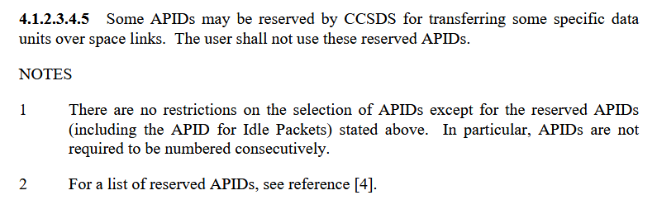
Reserved APIDs in SPP 133.0-B
Rewording TBD.
Now that also Encapsulation service exists it should be clarified that only special users (e.g. instances from Encapsulation Service) can use the reserved APIDs transparently to SPP. As SPP simply talks about (source/destination) User Applications, we do not really need to distinguish between users for unmanaged APIDs and users for reserved APIDs (i.e. Encapsulation). A NOTE may be sufficient without special checks in SPP.
GPC: This is an important point for Space Packets multiplexing. Greg, you may want to use the next (added) slide on this topic.

Slide 11
Which APIDs are allowed within a VC/MAP?
A VC/MAP can carry packets belonging to the complete range 0..2047 of APID values (including Idle Packets, of course).
This means that on a VC there could be
Space Packets generated by SPP (for unmanaged APID values 0 - 2039)
Space Packets generated by Encapsulation Service (e.g. for CFDP and/or LTP data units, with reserved APID values) and
Idle Space Packets generated locally within the Space Data Link Protocol (not by SPP).
This shall be reflected in the SPP Book.

Slide 12
4.2 SPP Procedures at the Sending End
SDLP_Channel

Slide 13
4.2.2 Packet Assembly Function
The Packet Assembly Function shall be used to generate Space Packets from Octet Strings submitted through the primitive: OCTET_STRING.request (Octet String, APID, APID Qualifier (optional), Secondary Header Indicator, QoS Requirement (optional))
The Packet Assembly Function receives Octet Strings from the Octet String Service user and shall build Space Packets by generating the Packet Primary Header.
The Secondary Header Indicator parameter shall be generated by the service user to indicate the presence or absence of a Packet Secondary Header at the start of Octet Strings.
The Packet Assembly Function shall translate the parameter by setting the Secondary Header Flag in the Packet Primary Header to a corresponding value. A sequence counter is maintained and shall be used to generate the Packet Sequence Count in the Packet Primary Header.
NOTE: Evaluate(study) to make the APID Qualifier (APID+SDLS Channel) mandatory in this primitive.

Slide 14
4.2.3 Packet Transfer Function
We keep this function but modify it as follows:
The Packet Transfer Function shall be used to transfer Space Packets to the next protocol entity in the LDP destination using services of the underlying subnetwork SDLP.
NOTE – There is an instance of the Packet Transfer Function in each sending end system.
If necessary, the Packet Transfer Function shall multiplex Space Packets received from the instances of the Packet Assembly Function and the Packet Service users, and shall put the Space Packets into a single packet stream for each MAPP SAP or VCP SAP by SDLP into a queue, in an appropriate order that is set by management. The algorithm to be used to order the Space Packets is not specified by CCSDS, but shall be defined by project organizations considering factors such as priority, release rate, etc.
The Packet Transfer Function, then, shall examine the Path ID of each Packet in the queue to identify the next protocol entity destination in the LDP of the Packet and shall transfer the Packet using a service of the underlying subnetwork SDLP. The Packet Transfer Function may transfer the Packet to multiple protocol entities which are not necessarily on the same subnetwork SDLP; i.e., it may perform a multicast function.
NOTE – Is Path ID the best term to use here or not ? Keep optional the APID Qualifier in case the destination is set up by management by e.g., look up table.

Slide 15
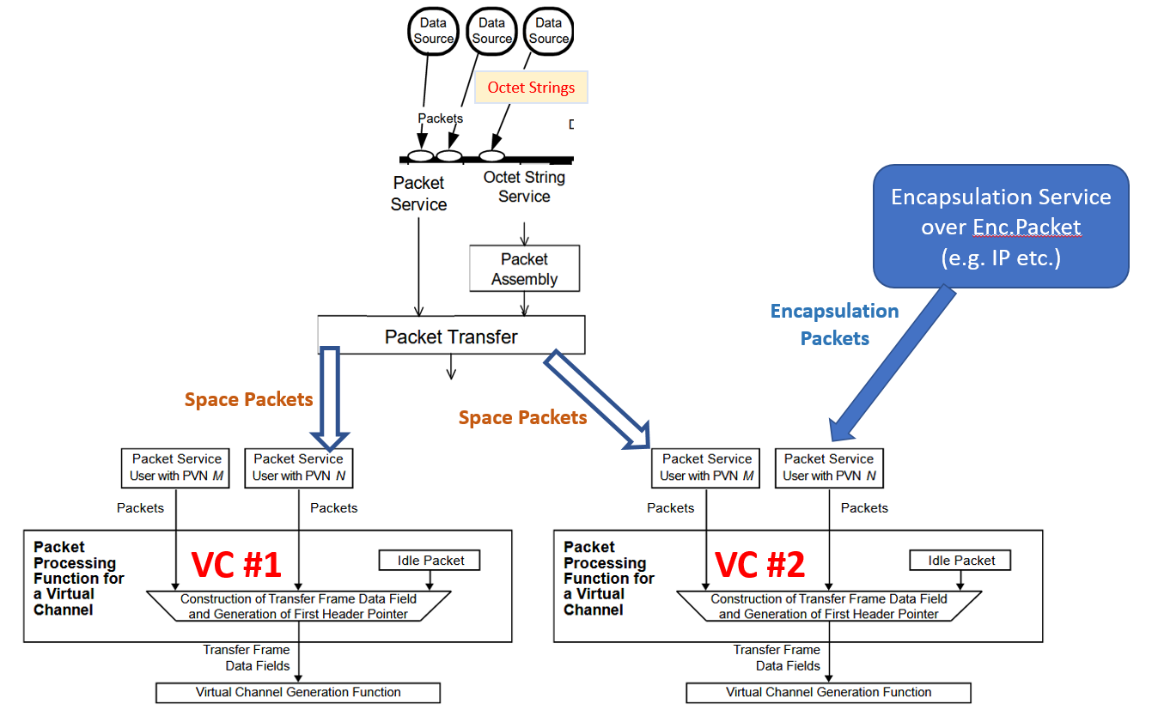
Scenario A examining SPP Packet Transfer Service

Slide 16
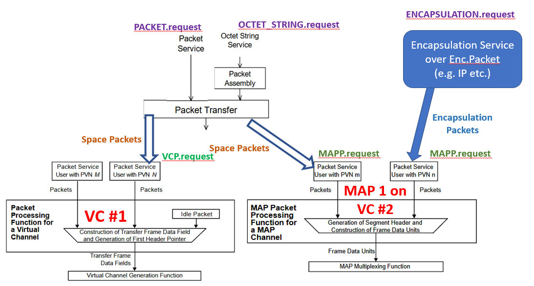
Scenario B examining SPP Packet Transfer Service

Slide 17
4.3 Protocol Procedures at an Intermediate System
Abandon this Section 4.3 Packet Relay Function (see requirements following), since there is nothing interoperable here.
NOTE: This is a routing capability – delete it

Slide 18
4.3.2 Packet Relay Function (sending side)
The Packet Relay Function shall be used to relay Space Packets to the next protocol entity in the LDP of each Packet using services of the underlying subnetwork.
NOTE: There is an instance of the Packet Relay Function in each intermediate system.
The Packet Relay Function shall receive Space Packets from the underlying subnetworks and shall put the Packets into a queue in an appropriate order that is set by management. The algorithm to be used to order the Space Packets is not specified by CCSDS, but shall be defined by project organizations considering factors such as priority, release rate, etc.
The Packet Relay Function, then, shall examine the Path ID of each Packet in the queue to identify the next Packet Protocol Entity in the LDP of the Packet, and shall transfer the Packet using a service of the underlying subnetwork.
If the optional APID Qualifier is used, the APID Qualifier of each received Packet shall be retrieved by a service of the subnetwork that carried the Packet. If the APID Qualifier is not used, the Path ID is derived directly from the APID of the Packet. Since APID_Qualifer = SDLP_Channel Parameter
The Packet Relay Function may transfer the Packet to multiple protocol entities, which are not necessarily on the same subnetwork; i.e., it may perform a multicast function.
The Packet Relay Function may temporarily store Packets, using a storage service provided by the Intermediate System, before they are transferred to the next Packet Protocol Entity, in case immediate transfer is impossible or impractical for some reason. The procedures for temporary storage of Packets are not specified by this Recommendation.

Slide 19
4.4 Protocol Procedures at the Receiving Side
We keep both the Packet Extraction Function (peer to Packet Assembly Function) and the Path Recovery Function (peer to Packet Transfer)
SDLP_Channel

Slide 20
4.4.2 Packet Extraction Function
The Packet Extraction Function shall be used to extract service data units from Space Packets.
NOTE – There is an instance of the Packet Extraction Function for each Path ID that delivers service data units with the Octet String Service.
The Packet Extraction Function shall receive Space Packets from the Path Recovery Function and shall extract Octet Strings by stripping the Packet Primary Header. The Secondary Header Indicator parameter shall be generated by the Packet Extraction Function to indicate the presence of a Packet Secondary Header at the start of the Octet Strings. The Packet Extraction Function checks the continuity of the Packet Sequence Count to determine if one or more Packets have been lost during transmission and shall generate the optional Data Loss Indicator parameter accordingly.

Slide 21
4.4.3 Path Recovery Function
The Path Recovery Function shall be used to receive and demultiplex Space Packets received from the underlying subnetwork SDLP.
NOTE – There is an instance of the Path Recovery Function in each receiving end system for each Packet User on VCP/MAPP SAP.
The Path Recovery Function shall receive Space Packets from the underlying subnetwork and shall demultiplex, if necessary, the received Packets on the basis of the Path ID of each Packet.
If the optional APID Qualifier is used, then the APID Qualifier of each received Packet shall be retrieved by a service of the subnetwork. If the APID Qualifier is not used, then the Path ID shall be derived directly from the APID of the Packet. Since APID_Qualifer = SDLP_Channel Parameter and is mandatory parameter
If the receiving user of the Path ID uses the Packet Service, the received Packets shall be delivered intact to the user identified by the Path ID. If the receiving user of the Path ID uses the Octet String Service, then the received Packets shall be delivered to the user through the Packet Extraction Function.
NOTE – Evaluate if the APID_Qualifier should or should not be mandatory; Come up with a better name for ”Path Recovery Function”

Slide 22
5. Managed Parameters - 1
Table 5-1 Protocol Configuration Parameters
Managed Parameter | Allowed Values
Maximum Packet Length (octets) | Integer
Packet Type of Outgoing Packets (Used only by sending systems) | 0, 1
Packet Multiplexing Scheme (Used only by sending systems) | Mission Specific
Service Type (This parameter is specified for each Path ID at the sending and receiving ends of the LDP Link) | Packet Service, Octet String Service
GPC: I think we need some discussion on the Service Type parameter as this was originally associate to the (killed) LDP. See also what is stated in 2.2.2.1 – Since now Path ID = APID + SDLP_Channel , I have the impression this is going to impose not pertinent requirements on the Space Data Link protocols that only care about receiving Space Packets and not about their contents. NOTE – Need to study further if Service Type is needed or not

Slide 23
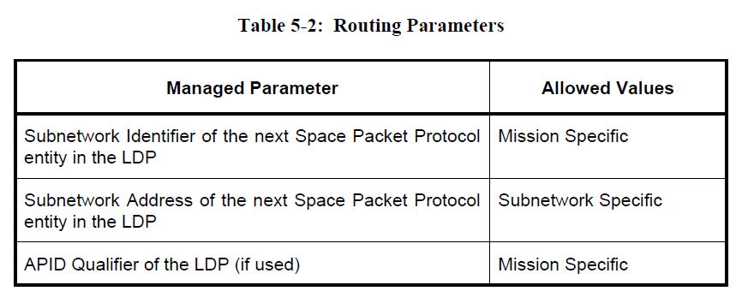
5. Managed Parameters - 2

Slide 24
“Packet” Service (rename/define)
In SPP 133.0-B it may be wise to rename the Packet Service to “Space Packet (SP) Service”. In fact SDL Protocols define VC Packet (VCP) Service and MAP Packet (MAPP) Service. At the end there will be 3 types of Packet Services:
Space Packet Service (defined in SPP)
Virtual Channel Packet Service (defined in SDLPs)
MAP Packet Service (defined in SDLPs)
Whenever possible, it would also be very good to formally define in 211.0-B the SAP Address (and the service primitives) for the Proximity-1 Packet Delivery Service.

Slide 25
QoS Requirement parameter in SPP 1/2
SPP 131.0-B, in NOTE to 3.4.2.5, states "If the TC Space Data Link Protocol (reference [B7]) is used as one of the protocols of the underlying subnetworks, the user can specify with this parameter whether the Type-A or Type-B service should be applied to the transfer of each Space Packet.“
However, also Proximity-1 provides two qualities of service (Sequence Controlled and Expedited) that determine how reliably data from the sending user are delivered to the receiving user.
The QoS Requirement parameter in the ENCAPSULATION.request is relevant when SDLP_Channel refers to the TC Space Data Link protocol and to the Proximity-1 Space Data Link Protocol
The Space Packet Protocol shall consider the QoS also for Proximity-1
But the current SPP (133.0-B) completely ignores the Proximity-1 Space Data Link Protocols (and TM, TC, and AOS are only listed as Informative References).

Slide 26
QoS Requirement parameter in SPP 2/2
Therefore the following is required in SPP
Add Proximity-1 Space Data Link Protocol to references
Add a second NOTE in 3.4.2.5 stating e.g. "If the Proximity-1 Space Data Link Protocol (reference [##]) is used as one of the protocols of the underlying subnetworks, the user can specify with this parameter whether the Sequence Controlled or Expedited service should be applied to the transfer of each Space Packet. “
Similar additions will be required at USLP Publication time as also USLP foresees the Sequence-Controlled QoS or the Expedited QoS.

Slide 27
SDU ID for Packet Transfer Function
SDU ID is a parameter needed when the underlying SDLP is TC [and Proximity-1 and eventually USLP] and it has no relationship neither with the ENCAPSULATION.request parameters nor with PACKET.request parameters. Therefore it shall be generated by the Packet Transfer Function in SPP (133.0-B).
SPP section 4.2.3 describes the Packet Transfer Function and in the forthcoming revision should describe that the Packet Transfer Function
generates “internally” the SDU ID parameter, and
generates Service Type parameter (this is somehow present but hidden) , and
receives VCP/MAPP_Notify.indication primitives (with mission specific processing?)
In other words, there is a need to state that there are more complex interaction with the TC SDLP [and Proximity-1 and eventually USLP] (with mission specific processing?).

Slide 28
Backup

Slide 29
Beyond SPP Revision Project…next steps ?
Do we want the SPP to have the capability of forwarding data (not routing data) on-board (mostly envisioned for on-board the spacecraft) within a single closed subnetwork in an A-B-A configuration ?
For Telecommand, Space Station uses Logical Data Path – Endpoint as the APID_Qualifier (this field occurs in the packet 2nd Header, which is currently non-compliant with SPP because there is currently no standard packet 2nd header defined) to forward commands to user modules on-board the ISS. In this case, Logical Data Path is short circuited to be a Logical Data Path Endpoint
We may need to hold open the possibility of Logical Data Path Endpoint or something similar until we get clarification from all agencies and the SIS area about their desires for eventually modifying the SPP packet 2nd header in order to accomplish data forwarding on-board a spacecraft. As mentioned this is an additional task (with respect to the current approved CWE Project) deserving proper discussion. I suggest that a proper proposal is formalized at CCSDS Spring 2018 Meeting in Gaithersburg.

Slide 30
Updated Stack Diagram suitable for OSCP Green Book
Application Layer
CFDP
SPP
AMS
BP
LTPCLA
ENCAPCLA
TCPCLA
UDPCLA
Transport Layer
TCP
UDP
Network Layer
IP
LTP
IPoC
Encapsulation Service
(
SPP/EPP)
Protocol Sublayer of
Data Link Layer
USLP
TM
TC
AOS
Prox
-
1
Ethernet
Coding sublayer &
Physical Layer
RF
/
Wire
Optical Coding & Modulation
Notes:
Figure 2-5

