Slide 1
SDLS Extended Procedure for KEM Exchange
For discussion – none of this is fully developed
Design considerations:
  Define a KEM Exchange PDU with flexibility to accommodate various algorithms & parameter sets
    Tried to extract the range of possibilities from the Triple-KEM paper
    Variants all appear to need the capability to exchange at least 2 arguments
    Prefer to remain nonspecific about content and size of those arguments, so that the PDU fields aren’t all managed-length
    Prefer to define a single PDU which covers all messages in the KEM Exchange sequence, rather than define multiple individual Command and Reply PDU variants
  Define control flow such that an instance can operate as either Initiator or Recipient depending on context
    For example, an instance might be expected to interact with certain entities as the Initiator, and as the Recipient with other entities
  Define error handling
    Reset (abort the transaction) in the event of crypto failures
    Timeouts and PDUs received out of sequence

Slide 2
KEM Exchange states & control flow (draft)

Slide 3
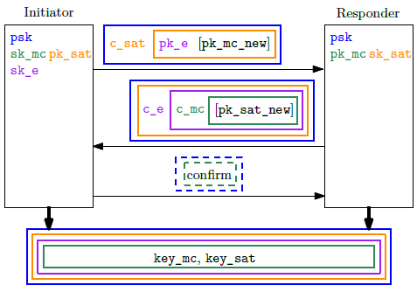
Objective is to support Triple-KEM
Per November 2024 meeting minutes Attachment 5 (Hulsing, Lange, Weber paper):
  (added for SDLS)
    Handshake to start (I → R)
    Handshake ACK (I ← R)
  KEM 1st message (I → R)
    Encaps (encrypted pk_e)
    Ciphertext (encrypted c_sat)
  KEM 2nd message (I ← R)
    Decaps (encrypted c_e)
    Ciphertext (encrypted c_mc)
  KEM 3rd message
    Completion ACK (I → R)
  (added for SDLS)
    Completion ACK (I ← R)

Slide 4
KEM Exchange PDU (draft)
KEM Cipher Suite Identifies the managed parameter set & KEM algorithms
KEM Message ID Identifies the specific message in the control flow
KEM Session ID Identifies the specific exchange session – randomly generated by Initiator
Timestamp For use in calculating timeouts (maybe unnecessary?)
Encaps/decaps length in bytes Identifies the size of encaps/decaps data
Encaps/decaps data Encaps or decaps
Ciphertext length in bytes Identifies the size of ciphertext data
Ciphertext data Ciphertext

Slide 5
KEM Exchange Message IDs (draft)
PDU allocates 4 bits for Message ID – 16 possible values
State diagram suggests we need at least the following message IDs (values are notional):
  0001 Handshake
  0010 Handshake ACK
        Receiving this signals that the Recipient is ready for a KEM session
  0011 Encaps Ciphertext
  0100 Decaps Ciphertext
  0101 Completion ACK
        Receiving this signals that the new shared key is agreed-upon and ready for installation
  1111 Reset
        Receiving this signals to abort the KEM session in progress

