Slide 1
A knowledge base of Adversaries Tactics and Techniques for Space (ATT4S)
TEC-ESS
14/09/2022

Slide 2
Disclaimer
While Phase 1 of this work has been completed, it is still work in progress and hence, it should not be consider as a final or as an ESA position on the topic. The purpose of its presentation at this phase is rather to contribute to iscussion on the topic, identify and fill any gaps.

Slide 3
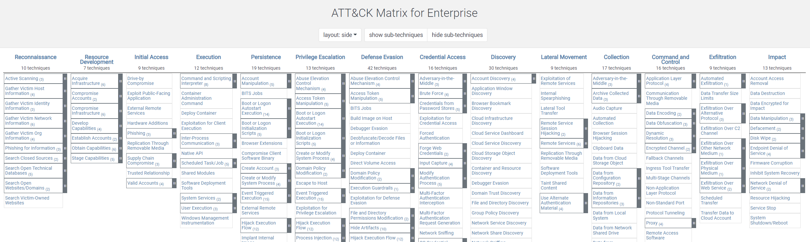
Background – The MITRE ATT&CK® Framework
A globally-accessible knowledge base of adversary tactics and techniques based on real-world observations.
Used as a foundation for the development of specific threat models and methodologies.
Matrices for Enterprise (Windows, Linux, Network, Cloud, etc.), Mobile and Industrial Control Systems.
Source: https://attack.mitre.org/

Slide 4
A MITRE ATT&CK® like Knowledge Base for Space
An one-stop place aggregating potential attacking tactics, techniques, and sub-techniques for space systems:
To model (future) Space Threat Intelligence (STI) information
To identify needed defensive techniques and mitigations.
To develop new security technologies for space.
To identify security monitoring and logging needs
To assist system risk analysis.
Mapping to CCSDS and other space standards.

Slide 5
Scope
Focus on Space Segment and Space Communication Links
It does not exist
More challenging
Ground Segment resembles to a great extent MITRE ATT&CK® Enterprise (but some tailoring is needed).
Still, we do make connections with Ground Segment.
Application specific systems (e.g. GNSS) out of scope at this moment
This work can be used as a stepping stone for specific systems.

Slide 6
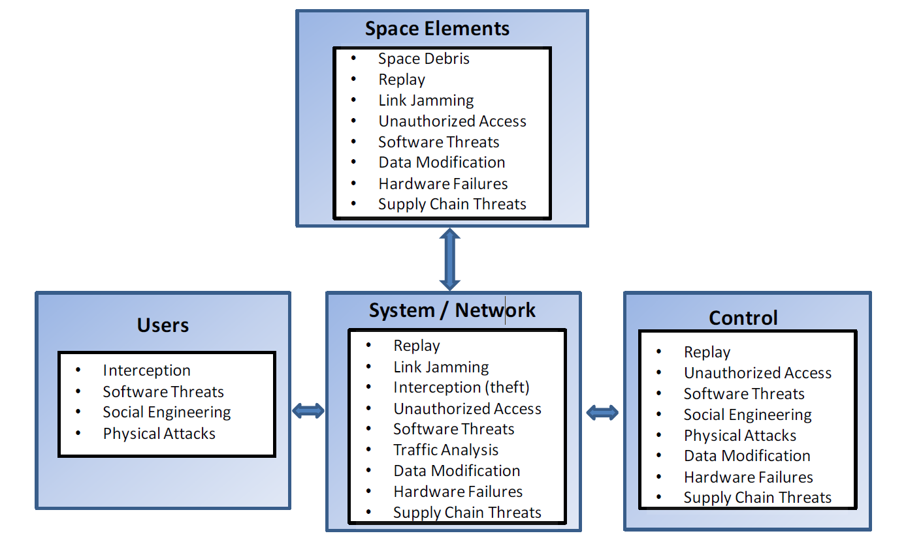
Methodology
MITRE ATT&CK® Enterprise as a starting point ➔ removed what not relevant for space
CCSDS Threats Against Space Mission and other CCSDS docs
Use of an attacker’s mindset.
Internal collaboration, interviewing, brainstorming with ESA experts on each topic (e.g. Avionics, software, etc.).
Some bi-directional influence with SPARTA (exchange between the two teams)

Slide 7
Tactics - MITRE ATT&CK ® Tactics were preserved
Reconnaissance
Resource Development
Initial Access
Execution
Persistence
Privilege Escalation
Defense Evasion
Credential Access
Discovery
Lateral Movement
Collection
Command and Control
Exfiltration
Impact

Slide 8
Reconnaissance
Passive Interception (RF/Optical) | Mission specific Channel Interception
 | Telecommand Protocol Interception
 | Telemetry Protocol Interception
Active Scanning (RF/Optical) | Mission specific channel scanning
 | Telecommand Protocol Scanning
 | Telemetry Protocol Scanning
Gather Victim Mission Information | Cryptographic algorithms
 | Firmware
 | Frequencies
 | Hardware
 | Software
 | Position/Trajectory
 | Protocol specifications
 | Other mission specific information
Gather Victim Org Information | Business Relationships
 | Determine Physical Locations
 | Identify involved industries and other organisations
 | Identify Roles
Phishing for Information | Spearphising to Ground Segment Operators
 | Spearphising to Industry/Space Agencies
Search Closed Sources | Purchase Technical Data
Search Open Websites/Domains | Social Media
In Orbit Proximity Intelligence | Optical (Visual) reconnaissance
 | Electromagnetic reconnaissance

Slide 9
Initial Access
Communication channels | Payload eavesdropping
 | TC Brute forcing
 | TC while in Clear (Safe) Mode
 | TC/TM eavesdropping
 | TC/TM Replay
 | TC/TM Spoofing
Supply Chain Compromise | Integration of malicious/non-genuine hardware
 | Compromise Software Dependencies and Development Tools
 | Compromise Software Supply Chain
Trusted Relationship | Trusted Relationship via Federated Operations
 | Gateway
Valid Credentials | Digital Certificates
 | Master/session keys
Ground Segment Compromise | Ground Mission Segment Compromise
 | Ground Control Segment Compromise

Slide 10
Privilege Escalation
Become Avionics Bus Master
Escape to Host | Escape from Hypervisors or space-time partitioning

Slide 11
Impact
Denial of Service | Direct Network Flood
 | Jamming
 | Receiver flooding
 | Receiver lock on a spurious carrier
 | SDR buffer overflow
Permanent loss to telecommand satellite | Replace session and master keys
Resource damage | Counterfeit hardware breakdown
 | Breakdown of hardware built to fail
 | Receiver damage
 | Space Debris Impact
 | Physical sabotage
 | Resource destruction
 | Intentional collision with other satellites
Resource Hijacking | Drain satellite's power
 | Illegitimate bandwidth usage
 | Waste of propellant
Runtime Data Manipulation
Service Stop | Ground system loss
 | Disabling Payload Service
Temporary loss to telecommand satellite | Replace session keys
Transmitted Data Manipulation | TC Data Manipulation
 | TM Data Manipulation
 | Range Data Manipulation
 | Payload Data Manipulation

Slide 12
Adversaries Tactics and Techniques for Space Navigator

Slide 13
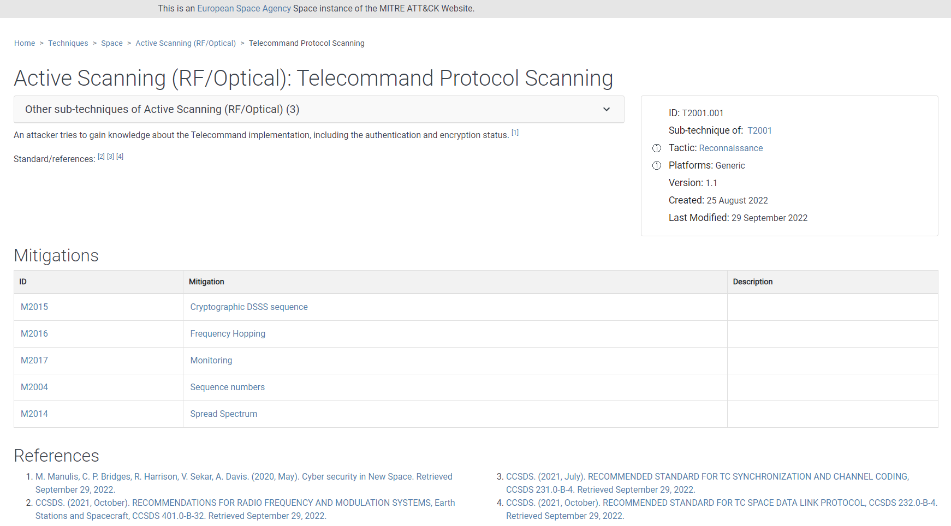

Slide 14
Conclusions and Future Work/Plans
A MITRE ATT&CK® - like framework for Space can contribute towards the security protection of space systems:
Identify threats, mitigations, needed technologies, security monitoring / logging needs, etc.
Standardisation could help towards this direction.
Space missions can use it as a stepping stone to tailor it for their case.
A Technical Note under compilation.
Further iterations with various experts is needed.
Some gaps to be filled.
It needs to be a continuous work; MITRE ATT&CK® is being evolved for years

Slide 15
Back Up Slides

Slide 16
Resource Development
Acquire Infrastructure | Ground segment
 | Satellite
Compromise Credentials | Compromise Services Account
 | Compromise Cryptographic Keys
Compromise Infrastructure | Ground Segment
 | Satellite
Obtain and/or Develop Capabilities | Code Signing Certificates
 | Digital Certificates
 | DSSS code or Frequency hopping sequence
 | Malicious supply chain capabilities
 | Software vulnerabilities
 | Space Debris production
 | Space Protocol Vulnerabilities
 | TC/TM forging

Slide 17
Execution
Hypervisor Ports between partitions
Native API
On Board Control Procedures modification | OBCP CLI
 | Python - Micropython
 | Unix Shell
Payload Exploitation to Execute Commands

Slide 18
Persistence
Backdoor installation | Hardcoded credentials and/or keys
 | Integration of custom malicious hardware
 | On-Board Software modification
 | Transponder reconfiguration
 | Payload modification
Key Management Infrastructure Manipulation | Replace session keys
Valid Credentials | Valid master/session keys
 | Digital Certificates
Pre-OS Boot | System Firmware

Slide 19
Defense Evasion
Impair Defenses | Triggering the Clear (Safe) Mode
Indicator Removal on Host | Clear Command History
Masquerading

Slide 20
Credential Access
Retrieve TT&C Master/Session Keys | Compromise of Key Management Facility
Indicator Removal on Host | Cryptographic Key Corruption
Masquerading | Interception of Key Management Communication

Slide 21
Discovery
Key Management Policy Discovery
Trust Relationship Discovery
System Service Discovery
Spacecraft’s Components Discovery

Slide 22
Lateral Movement
Compromise of another partition in Time and Space Partitioning OS or other types of satellite hypervisors
Lateral Movement via common Avionics Bus

Slide 23
Collection
Adversary-in-the-Middle | Unauthenticated gateway or unauthenticated interplanetary node
 | Satellite constellation
Data from link eavesdropping | Payload eavesdropping
 | Range Data eavesdropping
 | TC/TM eavesdropping

Slide 24
Command and Control
TC/TM delay
Telecommand | GNC timeline
 | OBCP modification
 | Update/patch channel

Slide 25
Exfiltration
Exfiltration Over Payload Channel
Exfiltration Over TM Channel

