Slide 1
NASA’s Plan for SDLS Testing
Presenter(s):
Brandon Bailey
brandon.t.bailey@nasa.gov
304-629-8992
ivv-itc@lists.nasa.gov
ITC Website: http://www.nasa.gov/centers/ivv/jstar/ITC.html
JSTAR Website: http://www.nasa.gov/centers/ivv/jstar/JSTAR.html

Slide 2
Background
Joined SEA-SEC Working Group July 2014 at ~.125 FTE
Not much experience with CCSDS
Spent time learning about CCSDS and SDLS
Simulation, Testing and Security Background
Could perform SDLS testing
Began developing approach to test SDLS for NASA
Complete approach outlined in CCSDS-SDLS-Prototype-Plan document

Slide 3
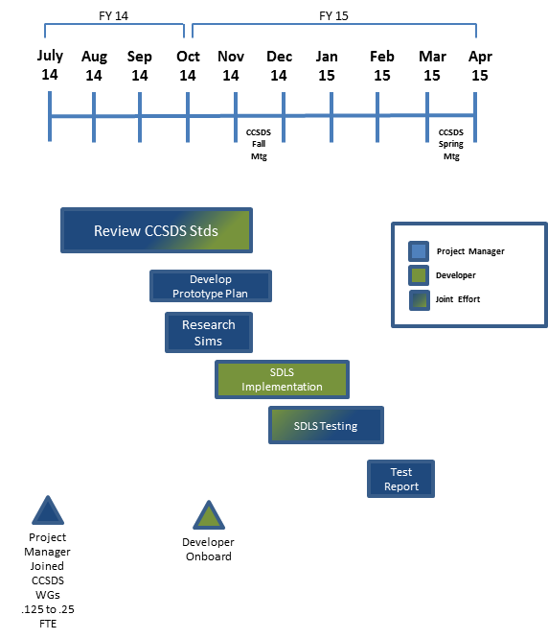
Proposed Schedule

Slide 4
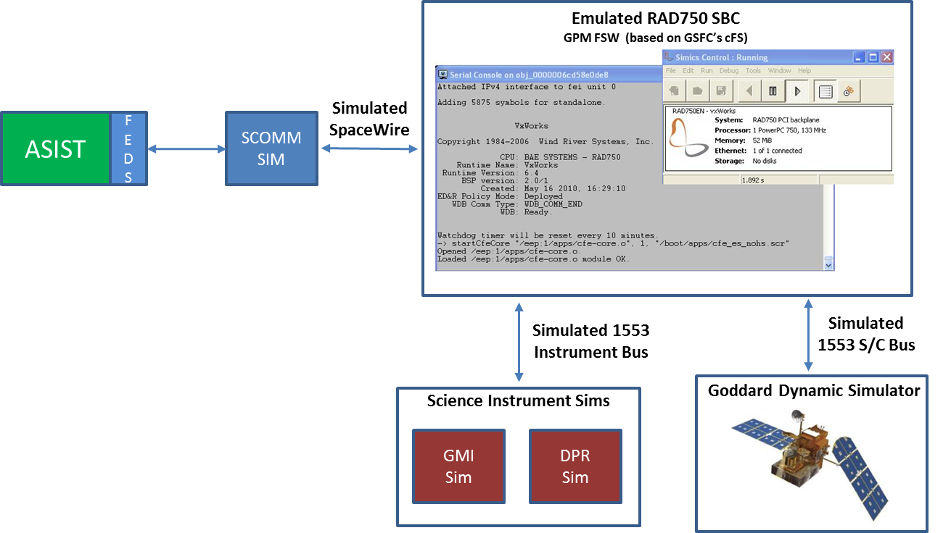
Approach
Use existing full spacecraft simulator (GO-SIM)
Implement SDLS in operational components
Front End Data System (FEDS)
Global Precipitation Measurement (GPM) FSW

Slide 5
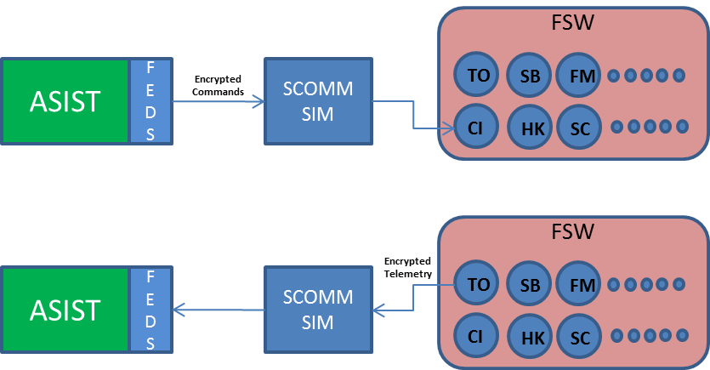
Approach (cont.)
The data (telemetry and telecommand) will be exchanged through the SLE services in real time. Encrypted telecommands will be sent to the FSW via FEDS and an SCOMM simulator. The incoming data can then be decrypted by the CI application within the FSW. Telemetry, sent from the spacecraft to the ground, functions the same way but in reverse. The TO application within the FSW encrypts the telemetry and downlinks via the SCOMM simulator to FEDS and then decrypted by FEDS and passed to the ground station ASIST.

Slide 6
Goals
To implement the SLDS protocol
To validate the SDLS protocol
To test compatibility of the SDLS protocol in a full operational simulator that includes operational ground software as well as flight software
Benefits of using existing NASA operational systems
Reduction in time to implement due to software reuse
Applicability after prototype is completed
Future missions will be able to take the lessons learned from the prototype and apply them to their mission when implementing SDLS (Or even reuse prototype code!)

Slide 7
SLDS Test Objectives
Objectives | Auth Only | Auth Enc.
Confirm a security association can be statically preloaded | X | X
Confirm a security association can be dynamically loaded | X | X
Confirm the sequence number is appropriately communicated and incremented during transmission and processing | X | X
Confirm if the sequence number verification fails, a failure is detected, communicated, and the transfer frame is not processed by the receiver and the sequence counter does not increment | X | X
Confirm the data area of the transfer frames can be encrypted using the AES algorithm using the security association authenticated encryption and entire transfer frame can be communicated |  | X
Confirm after receipt of the transfer frame, the data area of the transfer frames can be decrypted using when using the security association authenticated encryption |  | X
Confirm that when the Security Parameter Index (SPI) verification fails, a failure is detected, communicated, and the transfer frame is not processed by the receiver and the sequence counter does not increment | X | X
Confirm that when the MAC verification fails, a failure is detected, communicated, and the transfer frame is not processed by the receiver and the sequence counter does not increment | X | X
Confirm that when the Global Multiplexer Access Point ID (GVCID) verification fails, a failure is detected, communicated, and the transfer frame is not decrypted by the receiver and the sequence counter does not increment | X | X
Confirm that when the sequence number rolls over, the cryptographic key is reported as expired and the key can be replaced to resume operations | X | X
Confirm that when the transfer frames between ground and spacecraft are intercepted the data area of the frame is encrypted and cannot be deciphered without the encryption key |  | X

Slide 8
Summary
More detail in document CCSDS-SDLS-Prototype-Plan
Feedback wanted!!!
Will the proposed timeline provide value?

Slide 9
Backup Slides

Slide 10
NOS Middleware Interception
Interceptor Blocking Data
Interceptor Modifying Data
Data Flow With Interceptor
Normal Data Flow
Node A
NOS
Middleware
Node B
Block
Modify
Interceptor

