Slide 1
Radii Ratios in VCM
Jon Hamkins
October 22, 2019
This research was carried out by the Jet Propulsion Laboratory, California Institute of Technology, under a contract with the National Aeronautics and Space Administration.
© 2019 California Institute of Technology. U.S. Government sponsorship acknowledged.

Slide 2
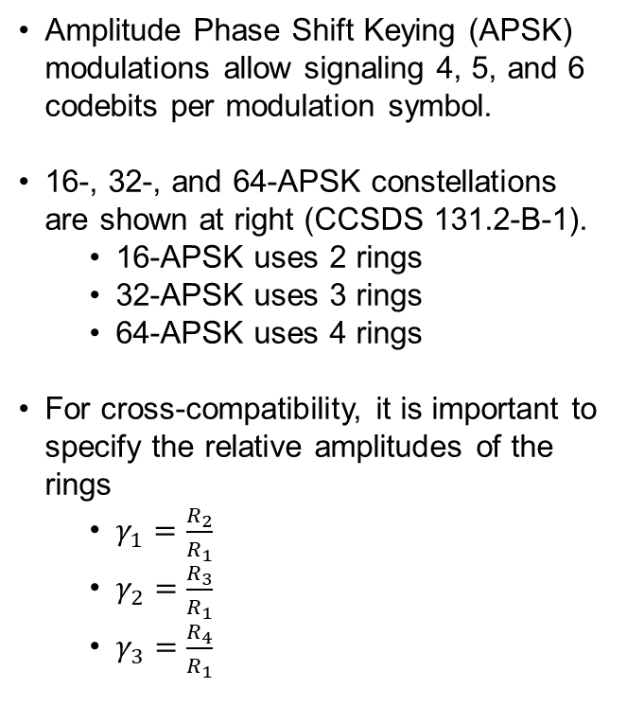
What APSK Radii Ratios Are
Amplitude Phase Shift Keying (APSK) modulations allow signaling 4, 5, and 6 codebits per modulation symbol.
16-, 32-, and 64-APSK constellations are shown at right (CCSDS 131.2-B-1).
16-APSK uses 2 rings
32-APSK uses 3 rings
64-APSK uses 4 rings
For cross-compatibility, it is important to specify the relative amplitudes of the rings
$γ_{1}=\frac{R_{2}}{R_{1}}$
$γ_{2}=\frac{R_{3}}{R_{1}}$
$γ_{3}=\frac{R_{4}}{R_{1}}$

Slide 3
Overview
ESA paper presented at May 2019 meeting [1] noted that in the VCM Red Book [2], the APSK radii ratios were not defined when VCM is used with TM codes in 131.0-B-3.
By contrast, the radii ratios for VCM with codes in 131.2-B-1 and 131.3-B-1 are defined.
131.2-B-1 (SCCC) defines the radii ratios directly.
131.3-B-1 (DVB-S2) defines the radii ratios by reference to ETSI DVB-S2 standard.
401.0-B-29 defines the APSK modulations and refers back to 131.2-B-1 and 131.3-B-1 for the radii ratios to use. This leaves open the question of how to state the radii ratios when VCM is used with codes from 131.0-B-1 (turbo/LDPC)
ESA proposed four possible paths forward.
Jon Hamkins took an action item (AI_19_04) to recommend how to state the radii ratios in 401.0-B and 431.1.
[1] Ricard Abelló, Enrico Vassallo, Andrea Modenini, “Proposed Changes in APSK constellation radii ratio for coding according to CCSDS 131.0.B-3,” SLS-RFM_19-02, presented at CCSDS meeting, RFM Working Group, May 2019.
[2] Variable Coded Modulation Protocol, CCSDS 431.1-R-1.

Slide 4
APSK Radii Ratios: 131.2-B-1 (SCCC)

Slide 5
APSK Radii Ratios: 131.3-B-1 (DVB-S2)

Slide 6
APSK Radii Ratios: 401.0-B-29 (RF Modulation)
The RF Modulation standard is consistent with 131.2-B-1 and 131.3-B-1.

Slide 7
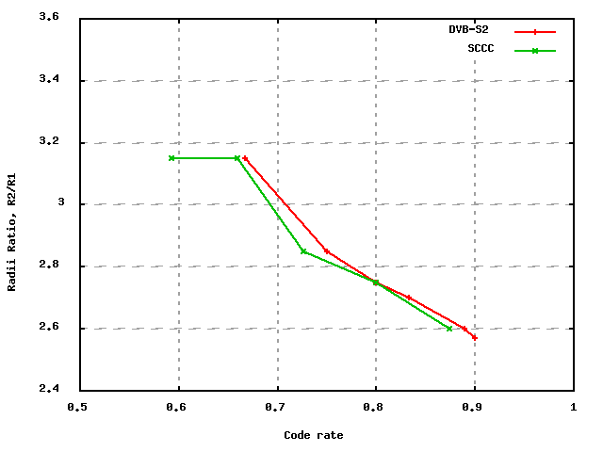
16-APSK Radii Ratios: 131.{2,3}-B-1
The same data, graphically:

Slide 8
16-APSK Radii Ratios: 131.0-B-3
What radii ratios should the VCM protocol use when the codes from 131.0-B-3 are used?
The following code rates are used with 16/32/64-APSK:
r=½
r=2/3
r=4/5
r=223/255

Slide 9
16-APSK Radii Ratios: 131.{0,2,3}-B
The optimal radii ratio for rate ½ was not defined in previous CCSDS standards.
Three of the 131.0-B-3 rates match existing standards. We can reuse those radii ratios.

Slide 10
Simulation Results for 16-APSK Radii Ratios
Simulations were run for mode 16 of the TM codes (rate ½ LDPC code with 16-APSK)
Varying radii ratio
Simulations recorded $E_{b}/N_{0}$ required to reach CWER=${10}^{−4}$.
Results indicate:
Any $γ_{1}$ between about 3.00 and 3.25 is optimal for this case
Performance is not sensitive to radii ratio – e.g., $γ_{1}=6$ would cause ~0.1 dB of loss.

Slide 11
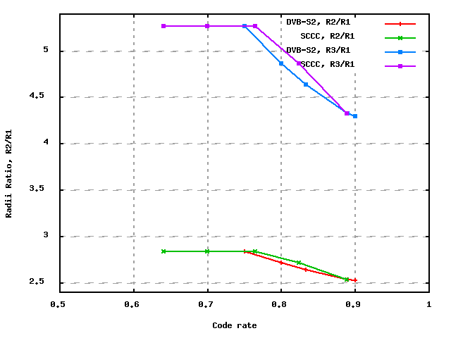
32-APSK Radii Ratios: 131.{2,3}-B-1
The same data, graphically:

Slide 12
32-APSK Radii Ratios: 131.{2,3}-B-1
The same data, graphically:
131.0-B-3 Codes.

Slide 13
ESA’s Proposed Options
From 2019-05 RFM WG minutes:
3.3 Recommendations 2.4.18 and 2.4.23
Input document SLS-RFM_19-02 was presented by R. Abello. The document deals with the radii ratios for 16APSK, 32APSK and 64APSK when these modulations are used with coding schemes different from SCCC and DVB-S2. For these codes, in fact, the ratios are not specified in 401 nor in the VCM blue book under development. ESA proposed four options for 16APSK and 32APSK and a subset of 3 for 64APSK (option 3 not valid):
Use the same constellation radius ratios of SCCC for Type 1 and DVB-S2 for Type 2. However, ESA stated that this is not really possible because there is no matching between the VCM modes and also the code rates are different.
Find the best constellations (radii and symbol mappings) by simulation, as was already done in the past decade for DVB-S2 and SCCC.
Compromise, by selecting the constellation with the nearest coding rate, from DVBS2. The degradation with this approach is below 0.1 dB, as indicated in literature.
Compromise, by selecting a single 16APSK and 32APSK constellation (radii and mapping) for all coding rates. The degradation with this approach should be less than 0.3 dB, but simplifies the modulator/demodulator.
Whatever the option selected, the WG agreed that the relevant normative data should be included as a table in both recommendation 2.4.18 and 2.4.23 in 401-B. The VCM book would simply refer to the 401 standard.
Action item AI_19-04 was assigned to J. Hamkins to produce an informed opinion about the four options proposed by ESA.

Slide 14
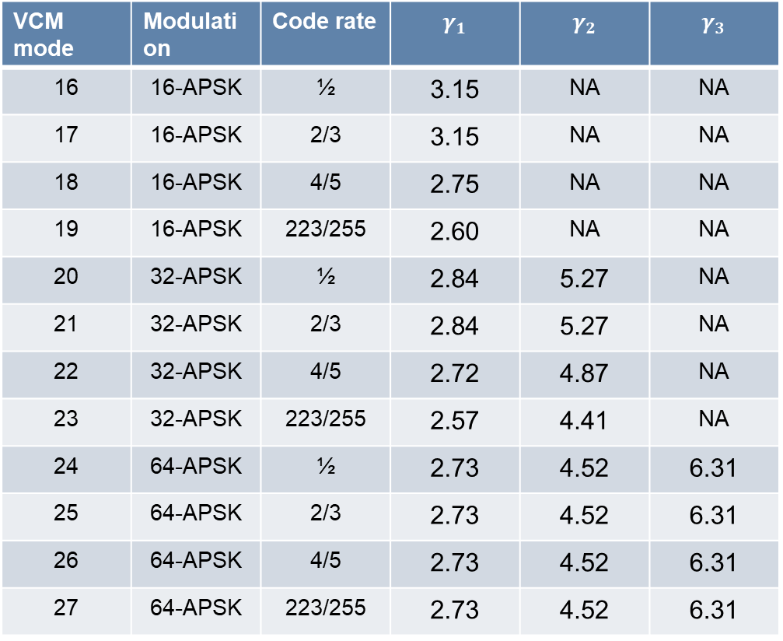
Recommended Radii Ratios for 131.0-B-3
VCM mode | Modulation | Code rate | $$γ_{1}$$ | $$γ_{2}$$ | $$γ_{3}$$
16 | 16-APSK | ½ | 3.15 | NA | NA
17 | 16-APSK | 2/3 | 3.15 | NA | NA
18 | 16-APSK | 4/5 | 2.75 | NA | NA
19 | 16-APSK | 223/255 | 2.60 | NA | NA
20 | 32-APSK | ½ | 2.84 | 5.27 | NA
21 | 32-APSK | 2/3 | 2.84 | 5.27 | NA
22 | 32-APSK | 4/5 | 2.72 | 4.87 | NA
23 | 32-APSK | 223/255 | 2.57 | 4.41 | NA
24 | 64-APSK | ½ | 2.73 | 4.52 | 6.31
25 | 64-APSK | 2/3 | 2.73 | 4.52 | 6.31
26 | 64-APSK | 4/5 | 2.73 | 4.52 | 6.31
27 | 64-APSK | 223/255 | 2.73 | 4.52 | 6.31

Slide 15
Recommended Pink Sheets:
431.1-R-1
Add the following, below Table 3-2:
“Note 3: The ratio of outer circle radius to inner circle radio to be used in modes 16-27 is defined in CCSDS 401.0-B-30.”
401.0-B-30
Add the following to Table 2.4.18-2 and Table 2.4.23-1:
“When VCM is used with CCSDS 131.0-B-3, as described in 431.0-B-1, the ratios in Table 2.4.18-3 shall be used.”
Add new Table 2.4.18-3, from previous page.

