Slide 1


> 176 participants
CNES 11 CNSA 5
DLR 18 ESA 33
FSA 4 JAXA 11
NASA 87 UKSA 3
ETRI 3
ASI 1
CCSDS Opening Plenary SRI |  | 8 May 2017 San Antonio. Texas, USA
08:30 | Opening remarks | Nestor Peccia, CESG Chair
08:35 | SRI Campus Logistics for CCSDS technical meeting | Mike Epperly, SWRI
08:45 | SRI Welcome address | Michael McLelland, SWRI
09:00 | Welcome by NASA | Phil Liebrecht, NASA HQ
09:20 | CCSDS meeting overview: Administrative, Boot Camp, Meetings | David Ross, NASA HQ
09:30 | CESG Open Issues & More | Nestor Peccia, CESG Chair
09:40 | Systems Engineering Area objectives | Peter Shames, SEA Area Director
09:50 | Mission Ops and Information Mgt Services Area objectives | Mario Merri, MOIMS Area Director
10:00 | Cross Support Services Area objectives | Erik Barkley, CSS Area Director
10:10 | Space Link Services Area objectives | Gian-Paolo Calzolari, SLS Area Director
10:20 | Space Internet Services Area objectives | S. Burleigh, SIS Area Director
10:30 | Spacecraft Onboard Interface Services Area objectives | J. Wilmot, SOIS Deputy Area Director
10:40 | Closing remarks; Adjourn

Slide 2
Administrative Overview
Registration will be set up near a central location and will also double as the Secretariat area through the rest of the week.
Recommended meeting and break schedules are as follows:
    Start time 08:15
    Coffee break 10:30-10:45
    Lunch Break 12:00-13:00
    Coffee Break 15:30-15:45
    End time 16:45
Beverages will be available in buildings 263, 161, 263 and 163 during the AM and PM breaks.
Lunch will be on your own from 12:00-13:00. There is a cafeteria on campus located in building 161. The cafeteria serves lunch from 11:00 to 13:00. Breakfast is also available in the cafeteria from 08:00 to 10:00.
Please let the Secretariat staff know as soon as possible if you will not be using your meeting room at your scheduled time.
WiFi access:
  SSID: See room information Password: N/A
Notes:
2

Slide 3
Administrative Overview - Meetings
Date | WG/CMC | Host | Location | Date | Comments
Spring 2017 | WG/CESG | NASA | San Antonio, Texas, USA | 08-12, 15 May 2017
 | CMC/SC13 | Roscosmos | St. Petersburg, Russia | 13-16 June 2017
Fall 2017 | WG / CESG | ESA | The Hague, Netherlands ESA/ESTEC | 6-9 November 2017 10 November 2017
 | CMC/SC13 | ESA | Darmstadt, Germany | 13-15 Nov 2017
Spring 2018 | WG/CESG | NASA | Gaithersburgh, MD, USA | 09-13 April 2018
 | CMC/SC13 | CNSA | China | TBD Date
Fall 2018 | WG/CESG | DLR | Berlin, Germany | 15-19 October 2018
 | CMC/SC13 | DLR | Germany | 22-24 October 2018
Spring 2019 | WG/CESG | NASA | USA | TBD Date
 | CMC/SC13 | CNSA | CSA | TBD Date
Fall 2019 | WG/CESG | ESA | ESA | TBD Date
 | CMC/SC13 | ESA | ESA | TBD Date
Spring 2020 | WG/CESG | NASA | USA | TBD Date
 | CMC/SC13 | CNSA | CNSA | TBD Date
5-Day
4-Day
Notes:
3

Slide 4



CCSDS Technical Editors:
“Boot Camp”
Tom Gannett - CCSDS Chief Technical Editor
Peter Shames – CCSDS SEA Area Director
The purpose of the technical editor “boot camp” is to improve overall quality and enable faster processing of documents submitted to the Secretariat by familiarizing working group technical editors with CCSDS requirements for technical content, publication style and procedures for document submission.
IT IS MANDATORY THAT ANY PERSON WHO IS ASSIGNED TO BE THE EDITOR OF A CCSDS DOCUMENT MUST ATTEND A BOOT CAMP.
This week, Boot Camp sessions are scheduled as follows:
Session
Room
Friday, 08:15- 12:00
Building 178
CR-2

Slide 5
CCSDS Overview
Active Publications
Currently Active Publications: 143 Normative (Blue & Magenta): 85
Informative (Green): 58
Downloadable for free from www.ccsds.org
All major pubs since 1982: ~336
(Some were historical mission needs
or superseded technology)
825 space missions have adopted and used various CCSDS standards

Slide 6
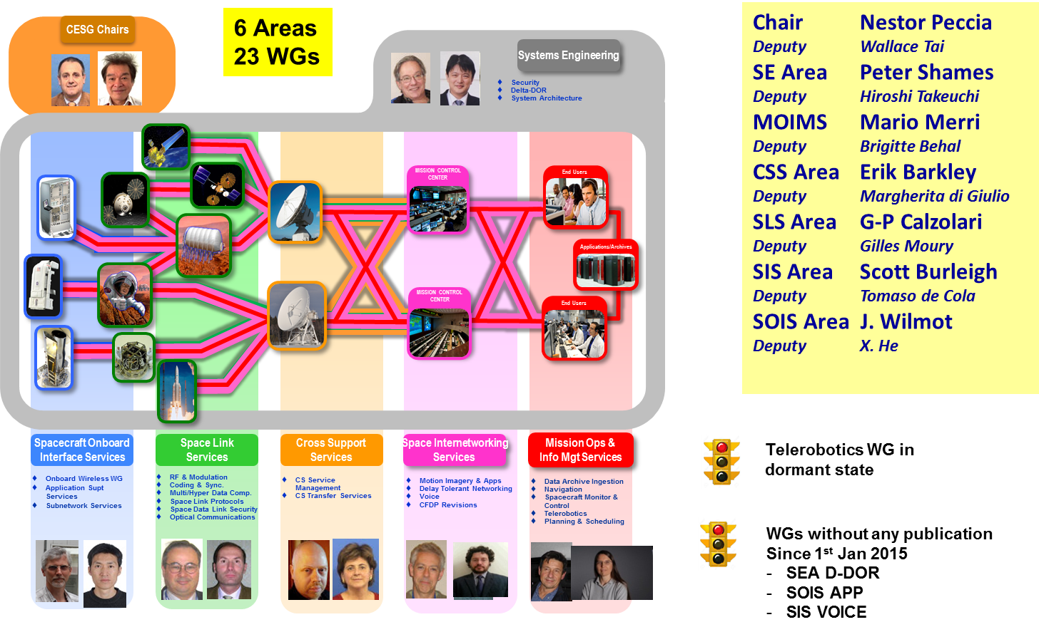
CESG Organization + E2E Overview
Notes:
6

Slide 7
CESG Open Issues & more
CESG main topics addressed since October 2016
  Procedures & Organization YB next update
    Criteria for joining WG mailing lists + Liaisons
  Telerobotics WG status
  Overlap with OMG SDTF
  CSS Area Functional resource Model
  CWE info on recently completed reviews
Project resources in the FW CWE
  86 Approved Projects with 5 behind schedule
  54 Draft Projects
  Only 1 Project still missing Proto 2 resources, out of 12 found 2 years ago
CESG meeting on Monday 11th April – Main topics
  Approved IOAG Service Catalogue SC#1 and updated SC #2
  CESG: AD/DAD responsibility to maintain technical quality and consistency of documents, CESG poll conditions raised at time of publication
  Overlap with OMG SDTF
  Proc & Org YB Update
  Update of “Omnibus” specifications
  DAI WG report to CMC
140 PROJECTS

Slide 8
CESG / CMC Poll Statistics since Oct 2016
CMC Polls
  Publication
    SLS Protocols over DVB-S2—Definition, Implementation, and Performance
    MOIMS Telerobotics Operations
    CSS CSTS Specification Framework
    CSS CSTS – Monitored Data Service
    SLS OPT Real-Time Weather and Atmospheric Characterization Data (poll on going)
  Agency Review
    SEA CCSDS Spacecraft Identification Field Code Assignment Control Procedures (Completed)
    MOIMS SM&C MAL C++ API (Completed)
    SLS MHDC Pre-processing Transform for Multi-Hyperscpectral Image Compression (Completed)
    SLS RFM Systems Part 1 Earth Stations and Spacecraft (Completed)
  Approval of SLS OPT, SEA SEC, MOIMS P&S new Projects + Proto 2 resources for MOIMS SMC
  Approval of Scott Burleigh (NASA/JPL) as new SIS AD
CESG Polls, not through CMC Poll yet
  Publication
    MOIMS SMC MO Monitor & Control Services Conditions resolved. New Agency review started.
    SOIS WIR Wireless Network Communications Overview for Space Mission Operations
    SLS RFM Simultaneous Transmission of GMSK Telemetry and PN Ranging
    SIS MIA STREAMING SERVICES OVER BUNDLE PROTOCOL REQUIREMENTS (poll requested)
  Agency review
    MOIMS SMC MAL Binding to HTTP Transport and XML
    SLS SLP USLP 2nd Agency review completed

Slide 9
CESG WG Chair / Deputy Chair Overview

Slide 10
RESOURCES

Slide 11
SEA Meeting Objectives: 1/1
Security WG
  Link Layer Security (BB) Joint with SLS, reported there
  Key Management (GB, MB) MB draft in work, application worked in SDLS
  Network Layer Security Testing IP, evaluating DTN & cloud based testing
  Application Credentials Evaluating approaches
  Standard security section Mandatory
Delta-DOR WG
  Overview document (GB) GB, planning v2 revision
  Delta-DOR implementation architecture (MB) BB, published Jun 2013
  Quasar catalog Update Procedure (MB) Including SANA X-band Catalog, being finalized
  Delta-DOR Operations (MB) MB, produced v2 revision, being finalized
System Architecture (SAWG) BoF
  CCSDS Application & Support Architecture GB Analyze & describe MOIMS & SOIS application architectures
  RASDS refresh Re-confirmed, TC20 / SC 14 discussions
  CCSDS Ontology On hold for now
SANA Steering Group (SSG)
  SANA Steering Group (SSG) Active, meeting this week
  CCSDS Registry Re-Engineering SANA Registries being re-engineered
Time Exchange / Sync Standards BoF In discussion with SIS, SLS, & MOIMS
  Initial exploration of topics
XML Standards & Guidelines (XSG SIG) SIG closed, no agency resources
  CCSDS RFC & XML guidelines CCSDS URN RFC published, YB in draft form

Slide 12
MOIMS Meeting Objectives: 1/2
Data Archive Ingestion WG (DAI)
  MB: Information Preparation to Enable Long Term Use Discussion
  MB: Open Archival Information System (OAIS) : 5y revision External review on-going
  MB: Audit and Certification of Trustworthy Digital Repository: 5y revision External review on-going
  OB: DEDSL XML To be submitted for AR
  DAI Architecture Analysis Discussion at CCSDS level
Navigation WG (NAV)
  GB: Navigation Data - Definitions and Conventions On-going/Discussion
  BB: Pointing Request Message (PRM - ESA, NASA/CNES/JAXA/AGI) Prototype almost done -> BB
  BB: Attitude Data Message (ADM - CNES, ESA): 5y revision On-going/Discussion
  BB: Tracking Data Message (TDM - NASA, ESA): 5y revision On-going/Discussion -> AR
  BB: Orbit Data Message (ODM - NASA, ESA): 5y revision On-going/Discussion
  BB: Navigation Data Message (NDM - no prototype): 5y revision Slow progress/Discussion
  BB: Re-entry Data Message (RDM - ESA, DLR) 2nd draft available/Discussion
  BB: Navigation Hardware Message (NHM) On hold/Discussion
  BB: Spacecraft Maneuver Message (SMM) Cancelled
  Future Topics (Fragmentation Data Message - FDM,
  Launch Data Message - LDM, Time Systems, …) Discussion
Notes:
NAV
Navigation Data—Definitions and Conventions Green Book: Version 4 updates in progress. Next draft targeted to be ready for discussion at Spring Meetings. Slightly delayed from last report.
Pointing Requests Message (PRM): Prototype testing is nearing completion; nearing completion of the document. We hope to file a resolution for polling and advancement to Blue Book at MOIMS Closing Plenary 12-May-2017.
Attitude Data Messages (ADM): Version 2 updates in progress. Next draft targeted for end of April. Slightly delayed from last report.
Tracking Data Message (TDM): Nearing "Agency Review readiness" of Version 2 update. Review of most recent draft in progress; very few comments have been received.
Orbit Data Message (ODM): Very good progress on Version 3 update. Latest draft provided 26-Apr-2017.
Navigation Data Messages XML Specification (NDM/XML): Project is in Framework, but no real progress yet. No change since last report.
Re-Entry Data Message (RDM): White Book #2 targeted to be ready for discussion at Spring Meetings. Slightly delayed from last report.
Navigation Hardware Message (NHM): The WG is evaluating whether or not this project should continue. We have no Prototype #2 commitment yet, and there are technical challenges as well. A potential change of direction that may address the technical issue has been proposed but not yet discussed.

Slide 13
MOIMS Meeting Objectives: 2/2
Spacecraft Monitor & Control WG (SM&C)
  GB: MO Services Concept: 5y revision Discussion
  BB: Monitor & Control Services (ESA, DLR) 4th AR
  BB: Common Services (ESA, CNES) Submitted for AR
  BB: Mission Product Data Distribution Services (ESA, CNES) Submitted for AR
  BB: TCP/IP Transport Binding and Split Binary Encoding (ESA, CNES) Submitted for publication
  BB: HTTP Transport Binding and XML Encoding (ESA, NASA/JPL) Submitted for AR
  BB: ZeroMQ Transport Binding (CNES, ESA) Submitted for AR
  MB: C++ MAL API (NASA) RIDs due 02May17/Discussion
  BB: XML Telemetric & Command Exchange (XTCE) (NASA, no prototype assumed) Awaiting OMG Approval
Mission Planning & Scheduling WG (MP&S)
  GB: Mission Planning and Scheduling Submitted for publication
  BB: Mission Planning and Scheduling (ESA, DLR) Initial discussion
Telerobotics WG (TEL)
  Will not meet, WG in dormant status
  GB: Telerobotics Standard Roadmap Published
  BB: Telerobotic Standard On hold. Demoted to draft
Other
  Supported SEA System Architecture WG
  MO Services Training Course given at GSAW 2017

Slide 14
CSS Meeting Objectives
Cross Support Transfer Services WG
  Cross Support Transfer Service Framework (BB) In final publication processing
  Monitored Data Service (BB) In final publication processing
  Tracking Data Service (BB) Finalize for R1 Agency review; prototype coordination
  Concept + Guidelines (GBs) Finalize for release to AD
  Forward Frame Advance recommendation; prototype plan
Cross Support Service Management WG
  Schedule Publication Format (BB) In agency review
  Planning Information Format (BB) Review, assess readiness for Red-1 Agency Review Terrestrial Generic File Transfer (BB) Review, determine Red-1 Agency Review date
  Service Management Utilization Request Format (BB) Review, determine Red-1 Agency Review date
  Service Package (BB) Review, discuss, assess formal project initiation
CSS (Area Level)
  Service Control – CSTS & CSSM Discuss, coordinate (event sequence v SC-CSTS)
  MOIMS NAV + CSS CSSM Discuss, coordinate (event definitions)
  CSS Area + Other Area WG Chairs Functional Resource Model follow-up
  o Thu, 1600, B189-VCT2
Notes:
14

Slide 15
SLS Meeting Objectives: 1/2
RF & Modulation WG
  401.0-B RF & Modulation:
    Modulation for Earth Exploration-Satellite Service (ESSS) downlinks Pink Sheets 2.4.18
    Review RIDs on 8 GHz Recommendation
    DDOR recommendation Pink Sheets 2.5.6B Review RIDs on low frequency tone options
    Turn-around ratios for EESS 7/8 GHz Finalize Recommendation for Agency Review
    Telemetry ranging Discussion of draft Recommendation
  Bandwidth-Efficient Modulations Green Book 413.0 Initial Proposals for Issue 3
  ACHIEVEMENTS: 415.1-B-1 Data Transmission and PN Ranging for 2 GHz CDMA Link via Data Relay Satellite. Issue 1: Reconfirmed; 413.1-G-1 GMSK Telemetry and PN Ranging Green Book: (going to start soon CMC Poll to be) Published;
Space Link Code/Sync WG
  LDPC Slicing (update 131.0-B) Review RIDs to Pink Sheets after Agency Review
  LDPC Uplink (update 231.0-B) Agree on Tail Sequence to close Agency Review
  Best Practice for VCM/ACM 431.1-M Update draft VCM Magenta Book (with RFM)
  SCCC Blue Book 131.2-B-1 Trigger 5 years review or reconfirmation
  SCCC Green Book New draft with additional results
  ACHIEVEMENTS: 130.12-G-1 CCSDS Protocols over DVB-S2. Issue 1. November 2016.: Published;
Space Link Protocols WG
  Unified Space Data Link Protocol Review RIDs from USLP RED-2 Agency Review
  Review updated USLP Green Book
  702.1-B-1 IP over CCSDS Space Links Trigger 5-year review or reconfirmation
  ACHIEVEMENTS: 133.1-B-2 CCSDS Encapsulation Service, 700.0-G-3 AOS and 200.0-G-6 TC Green Books: Reconfirmed;

Slide 16
SLS Meeting Objectives: 2/2
Space Data Link Security (SDLS) WG
  Extended Protocol Blue Book 355.1 Finalization of RED Book v1
  Review interoperability testing results
  Extended Protocol Green Book 350.5 Establish outline and start project for Issue 2
  ACHIEVEMENTS: 350.5-G SDLS Core Protocol Green Book: (Waiting CESG Poll to be) Published;
Multispectral & Hyperspectral Data Compression (MHDC) WG
  CCSDS 122.1-B (Lossy Compression via Transform Stage Extension of 122.0-B):
      Review and resolve RIDs from Agency Review of 122.1-R
      Review associated draft Green Book 120.3
  CCSDS-123.1-B: Near-Lossless Compression via Extension of CCSDS-123.0-B
      Review entropy coder simplification proposed for standardization
      Review several other proposed features/extensions, make keep/drop decision on each
      Establish plan to complete remaining sections of White Book
Optical Communications WG
  Optical Communications “Physical Layer” and “Coding & Synchronization” Blue Books.
    Deep Space Scenario: Finalize draft for High Photon Efficiency (HPE) and submit for agency review.
    Near Earth Scenario for Low Complexity (LC) Systems: Work towards reaching a consensus on LC to start project and draft chapters for issue 2.
  Real Time Weather and Atmospheric Characterization Data: Start drafting Magenta Book.
  High Data Rate (HDR) Near Earth Scenario: Review first proposals for 2 Orange Books.
  Review recent developments in optical communications across the various space agencies.
  ACHIEVEMENTS: 140.1-G Real Time Weather and Atmospheric Characterization Data: (ongoing CMC Poll to be) Published;

Slide 17
SIS Meeting Objectives: 1/2
CFDP Revisions WG
  Monday AM (160 Auditorium)
  Discuss way forward for interoperability testing
Motion Imagery WG
  Monday PM (160 Auditorium)
      Joint meeting with DTN WG
      Review of BSS Player for Video/Telemetry/Voice from JSC
      DLR Streaming Services Experiment Review
    Tuesday AM (Cafeteria CR2)
      Joint meeting with Wireless WG
      Discuss requirements for streaming video over wireless
Voice WG
    Tuesday PM (Cafeteria CR3)
  Review Blue Book status
  Green Book review and editing
Wednesday AM (Cafeteria CR3)
  Green Book review and editing
Notes:
17
17

Slide 18
SIS Meeting Objectives: 2/2
Delay Tolerant Networking WG
  Wednesday PM (Cafeteria CR3)
    WG Status
    NASA AES DTN Project Status
    Review plans for / update status of interoperability testing for the DTN Security Book
      Touch base with SANA about draft registries
      Informal discussion with SEA-SEC
      Status of and schedule for prototype development (NASA ION and DLR DTN2)
  Thursday AM (160 Auditorium)
    Review Schedule-Aware Bundle Routing Document
      Status of White Book
      Status of and schedule for prototype development (NASA ION and JAXA (JAXASABR?))
    Identify and prioritize future work such as network management, quality of service
    Discuss forward erasure coding work
  Thursday PM (160 Auditorium)
    DTN on ISS Status
    KPLO Update
    Network Management Experiences
SIS Plenary
  Friday AM (Cafeteria CR1)
    Review WG progress
    Identify issues/topics for CESG/CMC action
Notes:
18
18

Slide 19
SOIS Area Meeting Objectives 1/1
SOIS-APP WG and SOIS-SUBNET WG joint meeting
  Mature SOIS architecture layering diagrams
  Mature interoperability model between agencies to be described in updated SOIS overview green book.
  Update SOIS overview green book outline, work assignments/schedule.
  EDS/DoT overview green book outline, work assignments/schedule.
  Mission infusion updates for SEDS and tooling. cFS, CAST, ESA
  EDS and DoT book status, and planning.
  Packet Service (PS) Magenta book review status update
  Liaison with other CCSDS and external groups, MOIMS, DTN, CFDP, SEA XML SIG to align concepts
SOIS-WIR WG
  RFID Tag-Encoding Interoperability Testing report
  Presentations by Agencies and Industrials
  SIS-MIA/SOIS-WWG combined meeting to discuss high-rate video requirements for wireless communications transport
  Forward plans and projects
Notes:
19
19

Slide 20
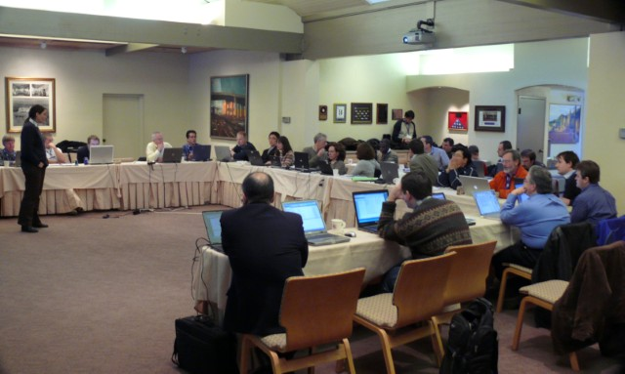





Have a great meeting week!
08:45
17:30
?

