Slide 1
O3K Gaussian channel model
Jon Hamkins and Dariush Divsalar
April 15, 2020
This research was carried out by the Jet Propulsion Laboratory, California Institute of Technology, under a contract with the National Aeronautics and Space Administration.
© 2020 California Institute of Technology. U.S. Government sponsorship acknowledged.

Slide 2
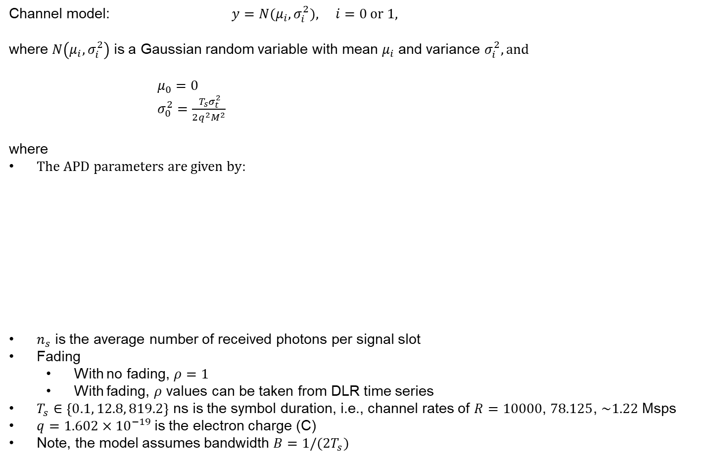
O3K Gaussian channel model
Channel model: $y={N(μ}_{i}, σ_{i}^{2}), i=0 or 1,$
where $N\left(μ_{i}, σ_{i}^{2}\right)$ is a Gaussian random variable with mean $μ_{i}$ and variance $σ_{i}^{2}, and$
$μ_{0}=0$ $σ_{0}^{2}=\frac{{ T}_{s}σ_{t}^{2}}{2q^{2}M^{2}}$
where
The APD parameters are given by:
$n_{s}$ is the average number of received photons per signal slot
Fading
With no fading, $ρ=1$
With fading, $ρ$ values can be taken from DLR time series
$T_{s}∈\left\{0.1, 12.8, 819.2\right\}$ ns is the symbol duration, i.e., channel rates of $R=10000$, $78.125$, $\sim 1.22$ Msps
$q=1.602×{10}^{−19}$is the electron charge (C)
Note, the model assumes bandwidth $B=1/(2T_{s})$
$$μ_{1}={ρn}_{s}$$
$$σ_{1}^{2}=σ_{0}^{2}+F{ρn}_{s}$$
Parameter | Symbol | Value
TIA noise density ($A/\sqrt{Hz})$ | $$σ_{t}$$ | $$\left\{\begin{matrix}?? & if R=1.22 Msps \\ 1.5×{10}^{−12} & if R=78.125 Msps \\ {10}^{−11} & if R=10 Gsps\end{matrix}\right.$$
Multiplication factor | $$M$$ | $$20$$
Excess noise factor | $$F$$ | $$5$$

Slide 3
Recommended way to express simulation results
Recommended simulation procedure
Use $n_{s}$ as the free simulation parameter to vary
Numerically fix the other parameters
Assume channel state information (value of $ρ$) is perfectly known at receiver
For each data rate, express results in terms of:
Codeword error rate vs. $n_{s}/2$, in dB (i.e., vs. average received photons/slot)
Bit error rate vs. $n_{s}/2$, in dB (i.e., vs. average received photons/slot)
Notes:
$n_{s}=\frac{η}{hν}P_{s}T_{s}$ is average number of photons in a signal slot, where
$P_{s}$ is the peak received power ($P_{s}/2$ is the average received power) (W)
$η=hνR_{res}/q$ is the quantum efficiency
$hν$ is the photon energy (J)
$R_{res}=0.9$ A/W is the APD responsivity
$σ_{t}=\sqrt{4κT/R_{L}}$
$T=300$ K is the temperature
$κ$ is Boltzmann’s constant
$R_{L}$ is resistance ($Ω$)

Slide 5
Backup

Slide 6
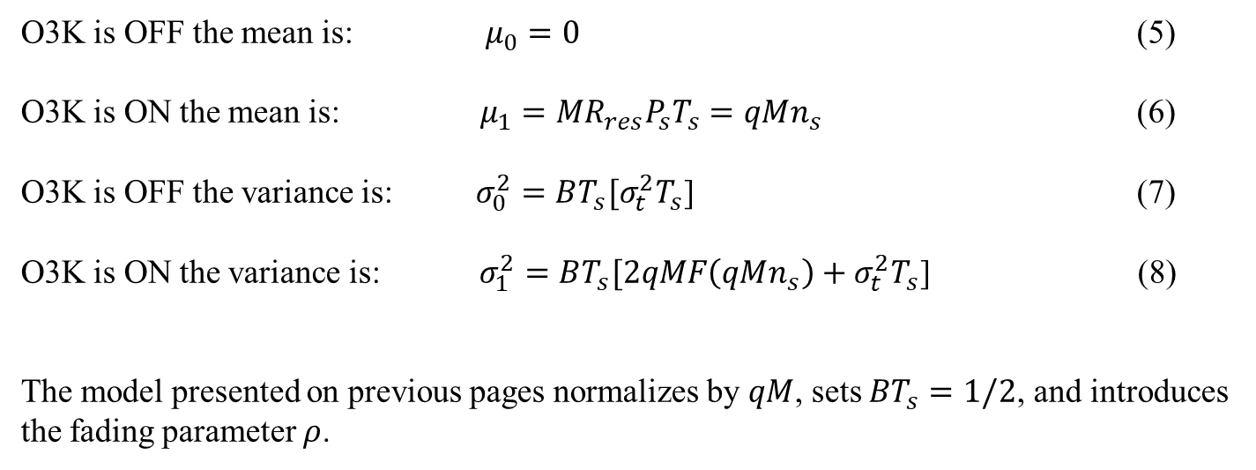
Dariush’s model from April 14, 2020
APD equations in absence of background noise
When there is no background noise:
O3K is OFF the mean is: $μ_{0}=0$ (5)
O3K is ON the mean is: $μ_{1}={MR}_{res}P_{s}T_{s}=qMn_{s}$ (6)
O3K is OFF the variance is: $σ_{0}^{2}=BT_{s}[σ_{t}^{2}T_{s}$] (7)
O3K is ON the variance is: $σ_{1}^{2}=BT_{s}[2qMF\left(qMn_{s}\right)+σ_{t}^{2}T_{s}$] (8)
The model presented on previous pages normalizes by $qM$, sets $BT_{s}=1/2$, and introduces the fading parameter $ρ$.

