Slide 1
CESG responses on CMC SP’s comments
SUGGESTION 1: the CESG should be tasked to periodically revisit the FP items identified in the extended SP as “Future Work”, so making the FP a live management tool.
In order to reduce the CESG Admin overhead, the CESG agrees to update the SP/ FP once a year.
CESG assumes that the CWE will give us the right environment to update the SP / SP
CMC needs to issue a resolution that every WG is allowed to enter Future Projects with an updateable Start Date . This could also imply changes to the Charters.
SUGGESTION 2: the process to integrate the external requirements in the CCSDS WP, as part of the FP, should be developed, so that schedules, priorities and resources for the added work may be discussed and arbitrations be made, in view of the other on-going or planned activities.
Not a CESG task. CWE shall provide this type of functions.

Slide 2
CESG responses on CMC SP’s comments
SUGGESTION 3: The structure of the CCSDS may be revisited taking into account the following:
The work programme envisaged in each area in the mid to long terms (2020)
Overlap should be minimised, by fostering reuse across WGs and Areas and by better understanding the CCSDS work assignments and the organization’s future objectives
A reference architecture for the CCSDS standards should be developed and used as an overall blueprint for the organization to prevent future overlap.
CESG fully endorses the proposal. We recommend to place an action upon CMC to deploy 3-4 FTEs supporting Reference Architecture, Ontologies and Reference Models for the time frame 2015-2018
SUGGESTION 4: a solution must be found to generate the RMP automatically after the revisions of the FW or SP are made.
CESG fully endorses the proposal that is totally outside our Terms of Refernce. It is an IT activity.

Slide 3
CESG responses on CMC SP’s comments
SUGGESTION 5: it would be helpful if the mapping presented in the RMP is double checked by the AD’s and validated at CESG level, when instrumented as per suggestion 3.
CESG agrees. See 3.

Slide 4
SEA Response to CMC comments
The standards on security architecture and D-DOR will be completed by 2016. No other standards are currently approved beyond 2016. Goals achieved? Have been extended by WGs
SEA plan of work does contain approved documents for XML schemas although this is needed in all areas, in particular CS, MOIS and SOIS. Is this an issue? Plan to cover in restarted SAWG if resources are provided by CMC.
SEA midterm focus (2017) is on timeline exchange (overlap with MO M&C / MAL). Issue to be resolved. Propose a data format Orange Book in ASN.1 or other standard syntax.
SEA long term plan is to standardise time services; this was discussed a long time ago in CMC but no decision yet. A decision is needed in order to ensure resource availability. Open issue until requirements and resources are identified.
Goal #7 CCSDS Standards Reference Architecture is a project not approved. This project is considered as high priority and should be started asap. This decision should be taken by the CMC in the very near future. Plan to cover in restarted SAWG if resources are provided by CMC
Security: key management BB is behind schedule and should terminate 2017. Is this an issue for other WGs (e.g.: interdependency with SLS / SDLS)? Issue is being worked collaboratively with SLS.
XML SIG is still a SIG while standards should be produced within 2 years: is there an issue as the WG(s) is (are) still to be created? Propose publication of RFC & Policy then closing SIG. Standards will be covered in SAWG.
Only Security and DDOR are approved WGs/Projects; Timelines and XML SIG could / should start soon, while not yet present in the FW. See 3 and 7.
In this context, is it wise to authorize the new Architecture activities (goals 3 and 7) which, in the past have always suffered a lack of resources, in the proposed schedule? See 2, 5, & 7, these will be started if resources are provided. Some external resources identified.
Where are the priorities? Is there a risk to delay or interfere with one or the other of the approved / engaged activities? Lack of assigned resources carries risk of delay.
Security and DDOR WGs have no activities identified as part of FP beyond 2016. Is it anticipated that all goals will then be achieved and the group has no further activity ? See 1.

Slide 5
Let’s do this right and avoid anything like this …

Slide 6
MOIMS Response to CMC comments on Strategic Plan
NAV WGs have no activities identified as part of FP beyond 2016. Is it anticipated that all goals will be achieved and WG has no further activity ?
WG discussed during London future standards (included in 5 years internal plan)
Spacecraft Perturbation Message 2018 – 2022
Events Message 2019 – 2022
Satellite Re-entry Message 2019 – 2023
CDM 5 year review 2018 – 2019
TDM / NHM / PRM 5 year review 2021 - 2022
DAI WGs have no activities identified as part of FP beyond 2016. Is it anticipated that all goals will be achieved WG has no further activity ?
MOIMS-Goal 3 (Reminder: DEDSL, EAST and XFDU group)
DEDSL (xml schema): 2015 – 2018
EAST 5 year review (June 2015)
Future projects: needs for data description are broader than preservation aims (further discussion required among the group with data description experts)
MOIMS-Goal 4 (Reminder: OAIS group)
5 years Reviews – PAIMAS (june 2015), OAIS 2017, TDR metrics 2016, TDR bodies 2019
From ICP stages: Further projects providing details of these stages
Roadmap for development of related OAIS standards (OAIS section 1.5)
standard(s) for the delivery of digital sources from the Archive;
protocol standard(s) to search and retrieve metadata information about digital and physical data sources;
Standards for provenance tracking and management

Slide 7
MOIMS Response to CMC comments on Strategic Plan
Goal 5 “Digital Repository Criteria” completed (no current/future work)
WG to be disbanded. Area Resolution to be raised. GB Project to be deleted.
Workplan for Tele-robotics defined?
No. Workplan will be defined once GB is ready for CESG / CMC review.
TEL WG has only 4 technical meetings.

Slide 8
MOIMS Response to CMC comments on Strategic Plan
“Mid-term objectives (2017-2018) only for MO services; they are linked to the standards on technology mapping and binding. The resources needed for this work should be assessed” “Most of the MO services BB’s in the CWE are not started and/or are behind schedule. What is the strategy proposed to progress these projects? Will the IOAG / MOSSG inputs on service priorities be considered to reschedule the parallel tasks”?
No long terms objectives (2019-2020) defined, although MO services are likely to take longer CWE will be updated as follows
Several MO services:
M&C Services and Common Services: See agreed resources/dates
Planning Service: start 2016 + 3y (done by Planning WG, if established)
File Management Service: start 2016 + 3y
Navigation Service: start 2017 + 3y
Scheduling Service: start 2017 + 3y
Software Management Service: start 2018 + 3y
Time Service: start 2018 + 3y
Automation Service: start 2019 + 3y
Remote Buffer Management Service: start 2019 + 3y
Note: the final MOSSG priority might change the above dates. Resources committed for up to M&C Services and Common Services
Technology Bindings:
Space Packet Protocol Binding: See agreed resources/dates
ZeroMQ Binding: New project to be created in CWE. CNES committed to BB production/Proto 1
Language API:
C++ Language API: New project to be created in CWE. NASA/JSC committed to MB production.
Books that are due for 5y review:
RM (start Jul 15)
GB (Dec 15).

Slide 9
CSS Response to CMC comments on Strategic Plan
All activities in the FW are behind schedule for the CSTS WG. Nevertheless, this group still shows a long list of parallel activities to be conducted. What is the strategy proposed to progress these projects or, preferably, to prioritize a few of them so that at least some CSTS standards may be proposed to users?
Activities/projects to be brought current; progress over the last year has made the question essentially overcome by events – see summary re CSTS
Extensible Terrestrial data Transfer services : approved activities are almost completed (in 2015). With the exception of Tracking Data CSTS BB no projects are approved. When and what should be considered in 2015 onwards related to this goal?
See area summary. (Forward frame, forward/return file, and SC-CSTS are being discussed)
Generic File Transfer to be moved to CSS Goal #4. Will this goal have been achieved on completion of this standard by 2015?
Project definition has been drafted. January 2017 is projected date for magenta book to be available, pending resources.
Service Management goals defined in the long term, but only 2 documents approved. Decision required for the approval of these projects on the basis of a resource assessment.
Resource estimates have been provided.
CSS CS-SM projects have target dates in the SP, as part of the FP. Nothing similar exists in the FW where status and target dates are blank. When will a tentative schedule be confirmed?
Resource estimates have been provided. CMC decision as to allocation of resource.

Slide 10
CSS Response to CMC comments on Strategic Plan
Project | Type | Projected Date | Document Work Months | Lead Agency | Supporting Agencies | Protoype Work Months (Agency 1) | P1 Agency | Protoype Work Months (Agency 2) | P2 Agency | Total WM
Simple Schedule of Services | Blue | 31-Jan-15 | 1 | ESA | DLR | n/a |  | n/a |  | 1
Planning Data Formats | Blue | 30-Mar-16 | 3 | ESA | NASA (TBC) | 3 | ESA (TBC) | 3 | NASA/JPL (TBC) | 9
Trajectory Prediction Data Format | Blue | 28-Feb-16 | 4 | NASA | ESA (TBC) | 1 | TBD ? | 1 | TBD ? | 6
Service Request and Service Package Data Formats | Blue | 1-Feb-17 | 12 | NASA | DLR, ESA (both TBC) | 6 | DLR | 6 | ESA (TBC), NASA/GSFC or other TBC | 24
Service Agreement and Service Configuration Profile Data Formats | Blue | 1-Feb-17 | 14 | ?? A problem | NASA (TBC), ESA (TBC), DLR (TBC) | 7 | NASA/GSFC (TBC) | 3 | NASA/JPL (TBC) | 24
Spacelink Event Sequence Data Format | Blue | 1-Feb-18 | 6 | NASA | ESA (TBC) | 3 | NASA/JPL (TBC) | 6 | TBD ? | 15
Generic File Transfer | Magenta | 30-Jan-17 | 6 | ESA | NASA/GRC | 2 | TBD ? (nice to have ESA) | 2 | TBD ? (nice to have NASA/JPL) | 10
Service Catalog | Blue | 10-Dec-19 | 12 | TBD (maybe UKSpace?) | NASA | 3 | TBD | 3 | TBD | 18
Service Accounting | Blue | 1-May-20 | 12 | TBD | TBD | 5 | TBD | 5 | TBD | 22
Management Services (Automation) | Blue | 30-Sep-20 | 12 | TBD | TBD | 6 | tbd | 6 | TBD | 24

Slide 11
SOIS response to CMC
Appl. Support WGs has no activities identified as part of FP beyond 2015. Is it anticipated that all goals will then be achieved and the group has no further activity ?
SOIS has been careful to obtain resources before pushing forwards with new work items and this may give a false impression to the CMC on what is planned
If required we can list a series of extensions and future work to take us way beyond the present near term vision
As a heads up we can state that the SOIS services must evolve in response to implementation feedback and development of electronic data sheets will take many years to mature and for the full potential to be realised
Example work items:
Synchronous service interfaces
Data Streaming services
Mapping to new subnets
Simplified MTS protocol
Network management
5 year review

Slide 12
SOIS response to CMC
The SOIS Area has only one WG (Wireless) and no activities identified as part of FP beyond 2017. Is it anticipated that all goals will then be achieved and the group has no further activity ?
The RFID encoding Blue book should be finalised in 2016 but the WLAN will not be completed before 2020
A new SIG has been proposed to evaluate the use of deterministic networks required for future exploration missions, this is likely to lead to significant new work
Should the group be disbanded earlier and the WG activities be re-allocated to another area (Wireless ⬄ SLS?)?
The rational behind this question is not understood as it could also be applied to other groups – There seems to be no technical reason to do this?
the SLS area is anyway overloaded, and it may be more appropriate to move any relevant SLS groups to SOIS and thus even the load on the SLS area director

Slide 13
SOIS response to CMC
More globally, only short term (2014-2015) workplan defined. Is this area required beyond 2015? Should CCSDS maintain a role in onboard interface standards?
The updated work plan take us well beyond 2020, so yes we need this area after 2015
The CCSDS has undertaken this area of activity and we now have many users and implementations, it is therefore incumbent on CCSDS to maintain these standards and evolve them according to Industry and Agency feedback

Slide 14
SOIS response to CMC
Future developments for onboard “Standard Avionics Architectures” were mentioned in the 2014 CMC spring meeting (SUMO). Is this a viable direction; should CCSDS get involved in standardising onboard architectures?
A “STANDARD Avionics architecture” is not foreseen by SOIS but a ‘REFERENCE communications architecture’ was developed to locate the SOIS services and then apply the electronic data sheets
Within the CCSDS we need a “Reference architecture” which is able to locate ALL CCSDS books and this will need to cover ground, the space-link and the onboard system (This is anyway a CMC request)

Slide 15
SLS Updating Strategic Plan on WEB
The SLS part of the Strategic Plan on WEB has been updated as requested (see at http://cwe.ccsds.org/fm/sp/default.aspx ):
Modify / add text in the area goals. DONE, WG Chairs to perform further checks.
Check the links of all Area published books. DONE, WG Chairs to perform further checks .
Check the links of all Area in production books and if needed modify the schedule (there are a lot of Projects with a very optimistic schedule). Link checking DONE, WG Chairs to perform further checks. Schedule update is performed regularly at lest at each meeting by WG Chairs.
4. Check for missing future Projects and add them also as Projects in the CWE with a start date in the future (and with a realistic schedule, not a 2 year production elapsed time). WG Chairs reported difficulties for adding CWE Projects for activities far in future.
ISSUE: NGSLP Projects are now approved but still presented as future: should the migration be automatic by CCCSD Tech Support?
ISSUE: who defines/keeps/numbers milestones (e.g. MIL-SLS-101) in this web version?

Slide 16
Strategic Plan: CMC comments for SLS Area
All WGs have a schedule which minimize the parallel activities. Prioritization seems to be made upfront. YES, SLS Area made an effort to streamlines activities.
The Data Compression and SDLS WGs have no activities identified in the RMP as part of FP beyond 2015/2016. However, the FW shows target dates beyond those (2017/2016). Is it anticipated that all goals will then be achieved and the group has no further activity? New activities for Data Compression and SDLS may rise but cannot be foreseen now.
Mid-long term is the Next generation Space Data Link protocol. What are the resources required for this development by 2018. Are they confirmed? Resources are stated in the related CWE Projects approved by CMC.
The Optical Communications seems to be the main/only longer term activity. Is this endorsed by the CMC? CMC has approved WG Charter and 4 Projects (2 BBs+ 2 GBs).

Slide 17
CMC Questions on Strategic Plan
SIS Goal 1 “Use of Internet standards” has no associated workplan. Has the goal been achieved?
Goal has not been achieved for robotic space flight. Work in applications may help with this.
Human spaceflight *is* using IP more and more (voice/video, file transfer)
Application Layer protocols: no work is planed beyond 2015. Has the goal been achieved?
SIS needs to help users understand the benefits and implications of running applications over the SSI internetworking layer. Reference applications of CFDP/BP, RemoteAMS/BP could help here.
Suspect that SIS needs to develop a MAL-to-AMS(over BP) binding
Goal #2 solar system Internet: No approved project beyond 2017. What should be approved to achieve this goal. What are the resources needed?
Additional work (e.g. multicast forwarding, dynamic discovery, streaming service) needed; charter modification and CMC concurrence required
The FW reflects projects behind schedule and target dates quite earlier than those in the RMP/SP. An alignment is required.
Items currently in the CWE Framework are in line with the resource management plan.
Contact graph and Bundle security projects have target dates in the RMP/SP, as part of the FP. Nothing similar exists in the FW where status and target dates are blank. When will a tentative schedule be confirmed?
Contact graph routing, Network Management, Security: work will begin immediately. Framework updated with realistic schedules for these.

Slide 18
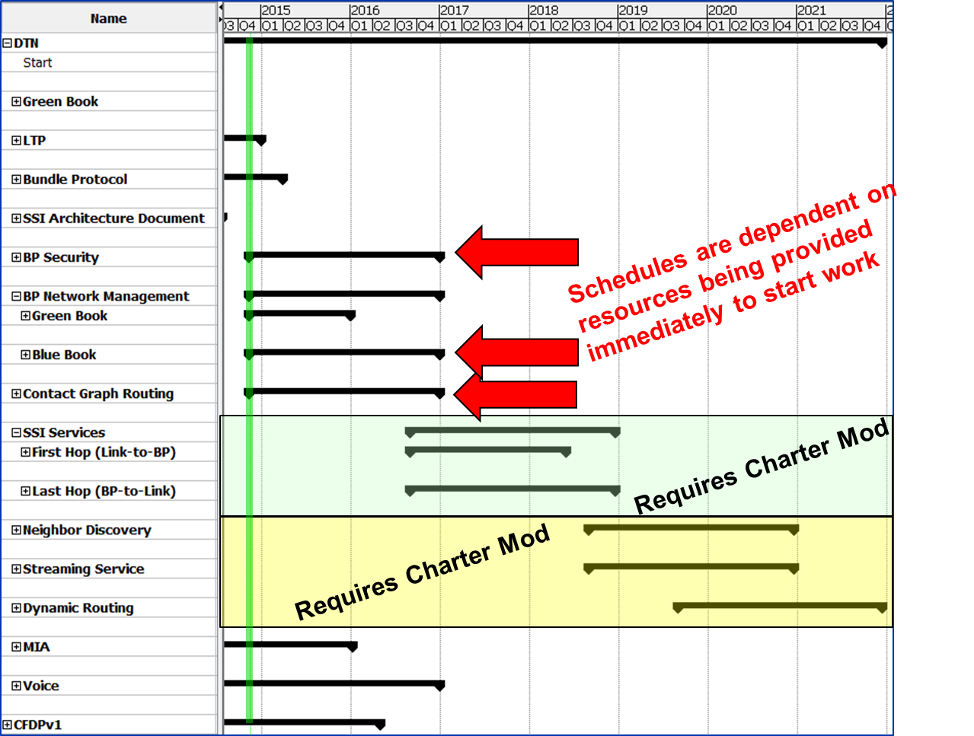
CMC Questions on Strategic Plan

Slide 19
SIS Response to CMC Comments
CFDPv1 WG -- CMC Questions
Book Schedules
Is Schedule realistic? If not, include new estimated completion date
All Book schedules are realistic; expect publication of Blue Book and all Green Books by June 2015
No more standards foreseen after 2016
Correct; all WG charter items will be complete and WG will disband

Slide 20
SIS Response to CMC Comments
Motion Imagery and Applications WG
CMC Questions
Digital Motion Imagery Applications BB
Is Schedule realistic ? If not, include new estimated completion date ?
Completion date in the framework was 7/1/2014.
Expect Blue Book by 12/31/2014
Green Book update also forthcoming
No more standards foreseen after 2015 -- Goals achieved? WG to be disbanded? or Schedule to be adapted?
WG may not meet in Spring 2015 depending on the schedule for industry to finalize transport for MJPEG2000, then pink sheet the blue book with MJPEG2000
Depending on industry schedule for H.265 (4k video), WG will either disband and wait for H.265 to solidify or immediately pink-sheet the existing blue book.
Notes:
H.265 probably 2 years out (could pink sheet ~Fall 2016)

Slide 21
SIS Response to CMC Comments
Voice and Audio Communications WG
CMC Questions
Book Schedules
Is Schedule realistic? If not, include new estimated completion date
Blue Book scheduled for completion Sept. 2016 (in the framework) (WG thinks they can be done by ~Sept. 2015)
No more standards foreseen after 2016
At Spring meeting / during update of Green Book, WG will discuss updating blue book to account for current trend towards all Voice Over IP (digital matrix).
Review Green Book (starting Spring 2015)

Slide 22
SIS Response to CMC Comments
Delay Tolerant Networking WG -- CMC Questions
Licklider Transmission Protocol BB
Schedule realistic?
Scheduled for completion by 12/31/2014
Bundle Protocol BB
Schedule realistic?
Updated framework for completion by 3/30/2015 (including interoperability testing)
BP Network Management
Green Book -- Work starting Fall 2014 – targeting completion by end of CY 2015
Blue Book – Not in framework – need to request work item – can target end of CY2016
Bundle Security Protocol BB
Work starting Fall 2014 – target completion end of CY2015 – draft specification exists; partial implementations exist.
Contact Graph Routing (CGR) BB
Work starting Fall 2014 – target completion end of CY2016 – draft specification exists; at least 1 implementation
Single-Agency NW Management Requirements GB
Work starting Fall 2014 on Network Management
No resources (or framework entry) for Network Management Blue Book
No more standards foreseen after 2017
Additional work (e.g. multicast, dynamic discovery) may be undertaken with recharter and CMC concurrence
Dynamic discovery / routing
Multicast protocol
Streaming service

Slide 23
CESG recommendations on CWE SP
CMC to endorse charter changes due to SP discussions
CMC to endorse Project creation for Future Projects (not currently in CWE) with
Upgradable Start date. If it is well in the future (after 2018 ??) other fields shall not be compulsory
The 1st draft circulated,
1st comments,
2nd draft,
2nd comments,
etc dates
Completion date to be deleted (it is included in Project description)
Document number to be filled ???
Milestone ID to be kept ?

