Slide 1
S-Band Proxy-1 - encoding of carrier frequency
ESA
07/06/2024

Slide 2
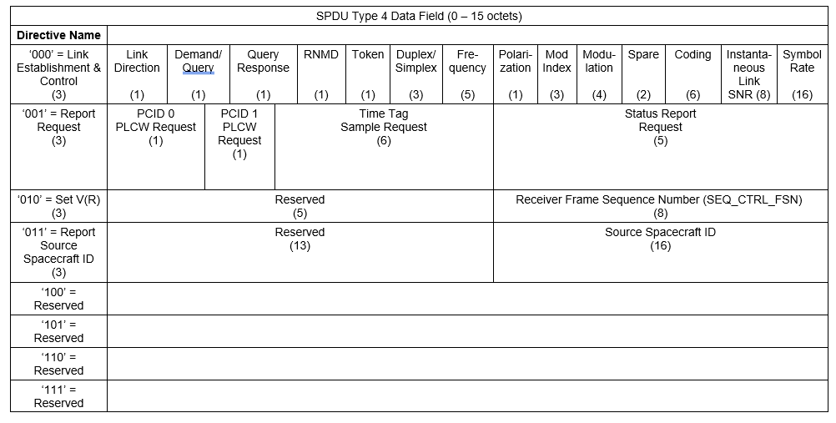
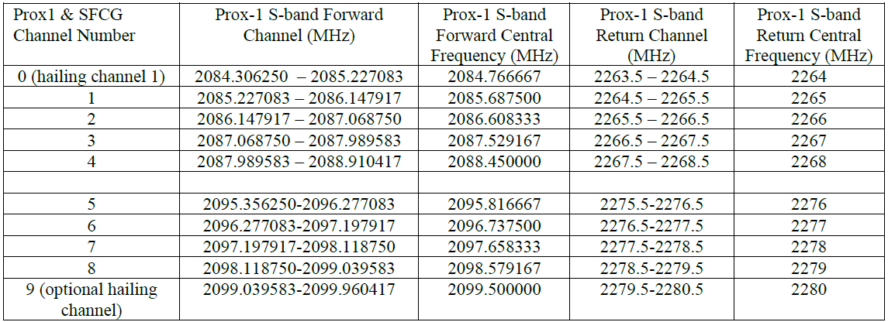
Introduction
proposal for Type 4 SPDU was presented in Spring 2024
For the frequency it was proposed to have 5 bits (32 values)
This is sufficient for covering the 10 channels provided in the Table, but needs to be evaluated for the subchannels (AI_24_09)
This presentation is the formal response to AI_24_09, and provide a summary of the different options that were thought

Slide 3
Option #1 – 5-bit fixed point, channel centred
Description: Use 5 bits (as now) as fixed point for covering all 8 channels
Usage:
First 3 bits are the integer part, that by adding +1 identify the channel number.
Last 2 bits are the non-integer part, that identify a deviation in [-250, 0, 250, 500] kHz
Example:
it is channel 3 (2267 MHz center), with deviation +250 kHz, i.e., 2267.25 MHz
0 | 1 | 0 | 1 | 0

Slide 4
Option #1 – 5-bit fixed point, channel centred
Advantages
Partially human readable
If seen as uint, it can be related to the Return centre frequency in MHz as $2265.5+\frac{n+1}{4}$ if n< 16, $2272.5+\frac{n+1}{4}$if n>=16
Requires just 5 bits
Disadvantages
The channel aggregation can be done only in step of 250 kHz
(while rates are as low as 2 ksps)
The non-integer part [1,1] identifies a frequency across two adjacent channels
It does not cover hailing channels
5-bit uint | F [MHz]
0 | 2264.75
1 | 2265
2 | 2265.25
3 | 2265.5
4 | 2265.75
5 | 2266
6 | 2266.25
7 | 2266.5
8 | 2266.75
9 | 2267
10 | 2267.25
11 | 2267.5
12 | 2267.75
13 | 2268
14 | 2268.25
15 | 2268.5
5-bit uint | F [MHz]
16 | 2275.75
17 | 2276
18 | 2276.25
19 | 2276.5
20 | 2276.75
21 | 2277
22 | 2277.25
23 | 2277.5
24 | 2277.75
25 | 2278
26 | 2278.25
27 | 2278.5
28 | 2278.75
29 | 2279
30 | 2279.25
31 | 2279.5

Slide 5
Option #1b – 5-bit fixed point, equally spaced
Description: Use 5 bits (as now) as fixed point for covering all 8 channels, but by equally dividing each channel in 4 sub-channels
Usage:
First 3 bits are the integer part, that by adding +1 identify the channel number.
Last 2 bits are the non-integer part, that identify a deviation in [-300, -100, 100, 300] kHz
Example:
it is channel 3 (2267 MHz center), with deviation 100 kHz, i.e., 2267.1 MHz
0 | 1 | 0 | 1 | 0

Slide 6
Option #1b – 5-bit fixed point, equally spaced
Advantages
Partially human readable
If seen as uint, it can be related to the Return centre frequency in MHz as $2264.7+\left\lfloor \frac{n}{4}\right\rfloor +0.2⋅MOD(n,4)$ if n< 16
$2275.7+\left\lfloor \frac{n}{4}\right\rfloor +0.2⋅MOD(n,4)$ if n>=16
Requires just 5 bits
Disadvantages
It does not cover hailing channels
It does not cover the centres of the Prox-1 channels
The frequency re-solution is still large: 200 kHz, with 400 kHz between sub-channel of different channels
5-bit uint | F [MHz]
0 | 2264.7
1 | 2264.9
2 | 2265.1
3 | 2265.3
4 | 2265.7
5 | 2265.9
6 | 2266.1
7 | 2266.3
8 | 2266.7
9 | 2266.9
10 | 2267.1
11 | 2267.3
12 | 2267.7
13 | 2267.9
14 | 2268.1
15 | 2268.3
5-bit uint | F [MHz]
16 | 2275.75
17 | 2276
18 | 2276.25
19 | 2276.5
20 | 2276.75
21 | 2277
22 | 2277.25
23 | 2277.5
24 | 2277.75
25 | 2278
26 | 2278.25
27 | 2278.5
28 | 2278.75
29 | 2279
30 | 2279.25
31 | 2279.5

Slide 7
Option #2 – fixed point, with high resolution
Description: Use a fixed point that can cover all 10 channels (including hailing channels, total 10 MHz), with a resolution as low as 2 kHz (comparable to minimum symbol rate)
Usage:
For covering the full spectrum with 2 kHz resolution, it is required 13 bits
The 13 bits identify a sub-channel of ~1.22 kHz, starting from 2263.5 MHz
Example:
it is 1.22 kHz * 10 = 12.2 kHz, i.e., 2263.5122 MHz
0 ….……….0 | 1 | 0 | 1 | 0

Slide 8
Option #2 – fixed point, with high resolution
Advantages
If seen as uint, it can be related to the Return centre frequency again in closed form
The sub-channel resolution is ~1.22 kHz that is sufficient for the application (2 ksps is minimum rate)
It covers the full range and hailing channels, giving full flexibility
Disadvantages
It requires 13 bits
It does not cover the centres of the Prox-1 channels
5-bit uint | F [MHz]
0 | 2263.5
1 | 2263.501
2 | 2263.502
3 | 2263.504
4 | 2263.505
5 | 2263.506
6 | 2263.507
… | …
7372 | 2279.499
7373 | 2279.5
7374 | 2279.501
… | …
8189 | 2280.496
8190 | 2280.498
8191 | 2280.499

Slide 9
Option #3 – 16-bit floating point
Description: Use 16 bits (as done for symbol rate) as floating point for covering all 10 channels
Usage:
Format specified by IEEE 754 for half-precision floating point numbers
For improving precision, sign is adopted for identifying the first chunk of the allocation (2263.5 – 2268.5 MHz) and second (2275.5-2280.5 MHz)
Frequency value is then provided as sum with the starting frequency (2263.5 if sign is ‘0’ or 2275.5 if sign is ‘1’)
Example:
2263.5 + 2^0 *(1.5) = 2265 MHz
Sign [1bit] 0 | Exponent [5 bit] 2^0 | Mantissa [10 bits] 1.5

Slide 10
Option #3 – 16-bit floating point
Advantages
It covers the full range
It covers hailing channel
It covers centres of frequency channels
It is standardized by IEEE
Disadvantages
It requires 16 bits
Precision is 2^-8, i.e., about 4 kHz (not ideal but considering that low rates are usually BiPhase-L can work) and depends on the exponent

Slide 11
Other options
Use non-standardized floating points (e.g., 16 bit but with smaller exponent in favour of the mantissa)
Use a standardized and larger precision floating, like float32, that gives full flexibility
If used as sum with start frequency can provide resolutions as low as 1 Hz
If used for representing the absolute value can provide still resolution as low as 1 kHz
It works also for potential K-Band extension

Slide 12
Summary
5-bit fixed point for the frequency channel seems quite limited when considering sub-channels as low as 2 kHz
If we are limited in bits, 13-bit fixed point can fit our purposes, since provides up to 8192 indexes for the sub-channels. This could work also for K-Band, and can be better tuned w.r.t. the example provided in this presentation. On the other hand, has limited flexibility for future updates.
In case more bits can be used, floating point is instead the preferred option
the half-precision 16-bit floating point can work, but with a limited resolution (~4 kHz)
Instead, the 32-bit floating point would instead provide the maximum flexibility and highest resolution, while covering precisely the centres of the channels

