Slide 1
Results of NRZ Study
Wai Fong, Ph.D.; Wing Lee
6/11/24

Slide 2
Background
Spring 2024 CCSDS meeting produced a consensus to move forward with a study to define the filtering for PCM/PM/NRZ as the Lunar gap filler to medium rate residual carrier telemetry Rec. 2.4.7.
NASA/GSFC to provide the initial filtering specification to ESA for performance verification.

Slide 3
Approach
Focus on two filters types: Butterworth and Bessel.
These two filters have the best passband phase linearity and good magnitude response.
In theory, Butterworth should be better than Bessel given the simulation model.
Find the best filter that will meet SFCG mask with lowest complexity, i.e., smallest order.
Develop a receiver model based on a PLL phase recovery loop and Gardner symbol time recovery loop with both loops set to a normalized loop bandwidth of 5e-4.
Assume symbol detector is a square pulse matched filter.
Coded Symbol rates (Rs) are set to1 Msps.
Look for the best BER performance among candidates at target BER of 1e-2.
Stopping condition for BER simulation is 100 block errors with 2000 symbols/block.
Plot the PSD with Tone Ranging and T4B PN Ranging with a sine pulse shape and number of samples/symbol set to 32 and 64 at various values of chip rates (Rc).

Slide 4
Study Results
We compared 2nd and 3rd order Butterworth and Bessel filters with various cut off frequencies.
We found that a 2nd order Butterworth with BTs = 1.3 with maximum Mod Index =1.26 and Effective Mod Index = 1.20 gave the best performance and least BER degradation.

Slide 5
Considerations
From ECSS-E-ST-50-05C Rev. 24, October 2011
In discussions with Andrea Modenini, the relevant 6.1.11 Residual carrier, out-of-band emission and discrete spectral lines requirement is:
For the case of filtered SP‐L (PCM/PM/Bi-phase) modulation, the spectral lines at the even multiples of the symbol rate shall not be higher than ‐20 dBc.
For RBW of 4KHz, the power in the unmodulated carrier = 1/normalized RBW = 1/(4KHz/1Msps)=24 dB.
ECSS upper limit for spectral lines is = power in unmodulated carrier – 20 dBc = 4 dB.

Slide 6
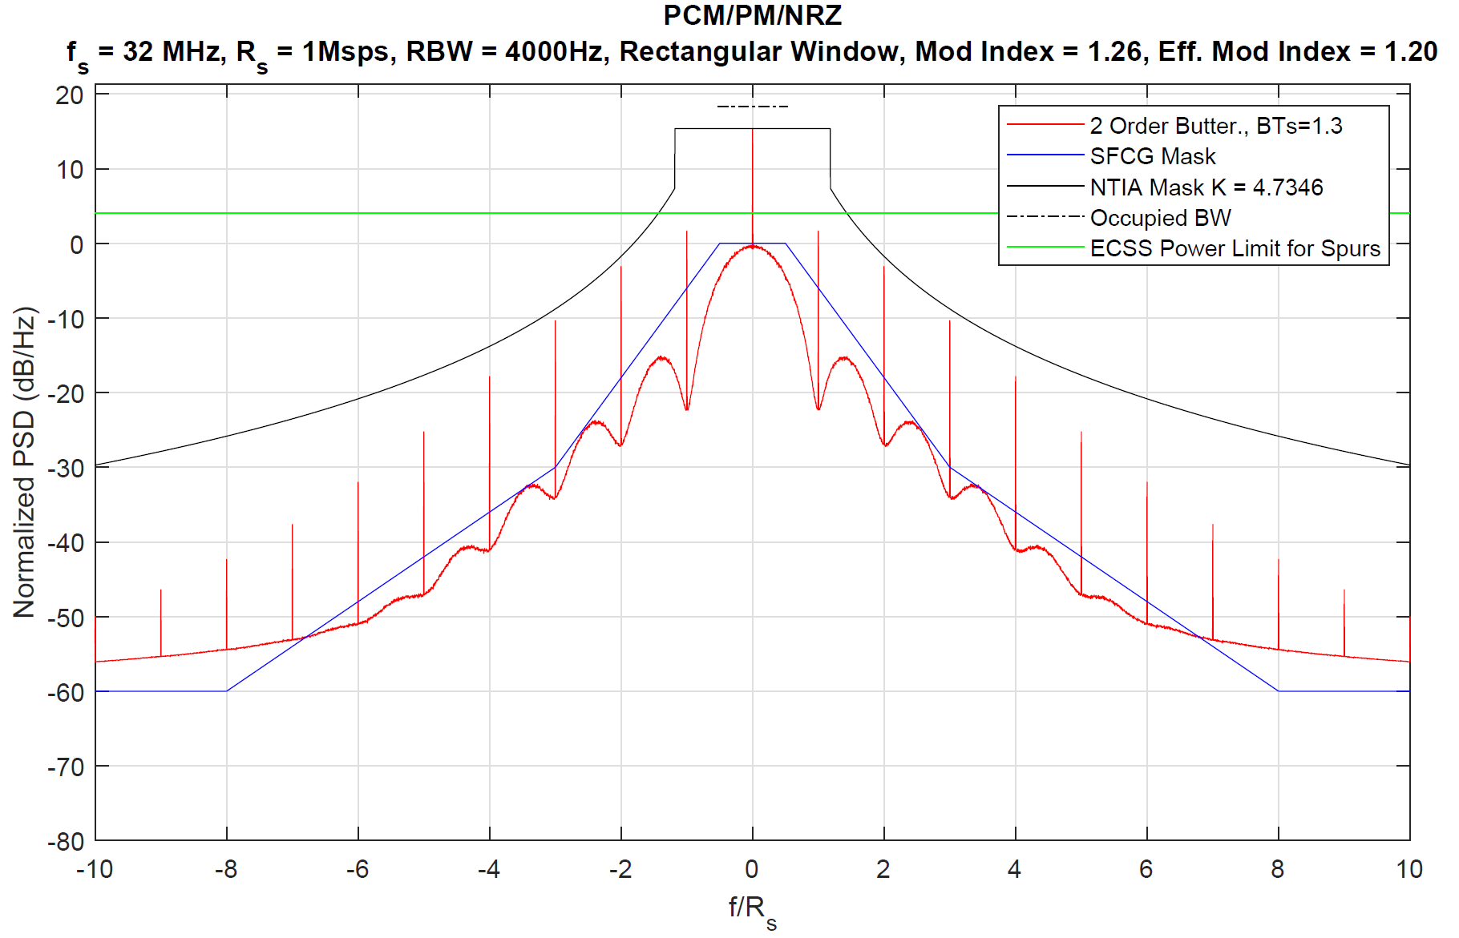
PSD at 4000 Hz Resolution Bandwidth
Note:
All spectral lines are within the ECSS upper limit.
When the RBW is 4000Hz, the floor will violate the mask? This is due to fact that the floor value is directly related to the RBW.
A rectangular window is required to accurately measure the power of the residual carrier and harmonics.
RBW of 4KHz is required to plot the NTIA mask.
Violation?

Slide 7
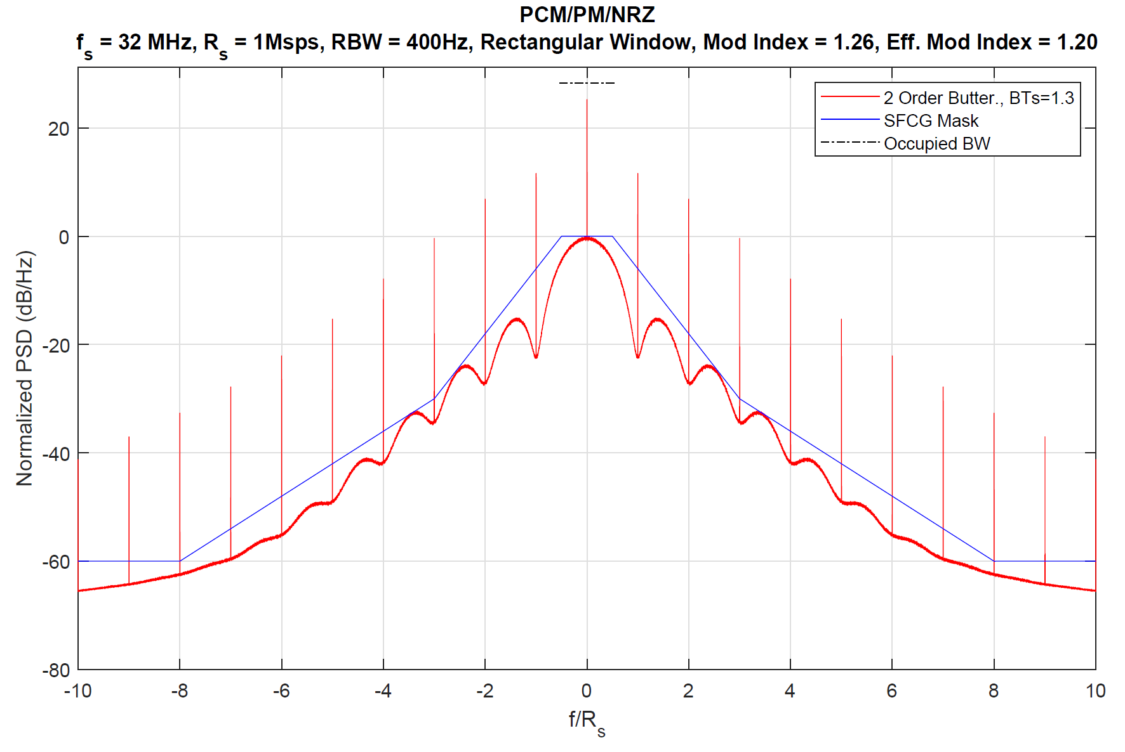
PSD at 400 Hz Resolution Bandwidth
Note: A rectangular window with RBW of 400 Hz shows the floor meeting the SFCG mask.

Slide 8
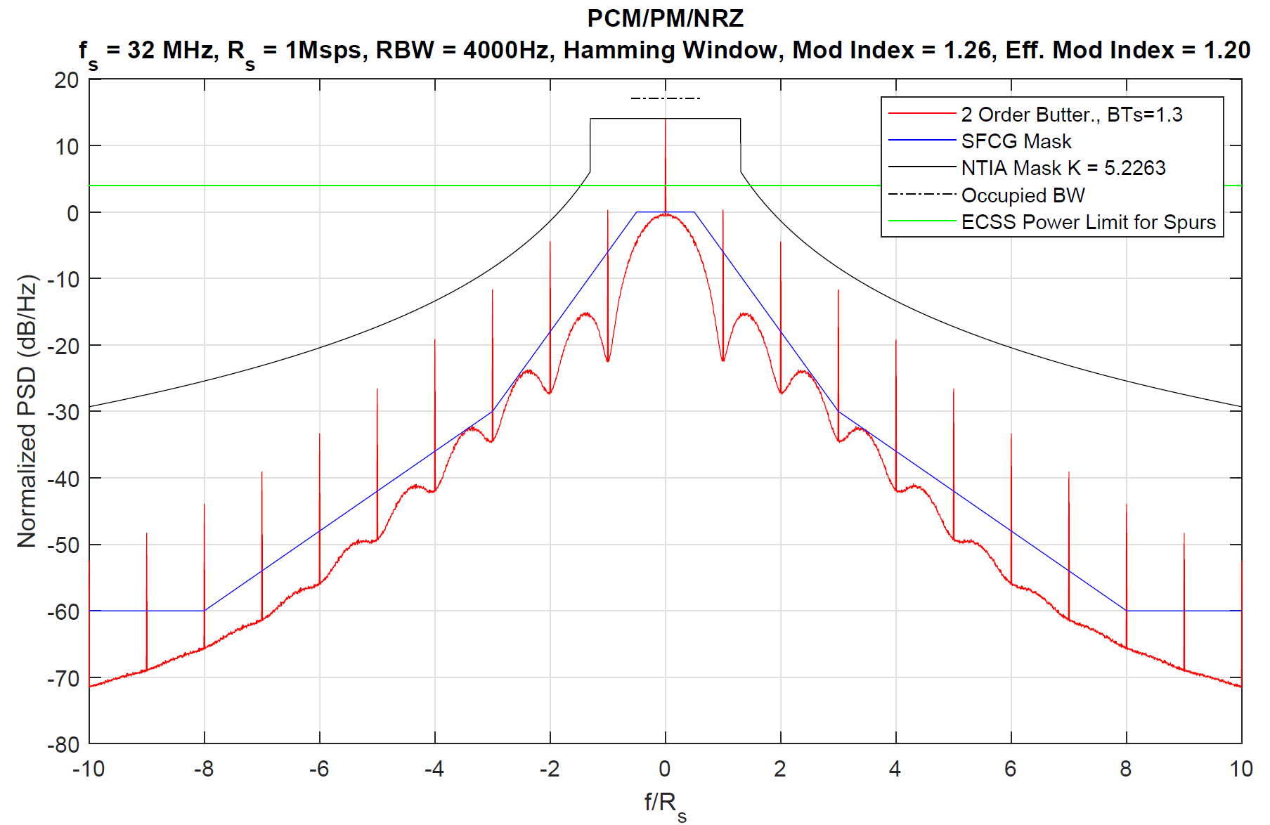
PSD at 4000 Hz RBW with Hamming Window
A Hamming window at 4KHz RBW shows no mask violation.

Slide 9
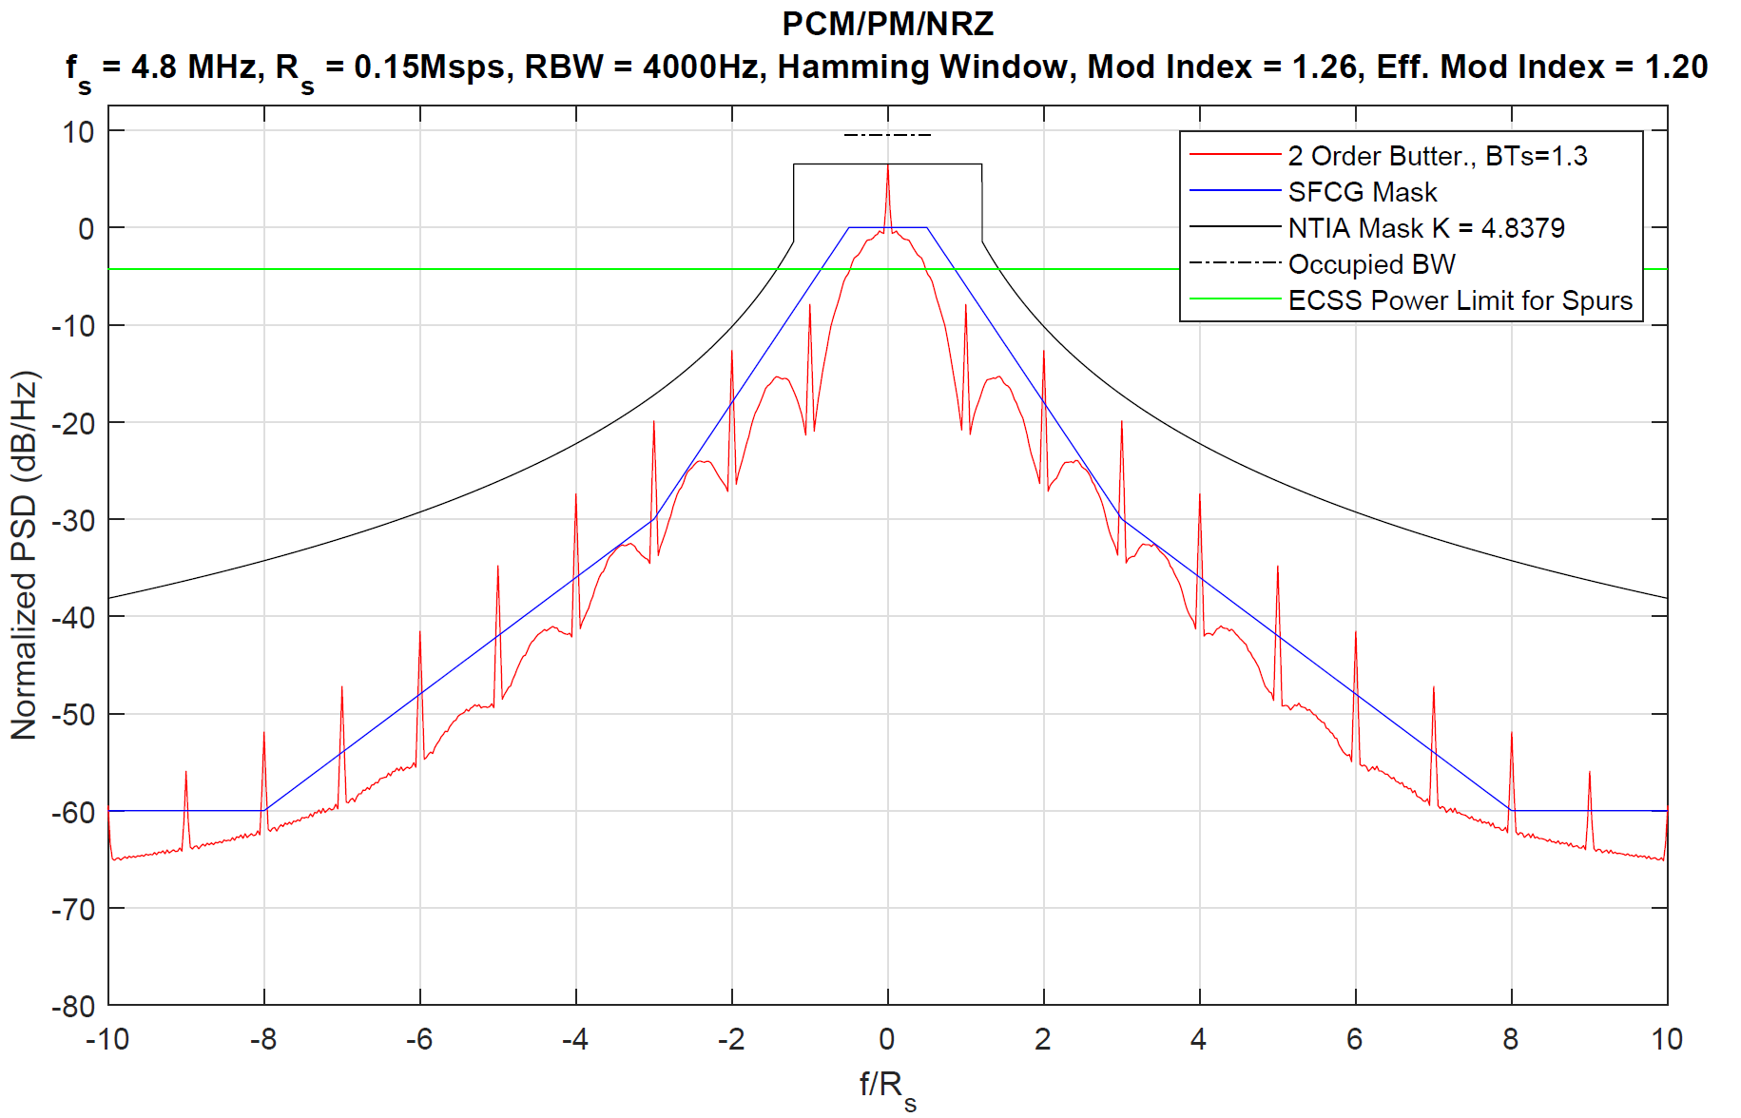
PSD at 150 Ksps
At the lowest data rate, modulation is still compliant.

Slide 10
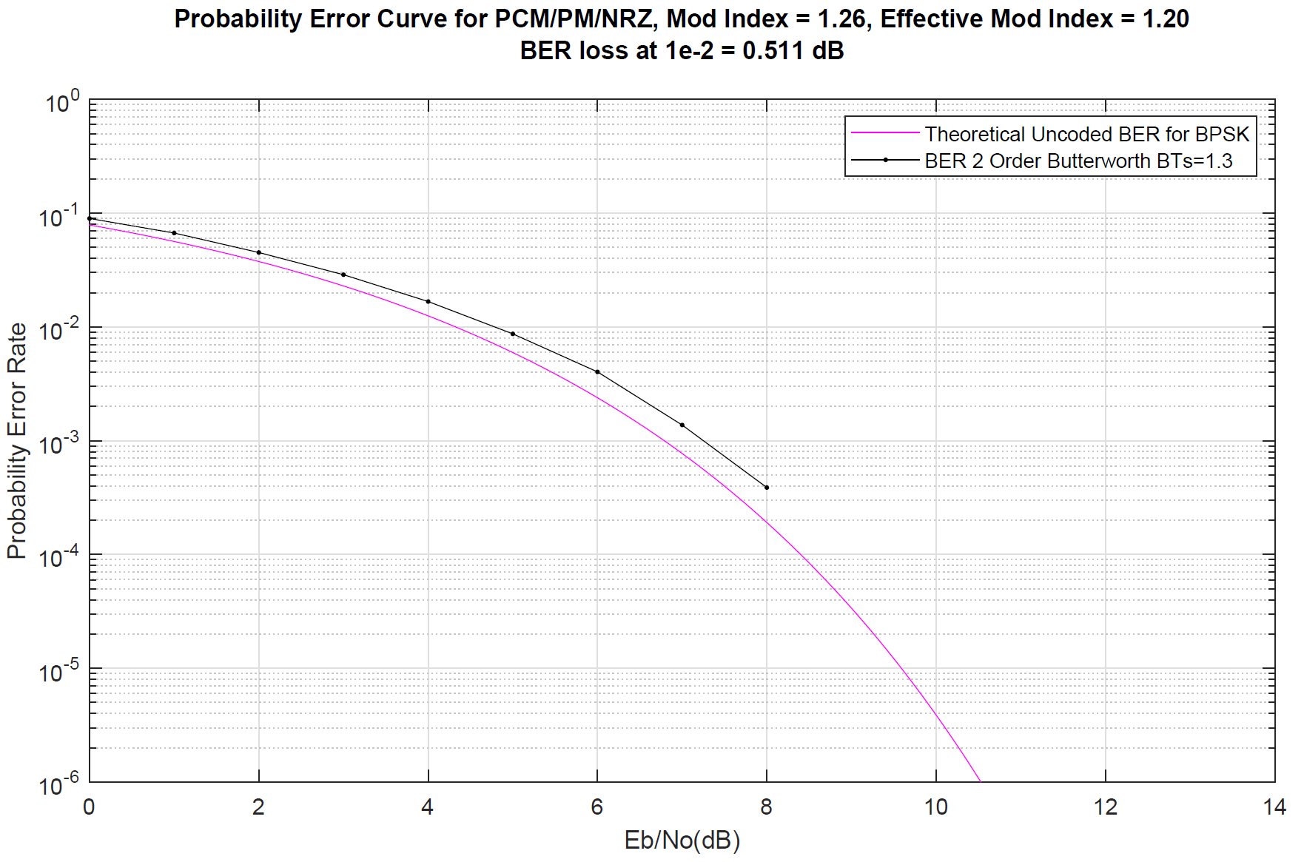
BER results
For the case of filtered SP‐L modulation, the spectral lines at the even
multiples of the symbol rate shall not be higher than ‐20 dBc.
Good results even with a matched filter mismatch.

Slide 11
Table of Effective Modulation Indices
Modulation Index | Effective Modulation Index
1.260 | 1.205
1.198 | 1.145
1.136 | 1.086
1.073 | 1.026
1.011 | 0.967
0.949 | 0.907
0.887 | 0.848
0.824 | 0.788
0.762 | 0.729
0.700 | 0.669
Effective Modulation Index is the result of the energy loss due to the filtering.

Slide 12
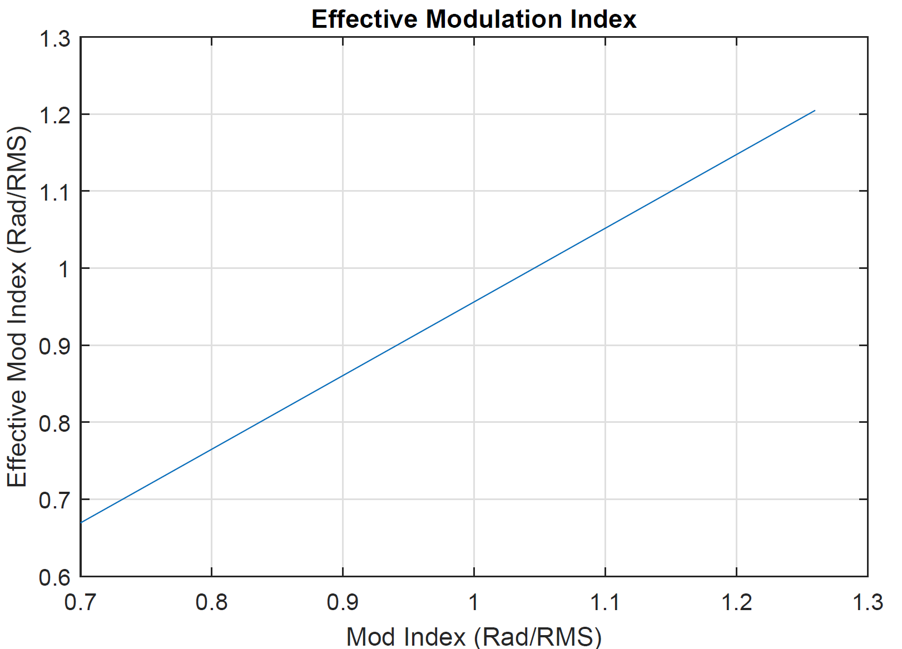
Effective Mod Index Plot

Slide 13
NRZ with Ranging
This section is focused on the spectral response of the NRZ modulation with Tone or PN Ranging

Slide 14
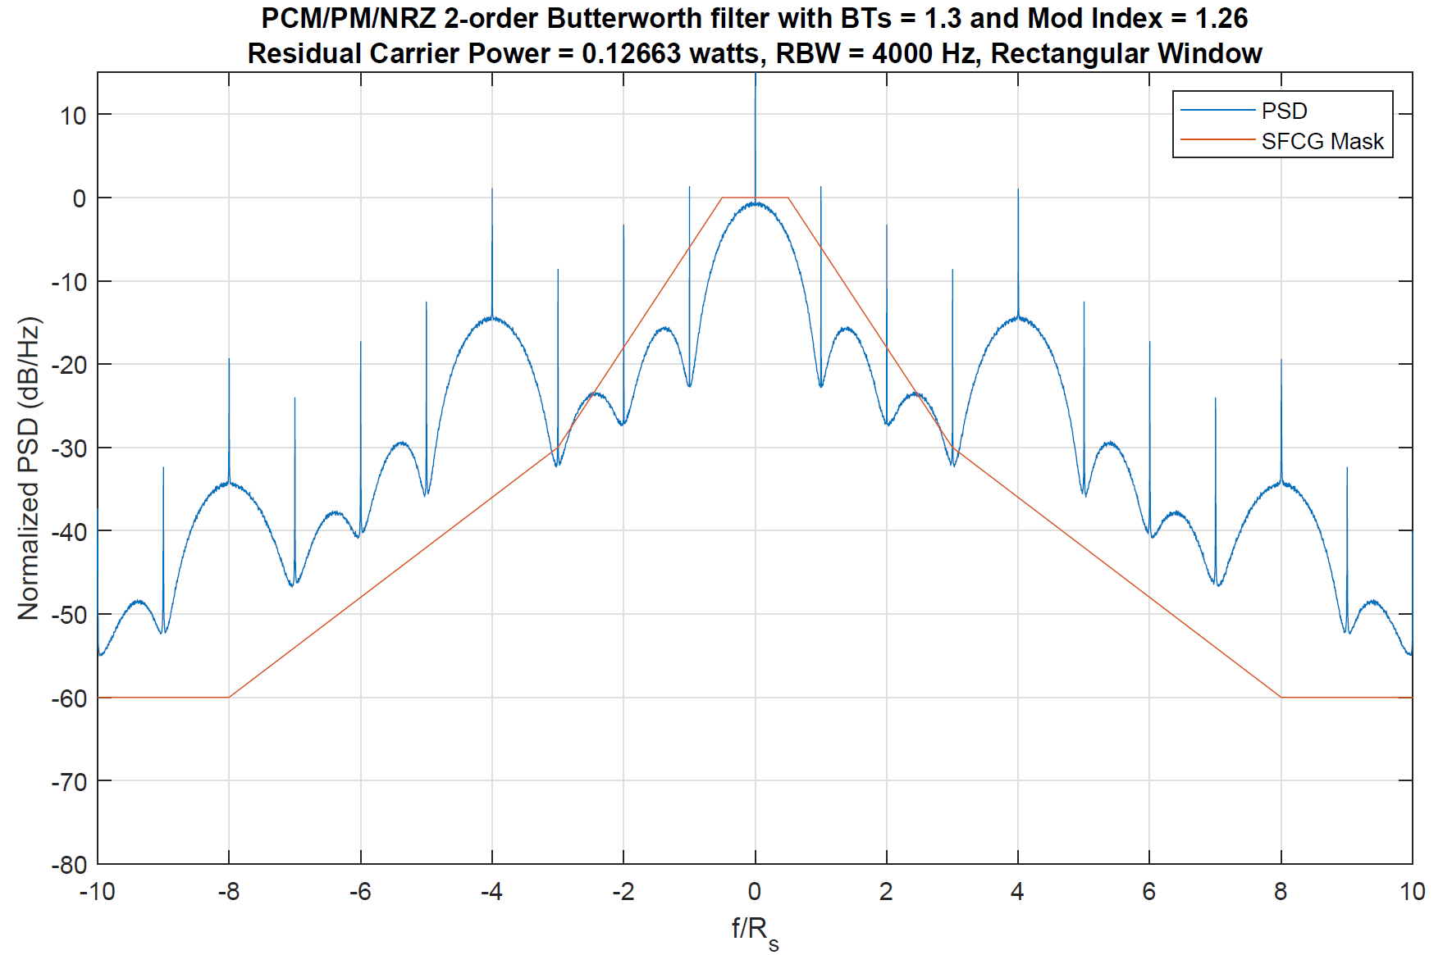
PSD with Tone Ranging at Fr=4.0005*Rs and Ranging Index = 0.4

Slide 15
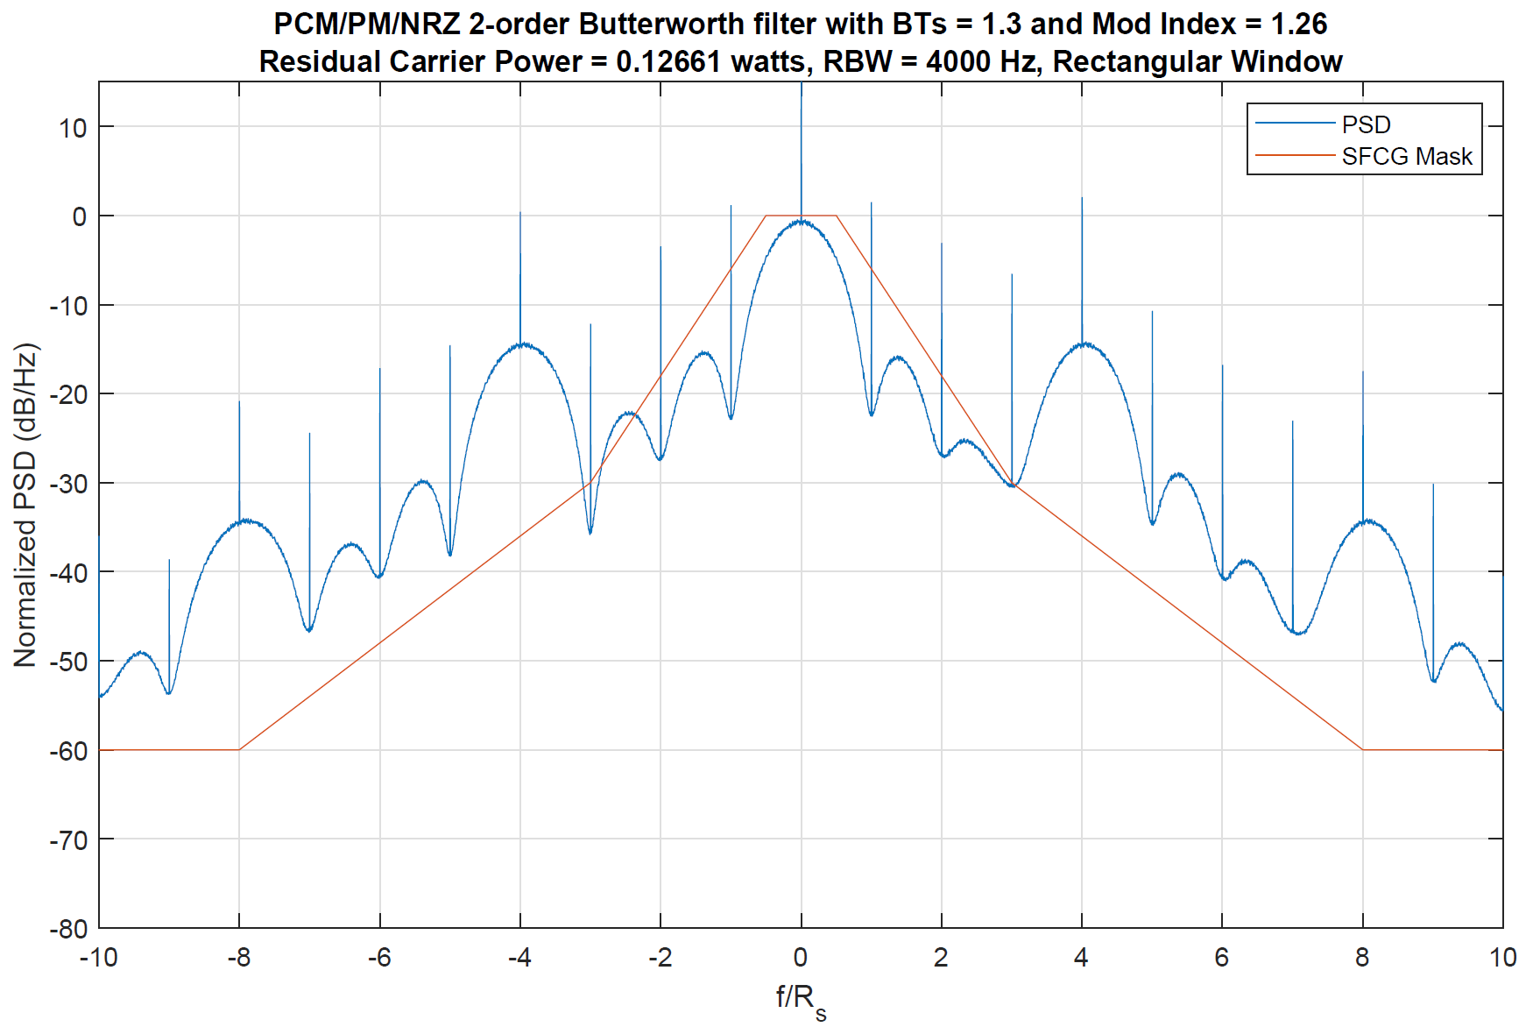
PSD with Tone Ranging at Fr=4*Rs and Ranging Index = 0.4
Asymmetry

Slide 16
Observations
Asymmetric PSD occurs when the ranging tone is coincident with the spikes of the filtered NRZ PSD.
A frequency separation of at least 500 Hz is required to maintain PSD symmetry.

Slide 17
PSD with PN Ranging at Rc=3xRs and Ranging Index = 0.4

Slide 18
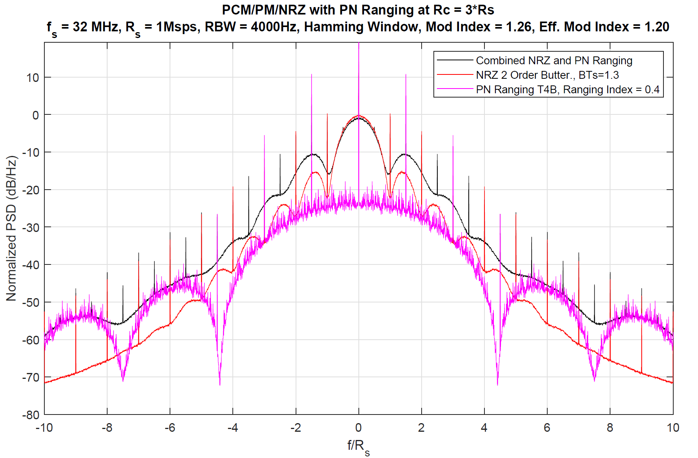
PSD of NRZ with PN Ranging Decomposed

Slide 19
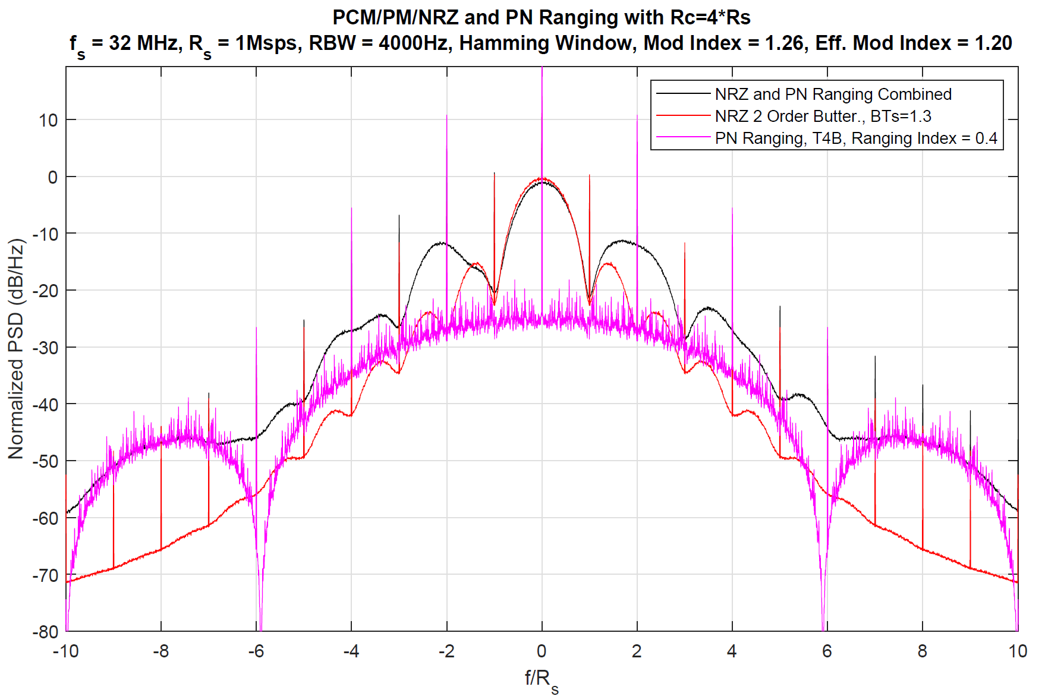
PSD of NRZ with PN Ranging Decomposed (2)
Asymmetry

Slide 20
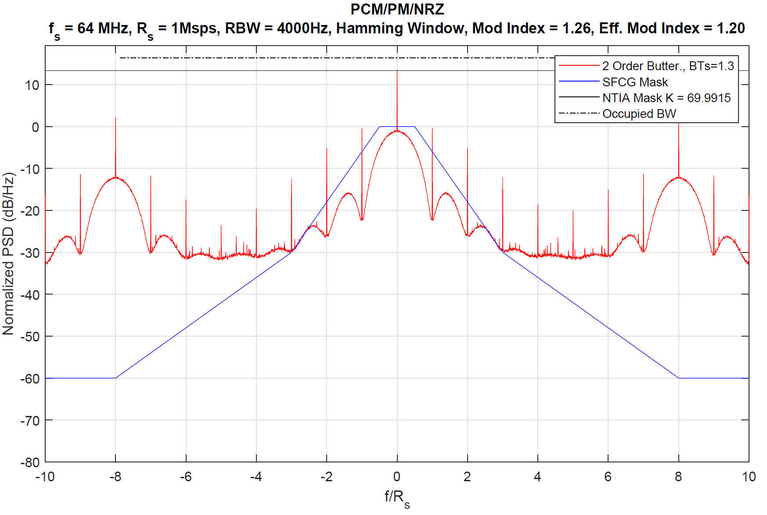
NRZ with PN Ranging at Rc=16*Rs

Slide 21
Observations
Asymmetry occurs when the spikes of the PN PSD are close or coincident to the spikes of the NRZ PSD and such is the case when the Rc and Rs are an even multiple of each other.
When the multiple is odd the symmetry returns.
However, if the Rc is large enough, i.e., Rc > 16 * Rs, then symmetry is maintained regardless of an even multiple.
Consequence of asymmetric PSD is a possible phase offset at the output of symbol detection circuit with the amount of offset dependent on the power levels of the asymmetry.
A secondary effect is possibly increased jitter from arm filters that assume symmetry if Costas Loops are used.
PCM/PM/Bi-phase with ranging has similar asymmetry issues.

Slide 22
Conclusion
NRZ with Butterworth 2nd order filtering at BTs=1.3 will provide the best BER performance with the best complexity trade off.
Possible asymmetric PSDs will occur if spikes from a ranging signal will be coincident with spikes from the NRZ signal however this can be avoided with careful selection of ranging frequencies and rates.

