Slide 1
Phase Noise Analysis on S-Band Proximity-1 Hailing Channel – Follow on
Wing Lee
Wai Fong, Ph.D.
July 23, 2024

Slide 2
Background
During the joint C&S/SLP/RFM meeting in Spring 2024, NASA presented input paper SLS-CS_24-09 to assess the use of the 401 phase noise mask recommendation within the S-band Prox-1 RFM 211.1-B blue book. The PLL analysis indicated that the mask is not adequately specified at f<10Hz, especially for the hailing channel (PCM/PM/bi-phase m=1.05, Rcs=1ksps, Rate ½ LDPC code).
Also in the last meeting, ESA presented an “informative input” to suggest a new phase noise mask based on Lunar Pathfinder (LPF) specifications. Estimated maximum Doppler rates of 75Hz/sec (non coherent mode) and 150Hz/sec (coherent mode) were provided based on LPF as well. In addition, it was noted that the coded symbol rate on the hailing channel should be 2ksps instead of 1ksps.
As a follow-on action, “ESA agrees to check with LPF if they can provide block diagram information in regards to the heterodyning of the RF chains and oscillators (also frequency multiplier and divider, if possible) specs for transmitter and receiver. Given this information, NASA agrees to reiterate the analysis for total phase noise.”
  Through follow-on emails, ESA indicated that due to proprietary issues, LPF cannot provide the requested information. However, it was confirmed that the suggested phase noise mask was based on measurements at the “transmitter” level.
  NASA then agreed to reiterate the analysis based on the transmitter mask.

Slide 3
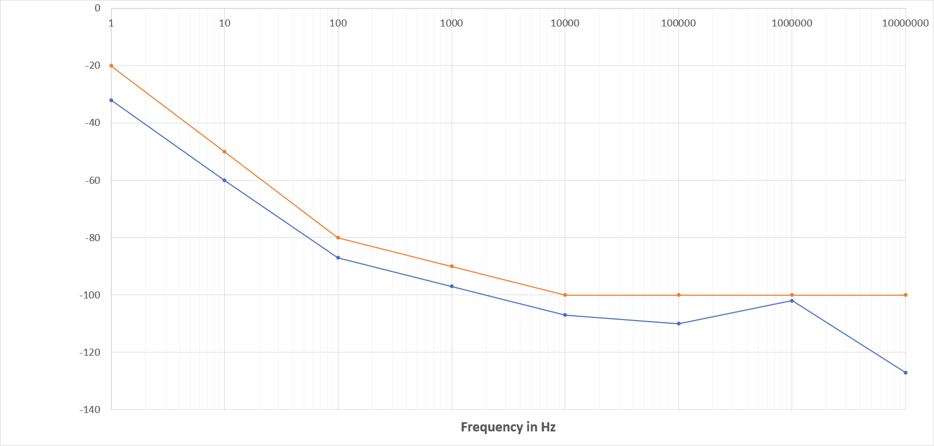
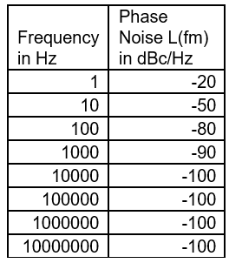
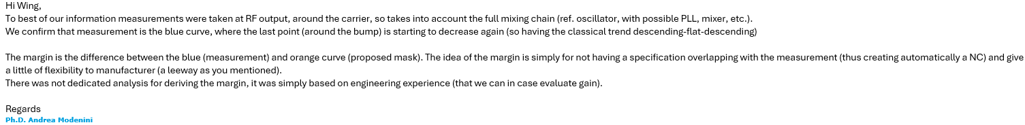
Transmitter Phase Noise Mask Proposed by ESA
Phase Noise L(fm) in dBc
(Blue Line) AD9361 oscillator reference performance (used as benchmark purposes)
(Orange Line) Proposed Phase Noise Mask to be inserted in Prox1 for SBand

Slide 4
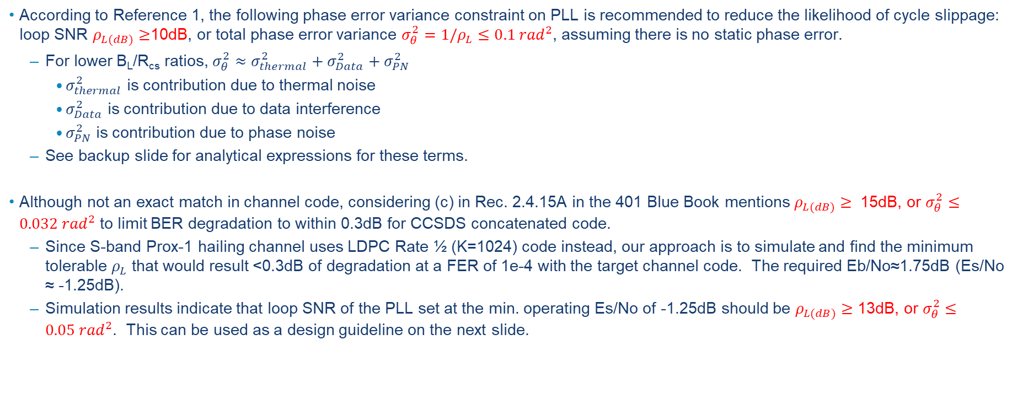
Minimum Loop SNR Guidelines for PLL to Reduce Likelihood of Cycle Slippage and Limit BER Degradation
According to Reference 1, the following phase error variance constraint on PLL is recommended to reduce the likelihood of cycle slippage: loop SNR $ρ_{L(dB)}≥$10dB, or total phase error variance $σ_{θ}^{2}=1/ρ_{L}≤0.1 {rad}^{2}$, assuming there is no static phase error.
  For lower B_{L}/R_{cs} ratios, $σ_{θ}^{2}≈σ_{thermal}^{2}+σ_{Data}^{2}+σ_{PN}^{2}$
    $σ_{thermal}^{2}$ is contribution due to thermal noise
    $σ_{Data}^{2}$ is contribution due to data interference
    $σ_{PN}^{2}$ is contribution due to phase noise
  See backup slide for analytical expressions for these terms.
Although not an exact match in channel code, considering (c) in Rec. 2.4.15A in the 401 Blue Book mentions $ρ_{L(dB)}≥$ 15dB, or $σ_{θ}^{2}≤0.032 {rad}^{2}$ to limit BER degradation to within 0.3dB for CCSDS concatenated code.
  Since S-band Prox-1 hailing channel uses LDPC Rate ½ (K=1024) code instead, our approach is to simulate and find the minimum tolerable $ρ_{L}$ that would result <0.3dB of degradation at a FER of 1e-4 with the target channel code. The required Eb/No≈1.75dB (Es/No ≈ -1.25dB).
  Simulation results indicate that loop SNR of the PLL set at the min. operating Es/No of -1.25dB should be $ρ_{L(dB)}≥$ 13dB, or $σ_{θ}^{2}≤0.05 {rad}^{2}$. This can be used as a design guideline on the next slide.

Slide 5
PLL Analysis with Proposed Phase Noise Mask for S-band Prox-1 Hailing Channel (Assume no Doppler)
With Proposed Transmitter Phase Noise Mask:
With Proposed Transmitter Phase Noise Mask + 3dB in an attempt to account for Receiver:
Acceptable
Acceptable
Analysis suggests that the design guideline of phase error variance can be met with the proposed phase noise mask, when no Doppler is assumed.

Slide 6

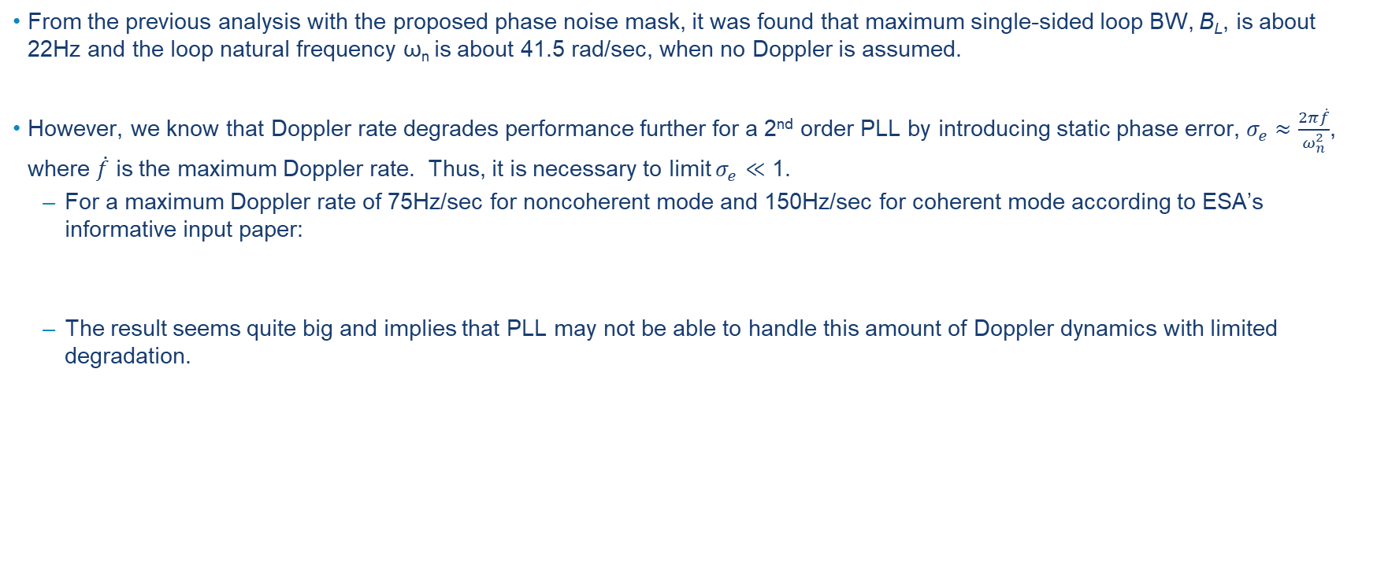
Can the 2nd Order PLL Track the Doppler Specified?
From the previous analysis with the proposed phase noise mask, it was found that maximum single-sided loop BW, B_{L}, is about 22Hz and the loop natural frequency ω_{n} is about 41.5 rad/sec, when no Doppler is assumed.
However, we know that Doppler rate degrades performance further for a 2nd order PLL by introducing static phase error, $σ_{e}≈\frac{2π\dot{f}}{ω_{n}^{2}}$, where $\dot{f}$ is the maximum Doppler rate. Thus, it is necessary to limit $σ_{e}$ $≪\text{1}$.
  For a maximum Doppler rate of 75Hz/sec for noncoherent mode and 150Hz/sec for coherent mode according to ESA’s informative input paper:
  The result seems quite big and implies that PLL may not be able to handle this amount of Doppler dynamics with limited degradation.
  $$\frac{2π\dot{f}}{ω_{n}^{2}}=\frac{2π(150)}{{(41.5)}^{2}}=0.55$$

Slide 7
Concluding Remarks
Our PLL analysis indicated that the design guideline on phase error variance can be met with the transmitter phase noise mask suggested by ESA, when no Doppler is assumed. And since the mask specification only represents the transmit side but not receiver side, we also repeated the analysis by adding 3dB.
  For this, we are ok with ESA’s proposal on recommending this mask for hailing. The only question is whether to include something for the receiver side.
In addition, a simple calculation was performed using Doppler rate estimates based on Lunar Pathfinder and result indicated that for the hailing channel which operates at Rcs=2ksps, it is difficult to design a 2nd order loop that would track this Doppler dynamics without introducing significant loop stress.
  For this, we suggest that a note can be added to the Prox-1 RFM Blue Book to alert implementers of this potential issue and that some means of Doppler mitigation strategy might be required.
    “NOTE: Implementers should be aware that a 2nd order phase locked loop could have potential issues with Doppler tracking when the system operates at low coded symbol rates. One should perform proper engineering trade-off and apply some means of Doppler mitigation strategy if needed.”, OR
    “NOTE: To maintain a BER implementation loss within 0.3 dB, one should perform engineering trade-off with various Doppler mitigation strategies if the required loop bandwidth is too limiting.”

Slide 8
References
“DSN Telecommunications Link Design Handbook” by JPL.
“A Comparison of Telemetry Signals in the Presence and Absence of a Subcarrier” by Shihabi.

Slide 9



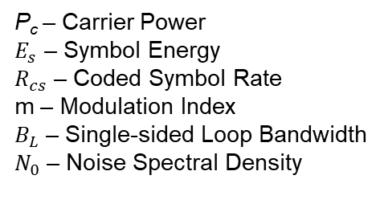


Backup
P_{c} – Carrier Power
$E_{s}$ – Symbol Energy
$R_{cs}$ – Coded Symbol Rate
m – Modulation Index
$B_{L}$ – Single-sided Loop Bandwidth
$N_{0}$ – Noise Spectral Density
$$σ_{thermal}^{2}=\frac{N_{0}B_{L}}{P_{c}}=\frac{\left(B_{L}/R_{cs}\right)\tan^{2}\left(m\right)}{\left(E_{s}/N_{0}\right)}$$
$$σ_{Data}^{2}=2 \tan^{2}\left(m\right)\int_{0}^{∞}{{\left|H\left(f\right)\right|}^{2}S_{D}\left(f\right)}df$$
H($f$) – PLL Closed loop Transfer Function
S_{D}(f) – PSD of Unfiltered PCM/PM/Bi-Phase
$$S_{D}\left(f\right)=\frac{1}{R_{cs}}\frac{\sin^{4}\left(πf/{2R}_{cs}\right)}{{\left(πf/{2R}_{cs}\right)}^{2}}$$
$$σ_{PN}^{2}=2\int_{0}^{∞}{{\left|1−H\left(f\right)\right|}^{2}L\left(f\right)}df$$
L($f$) – Single Sideband Phase Noise Spectral Density

