Slide 1
C&S Working Group - Opening
Andrea Modenini, C&S Chair
CCSDS Spring meeting 2024

Slide 2
Agenda

Slide 3
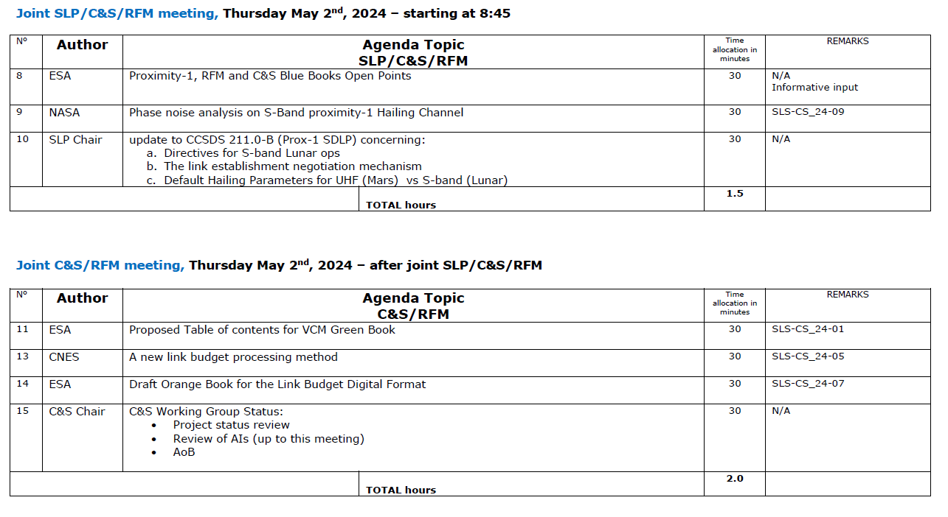
Agenda

Slide 4
Organizational notes
ESA input SLS-CS_24-02 (HoM for SCI missions) was moved in RFM working group, on Tuesday 30th April.
Input dealt with a 401.0-B recommendation
The following inputs are informative only, since delivered after deadline (thus, cannot propose changes to standards):
ESA, “Proximity-1, RFM and C&S Blue Books Open Points”
CNES, “A new link budget processing method”
CNES, “Use of LDPC optical for RF links”
Inputs are available on CWE at https://tinyurl.com/CCSDSSpring2024 (C&S WG private folder, requires login)

Slide 5
C&S objectives for Spring 2024
131.0-B, TM synchronization & coding
Update of 131.0-B for TF slicing Achieve consensus on technical updates
Update of 131.0-B for Turbo interleaver Achieve consensus on technical and editorial updates
231.0-B, TC synchronization & coding
Performance analysis of LDPC tail sequence Introduction of possible technical issue on LDPC TC tail sequence
Joint topics
VCM Green Book (C&S, RFM) Proposing new project
Link budget digital format Proposing new project
Proximity-1 (SLP, C&S, RFM) Status check of the project on S-Band proximity-1 extension
Status of Slicing for potential use of Variable Length Frames (SLP, C&S, OPT) Status check, for possible harmonization in 131.x-B, 431.1-B, 142.0-B
Use of LDPC optical codes for RF links Introduction of new topic
New link budget processing method Introduction of new topic

Slide 6
Issues
ESA-ESTEC limited manpower and travel budget for CCSDS activities (here discussed with impact to C&S activities, including joint meetings)
In 2023, manpower was secured only for chair activities (A. Modenini), while normal technical activities (requiring up to 4 people, including those working offline) had only ~50 hours for the full year;
At begin of 2024, there was a similar manpower situation; this was partially recovered last minute (two weeks before Spring meetings) with ~250 hours for technical activities for the full year;
ESA-ESTEC has also limited travel budget (together with CO2 budget) for attending CCSDS meetings in person.
Spring 2024 meeting was eventually secured last minute for the ESA-ESTEC representatives,
no guarantee that ESA-ESTEC will be able to attend Fall 2024 meeting in London.

Slide 7
Issues
ESA-ESTEC limited manpower and travel budget for CCSDS activities (here discussed with impact to C&S activities, including those in joint meetings)
Currently ESA-ESTEC has committed to the following headings in C&S WG:
C&S chairmanship;
Proximity-1 extension project (under RFM/C&S WGs, for update of 211.1 and 211.2);
Link Budget Digital Format (proposed new project);
HoM for Scientific missions (as part of 401.0 updates project, under RFM/C&S WGs);
VCM Green Book (proposed new project);
Transfer Frame slicing project – ESA prototype (needed for future publication of the Blue Book of the existing project)
Next review cycle of TM Green Book (planned in 2025)
Already at this meeting, AI_23_(20, 22, 23) regarding Proximity-1 extension were not completed within deadlines, with consequent delay of S-Band proximity-1 activities.

Slide 8
Issues
ESA-ESTEC limited manpower and travel budget for CCSDS activities (here discussed with impact to C&S activities, including those in joint meetings)
ESA-ESTEC will give anyway a last-minute (informative) presentation on the status of S-Band proximity-1 at this Spring 2024 meeting; This deviation to CCSDS YB procedures was accepted by the WG by consensus;
As follow-up, the following draft recovery plan is proposed (to be discussed and agreed):
C&S WG to have a progress meeting in July (remote) for progressing (best effort) on S-Band proximity-1
In turn, ESA-ESTEC will continue to contribute to CCSDS activities as previously, under the assumption that also travel budget for London 2024 will be approved. Priority will be given to S-Band proximity-1 extension activities.
In case ESA-ESTEC representatives in C&S should become aware of the possibility of not attending London, to inform immediately the WG for ensuring that technical meetings can be held (e.g., with WG delegation to deputy chair, re-assignment/re-scheduling of AIs, withdrawn of projects not yet approved)
To raise the issue at SLS AD for possible escalation to CESG/CMC

Slide 9
C&S Working Group Status
Andrea Modenini, C&S Chair
CCSDS Spring meeting 2024

Slide 10
Outline
Project status review
Slicing of TFs (131.0-B)
Turbo Channel Interleaver (131.0-B)
Proximity-1 extension (211.x-B)
VCM Green Book (proposed new project)
Link Budget Digital Format (proposed new project)
Erasure Correcting Codes for NE and DS (obsolete draft project)
Review of AIs

Slide 11
Project Status Review
CWE approved projects
CWE draft projects
Latest status of the projects:
TM BB, Slicing of TFs, CWE project under approval, draft update presented during this meeting
TM BB, Turbo Channel interleaver: draft update presented during this meeting
S-Band proximity-1, CWE project under approval, draft(s) update will be presented in The Hague
Erasure Correcting Codes for NE and DS, draft project is withdrawn
TO BE UPDATED AFTER SPRING TECHNICAL MEETINGS
ONE SLIDE WILL BE REPORTED FOR EACH PROJECT

