Slide 1
A NEW LINK BUDGET PROCESSING METHOD
CNES
CCSDS Spring 2024
Hervé GUILLON, Marie VIALARD, Claire DURAND, Franck ROUSSEAU, Clément DUDAL

Slide 2
SUMMARY
A NEW LINK BUDGET PROCESSING METHOD – CCSDS spring 2024
LINK BUDGET GENERAL PRESENTATION
CCSDS/ECSS STANDARDIZED METHOD
NEW METHOD BASED ON RANDOM DRAWS
PRESENTION OF CNES LINK BUDGET TOOLS

Slide 3

LINK BUDGET
A NEW LINK BUDGET PROCESSING METHOD – CCSDS spring 2024
A Key problem for RF link design, but the generic processing is well known:
Estimation of transmitted power
Estimation of losses between the transmitter and the receiver
Estimation of the received power
Estimation of the noise level at receiver level
Several calculations can be performed to estimate :
received power,
C/N₀, E_{b}/N₀, signal to noise ratio at various point in the reception chain processing,
power flux level,
etc…
ex:
working with dB leads to a generic formulation:
$$\frac{C}{N_{0}}=\frac{P_{R}}{N_{0}}=P_{T}.G_{T}.\frac{G_{R}}{T}.{\left(\frac{λ}{4πd}\right)}^{2}.\frac{1}{L}.\frac{1}{k}$$
$$X= \sum_{k=1}^{n}{±m_{k}}$$
« + » for gain, « - » for loss

Slide 4
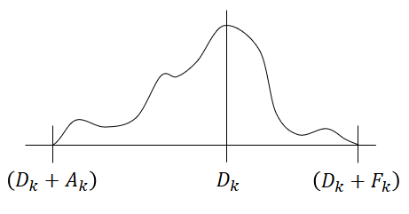

AVAILABILITY
A NEW LINK BUDGET PROCESSING METHOD – CCSDS spring 2024
Mission safety analysis takes the RF link into account
RF link is considered as a specific contributor in the availability estimation
A single link budget does not consider that availability aspect
CCSDS/ECSS link budget processing method
provides a way to estimate link budget at N-sigma
Downlink: 2 σ for CCSDS, 3 σ for ECSS ➔ depend on the safety hypothesis
Uplink: 3 σ for CCSDS and ECSS
ECSS provide a way to estimate worst case RSS link budget
Each contributor is defined thanks to:
its Design value D_{k}
its Adverse value (D_{k}+A_{k})
its Favorable value (D_{k}+F_{k})
its distribution law (Triangular, Gaussian or Uniform)
calculation of mean (µ_{k}) and variance (σ_{k}²) values
$$X_{Nσ}= \left(\sum_{k=1}^{n}{±μ_{k}}\right)−N.\sqrt{\sum_{k=1}^{n}{{σ_{k}}^{2}}}$$

Slide 5
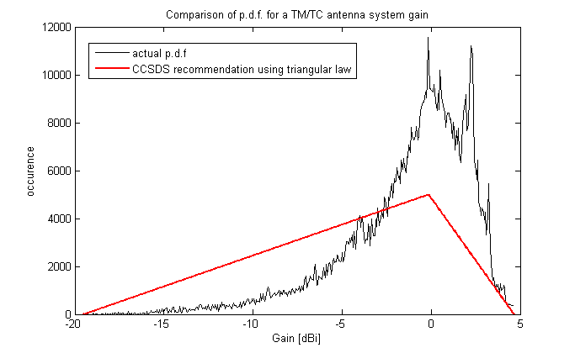
CCSDS/ECSS method limits
A NEW LINK BUDGET PROCESSING METHOD – CCSDS spring 2024
Several drawbacks of the method have been identified:
Independence of the contributors in CCSDS/ECSS method
actually, antenna gain and axial ratio are correlated
Gaussian consideration (correspondance availability ↔ number of sigmas)
does not work if a contributor has a range largely higher than the other contributors
it is the case in survival mode (when satellite attitude is not controlled)
the global behavior is not Gaussian
Discrepancy between the modeled distribution and the actual one
example: antenna gain (Triangular for CCSDS/ECSS)
Hidden hypothesis about polarisation loss computation:
The ground station is able to receive both LHCP and RHCP polarizations
Method not adapted to single receiving chain ground stations
=> Details page 4 of the article

Slide 6
NEW METHOD
A NEW LINK BUDGET PROCESSING METHOD – CCSDS spring 2024
Method based on random draws:
Random draws using:
the recommended distribution law if the actual one in not known (triangular, uniform, gaussian)
the actual distribution law if this one is known (on-board antenna gain and axial ratio thanks to antenna description files)
Since version 1.4 of this tool (version 1.3 and before it was CNES DLL propagation library) : uses of the CNES Matlab ITU model (june 2023) to compute atmospheric loss, either using a single value or the modeled distribution law of atmospheric loss
use of a new distribution law: PLCKMOD (for antenna gain and axial ratio if no data are available)
Sense of circular polarization can be considered (for single receiving/transmitting chain ground stations)
Q independent link budgets (Q = 10⁶ in our analysis)
for an availability of p, estimation of the value respected with this probability
ex: for 99.865% availability (equivalent of 3 σ), the value is the one respected in 99.865% of the calculated cases.
Possibility to estimate the availability of the link

Slide 7
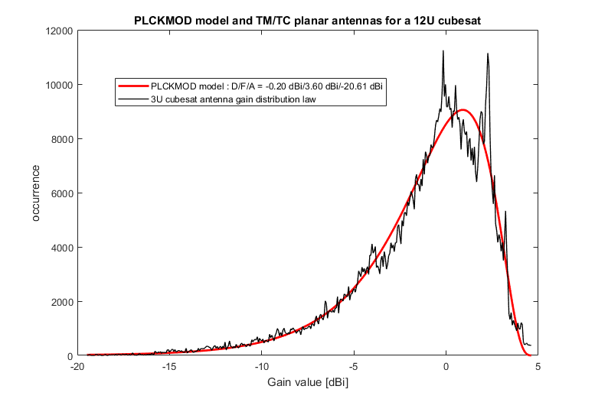
PLCKMOD DISTRIBUTION LAW
A NEW LINK BUDGET PROCESSING METHOD – CCSDS spring 2024
Useful for Antenna Gain and Axial Ratio:
Used with random draws
Inspired by the black body radiation law
Can be defined with Design/Favorable/Adverse values
Generally speaking: Very good fit with actual antenna gain distribution
Useful for analysis if the antenna description file is not available
$$P_{λ}\left(x\right)=ξ.\frac{x^{5}}{exp\left(λ.\sqrt{x}\right)−1} for x>0$$
normalisation term
parameter of the distribution

Slide 8
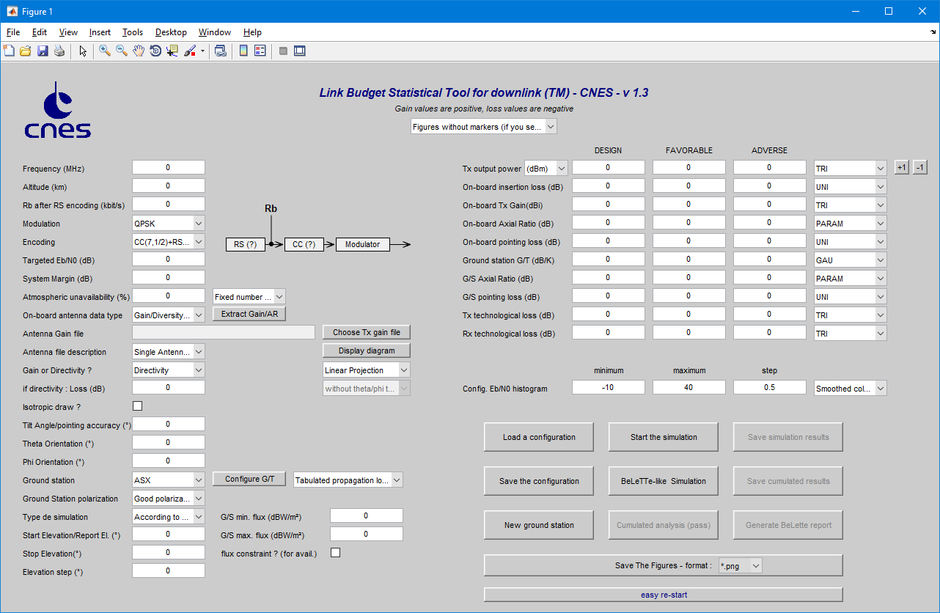
CALCULATION TOOLS
A NEW LINK BUDGET PROCESSING METHOD - CCSDS spring 2024
Tools developed:
Under Matlab environnement
tool for downlink (TM, HDRTM)
tool for uplink (TC)
tool for Inter Satellite Link (ISL)
tool for DVB-S2 still under development
CCSDS/ECSS method calculation
Random draws calculation
Possibility to compare results
First use: X-Band link for MICROCARB satellite with Kourou Ground Station, availability estimation
Tools available in standalone version using Matlab runtime

Slide 9
PERFORMANCES OF THE TOOL
A NEW LINK BUDGET PROCESSING METHOD – CCSDS spring 2024
Cross validation of processing:
Using the previous budget link tool used in CNES (BeLeTTe) on previous CNES missions
Comparision of results using CCSDS/ECSS recommended distribution for random draws (with limited range)
Comparision of independent and parallel analyses using previous and new methods
Error statistics of the tool:
better than 0.1 dB on the 3 σ link budget calculation
better than 2·10⁻⁴ (TM/TC case) and 5·10⁻⁴ (ISL case) for availability estimation
better than 0.1° for the elevation threshold where the targeted link budget is complied with (for TM/TC)
Notes:
Précision au niveau de la restitution des résutats environ 300 simulations identiques comparées entre elles

Slide 10
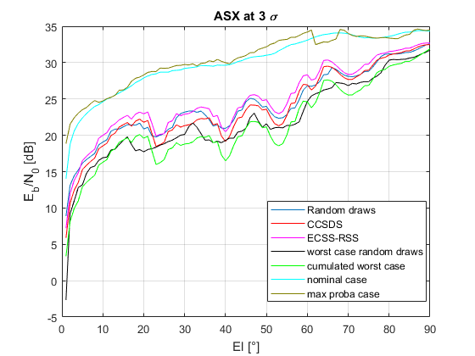
RESULTS OF THE TOOL (1/2)
A NEW LINK BUDGET PROCESSING METHOD – CCSDS spring 2024
Nadir pointed satellite (Microcarb – S-Band TM link)
Results are comparable using CCSDS/ECSS method and random draws method
Results differences ± 2 dB

Slide 11
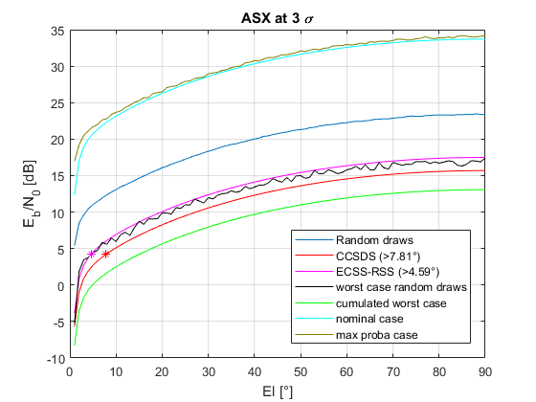
RESULTS OF THE TOOL (2/2)
A NEW LINK BUDGET PROCESSING METHOD – CCSDS spring 2024
Satellite in survival mode (Microcarb – S-Band TM link)
Huge difference between random draws results and CCSDS/ECSS method: 6 to 8 dB
main contributor of the difference: on-board antenna gain
difference could be even higher for cubesat:
up to 30 dB for Eyesat 3U cubesat
for ISL where both spacecrafts can be considered « in survival mode », the difference could reach 60 to 90 dB using CCSDS/ECSS method

Slide 12
CONCLUSION
A NEW LINK BUDGET PROCESSING METHOD – CCSDS spring 2024
A new method for link budget processing is proposed:
More accurate modelization of physical phenomenon (Antenna Gain, polarization loss, propagation loss)
Possibility to estimate the availability of the RF link
Possibility to rationalize the margin and reduced the on-board power
Tools available for TM, TC and ISL RF links (on www.connectbycnes.fr).

Slide 13
A NEW LINK BUDGET PROCESSING METHOD – CCSDS spring 2024
Questions ?

