Slide 1
Proximity-1, RFM and C&S Blue Books Open Points
Nicola Maturo and Brice Dellandrea
09/04/2024

Slide 2
Summary
Phase Noise Mask and end-to-end system performance
Modulation Index discrete values proposition
Frequency Set for S-Band
  In particular: channels from 5 to 9 usage wrt SFCG 42-1
Emissivity mask dispositions for Prox1
  Keep the proposed filtering from the TM Blue Book
  Do we make the filter mandatory? -> Should we make a Proximity-1 RFM green book, informative note ?
Doppler and Doppler Rate handling - constraints
  No oscillator Effects
  Impact on the PLL Stability -> not possible to handle the Doppler of the Moon scenario at very low data rate -> Add a warning or a informative note to make the manufacturer aware of this
Data Rate vs Symbol Rate Matching clarification -> check the Books are consistent with the CCSDS Figure
Coded Hailing Process & Problematics
Enabling a Coherent Mode in Proximity-1

Slide 3
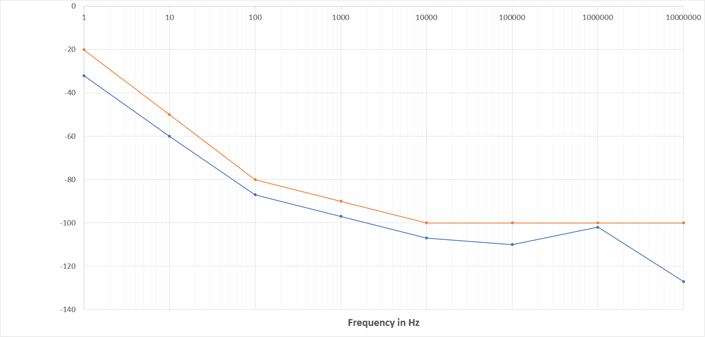
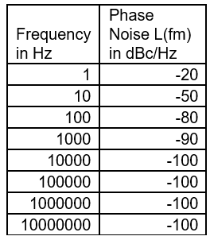
Phase Noise Mask and end-to-end system performance
Phase Noise L(fm) in dBc
(Blue Line) AD9361 oscillator reference performance (used as benchmark purposes)
(Orange Line) Proposed Phase Noise Mask to be inserted in Prox1 for SBand

Slide 4


Phase Noise Mask and end-to-end system performance
Performance analysis vs LNISv5 Bi-Phase-L parameters (wavefront PFS1b/PRS1b):
Symbol rate 48 ksps < Rs < 1.024 Msps
Data Modulation Index: 0.2 to 1.4 radians (peak)
Performance analysis vs LNISv5 GMSK parameters (wavefront PFS1d/PFS1e/PRS1d/PRS1e):
Symbol rate 1 Msps < Rs < 5 Msps
These tables provide an equivalent EVM in the signal phase induced by the oscillator phase error, considering:
That the receiver is locked on the residual carrier, which filters the low frequency error of the transmit phase
That no multiplier is applied between the oscillator frequency and the symbol rate generation
That the phase error (rms) is divided by the modulation index and computed as:
This computation only aims at checking whether the mask is “good enough” for Prox1.

Slide 5
Phase Noise Mask and end-to-end system performance
Phase noise is only a subset of the signal distortion happening on a transmit chain – we could define an EVM.
The EVM is understood as measured with an ideal receiver, to distinguish the contribution of the transmit chain (with transmitting chain imperfections: modulator, amplifier, filters, group delay, spectral regrowth/compression due to amplifying stages, …) from the receive chain imperfections.
Considering the modulations used for Sband, it is proposed to recommend an EVM of 10% to cover for the overall imperfections of the transmit chain and help the system integrators to pre-allocate a reference performance level in the link budget.

Slide 6
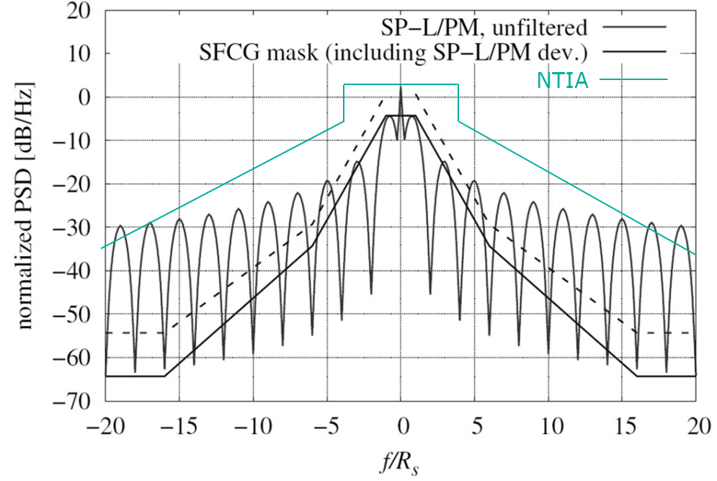
Emissivity mask dispositions for Prox1
Emissivity masks are being defined by:
NTIA (based on dBsd wrt residual carrier & necessary bandwidth computation) → green line
SFCG 41-1 (based on dBc wrt data carrier with potential relaxation for rates <300ksps) → doted line
ECSS-E-ST-50-05Crev2 uses the SFCG mask for rates > 60ksps but without the potential relaxation → hard line
Question: What to do for Prox1 Sband knowing that channels have 1MHz resolution?
Are the NTIA/SFCG/ECSS applicable by default?
Should we specify a mask?
Should we simply set an inter-channel interference value / spectral confinement criterion? NTIA/SCFG/ECSS might be over-constraining for Prox1 when using <32ksps Bi-Phase-L modulation over 1MHz channels. RF filters come with a cost and an implementation loss impact for the Users
We could also define a guard band vs 1MHz to cover for Doppler + Oscillator drift

Slide 7
Modulation Index
Proposition of 8 discrete default values for Prox1 Sband:
0.2 rad/pk (LNISv5 low value for Bi-Phase-L)
0.4 rad/pk
0.6 rad/pk
0.8 rad/pk
π/3 rad/pk (Prox1 default setting in UHF, used by Lunar Pathfinder)
1.15 rad/pk (GTW nom value for Bi-Phase-L, still enables ranging if need be in non-regenerative mode)
1.3 rad/pk (GTW high value for Bi-Phase-L, still enables ranging if need be in regenerative mode)
1.4 rad/pk (LNISv5 high value for Bi-Phase-L)

Slide 8
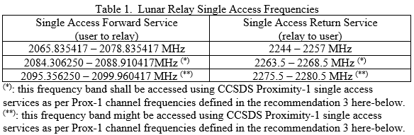
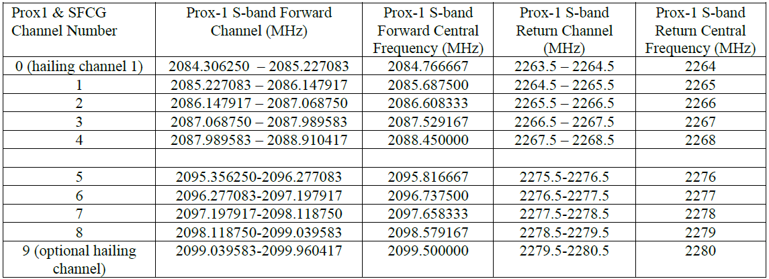
Frequency set
SFCG recent feedback is that channels 0-4 could be allocated to CCSDS Prox1
SFCG recent feedback is that channels 5-9 might be used by CCSDS Prox1 (potentially in concurrence with other protocols)
To be confirmed in June 2024 in SFCG meeting

Slide 9
Doppler and Doppler Rate handling
Doppler & Doppler rate assumptions
Max axial relative speed: 4760m/s (twice the lunar escape velocity to cover all cases of coms between orbiters in opposite clocked orbits and departing vehicles)
  Max Doppler (non-coherent) in SBand: 36.5KHz (note: typical ELFO-Surface doppler: 5-6 KHz)
  Max Doppler (coherent) in SBand: 73KHz
Max axial relative acceleration: 1G (significant conservative margins vs the ascending/landing and orbiters manoeuvers)
  Max Doppler Rate (non-coherent) in SBand: 75Hz/s (note: typical ELFO-Surface doppler rate: 3-10Hz/s)
  Max Doppler Rate (coherent) in SBand: 150Hz/s
Problematics:
A classical PLL order 2 is not able to lock the lowest energy signal authorized by Prox1 in such a Doppler Rate
  SP-L/PM (Bi-Phase-L), Modulation Index = 60 degrees, 2ksps coded symbol rate:
    Maximal PLL double band size to lock with positive margins ~ 25Hz
    Maximal Doppler Rate tolerance ~ 30Hz/s
    Note: new directive could define rates as low as 1/256 sps. The DR tolerance at the equivalent SNR would be far worse
The contradiction of MODCOD and DR cannot be solved by the standard, but either by design or conops on User side
A warning should be added in Prox1, inviting the User to trade-off PLL order with actual Doppler Rates and MODCOD settings for a mission

Slide 10
Data rate and Symbol rate matching
As discussed between ESA and NASA, there is a problem of consistency in Prox1 between the datalink layer and the physical layer in terms of rates. The directives are defined in data rate whereas the physical layer is consistent with coded symbol rates defined at the power of 2, creating an ambiguity for the Users departing from convolutional (1/2) schemes and going toward LDPC codes without round rate multipliers.
The new definition of directives proposed by NASA will solve this ambiguity, yet care should be taken that it is consistent through the full documentation (many occurrences to be checked):
“Bits 40-55 of the LINK ESTABLISHMENT & CONTROL directive shall indicate the symbol rate in symbols per second”
Notes:
  LDPC 2/3 rate (Rd/Rcs) = 4096/(4096*3/2+64)
  LDPC ½ rate (Rd/Rcs) = 1024/(1024*2+64)

Slide 11
Coded hailing & problematics
Coded Hailing:
“1 ksps” symbol rate (as per ‘old’ half-rate Prox1 definition)
Full details setting to avoid any ambiguity : LDPC coded r=1/2 k=1024, codeblock = 2048, Rcs = 2000 sps, Rd = 969.7 bps
Sequence shall be:
  Carrier only (2 seconds – configurable)
  N codewords = idle (N blocks expected to be lost during CSM acquisition of the decoder block)
  N+1 codeword = directive padded with idles to complete the block
If timing accuracy allows it then it shall be placed close to the middle of this codeword.
Remaining codewords contain idles
After the timeout period (set by Carrier only, Acquisition Idles, Directive period, Tail Idles MIB parameters) the transmitter turns off and the Hailer awaits hail response.
Timings for placement of the directive in the codeword to be discussed; “N” value for the idle codeblocks to enable decoder lock on CSM a priori = 3 or 4 (to be tested)

Slide 12
Coherent mode establishment
Problematics:
LNISv5 will require TWR ranging capability which is making use of coherent mode in CCSDS and ECSS
CCSDS Prox1 does not include a coherent mode in its state machine
CCSDS Prox1 link establishment method between Sat A (initiator) and Sat B (target) is:
  Sat A: Hail (channel 0 or 9)
  Sat B: answers in commanded data channel (channel 1-8)
  Sat A: switches to the agreed data channel (channel 1-8)
Expected behaviour:
If Sat B is the TWR source, Sat A can use the Sat B data channel carrier to establish the coherent mode
If Sat A is the TWR source (more likely: the relay would hail and assume TWR source & computation):
  Sat B could use the Hail carrier to compute the expected data channel return frequency yet the chances are high that when Sat A switched to the data channel, the computation error exceeds the PLL bandwidth and results in com loss and link management state-machine reset
  Sat B could wait for Sat A switch-over to the data channel before establishing the coherent mode, this would almost certainly result in a frequency jump higher than the PLL bandwidth and result in com loss and link management state-machine reset
Proposition:
Revisit the link establishment state-machine (for Full Duplex mode) to add a transition to account for coherent mode handling → the directive include the coherent/non-coherent option but it is not clear how it is supposed to be done

