Slide 1
Summary of C&S activities on Transfer frame slicing for possibly enabling VLFs
Andrea Modenini, C&S Chair
CCSDS Spring 2023 meeting

Slide 2
Background history
In Q3 2021, SLS AD disapproved with comments the following BB for publication:
  -911.2 - SLE-RAF, 911.1 - SLE-RCF, 911.5 - SLE-ROCF, 912.1 - SLE- FCLTU, 912.3 - SLE-FSP
  Main issue was the use of TC coding for space-to-Earth link, for enabling Variable-length frames (VLF)
  SLS SLP and C&S telco held on 30th September 2021 for deciding AIs for Spring 2022
In Spring 2022, member agencies proposed technical solutions (GFP vs ASM) in the framework of C&S/SLP/OPT WGs joint meetings
In Fall 2022, it was discussed the needs in terms of Space institutional vs commercial missions. Two main positions:
  For EO/SCI missions based on RF links, currently no need for VFLs
  Strong interest for VLFs (and in particular GFP) for enabling high-rate optical links

Slide 3
Background history (cont’d)
Finally, SLP/OPT/C&S working groups reached consensus on the following approach:
  C&S to introduce a generic TF slicer that can de-couples TFs lengths from Error correction codes lengths, to be adopted in
    131.0 TM coding, 131.2 SCCC, 131.3 DVB, 142.0 Optical coding
  With this approach the slicer allows either to use CCSDS TFs, and provides an unique interface for using other standards (including GFP)
  VLFs will be not standardized as Blue Book (for time being), but commercial operators can easily introduce their TF standard (see right picture)
AOS/USLP/TM
Generic VLFs standard (non CCSDS)
Slicer
(optional in some cases)
slicer
Coding layer
Coding layer
physical layer
physical layer

Slide 4
On-going activities
SCCC/DVB/OptCod Blue Books already included a slicer. Hence, C&S WG activities were focused on the following:
  Chair to prepare draft project in CWE
  WG to extend slicing also to the TM Coding & Synch Blue Book
  WG to ensure that there is a single TF slicing across CCSDS coding standards
  In light of above, WG to possibly implement a “Shim Book” about TF slicing, that all other Blue Books can refer to
For this Spring 2023 meeting, C&S working group prepared a draft of the Shim Book

Slide 5
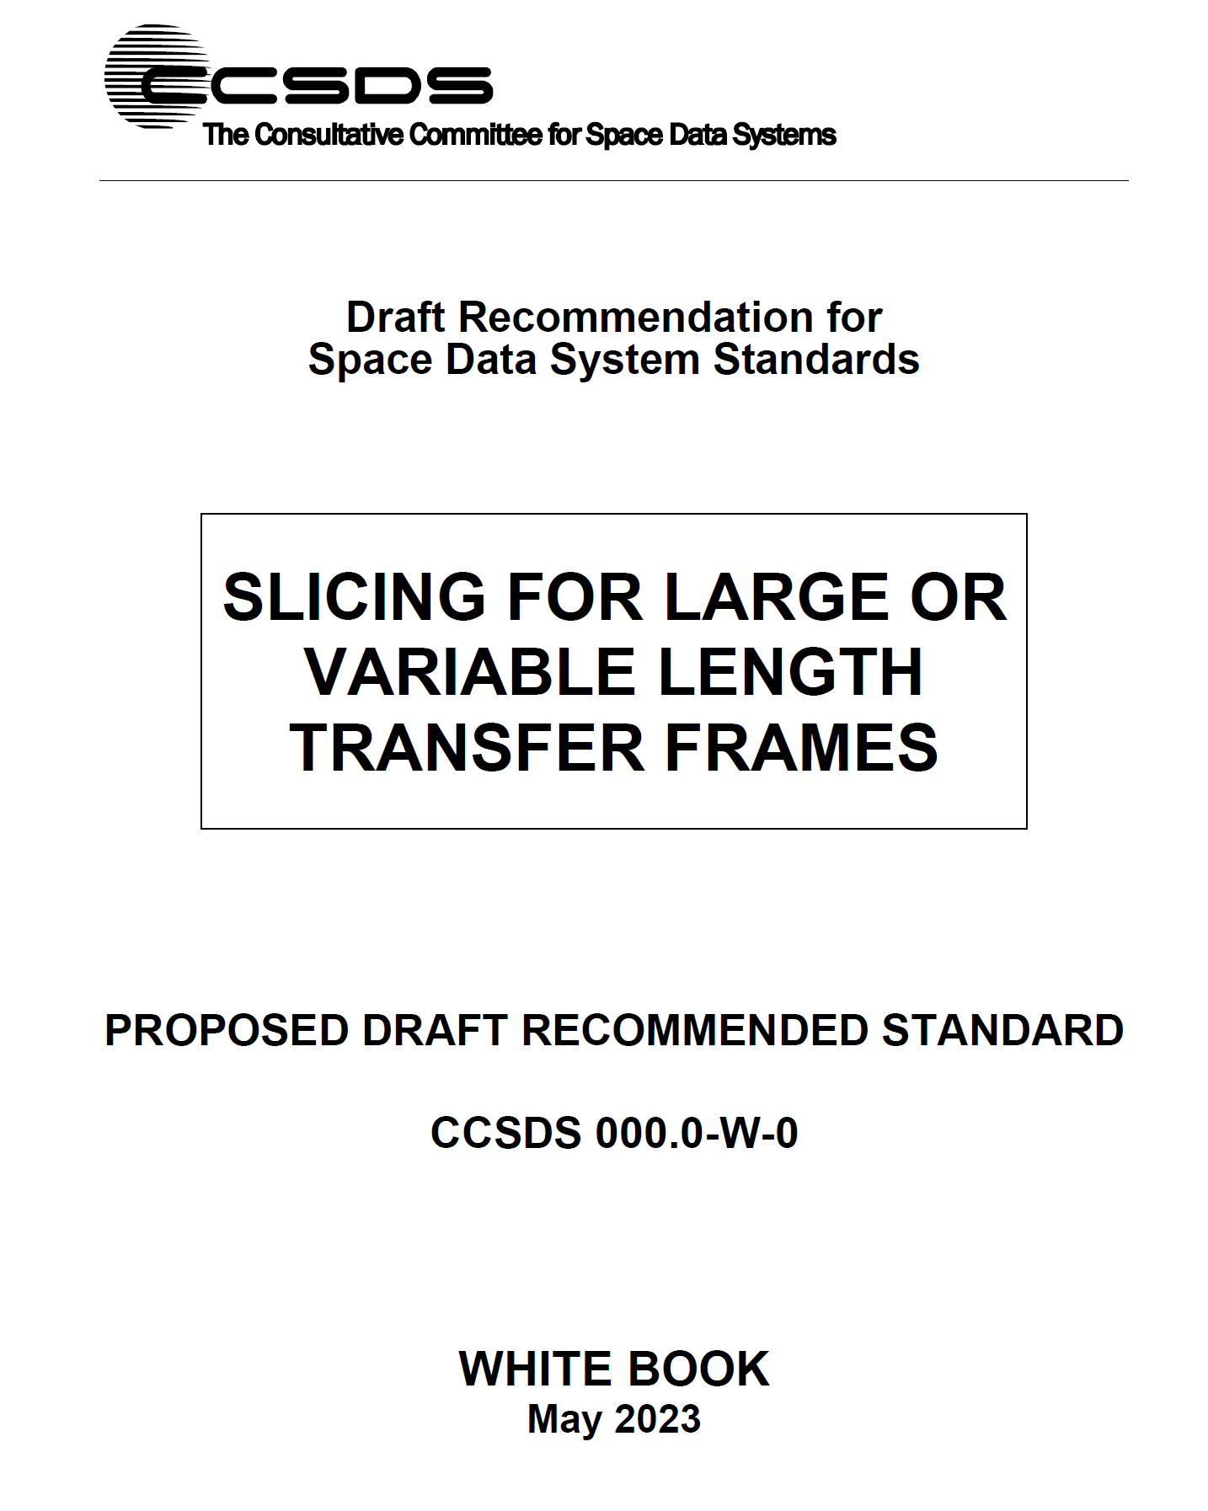
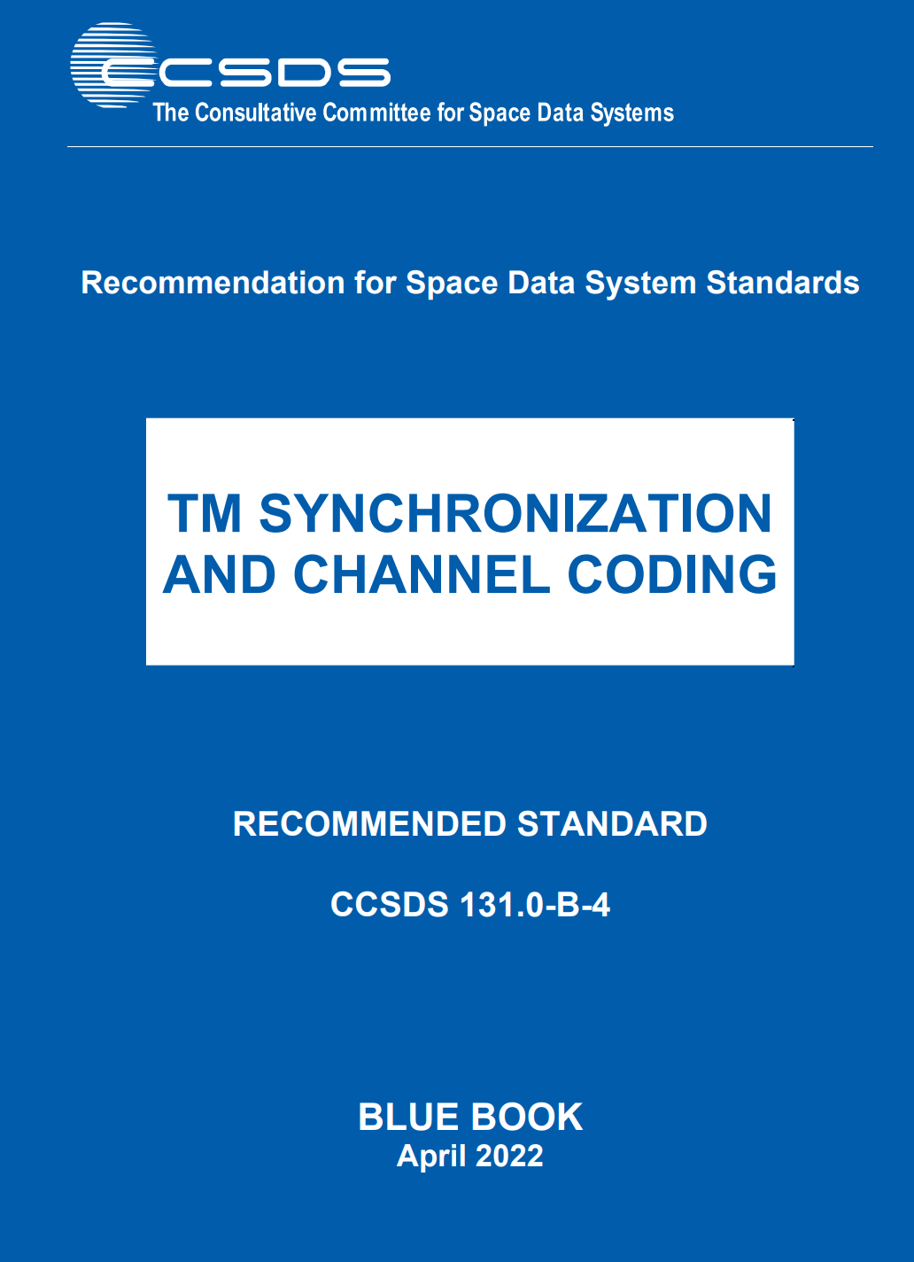
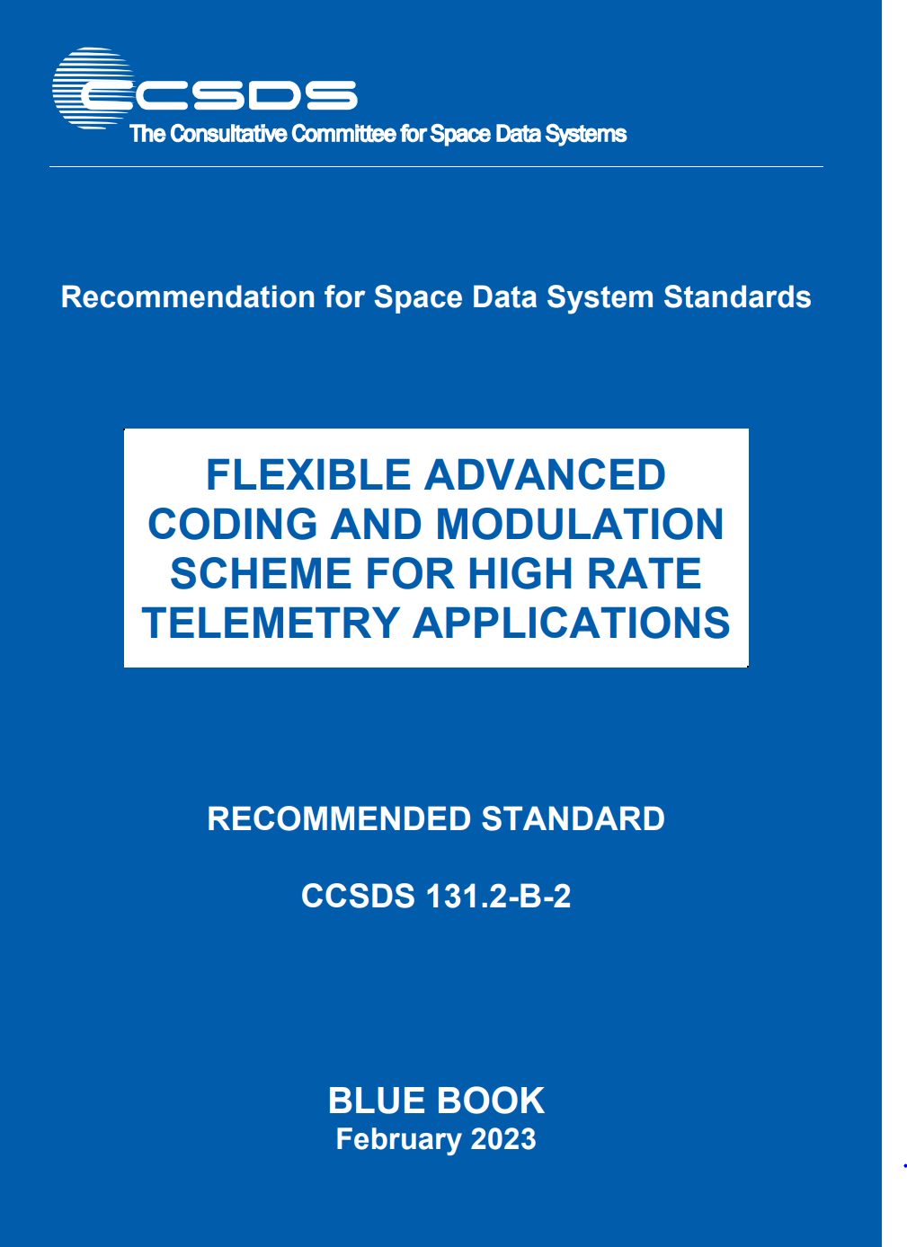

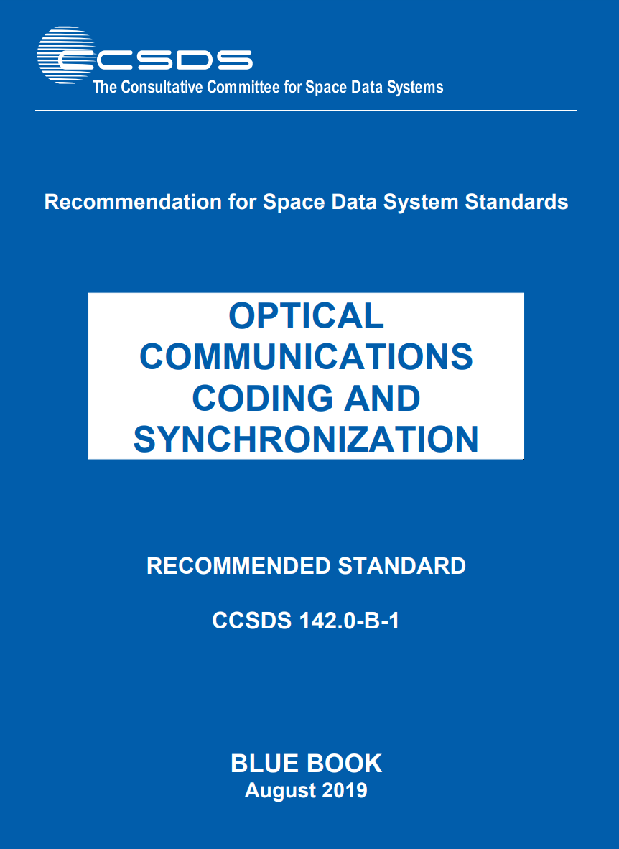

Slide 6
Observations
During the drafting of the Shim Book, the C&S had the following observations:
  Slicing cannot be an independent layer
    TF lengths depends on codeblock length when bypassed
    The presence of slicing requires that randomization is mandatory (for not confusing ASM with CSM)
  If slicing is described in its own book, makes the reading more difficult
    Slicing becomes just a reference in other blue books (no picture, description, etc.)
  Even with a shim book, changes in other standards could require to change the shim book
    E.g., introducing a new code could require an update of the shim book
  For GFP, it is required to
  replace/remove the ASM for avoiding
  useless overhead
DRAFT

Slide 7
Points of discussion / Way forward
Point # 1
the slicer can be implemented directly inside the TM coding & synch
This approach, does not change the technical solution (a single slicer is adopted in all blue books). Rather it is just a better organization of the standards
DRAFT

Slide 8
Points of discussion / Way forward
Point # 2
The slicer, for acting as an interface for GFP, requires to bypass the ASM (that is a change w.r.t. standards)
Hence, for providing such interface, seems it is required an Orange Book(?), with the following content:
  modified slicing (making it mandatory, w/o ASM)
  Reference to all four blue books (i.e., stating that remainder of coding & synch does not change)
Other ideas/points?
DRAFT

Slide 9
Notes/Agreements (end of meeting)
TO BE WRITTEN
DRAFT

