Slide 1
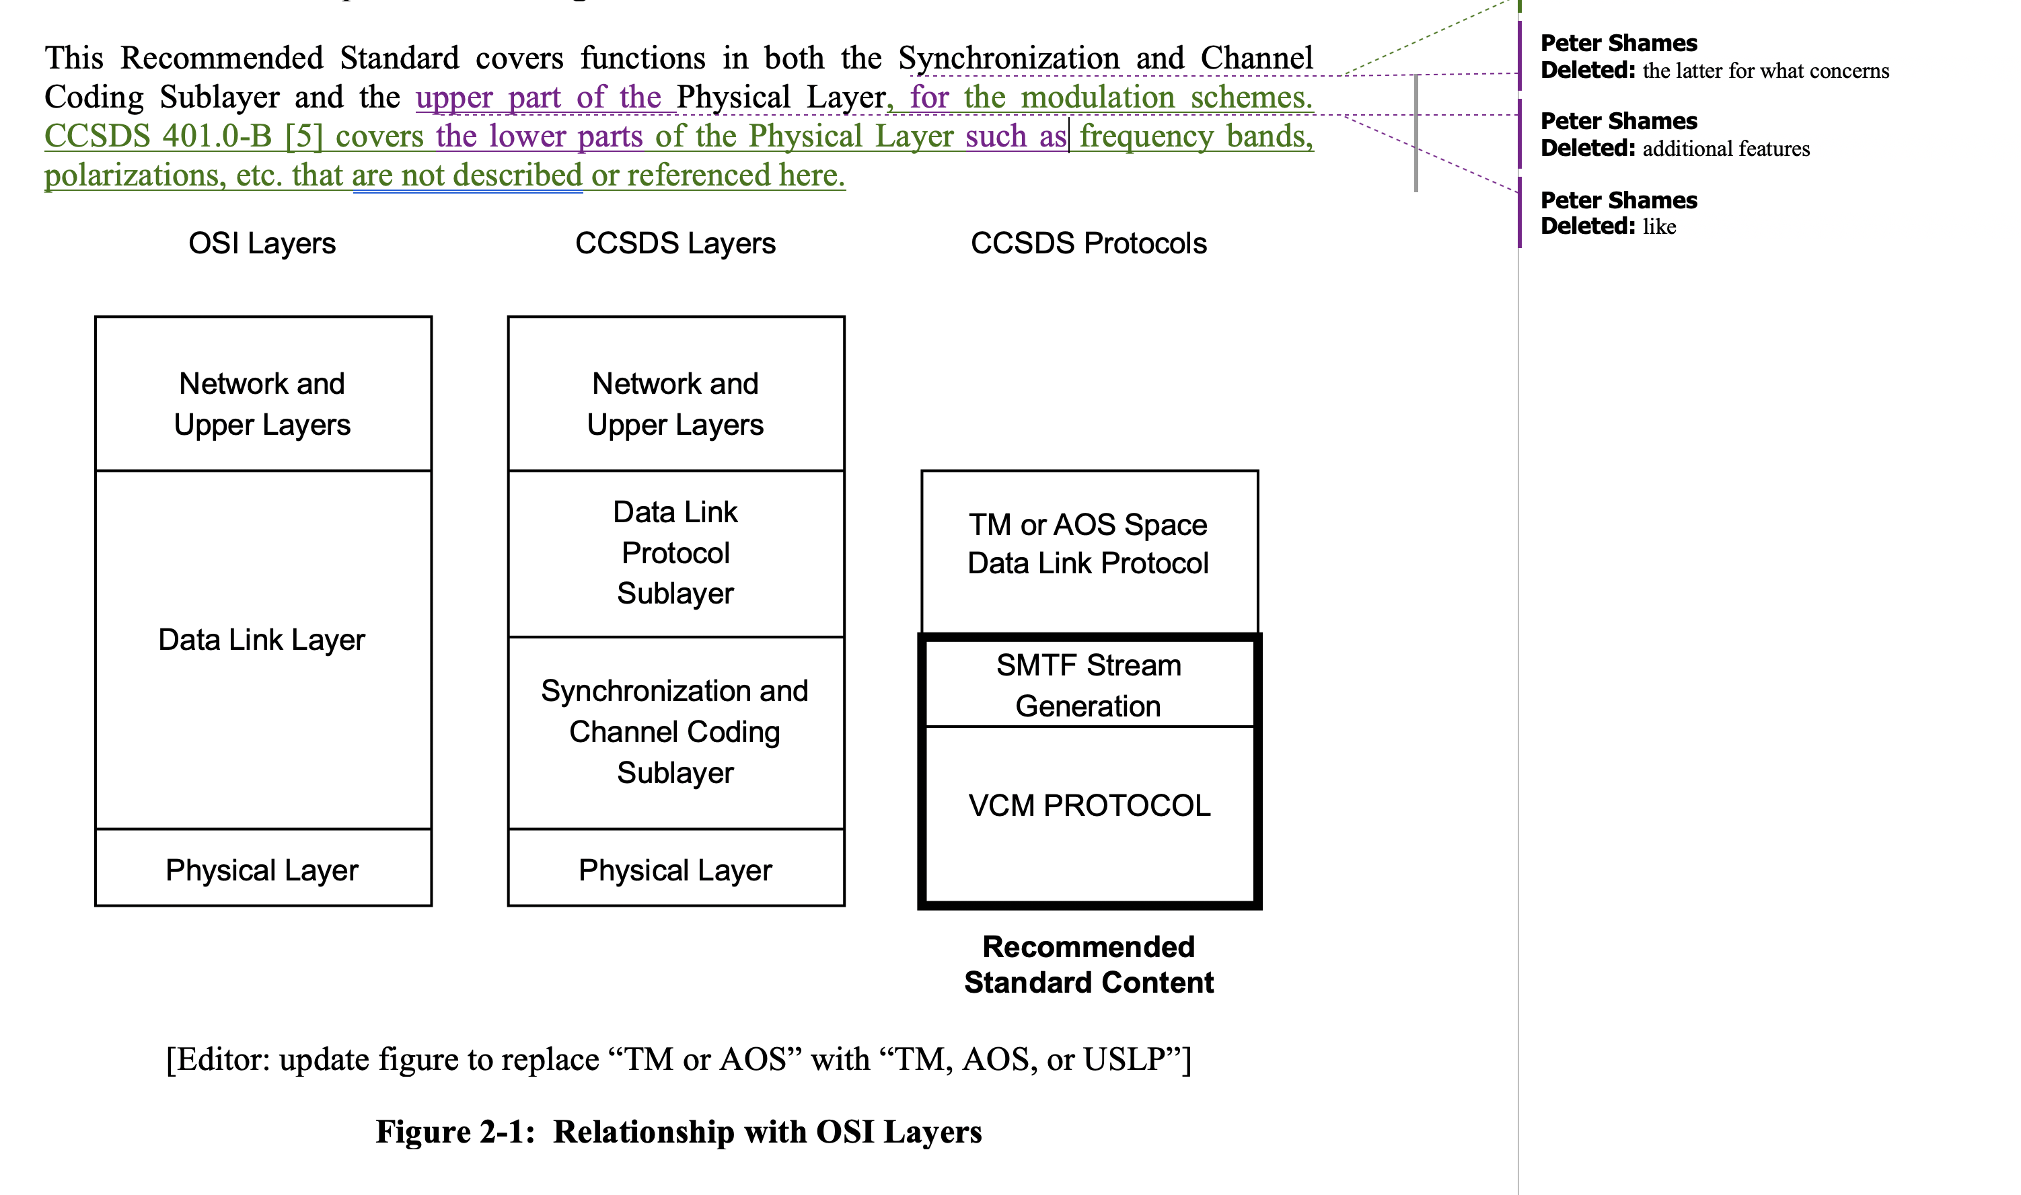
VCM Fig 2-1, proposed mods
My request is that you clearly distinguish, on this diagram and related ones in the other two “VCM Suite” specs, that only the upper (modulation) part of the physical layer is covered by these specs, but that the lower (RF or Optical) part of the Physical Layer is covered by the 401.1 and the 141.0 books.
In fact, I even question the inclusion of 141.0 optical comm physical layer since the optical comm coding specs, to my knowledge, are not included within the purview of the VCM suite.
Physical Layer

Slide 2
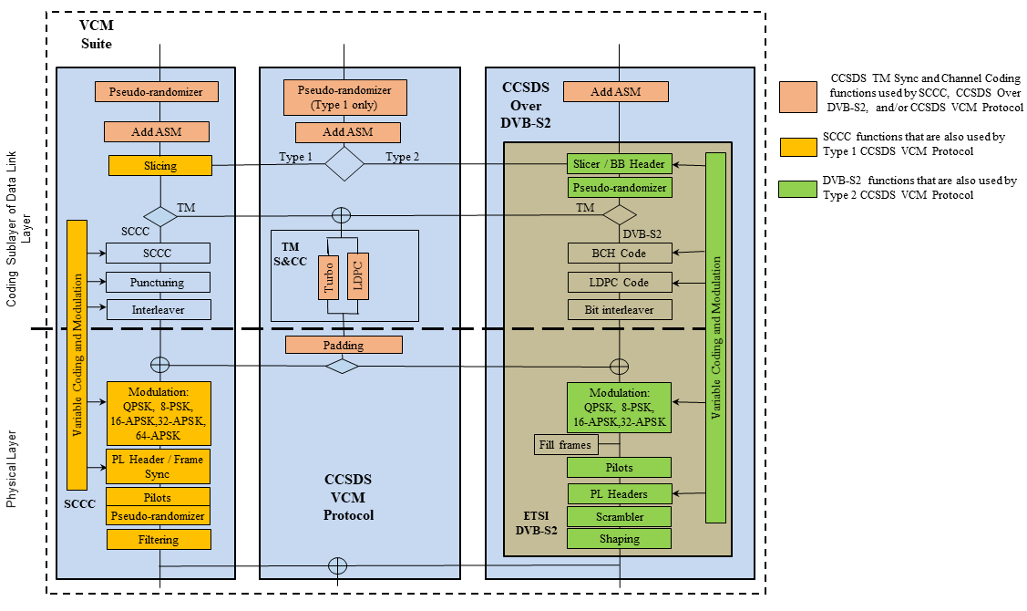
VCM Suite Details, Revised Diagram

Slide 3
All Stacks Diagram
Blue book
Space Packet Protocol
Encapsulation Packet Protocol
Mixed CCSDS/ non-CCSDS
Upper layers
Data Link Protocol Sublayer
TC Space Data Link Protocol
TM Space Data Link Protocol
AOS Space Data Link Protocol
Prox-1 Space Link Protocol — Data Link Layer
Unified Space Data Link Protocol
Synchronization and Channel Coding Sublayer
TC Sync and Channel Coding
TM Sync and Channel Coding
VCM Suite
Prox-1 Space Link Protocol — Coding and Sync Sublayer
Optical Communications Coding and Synchronization
Physical Layer
RF and Modulation
Prox-1 Space Link Protocol — Physical Layer
Optical Communications Physical Layer
Uplink
Downlink / Uplink
Downlink / Uplink
Proximity link
Optical link

