Slide 1
RIDs responses for DVB-S2 Blue BOOK
07/07/2021
Marie VIALARD CNES

Slide 2
New version fo DVB-S2 Blue book
RIDs responses for DVB-S2 Blue BOOK
Last version of blue Book taking into account most of the RIDs
131x3-update_v5.doc

Slide 3
RID TITLE: Add reference to 401.0-B ESA-EV-01
RIDs responses for DVB-S2 Blue BOOK
PAGE NUMBER: 1-1 PARAGRAPH NUMBER: 1.2 PURPOSE
FROM: The purpose of this document is to define a recommended interface between CCSDS Space Link Protocols (references [3], [4], and [7]) and the DVB-S2 telecom standard (reference [1]), and to recommend options of the DVB-S2 standard suited to high data rate transmission applications, such as Earth Exploration Satellite Services (EESS) payload telemetry and ground-to-space and space-to-space applications (Space Research Services [SRS], inter-satellite links).
TO: … Services (EESS) payload telemetry and ground-to-space and space-to-space applications (Space Research Services [SRS], inter-satellite links), as long as compliance to CCSDS recommendations for Radio Frequency modulations in [401.0-B] is ensured.
Enrico Vassallo

Slide 4
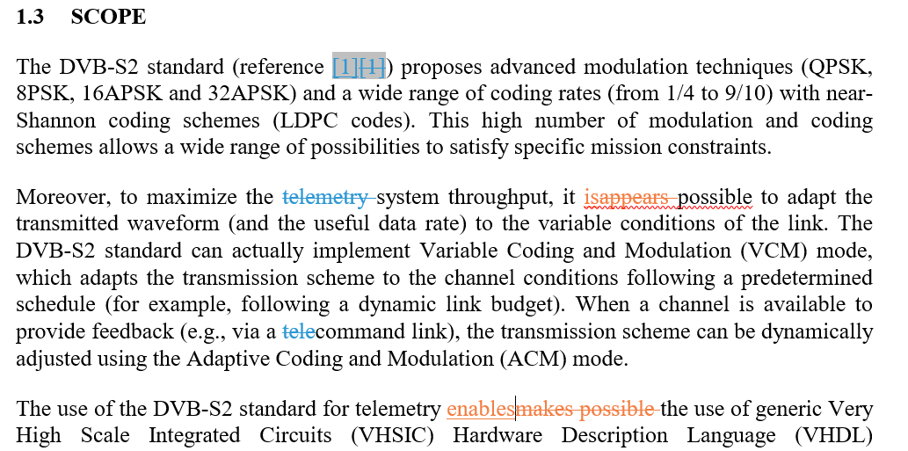
RID TITLE: ESA-FF-01
RIDs responses for DVB-S2 Blue BOOK
PAGE NUMBER: 1-1 PARAGRAPH NUMBER: 1.3
Delete 2nd and 3rd paragraph in Section 1.3 (text from "Moreover, to maximize …" to "… could be reused. ").
OR (if not deleted which is my preferred option) :
Move these two paragraphs to the background section 1.1 and apply the following changes.
From : Moreover, to maximize the telemetry system throughput, it appears possible to adapt the transmitted waveform (and the useful data rate) to the variable conditions of the link.
To :Moreover, to maximize the telemetry system throughput, it is possible to adapt the transmitted waveform (and the useful data rate) to the variable conditions of the link.
From :The use of the DVB-S2 standard for telemetry makes possible the use of generic Very High Scale Integrated Circuits (VHSIC) Hardware Description Language (VHDL) Intellectual Property (IP) modules for developments.
To : The use of the DVB-S2 standard for telemetry enables the use of generic Very High Scale Integrated Circuits (VHSIC) Hardware Description Language (VHDL) Intellectual Property (IP) modules for developments.
FELIX FLENTGE

Slide 5
RID TITLE: Add reference [X]=401.0-B ESA-EV-02
RIDs responses for DVB-S2 Blue BOOK
PAGE NUMBER: 1-6 PARAGRAPH NUMBER: 1.9 REFERENCE DOCUMENTS
Add Reference to 401.0-B in section 1.9 REFERENCE DOCUMENTS.
Enrico Vassallo

Slide 6
RID TITLE: ESA-AM-02
RIDs responses for DVB-S2 Blue BOOK
PARAGRAPH NUMBER: Section 2
From :This Recommended Standard covers the functions of both the Synchronization and Channel Coding Sublayer and the Physical Layer.
To :This Recommended Standard covers the functions of both the Synchronization and Channel Coding Sublayer and the Physical Layer, the latter for what concerns the modulation schemes. CCSDS 401.0-B [REF] covers additional features of the Physical Layer like frequency bands, polarizations, etc. that are not described or referenced here.
A. Modenini

Slide 7
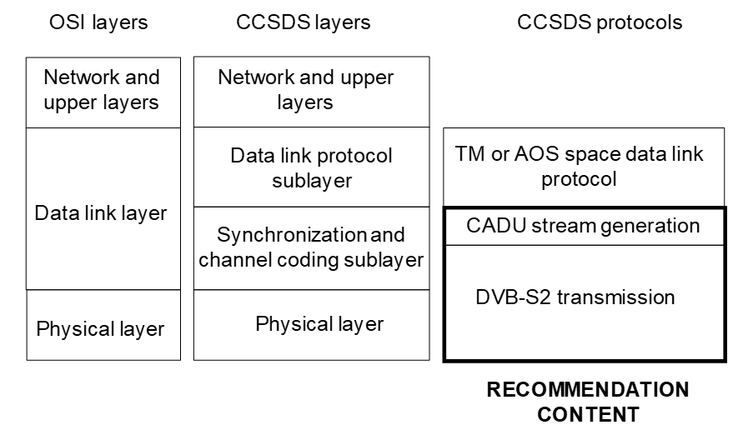
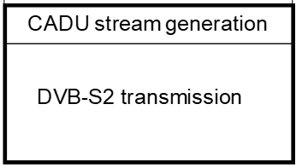
RID TITLE: Scope of the Recommended Standard does not cover all of Physical Layer JPL-Pietras-1
RIDs responses for DVB-S2 Blue BOOK
PAGE NUMBER: 2-1 PARAGRAPH NUMBER: Figure 2-1
Change Figure 2-1 so that the scope of the thick-bordered box (RECOMMENDED STANDARD CONTENT) extends only partially into the area corresponding to the CCSDS Physical Layer but not to the bottom of the Physical Layer, and insert a regular-thickness-lined box labelled +IBw-Radio Frequency and Modulation Systems+IB0- beneath it.
John Pietras
Radio Frequency and Modulation Systems

Slide 8
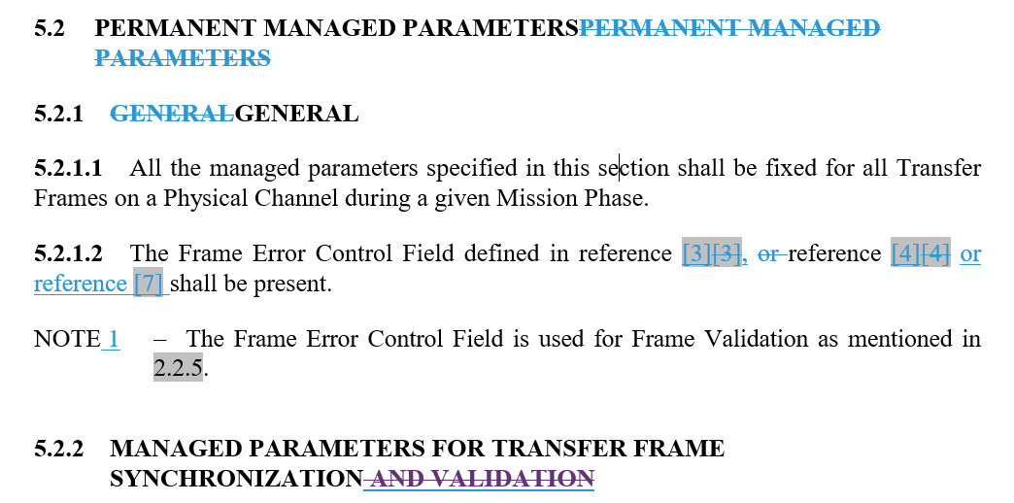
RID TITLE: USLP deleting CRC-32 SLS-AD-01
RIDs responses for DVB-S2 Blue BOOK
PAGE NUMBER: 5-1 PARAGRAPH NUMBER: Note 2 to 5.2.1.2
If CRC-32 removal is approved by SLP WG, delete (or reword) this NOTE
Gian Paolo Calzolari

Slide 9
RID TITLE: USLP deleting CRC-32 SLS-AD-02
RIDs responses for DVB-S2 Blue BOOK
PAGE NUMBER: 5-2 PARAGRAPH NUMBER: 5.2.2 & Table 5-1
If CRC-32 removal is approved by SLP WG,
Remove “and Validation” from title of section 5.2.2
Remove “and Validation” from text inside section 5.2.2
Remove “and Validation” from title of Table 5-1
Remove row CRC Procedure from Table 5-1
Gian Paolo Calzolari

Slide 10
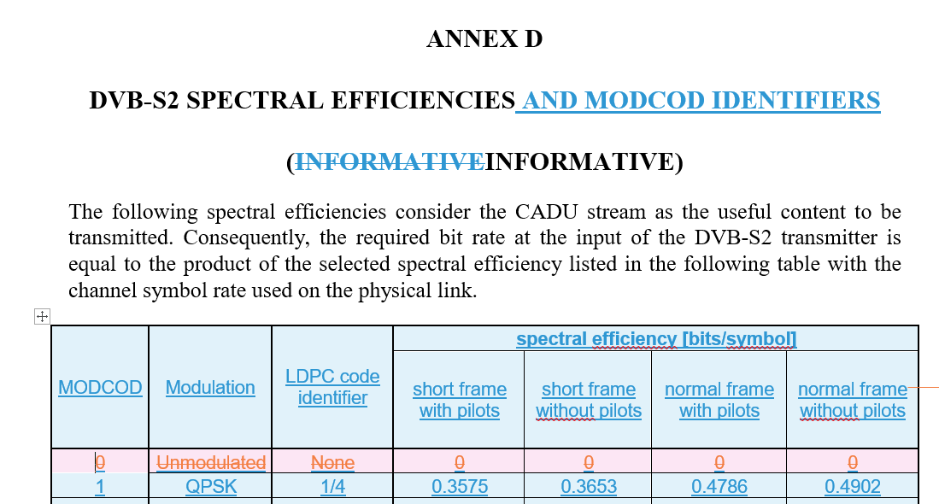
RID TITLE: ESA-AM-01
RIDs responses for DVB-S2 Blue BOOK
PARAGRAPH NUMBER: Annex D
Remove the entry "Unmodulated"
A. Modenini

Slide 11
RID TITLE: applications such as EESS and SRS
RIDs responses for DVB-S2 Blue BOOK
PAGE NUMBER: 1-2 PARAGRAPH NUMBER: 1-4
From:
"This Recommended Standard applies to the creation of Agency standards and to data communications over space links between CCSDS Agencies in cross-support situations for near EESS and SRS."
To:
"This Recommended Standard applies to the creation of Agency standards and to data communications over space links between CCSDS Agencies in cross-support situations for applications such as EESS and SRS."
David Ni

Slide 12
RID TITLE: applications such as EESS and SRS
RIDs responses for DVB-S2 Blue BOOK
PAGE NUMBER: 5-1,5-2 PARAGRAPH NUMBER: 5.2.1.2, 5.2.2
​In §5.2.1.2, delete NOTE 2.
​In §5.2.2 Table 5-1, delete the words "or CRC-32".
Craig Biggerstaff

