Slide 1
CESG Fall 2016
MEETING STATISTICS

Slide 2
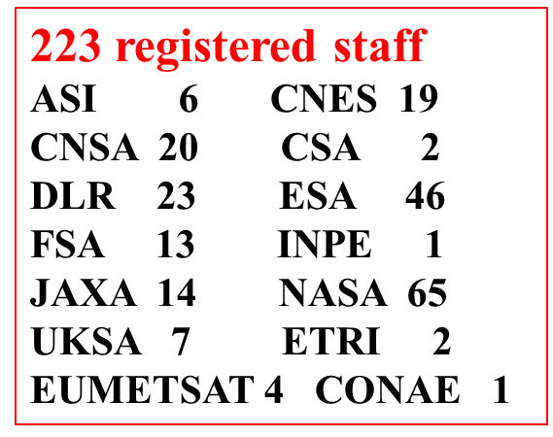
CCSDS Spring 2016 statistics

Slide 3
  Fall 2016 Total Attendance
Notes:
3

Slide 4
Fall 2016 Attendance By Sponsoring Agency

Slide 5
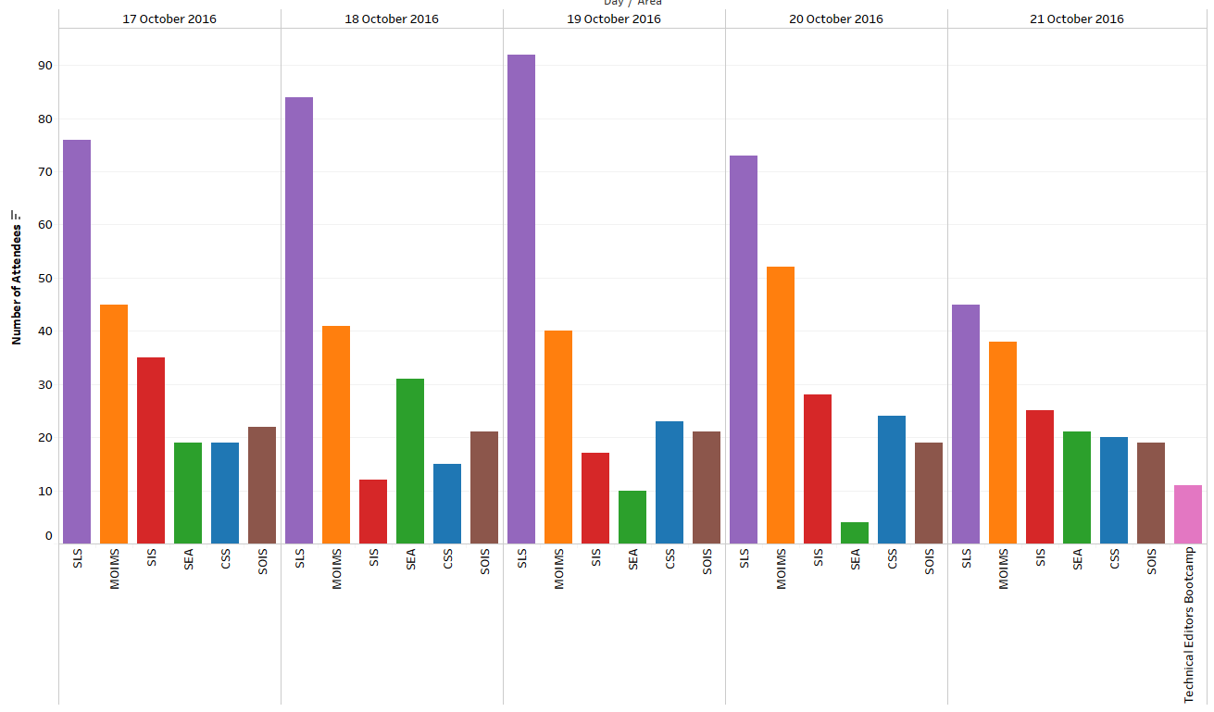
Fall 2016 Daily Attendance By Area

Slide 6
Fall 2016 Daily Room Utilization

Slide 7
Fall 2016 WG Statistics

Slide 8
CCSDS F2016 – Some issues with Registration
CESG recommended actions to be placed upon Secretariat
  Secretariat to produce a list of no show-ups to identify if anybody registered only for webex
  Secretariat to enable the option “only webex” when registering
  Secretariat to make it easier the de-registration

Slide 9
CESG Fall 2016:
items brought to attention
of the CMC

Slide 10
CESG – Poll Conditions
Discussion of CESG and AD responsibilities
  CESG reaffirms the spirit of the Proc & Org YB related to the AD responsibilities.
Scope of conditions prior to Publication (including AD/DAD participation in Agency Reviews)
  CESG suggests that AD/DAD minimize their conditions at time of CESG book publication polls. CESG members have the opportunity to raise technical issues prior / during Agency Review(s)
Are conditions un-rejectable by definition for all CESG Polls?
  Conditions are not rejectable according to the YB, which contemplates a negotiation instance and possibly escalation if negotiation fails.
  CESG recommends to raise PIDs (Poll Item Discrepancy) at least for showstopper conditions during polls and identify conditions that are non showstopper as such.

Slide 11
CESG – Other Issues
Non CCSDS Members / Observers / spomsor subscription to mailing list
  There is no clear rule to manage this type of subscriptions.
  CESG requests CMC to give the CESG the required criteria to approve subscriptions.
DAI WG on long term data preservation
John Garrett as DAI WG Deputy Chair
Support to MOIMS Telerobotics WG
Support to SOIS WIR HDR future work (ISS, Launchers, AIT, cislunar, exploration)

Slide 12
CESG – Issues not addressed
RID Requirements
  Feedback received from SM&C WG, SLS and SOIS. CESG Chair will produce a new consolidated version of the document.
Overlap with OMG SDTF
  It will be discussed during the next CESG webex (Dec 2016)
CSS Functional Resource Model Presentation
  It will be presented during the next CESG webex (Dec 2016)
Interoperability YB for cloud based tests
  It will be discussed during the next CESG webex (Dec 2016)

Slide 13
CESG Spring 2016:
IOAG Presentation and ICPA Update

Slide 14
IOAG Draft Documents
Approved IOAG Service Catalogue 1
  IOAG has agreed that the SC#1 WG will deal with the new file services, the SM functions and the radiometric service.
ICPA
  CCSDS shall not take any action on the ICPA wrt previous bullet.
  Radiometric Service: CSS will not produce any future Project on validated Radiometric Data because it is not clear what it does mean. CSS has no the right expertise.
  Monitored Data: Final publication date is July 2017
  Existing file services ghost projects shall be deleted.
  CFDP publication date to be updated. End 2018.

Slide 15
IOAG Draft Documents
IOAG Draft Service Catalogue 3
  CESG raised comments on IOAG MOSSG Draft Report and Sc#3
  As it will take more than 1 year to receive an approved IOAG SC#3, MOIMS SM&C will continue with its Workplan from the priorities, resources and schedule point of view.
  No ICPA update planned
IOAG Update SC#2
  CESG is expecting an approved update of SC#2 by Q2 2017
  No ICPA update planned

Slide 16
CESG Spring 2016:
Resources status

Slide 17
CESG Area Chair / Deputy Chair Overview

Slide 18
CESG WG Chair / Deputy Chair Overview

Slide 19
RESOURCES

Slide 20
RESOURCES

Slide 21
Approved Projects Missing P2 Resources
We were missing 7 (originally there were 12)
We are only missing two P2 resources
Notes:
21

Slide 22
Approved Projects Resource Issues
Area and WG Name | CCSDS Ref # | Activity (RB, Pink, Draft, Update) | Document Title | Status | Start and / or Target Publication Date | Comments
SIS-CFDPv1 | CCSDS 727.0-B-5 | Red Book | CCSDS File Delivery Protocol (CFDP). | Problem; Delayed | Start: 9/13/2013 End: 12/31/2016 | Agency review complete and all RIDs addressed
Area and WG Name | CCSDS Ref Nr | Activity | Document Title | Target Publication Date | Missing Resources | Comments
SOIS-APP | 870.1 | GB | Electronic Data Sheets and Common Dictionary of Terms - Overview and Rationale | 01-Oct-2017 | 1 WM 2017 | Additional funding required for NASA book editor
SOIS-APP | 876.0 | BB | XML Specification for Electronic Data Sheets for Onboard Devices and Software Components | 15-Jun-2018 | 4 WM 2018 | Need commitment from ESA for completion of prototype effort

Slide 23
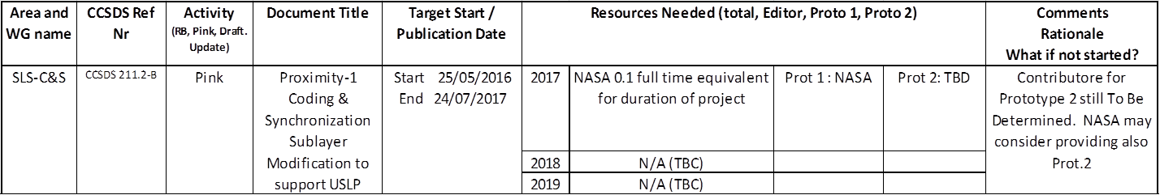
NWI – Projects to be submitted for approval in next 6 months
Area and WG name | CCSDS Ref No. | Activity | Document Title | Target Start/ Publication date | Resources Needed (total, Editor, Proto1, Proto 2) |  |  |  | Comments, Rationale. What if not started?
MOIMS DAI |  | GB | Digital Archive Architecture Description Document | Start 2017 Publication 2020 | 2017 2018 2019 | 4 WM for GB 4 WM for GB 2 WM for GB | 0 WM | 0 WM
MOIMS MP&S |  | BB | Mission Planning and Scheduling BB | Start 2017 Publication 2019 | 2017 2018 2019 | 3 WM 3 WM | 3 WM | 3 WM | ESA will provide editor. DLR confirmed Proto 1.
MOIMS SM&C | 520.0 | GB (5y revision) | Mission Operations Services Concept | Start Mar 2017 Publication Dec 2017 | 2017 | 1 WM |  |  | No prototypes required, full WG participating, ESA has expressed willingness to lead.

Slide 24
NWI – Projects to be submitted for approval in next 6 months
Area and WG name | CCSDS Ref Nr | Activity | Document Title | Target Start / Publication Date | Resources Needed (Total, Editor, Proto 1, Proto 2) |  |  |  | Comments Rationale What if not started?
SOIS-APP | 850.0 | GB | Spacecraft Onboard Interface Services | Start: 15-Nov-2016 End: 01-Oct-2017 | 2017 | 4 WMs | N/A | N/A | Update with new architecture views and user's guide content. This effort replaces the Spacecraft Onboard Interfaces Services User’s Guide effort
Area and WG name | CCSDS Ref Nr | Activity (RB, Pink, Draft. Update) | Document Title | Target Start / Publication Date | Resources Needed (total, Editor, Proto 1, Proto 2) |  |  |  | Comments Rationale What if not started?
SEA SEC | None | BB | CCSDS Authentication Credentials | Start 20/11/2016 End 10/12/2018 | 2017 | 6 WMs for BB | 3 WMs Prot 1 | 3 WMs Prot 2 | Poll just requested to approve project.
 |  |  |  |  | 2018 | 6 WMs for BB | 3 WMs Prot 1 | 3 WMs Prot 2
 |  |  |  |  | 2019

Slide 25
NWI – Projects to be submitted for approval in next 6 months
Area and WG name | CCSDS Ref Nr | Activity | Document Title | Target Start / Publication Date | Resources Needed (total, Editor, Proto 1, Proto 2) |  |  |  | Comments Rationale What if not started?
CSS-CSTS | CCSDS 922.4-B-1 | BB | Forward Frame CSTS | Start 15/01/2017 End 10/07/2019 | 2017 | 4 WMs for RB/BB | 1 WMs Prot 1 (User) | 1 WMs Prot 2 (Provider) | Supports transition/bridging to DTN/SSI
 |  |  |  |  | 2018 | 2 WMs for RB/BB | 1 WM Prot 1 | 3 WMs Prot 2
 |  |  |  |  | 2019 | 2 WMs for BB | 1 WM Prot 1 | 2 WMs Prot 2
CSS-CSTS | CCSDS XXX.X-B-1 | BB | Service Control CSTS | Start 15/01/2017 End 07/05/2020 | 2017 | 1 WMs for RB/BB | N/A | N/A | Compliment to MD-CSTS; odd siutation of standardized monitoring without standardized control capaiblity --> higher recurring costs for inter-agency inter-operations;
 |  |  |  |  | 2018 | 4 WMs for RB/BB | N/A | N/A
 |  |  |  |  | 2019 | 2 WMs for RB/BB | 1 WMs Prot 1 (User) | 1 WMs Prot 2 (Provider)
 |  |  |  |  | 2020 | 2 WMs for BB | 1 WM Prot 1 | 3 WMs Prot 2
CSS-CSSM | CCSDS 902.4-B-2 | BB | Service Package Data Format | Start 15/01/ 2017 End 01/02/2020 | 2017 | 2 WMs for RB/BB | N/A | N/A | No standarized way to provide responses for service requests --> higher recurring costs ofr inter-agency inter-operations.
 |  |  |  |  | 2018 | 2 WMs for RB/BB | 1 WM Prot 1 (User) | 2 Wms Prot 2 (Provider)
 |  |  |  |  | 2019 | 2 WMs for BB | 2 WM Prot 1 | 3 WMs Prot 2

Slide 26
NWI – Projects to be submitted for approval in next 6 months – Total requested resources

Slide 27

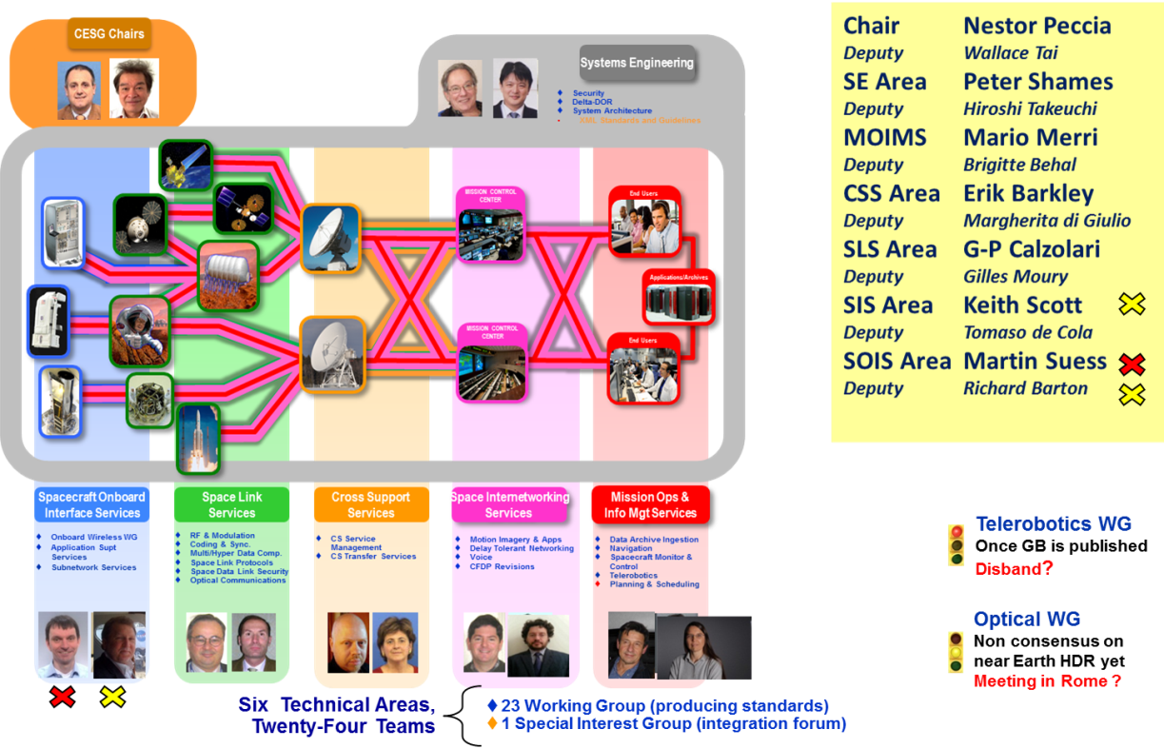


We’re done!
Many thanks to ASI for hosting the CCSDS Fall 2016 meetings!
Excellent organization, logistics and facilities

