Slide 1

DTN Network
Operations
DTN DNS-like Registry Discussion
5/26/2022
Leigh Torgerson
332 Protocol Technology Lab
DTN Core Team
Jet Propulsion Laboratory, California Institute of Technology
This document has been reviewed and determined not to contain export controlled technical data..
Notes:
Diagrams from InfusionPlanningOpsCon.curio, NM&CforDSNNetworkEval.curio - ~/Documents/Working Data/CurrentWork-LaptopSynch/ActiveProjects/DTN Readiness Program/DTN Program FY18/NASA_DTN_Infusion_planning/InfusionPlanningOpsCon.curio
Unlimited Release clearance number is CL#22-2946

Slide 2
Generalized Operations Flow to Create a DTN Network
Information
Process
Actors
DTNNS info could be populated from SANA registries, something run by SANA or run by Programs or Management authorities for a Region
The existence and mutability of this DB is key to future automation plans and DNAC.

Slide 3
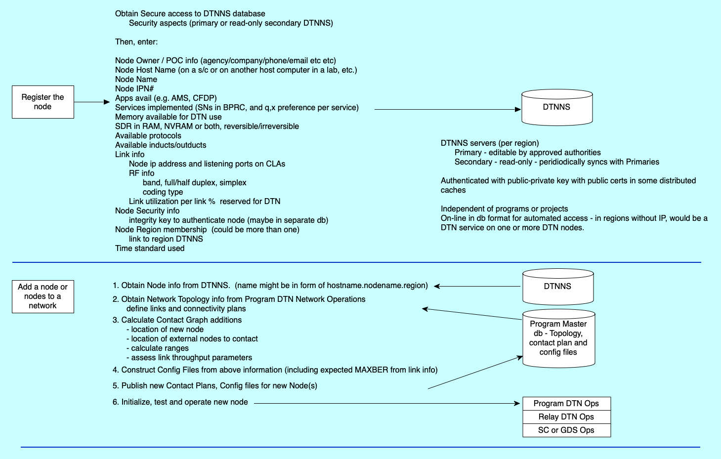
DETAILS – Registration to Initialization

Slide 4
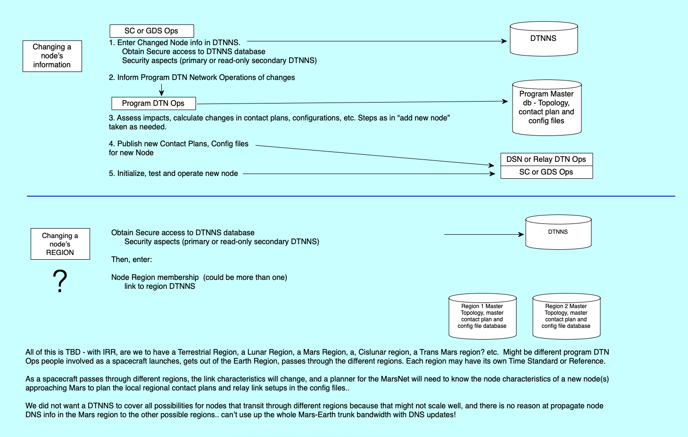
DETAILS – Changes to Node or Region

Slide 5
Notes / questions / comments after presentation
Ed Birrane
  What ”state info” is critical to the network architecture?
Vint
  Internet – routers/gateways versus nodes
  Who-is hairball – up to programs only, not in a public DTN DNS system?
Oscar
  Question about NAT’d networks – (has been suggested by IETF as the main way to do DTN addressing)
  Database thoughts – SQLlite easy to replicate and XML to sync / transfer data between dbs.
Keith
  How to measure available resources for a router/relay? What do we do with that knowledge?
  Synchronization in a disrupted/delayed network is hard, should be simplified
  Inter-node connectivity (NASA/ESA/JAXA all mixed in same network)
  A way to correlate node name to horrible CBHE numbers
Scott
  DTN NS can be just program-managed only. Scott doesn’t like a DTNNS for the entire SSI.
  Prefers distributed management; lots of little local networks coordinating among themselves to expand the network.
    (Leigh would refer again to slide one where it notes that “DTNNS info could be populated from SANA registries, something run by SANA or run by Programs or Management authorities for a Region -- The existence and mutability of this DB is key to future automation plans and DNAC.”)
Ed
  Decentralization is key – domain or regional administration considerations need to be debated.
Dave
  Luna Net is planning dedicated relay-only orbiters
  Need some example topologies / network architectures to explore
Kaneko
  From a governance standpoint, global systems should minimize what needs to be managed

