Slide 1
Space Communications Cross Support – Architecture Definition Document (SCCS-ARD) 5-Year Refresh
SEA SAWG
23 June 2021
Peter Shames/ JPL
John Pietras/ Global Science and Technology, Inc.

Slide 2
Briefing Outline
Background
Range of SCCS-ARD update topics
Progress to-date
Next steps

Slide 3
Background
CMC asked for a “reference architecture” for CCSDS showing how all of the existing and planned standards fit together
The Space Communication Cross Support Architecture (SCCS ADD/ARD) already covers physical to networking layers and systems engineering (SIS, SLS, CSS, SEA).
The “missing link” in CCSDS architecture documents is covered by the Application and Support Layer Architecture (MOIMS, SOIS).
SEA SA WG has developed the ASL as a companion to the SCCS ARD/ADD.
The SCCS ARD and ADD are due for refresh
The SCCS ARD, CCSDS 901.1-M-1, was published in May 2015.
The SCCS ADD, CCSDS 901.0-G-1, was published in Nov 2013.
CCSDS has published many new standards in the interim, in SLS (optical, USLP , coding & modulation), SIS (DTN), CSS (CSTS & SM), and SEA (Security & D-DOR).
In order to have a complete, and up to date, CCSDS Reference Architecture these documents must be updated.
Approach: update the ARD first, then update the ADD

Slide 4
Range of SCCS-ARD Update Topics
Current Issues of already-cited Recommended Standards (many)
[Future] > Current: books that have now been published
SLS (coding, modulation, other changes to SPP)
SIS (DTN, routing, management, security)
CSS (new CSTS & SM)
SEA (security, key management & D-DOR, SANA & RMP)
[Future] > Current: books expected to be published by December 2021 (TBR)
Updates to referenced [Future] documents (that are still [Future])
E.g., SC-CSTS
Replacement of the deprecated Space Communication Cross Support Service Management Recommended Standard (CCSDS 910.11-B-1)
Newly added (since Issue-1) published Recommended Standards
Optical Communications
USLP
Digital Motion Imagery (CCSDS 766.1-B-1)
Voice and Audio Communications (CCSDS 766.2-B-1)
Other new [Future] topics
E.g., Time Management, SOIS WiFi & LTE
CSS Functional Resource Model (FRM)
Are there others???

Slide 5
Progress to-date (1 of 2)
Updated the referenced Recommended Standards (and other references) to their current Issues
72 normative references
35 informative references
Focus so far has been primarily on the ABA (space data link-layer) configuration, with a bit of work on SSI/ABCBA configuration
Definitions have been tightened up regarding relationships among ABA and ABCBA configurations and to “top” protocol layers that are cross-supported (space data link layer vs. SSI)
Contents of sections 4 (Service View), 5 (Physical View), and 6 (Communications View) re-organized to reduce complexity, increase clarity, and minimize redundancy
Detailed protocol combinations/options are now concentrated in tables in section 6
Requirements in sections 4 and 5 now reference relevant parts of section 6
Examples on following pages …

Slide 6
Progress to-date (2 of 2)
Variable-coded modulation standards integrated into the cross support architecture
Worked with SLS C&S experts
Updated ABA ESLT protocol stack diagrams from section 6
Issue – CFDP Forward File and CFDP Return File services
Discussions re ESA desired changes for split mode responses, which are in no way standardized

Slide 7
Issues with Complexity, Clarity, and Redundancy (1 of 3)
Section 4 requirements in version 1 ARD identify the specific protocols that are to be performed for each service
For services that involve multiple protocols, each requirement is a complex statement
As new CCSDS protocols have been added to the ARD, multiple combinations of protocols become available to provide the same “service”
Some combinations are preferable to others, from the perspective of future capability and flexibility
Most of the service-to-protocol information is addressed in section 6 in table form
Repeating the same service-to-protocol information in section 4 is redundant at best and would be increasingly difficult to keep synchronized across the various sections of the book

Slide 8
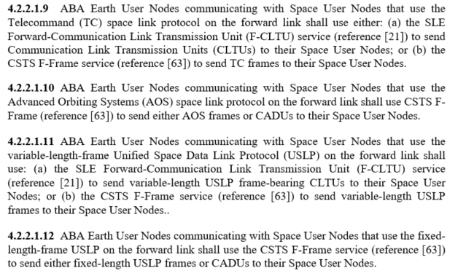
Issues with Complexity, Clarity, and Redundancy (2 of 3)
Example of new requirements in version-1 “style” (identification of all protocols)

Slide 9
Issues with Complexity, Clarity, and Redundancy (3 of 3)
Representing the equivalent requirements using the updated ARD approach

Slide 10
Consolidating Protocol Requirements into Section 6 (1 of 2)
ARD section 6 tables in version 1
Table 6-1: Referenced Communications Protocols
Table 6-2: Referenced Cross Support Protocols
Table 6-3: Referenced Security Protocols
Table 6-4: Required and Optional ABA ESLT Terrestrial Side Protocols
Table 6-5: Required and Optional ABA ESLT Space Side Protocols
Tables 6-4 and 6-5 have been reorganized to accommodate additional space communications services, radiometric services, and multiple service management data entities Table 6-1: Referenced Communications Protocols
Table 6-4: Terrestrial Side Protocols for ABA ESLT Space Communications Services
Table 6-5: Terrestrial Side Protocols for ABA ESLT File-Oriented Space Communications Services
Table 6-6: Terrestrial Side Protocols for ABA ESLT Radiometric Data Services
Table 6-7: Information Entities and Terrestrial Side Protocols for ABA ESLT for Service Management
Table 6-8: Space Side Protocols for ABA ESLT Space Communications Services
Table 6-9: Space Side Protocols for ABA ESLT File-Oriented Space Communications Services
Table 6-10: Space Side Protocols for ABA ESLT Radiometric Data Services

Slide 11
Consolidating Protocol Requirements into Section 6 (2 of 2)
Tables use PICS Proforma-inspired optional and conditional designations to define permissible and recommended combinations
M: mandatory
N/A (or blank/empty): not applicable
O: optional
O<n>: optional, but support from at least one of the group of options labeled by the same numerical index <n> is required
R<n>: the recommended option of a group of options labeled by the same index <n> (if and as appropriate)*
C<m>: conditional as defined in corresponding expression below the table
N[<p>]: A note that contains additional information, qualification, or clarification
*Options that are identified, but that do not carry the “recommended”
label, still satisfy the requirement and may be implemented for
other reasons (such as compatibility with or ease of use for legacy users)

Slide 12
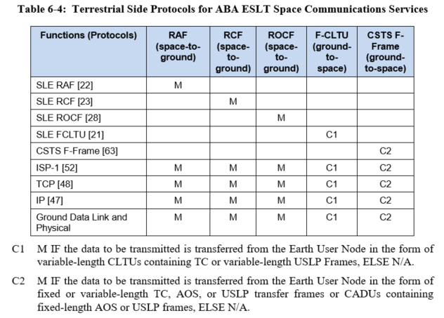
Table 6-4: Terrestrial Side Protocols ABA ESLT Space Communications Services

Slide 13
Table 6-5: Terrestrial Side Protocols for ABA ESLT File-Oriented Space Communications Services
The viability of the CFDP
Forward File and Return File
services is being explored

Slide 14
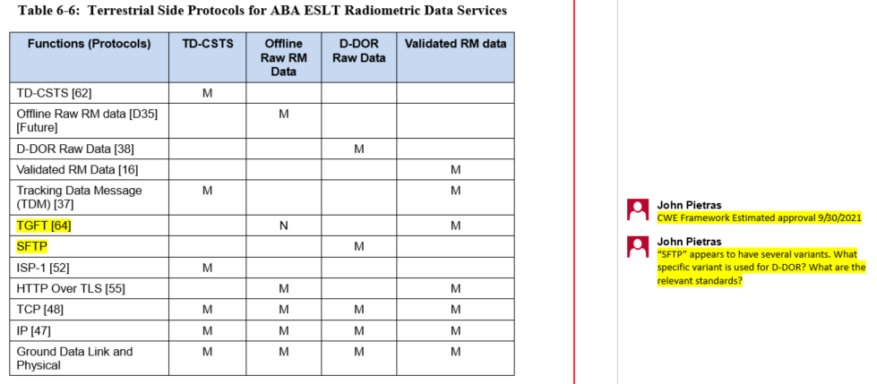
Table 6-6: Terrestrial Side Protocols for ABA ESLT Radiometric Data Services

Slide 15
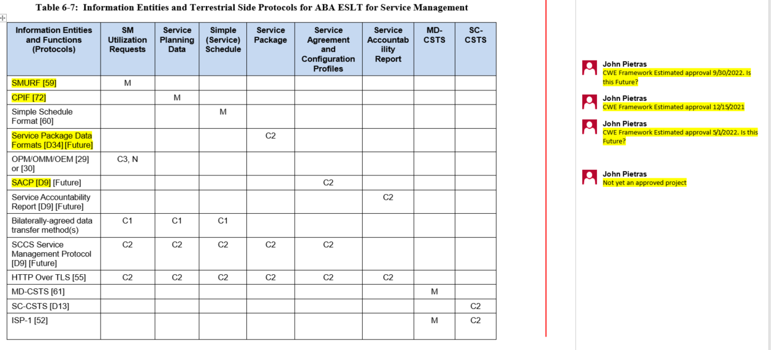
Table 6-7: Service Management Information Entities and Terrestrial Side Protocols for ABA ESLT (1 of 2)

Slide 16
Table 6-7: Service Management Information Entities and Terrestrial Side Protocols for ABA ESLT (2 of 2)

Slide 17
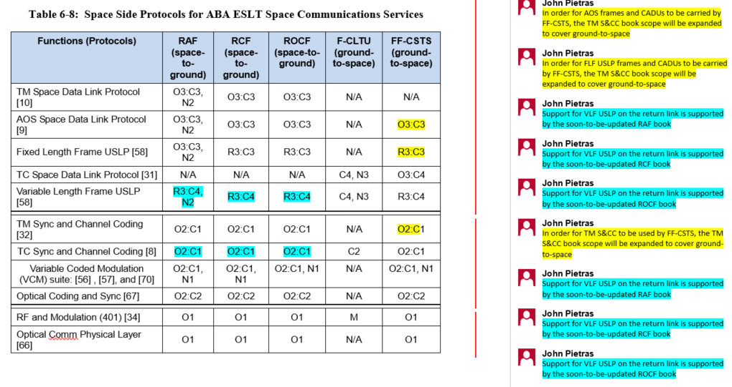
Table 6-8: Space Side Protocols for ABA ESLT Space Communications Services (1 of 2)

Slide 18
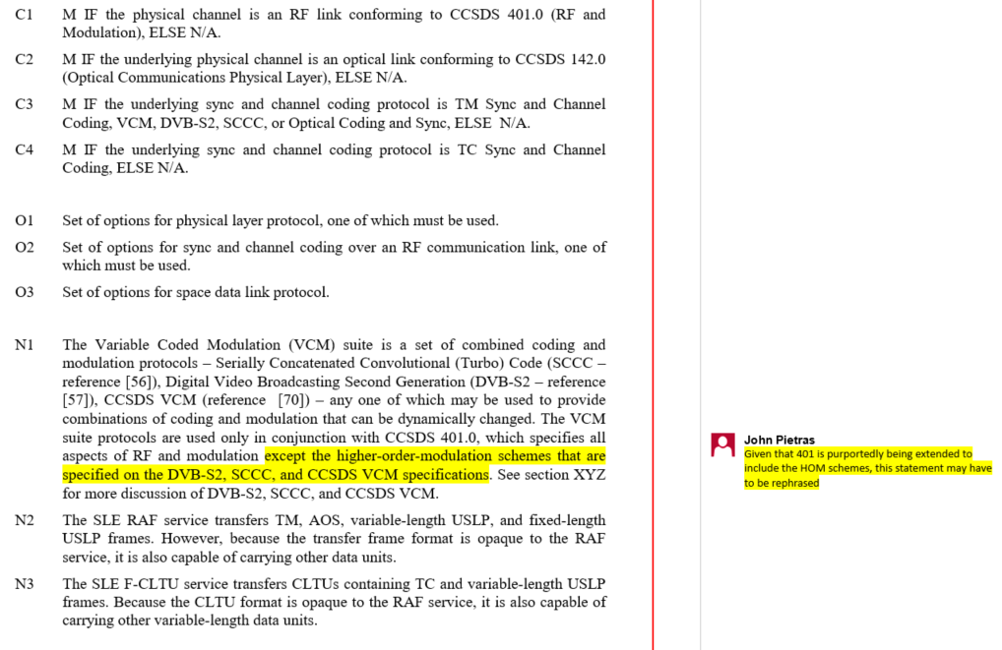
Table 6-8: Space Side Protocols for ABA ESLT Space Communications Services (2 of 2)

Slide 19
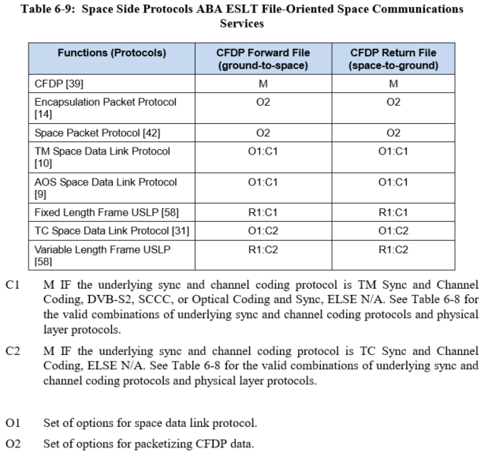
Table 6-9: Space Side Protocols for ABA ESLT File-Oriented Space Communications Services
The viability of the
CFDP Forward
File and Return File
services is being
explored

Slide 20
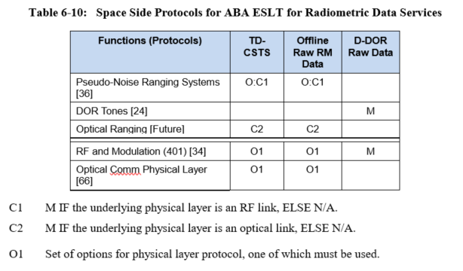
Table 6-10: Space Side Protocols for ABA ESLT Radiometric Data Services

Slide 21
Variable-Coded Modulation (1 of 2)
VCM allows for combinations of coding and modulation that can be dynamically altered to adjust for changes in propagation environment
CCSDS has 3 VCM standards
Flexible Advanced Coding and Modulation Scheme for High Rate Telemetry Applications (CCSDS 131.2-B-1, Match 2012)), commonly referred to as Serially Concatenated Convolutional (Turbo) Code (SCCC)
CCSDS Space Link Protocols over ETSI DVB-S2 Standard (CCSDS 131.3-B-1, March 2013)
Variable Coded Modulation Protocols (CCSDS 431.1-B-1, February 2021)
Combines SCCC and CCSDS over DVB-S2 and allows their modulation and signaling schemes to be used with CCSDS Turbo and LDPC codes

Slide 22
Variable-Coded Modulation (2 of 2)
The first issues of the 3 CCSDS VCM books imply that they specify (by reference) the full physical layer in addition to the sync and coding sublayer
Subsequent correspondence between the SEA-SAWG and SLS-C&S WG clarifies that these VCM books only specify the modulation schemes of the physical layer
CCSDS RF and Modulation (CCSDS 401.0) is still assumed to specify the other aspects of RF waveform generation and reception
The 3 CCSDS VCM books have Technical Corrigenda in-process that address this ambiguity

Slide 23
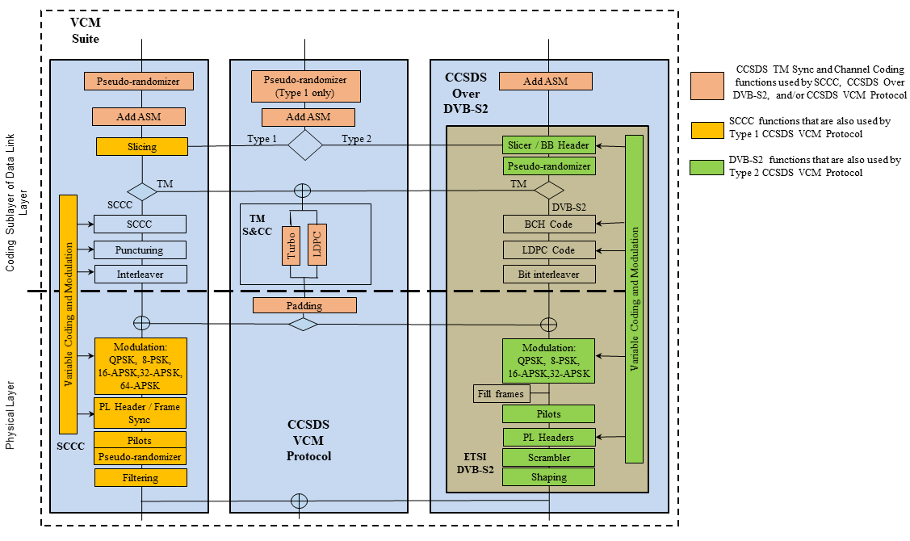
VCM Suite Details, Revised Diagram

Slide 24
All Stacks Diagram
Blue book
Space Packet Protocol
Encapsulation Packet Protocol
Mixed CCSDS/ non-CCSDS
Upper layers
Data Link Protocol Sublayer
TC Space Data Link Protocol
TM Space Data Link Protocol
AOS Space Data Link Protocol
Prox-1 Space Link Protocol — Data Link Layer
Unified Space Data Link Protocol
Synchronization and Channel Coding Sublayer
TC Sync and Channel Coding
TM Sync and Channel Coding
VCM Suite
Prox-1 Space Link Protocol — Coding and Sync Sublayer
Optical Communications Coding and Synchronization
Physical Layer
RF and Modulation
Prox-1 Space Link Protocol — Physical Layer
Optical Communications Physical Layer
Uplink
Downlink / Uplink
Downlink / Uplink
Proximity link
Optical link

Slide 25
Updated ABA ESLT protocol stack diagrams from section 6 – Figures 6-1 to 6-4
SLE F-CLTU
Processing
SLE RAF
Processing
SLE F-CLTU
SLE RAF
TCP
TCP
IP
Frame Sync & De-Code
IP
Physical Layer Modulation
Ground Data Link & Physical
Physical Layer Demodulation
Ground Data Link & Physical
Figure 6-1: F-CLTU Figure 6-2: RAF
SLE RCF
Processing
SLE ROCF
Processing
SLE RCF
SLE ROCF
TCP
TCP
Frame Sync & De-Code
IP
Frame Sync & De-Code
IP
Physical Layer Demodulation
Ground Data Link & Physical
Physical Layer Demodulation
Ground Data Link & Physical
Figure 6-3: RCF Figure 6-4: ROCF (NEW!)

Slide 26
Updated ABA ESLT protocol stack diagrams from section 6 – Figure 6-5
CSTS F-Frame
Processing
FF-CSTS
SDLP VC & MC MUX
TCP
Code & Sync
IP
Physical Layer Demodulation
Ground Data Link & Physical
Figure 6-5: CSTS F-Frame

Slide 27
Updated ABA ESLT protocol stack diagrams from section 6 – Figure 6-6
TD-CSTS is the focus of the diagram
Forward Transfer Service
Processing
Generic example services/protocol stacks for TD-CSTS environment (dashed icons)
TS protocol entity
space data link protocol
TCP
Ranging Sequence Generation
IP
Code & Sync
Ground Data Link & Physical
RF Physical Layer Modulation
Ranging Data
TD-CSTS
Processing
Ranging
Signal
Doppler Data
Return Transfer Service
Processing
TD-CSTS
TCP
Space data link protocol
TS protocol entity
Ranging Sequence Recovery
IP
TCP
Frame Sync & De-Code
IP
Ground Data Link & Physical
RF Physical Layer Demodulation
Ground Data Link & Physical

Slide 28
Updated ABA ESLT protocol stack diagrams from section 6 – Figure 6-7
MD service is the focus of the diagram
Forward Transfer Service
Processing
Generic example services/protocol stacks being monitored (dashed icons)
TS protocol entity
Space Data Link Protocol
TCP
Ranging Sequence Generation
IP
Code & Sync
Ground Data Link & Physical
Physical Layer Modulation
Ranging state on/off
Monitor Data
ESLT Service Management Monitor Data Processing
Symbol sync lock status
RCF Processing status
Actual receive frequency
Return Transfer Service
Processing
MD-CSTS
TCP
TS protocol entity
Ranging Sequence Recovery
Frame Sync & De-Code
IP
TCP
Subcarrier lock status
IP
Ground Data Link & Physical
Physical Layer Demodulation
Ground Data Link & Physical

Slide 29
Next Steps
Complete ABA configuration requirements
Issue: should the CFDP Forward File and CFDP Return File services as called for in IOAG Service Catalog #1 be part of the recommended architecture?
Details on following slides
Update the SSI/ABCBA sections of the document
Update the security requirements sections
Incorporate other “Future” capabilities
E.g., WiFi for proximity communications

Slide 30
Issue – CFDP Forward and Return File Services (1 of 2)
IOAG SC #1 calls for a “Forward CFDP-File Service” and a “Return CFDP-File Service”
Forward CFDP
File Processing
User Forward-
File Application
CFDP
Terrestrial Generic File Transfer
Terrestrial Generic File Transfer
Encapsulation
CSTS F-Frame Processing
SDLP VC Frame Gen
SDLP VC & MC MUX
CSTS F-Frame
Code & Sync
TCP
TCP
IP
IP
Physical Layer Modulation
Ground Data Link & Physical
Ground Data Link & Physical

Slide 31
Issue – CFDP Forward and Return File Services (2 of 2)
Note that these services are not the SSI overlay of the end-to-end association
Issue – no one seems to really want the service as envisioned by IOAG
ESA is developing a CFDP-based ABA service where the CFDP ground endpoint resides in the MOC
ESLTs’ role would be to relay CFDP indications to the MOC
There is not defined standard for this configuration
Correspondence exchanged in Jan-Feb 2021, Webex on 20 Jan 2021
No follow-up since
There should be some resolution before Issue-2 of the ARD is published

