Slide 1
SIS-DTN WG Meeting The Hague November 2017
Keith Scott
CCSDS Meetings, Fall 2017

Slide 2
Agenda -- Wednesday
Intro and Agenda Bashing
WG Status Current Projects Discussion Bundle Security for CCSDS Schedule-Aware Bundle Routing (CGR)
NASA DTN Project Update
Schedule-Aware Bundle Routing Implementation Update Status, timeline, any issues? JAXA Presentation
IETF Bundle Protocol Specification Status
New Work Discussions Network Management Review of previous materials Decide on proposed work / scope Resource commitments First Hop / Last Hop Communications Requirements Coordination w/ other CCSDS groups Resource requirements Green Book Updates
SIS Area dinner tonight?
7:30? Send Scott email

Slide 3
Notes
NASA AES Status Update
JAXA SABR Update
Kiyo
Target completion March 2018
No major issues identified
Who’s going to write the test plan?
Probably NASA
Mechanics of interoperability testing
No protocol interoperability needed
Eitaro -- Interoperability
ION 3.6.1 (December) will have the new SABR implementation
Question about testing 5.2 (and 5.3) or just 5.1 (CGR) out of the SABR book
Probably Just 5.1
IETF BP Spec Last Call
Small tweaks identified, nothing that looks like a show-stopper

Slide 4
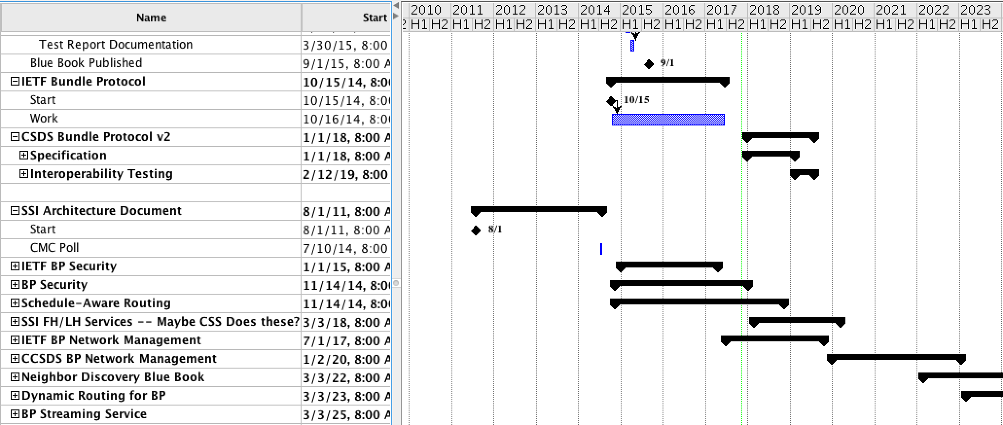
Nominal Schedule

Slide 5
New Work Discussion: SIS-DTN Book Updates
DTN Green Book (CCSDS 734.0-G-1, August 2010): Recommend either light editing or refresh with no changes
There are a number of things that could be addressed in a refresh, but I don’t think any of them warrant doing a lot of work. I could take a cut at some subset of what’s listed here and circulate the result by email with the intent of having this DONE by e.g. the Spring meetings, if that makes sense. Otherwise I’d suggest simply refreshing it with no changes.
Could be updated with a more in-depth discussion of what it means to write applications to the network interface instead of a link interface
Probably SHOULD remove the reference to SCPS-NP as a CCSDS network layer
Should update document map to remove BP and LTP over Encap specifications (they’re in the BP and LTP books)
Could be updated with language that references / is more consistent with the System Architecture Requirements Document
Could be updated to better reference current cross-support services nomenclature
Could be updated to include discussion of DTN on ISS and lessons learned
I don’t think anybody REALLY wants to use DTN to carry SPP or EP (CFDP and AMS yes/maybe) – maybe modify or delete 4.2.2.3.3

Slide 6
New Work Discussion: SIS-DTN Book Updates
SCPS-TP (CCSDS 714.0-B-2, October 2006): Recommend refresh with no changes
Is this in the works? Didn’t show up on Nestor’s slide
AMS (CCSDS 735.0-G-1, December 2012): I don’t have an opinion on this one.
Mars Mission Profiles (CCSDS 740.0-G-1, July 2008): Retire?
I remember this as being highly political when it was generated. I think Dai and maybe Wolfgang Hell were the folks on the ESA side, and I don’t recall who the NASA-side representatives were. Looking through the document, I pretty strongly dislike a lot of the ‘file relay operations’ methods it describes. It mentions DTN exactly once as a possible future thing.

Slide 7
Network Management Green Book
White Book – Spring 2018
Done by Fall 2018

Slide 8
Network Management Blue Book Track Document
Maybe delay all by 1 meeting cycle to account for Green Book
White Book – Spring 2018
Draft Red-1 – Fall 2018
Through agency review by Spring 2019
Red-2 summer 2019
Book by Fall 2020 (published by ~Nov?)
NASA can be editor
NASA can do 1st implementation (ION)
JAXA can do 2nd implementation (name forthcoming)
DLR can review documents

Slide 9
Other Projects (Prioritization)
Network Management Green Book
NASA to be book editor
JAXA / DLR can review
Network Management Blue Book (ICPA end of 2018)
Have identified all resources
Streaming
To support MIA / maybe voice
Bundle Streaming Service Protocol
There are performance requirements here
NASA could be book editor
CNSA can review documents and provide inputs
Prototype 1: NASA ION (BSSP)
Prototype 2: ??????
Multicast
NASA could be book editor
???????: Review / edit
Prototype 1: NASA ION (IMC)
Prototype 2: ??????
5-year review of BP
Probably just reconfirm
5-year review of LTP
There are a few items identified
MAL-to-BP Binding
Have a SMC / SIS Joint Meeting Spring 2018
First Hop / Last Hop (ICPA end of 2020) (Blue Book)
NASA MSFC to draft a white paper Spring 2018
Coordinate w/ CSS and SLS
Jeremy: is there a relationship here to defined MAL messages for radio interface?
Dynamic Discovery
Opportunistic Forwarding
Erasure coding together with LTP (Coding Orange Book underneath LTP – interface LTP/Shim layer)
SSI Architecture (APIs for info exchange driving scheduling)
Security Key Management

Slide 10
New Work Discussion: New Specification Development
Network Management
Green Book
Blue Book
First Hop / Last Hop
In ICPA w/ target end of CY2018

