Slide 1
SIS-DTN: Tuesday 11/10 PM
Tues. PM | Hassium 3.02
1600—1730 Late start in slot | General design of a space internet experiment based on China’s Space Station project. |  | Peng WAN

Slide 2
SIS-DTN: Wed 11/11 PM
1330—1730 | Intro and Agenda Bashing | Keith SCOTT
 | WG Status Long-Term Schedule Review Need to plan for reviews of BP, security to track IETF Current Projects Resourcing Discussion Bundle Security for CCSDS Scheduled Routing (CGR) | Discussion
 | NASA DTN Project Update Network management Bundle security mechanisms DTN Network Configuration Tools ‘Development kits’ | Various
 | Security Resolution of the what about Cryptographic Message Syntax’ question. Current document status / plans / schedule Second prototype development – who? [Probably DTN2-based, NASA will do ION] IETF coordination – any issues? | Dennis IANNICCA / Jeremy PIERCE-MAYER / Discussion

Slide 3
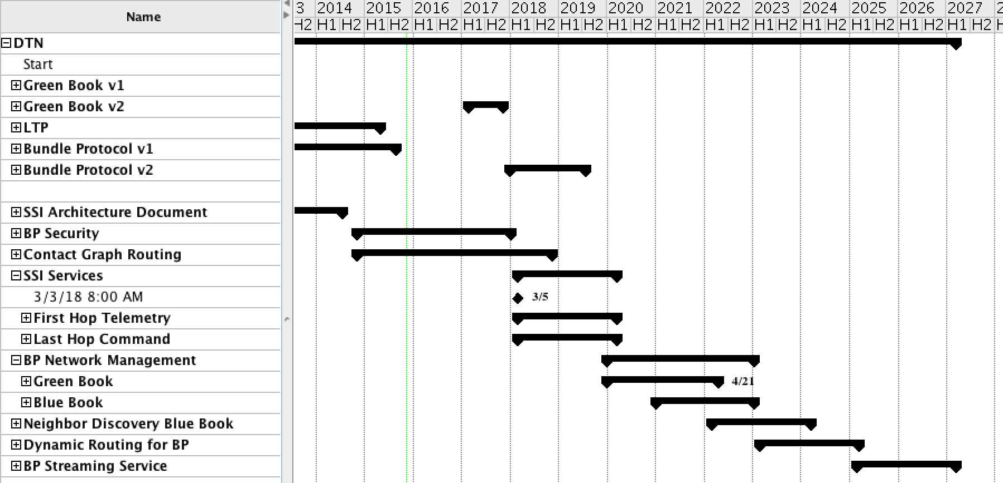
SIS-DTN Document Schedule

Slide 4
Current Projects Resources
Bundle Security
Book Editor: NASA (Dennis Iannicca)
Prototype 1: ION
Prototype 2: ????
Can leverage DTN2 implementation – shouldn’t be too difficult
Target: Done by end of CY2017
Scheduled Routing
Book Editor: NASA (Scott Burleigh)
Prototype 1: ION
Prototype 2: JAXA
Target: Done by end of CY2018

Slide 5
NASA DTN Project: Network Management
Asynchronous Management Protocol (AMP)
https://tools.ietf.org/html/draft-birrane-dtn-amp-01
Asynchronous Management Protocol Agent Application Data Model
draft-birrane-dtn-adm-agent-00
AMP Manager SQL Interface
https://tools.ietf.org/html/draft-birrane-dtn-ampmgr-sql-00
Asynchronous Management Architecture
draft-birrane-dtn-ama-01

Slide 6
NASA DTN Project: Security
Streamlined Bundle Security Protocol Specification
draft-birrane-dtn-sbsp-01

Slide 7
NASA DTN Project: DTN Network Configuration Tools
JPL’s ION Configurator
Linux and Mac applications (based off of Eclipse Models)
Allow configuration of the entire network at once (all the nodes, contact plan(s), …)
Assistants to e.g. form bidirectional links, verify the overall configuration, …
Generates a set of configuration files (1 set for each of the ION nodes)

Slide 8
NASA DTN Project: Configuration Kits
Set of scenarios using the CORE Virtualization capability in Linux (LXC)
‘Pre-set-up’ with ION configurations
Sample applications (bping, image transfer, etc.)

Slide 9
Background
Recap from Joint SIS-DTN / SEA-SEC Meeting Monday AM
Bundle Protocol for CCSDS
Think ‘IP for possibly-intermittently-connected environments’
A ‘bundle’ is a collection of blocks (like IPv6 extension headers, though blocks are more like first-class objects)
SIS-DTN is developing a security protocol for BP
Think IPSec-like for BP
Requirements:
Confidentiality, Integrity, Authentication services
‘Block’-layer granincrementally ularity
Needs to be deployable
For Integrity and Authentication, don’t modify the ‘target’ blocks
Bundle Security Protocol, Streamlined Bundle Security Protocol
Defines mechanisms and formats, ciphersuites are an independent variable
“Why not just use Cryptographic Message Syntax”

Slide 10
SBSP and CMS
Recap from Joint SIS-DTN / SEA-SEC Meeting Monday AM
Don’t want to use exclusively CMS
APL has done some investigation with flight missions – CMS processing seems heavy-weight for them
Need (want) ciphersuites for space that would map to ‘dissociated signature, shared secret key’ (or, for encryption, just ‘shared secret key’)
Get the size of the BP security block down to a few bytes
Do want to support CMS
DLR is interested in using public-key infrastructure to support e.g. authentication of bundles to a remote (different agency) ground station for radiation
On the ground, processing power and bandwidth are more readily available
Current proposed solution: Merge the two approaches

Slide 11
Current SBSP with CMS
Recap from Joint SIS-DTN / SEA-SEC Meeting Monday AM
SBSP defines BP block types for both ‘SBSP-like’ and ‘CMS-like’ blocks
Way Forward
Proceed with current plan
Turn IETF draft into CCSDS book with appropriate modifications

Slide 12
Open Questions
For our book, look at adopting ciphercuites based on CCSDS SEA documents (I think they have an algorithms document, e.g.)
Should we roll in ciphersuites as appendices to the book?
Should we drop the BAB to follow bleeding-edge IETF?
Does signing the primary block and the previous-hop block get essentially the same (or enough) functionality?
Rationale for dropping BAB – BAB includes pre- and post- blocks
Post- block makes it difficult to do security
It looks like CMS defines a ‘detached’ ‘pre-shared-key’ ciphersuite
Does it really?
How can this be invoked from e.g. openssl?
Would this address the overhead concerns with CMS? (maybe we don’t care given the current understanind with SEA)
Are the overhead concerns with CMS significant?
If we had the detached, pre-shared-key ciphersuite above…
Are the processing power concerns with CMS significant?
Isn’t all the cost in the actual crypto operations…?

Slide 13
BPSec for CCSDS Resources

Slide 14
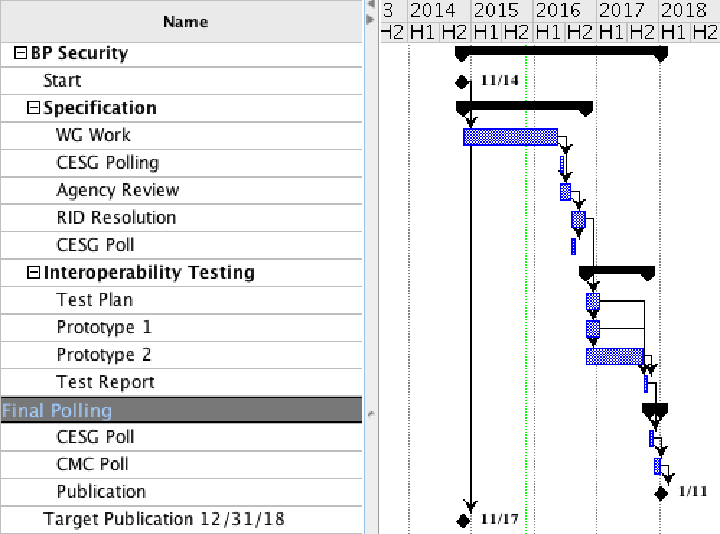
BPSec for CCSDS Schedule

Slide 15
CCSDS Bundle Protocol Security – Next Steps
Start processing SBSP Internet Draft into CCSDS Document (Dennis)
Start looking at cryptographic algorithm choices (???)
Think about what ciphersuites we’ll want
Thoughts on rolling ciphersuites into the current book (as opposed to going and asking for more resources to do another book)?

Slide 16
SIS-DTN: Thurs 11/12 AM CGR Discussion
Thurs AM | Europium 3.04
0845—1230 | Contact Graph Routing CGR Goals Discussion (i.e. what are the forwarding rules trying to achieve?) CGR Specification status | Scott BURLEIGH
Discussion of how to present the work (content for the non-normative portion of the document)
Presentation by Scott Burleigh on how Contact Graph Routing works in the Interplanetary Overlay Network (ION) implementation
Discussion of possible metrics (e.g. total number of bytes delivered regardless of priority, delivery of bytes weighted by priority, etc.)
Discussion of assumptions (e.g. ‘there’s always more data to send than the system can support)

Slide 17
Scheduled Routing – Next Steps
Start preparing information for non-normative portion of the document
Come to agreement on assumptions and metrics
Start documenting the CGR implementation from ION for the normative portion of the document

Slide 18
SIS-DTN: Thurs 11/12 PM Streaming Discussion
Thurs PM | Titanium 2.04
1330—1600 | DTN on ISS Status | Kelvin NICHOLS
 | Streaming over Bundle Protocol ION BSS CL Implementation / API ION BSS CL Documentation (?) Streaming Requirements and how they stack up against the API JPL experience with ION BSS | Scott BURLEIGH Rodney GRUBBS Osvaldo PEINADO Leigh TORGERSON
DTN On ISS
Service should be active about January 2016

Slide 19
Differing Approaches to Bundle Streaming

Slide 20
JPL Experience with Streaming
JPL has some applications that will ‘tunnel’ regular streamed video over BP, using the Bundle Streaming Service (BSS) and the Bundle Streaming Service Protocol (BSSP) convergence layer

Slide 21
Next Steps
SIS-MIA will take on the tasks of
Defining requirements for streaming services
Documenting existing approaches to streaming, with performance
Look at defining a common test suite to do ‘apples-to-apples’ comparisons

