Slide 1

CCSDS SEA-SA WG:
Welcome, Logistics, and Charter Review
12-June 2024
AM Session

Slide 2
Tech Meeting Minutes
Last Name | First Name | Email Address | Organization
Cheng | Shelbun | shelbun.k.cheng@jpl.nasa.gov | NASA/JPL
LECLERC | Clément | clement.leclerc@cnes.fr | CNES
Lux | James | jimlux@jpl.nasa.gov | NASA/JPL
Johnson | Josiah | josiah.m.johnson@nasa.gov | NASA
Thompson | Paul | paul@redspace.ltd | RedSpace Ltd
Virtual
Rovetto | Robert | ontologos@yahoo.com | Am member of AIAA/ANSI, ISO Space Systems TC, and NASA Datanauts Open Data Initiative. Also: Independent consultant. And PhD student researcher at University of New South Wales.

Slide 3
Minutes/Actions
Charter Review: Shelbun and the team reviewed the latest Charter, discussing the need for updates and potential new books to support various projects. They focused on the architectural requirements document (ARD) and the architecture description document (ADD), noting that the green book needs a refresh.
RASDS Document: Shelbun and the team discussed the RASDS document, noting that it was released before Peter's departure and may need monitoring and potential updates. They considered the possibility of pushing up the refresh interval due to the fast-moving nature of the field.
Terminology and Ontology: Shelbun and Robert discussed the need for a common terminology and ontology across CCSDS working groups. Robert suggested creating a standardized ontology ecosystem and offered to spearhead the project.
Lunanet Integration: Shelbun reviewed the Lunanet specification and discussed how it could be integrated into CCSDS. They noted that the Lunanet document did not reference the ARD or ABA/SSI and considered the need for outreach to ensure alignment.
ARD Updates: Shelbun provided an update on the ARD, highlighting the need to review and update sections, add optical definitions, and ensure consistency with other documents. The team agreed to review the updated ARD by the end of July.
Cloud Implementation Considerations – RASIM Green Book: Josiah discussed the challenges of implementing cloud-based architectures and the need to provide guidance on data flow and cost considerations. The team agreed to include pros and cons for different architectures in the document.
Future Work Items: The team reviewed a list of future work items, including data ownership, commercialization, and systems modeling. They agreed to document these items and consider them for future projects

Slide 4
Actions
Charter: Define who is the audience for the SA book/activities/stakeholders/beneficiaries Action: (Shelbun/Paul)
RASDS: Contact Fred about Path Forward for RASDS. (Shelbun)
Terminology and Ontology: Write a one-paragraph description of a project to standardize terminology and ontology across CCSDS working groups and send it to the team for review. (Robert)
ARD Review: Complete updates to the ARD document and send it to the team for review by the end of July 2025. (Shelbun)
  Team review the SCCS-ARD for 2 months, and review the RIDs at the Fall Tech Meeting in Hamburg, Germany (Team)
Cloud Architecture
  Draft the integrated architecture section of the Green Book, including data flow and considerations for on-premises, cloud, and hybrid deployments. (Josiah)
  Develop trade option (pros/cons) for the three (3) deployment architectures (on-prem, cloud, hybrid) (Josiah)
  Complete draft RASIM document in time for the Fall Meeting (Josiah)

Slide 5
Agenda
Topic | Time (Eastern) | POC
Welcome, Introductions, Logistics, Agenda review, Charter Review, Strategies | 0845 – 0945 | Jim Lux Shelbun Cheng
901.1-M-1 Space Communications Cross Support—Architecture Requirements Document | 0945 - 1115 | Shelbun Cheng
Walk-On Topics (If Any) | 1115 - 1230 | All
Break | 1230 – 1330 | All
312.0-G-1 Reference Architecture for Space Information Management (RASIM) | 1330 – 1630 | Josiah Johnson
Walk-On Topics (If Any) | 1630 – 1730 | All

Slide 6
SEA-SA WG Charter Overall
The work done in the other Working Groups is focused upon services and protocols provided by specific components of space data systems. In order for these Working Groups to generate standards in such a way that every standard is consistent and coherent with any other standard generated by CCSDS, CCSDS requires a reference architecture that can be used as a common framework by all the Working Groups of CCSDS and also by engineers in the member Agencies who use CCSDS standards to build systems and to provide services. The reference architecture should encompass both informatics and telematics aspects of space data systems and cover all problem areas associated with space data systems (such as organizational, functional, operational and cross support issues).

Slide 7
CCSDS Reference Architecture
Approach: Developed as a pair of documents using the RASDS reference architecture methodology. The lower layers (1-4, and some 7) are covered by the SCCS-ARD/ADD, and include the standards developed by the CSS, SLS, SIS, and SEA Areas. The upper layers (5-7 and applications) are covered by the ASL-ADD, and include the standards developed by the MOIMS and SOIS Areas.
Describe how all of the CCSDS application standards fit together with other communications standards, the map of the territory
Define and refine necessary interfaces and ontology terms
Update and revise these documents, as needed, with direct support from CSS, SLS, SIS, SEA, SOIS, and MOIMS area expert.
SEA-SA | CCSDS 901.1-M-1 | Space Communications Cross Support - Architecture Requirements Document | Shelbun Cheng | Magenta | May 2015 | In-Progress
SEA-SA | CCSDS 901.0-G-1 | Space Communications Cross Support - Architecture Description Document | Shelbun Cheng | Green | November 2013 | Needs updating; Not started

Slide 8
Perform RASDS refresh, include Annex for SysML/UML representation
Approach: Update and refresh RASDS
Work with ISO SC-14 to define needs for operational, physical, and service viewpoints
Refine existing viewpoint specifications based on user experience and feedback, as well as ASL ADD developed extensions
Include Annex for UML/SysML representation that uses the core methodology, consider Annex to describe abstraction, protocol, concrete realization relationships
Complete RASDS revision and update now that resources are available
ACTION: Contact Fred about Path Forward for RASDS.
SEA-SA | CCSDS 311.0-M-2 | Reference Architecture for Space Data Systems | Peter Shames | Magenta | February 2025 | No change

Slide 9
CCSDS Registries & Information Model
Approach: Support CCSDS registries and information models, develop a unified approach across all CCSDS working groups
Registry Management Policy (RMP) document derived from existing SCID and MACAO registries. Provide updated WG guidelines and SANA Operator guidelines.
Extend registry model to define core, re-usable, registries for agencies & other organizations, identified persons (head of delegation / points of contact), assigned registry management role.
Develop other core registries for object identifiers (OID), URN, Schema, service sites & apertures, as needed.
CCSDS wide registry information model covering all of the major defined info / data objects and their relationships
Reference Architecture for Space Information Management (RASIM) document that encompasses the capture, management, access, and exchange of data for both flight and ground systems
SEA-SA≈ | CCSDS 312.0-G-1 | Reference Architecture Software Information Model | Josiah Johnson | Green | March 2013 | In-Progress

Slide 10
CCSDS XML standards
Approach: Identify source of adequate XML schema development guidelines, develop draft for CCSDS and review with CESG
Adopt suite of schema analysis and validation tools
Extract set(s) of common terms as library elements
ACTION: Ask Josiah to determine if this could be added to RASIM
SEA-SA≈ | CCSDS 312.0-G-1 | Reference Architecture Software Information Model | Josiah Johnson | Green | March 2013 | In-Progress

Slide 11
CCSDS ontology (terms, definition, and relationships; glossary revision)
Approach: Complete analysis, work key issues within WG as part of CCSDS Reference Architecture
Based on existing CCSDS Glossary, with refinements
Deploy On-line; queryable, leverages RASDS & QUDV as core
Extensible with other domain ontologies, specializations and extensions
Revised and reviewed with the other WGs
Work integration of TC20 / SC14 terminology and develop a more formalized governance approach with their support
Action: Robert Rovetto to provide 1-paragraph project on what needs to be done here.
SEA-SA | CCSDS 311.0-M-2 | Reference Architecture for Space Data Systems | Peter Shames | Magenta | February 2025 | No change

Slide 12

Rationale for Activity
Review Word Doc

Slide 13
Strategies
Action: Shelbun/Paul to define who is the audience for the SA book/activities/stakeholders/beneficiaries
Strategy | Description | Working Group | Book Number | Title | Author | Book Type | Published | Status
SEA GOAL 3 - Information Architecture and Services | Complete a reference information architecture, information infrastructure services including service-oriented architecture (SOA) and interfaces, and frameworks for handling operational data flows and supporting multi-agency federated data systems.​ | SEA-SA | CCSDS 312.0-G-1 | Reference Architecture Software Information Model | Josiah Johnson | Green | March 2013 | In-Progress
 |  | SEA-SA | CCSDS 371.0-G-1 | Application Support Layer | TBD | Green | November 2020 | No change
SEA GOAL 7 - CCSDS Reference Architectures, Applications, Communications, and Terminology | Produce documents that will provide an architectureal description of the CCSDS work, understanding of the links/interactions between the different standards, identification of gaps, and provide the means to describe these architectures, information models, and policies in a consistent way. Produce a CCSDS Application Layer Architecture showing the relationships among all of the application layer standards and services and their relationships to supporting standards for space communication and cross support. This is a companion document to the Space Communication Cross Support architecture (SCCS-ADD) that documents SLS, SIS, CSS, and SEA standards relationships. Work with MOIMS and SOIS to document the relationships between the standards in these two areas and with those already documented in the SCCS-ADD. Revise the CCSDS Reference Architecture for Space Data Systems (RASDS) to accomplish its 5-year review and, in a second phase, augment the existing document with methods using Model-Based System Engineering (MBSE) and SysML​. Working with the other areas, update the CCSDS Glossary to provide a self consistent and unambiguous set of terms. Create a Registry Management Policy and related procedures and information models for managing the sets of registry information created by the other CCSDS areas.​ | SEA-SA | CCSDS 311.0-M-2 | Reference Architecture for Space Data Systems | Peter Shames | Magenta | February 2025 | No change
 |  | SEA-SA | CCSDS 901.1-M-1 | Space Communications Cross Support - Architecture Requirements Document | Shelbun Cheng | Magenta | May 2015 | In-Progress
 |  | SEA-SA | CCSDS 901.0-G-1 | Space Communications Cross Support - Architecture Description Document | Shelbun Cheng | Green | November 2013 | Needs updating; Not started
 |  | SEA-SA | NEW | Space Communications Cross Support - Architecture Requirements Document - Lunar-specific?? Communication, Position, Navigation, and Timing (CPNT) Architecture Requirements Document - Lunar-specific?? | TBD | Magenta | NEW | Suggestion to create

Slide 14
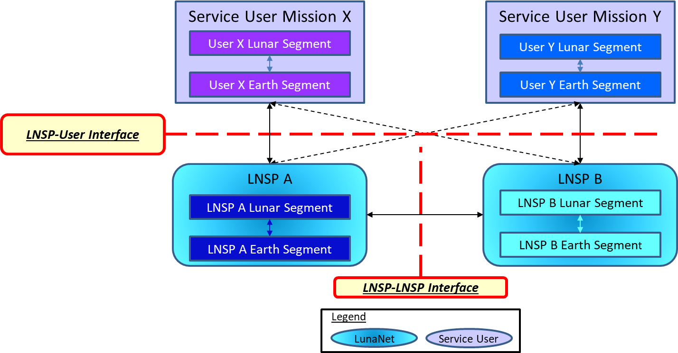
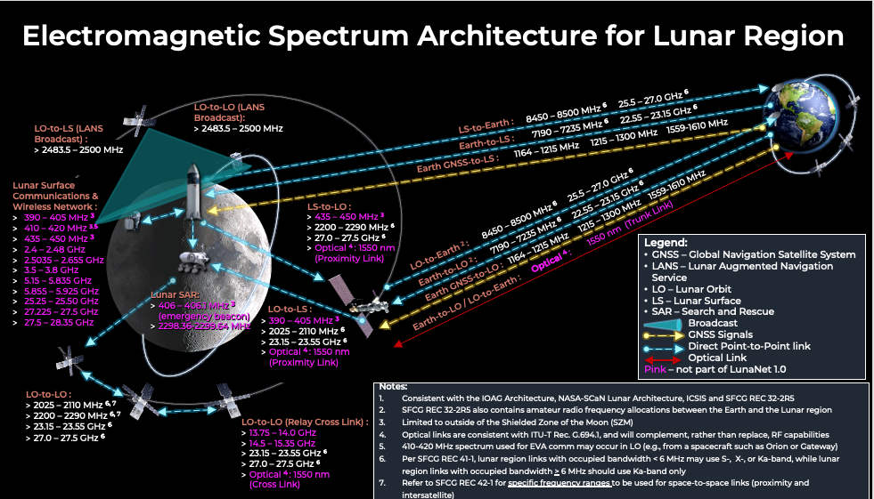
LunaNet Interoperability Specification Document
LunaNet Interoperability Specification Document (LNIS)
  References many CCSDS Standards
Describes overall architecture, PNT, services, LNSP-User, LNSP-LNSP, interface specifications
LunaNet Appendices describe signal interface specification
  LNSP-USER PROXIMITY INTERFACES
  SINGLE ACCESS LNSP-USER PROXIMITY INTERFACES
  SPREAD SPECTRUM LNSP-USER PROXIMITY INTERFACES
  LNSP-USER DWE INTERFACES
  LNSP-USER CONTINGENCY INTERFACES

Slide 15
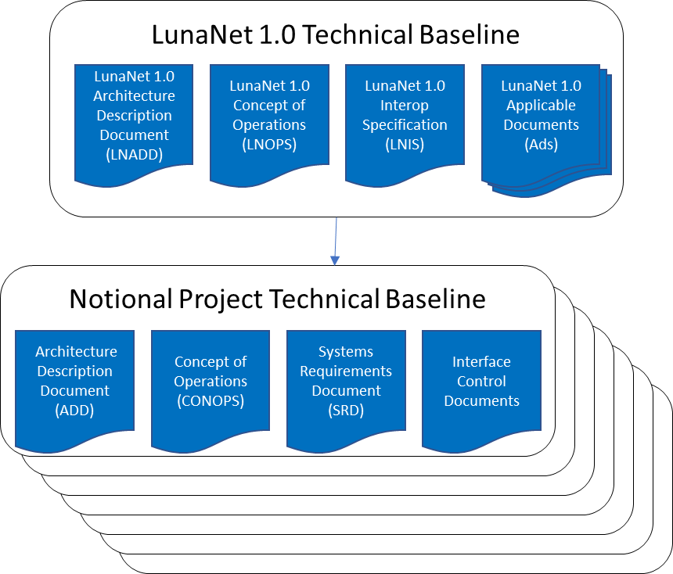
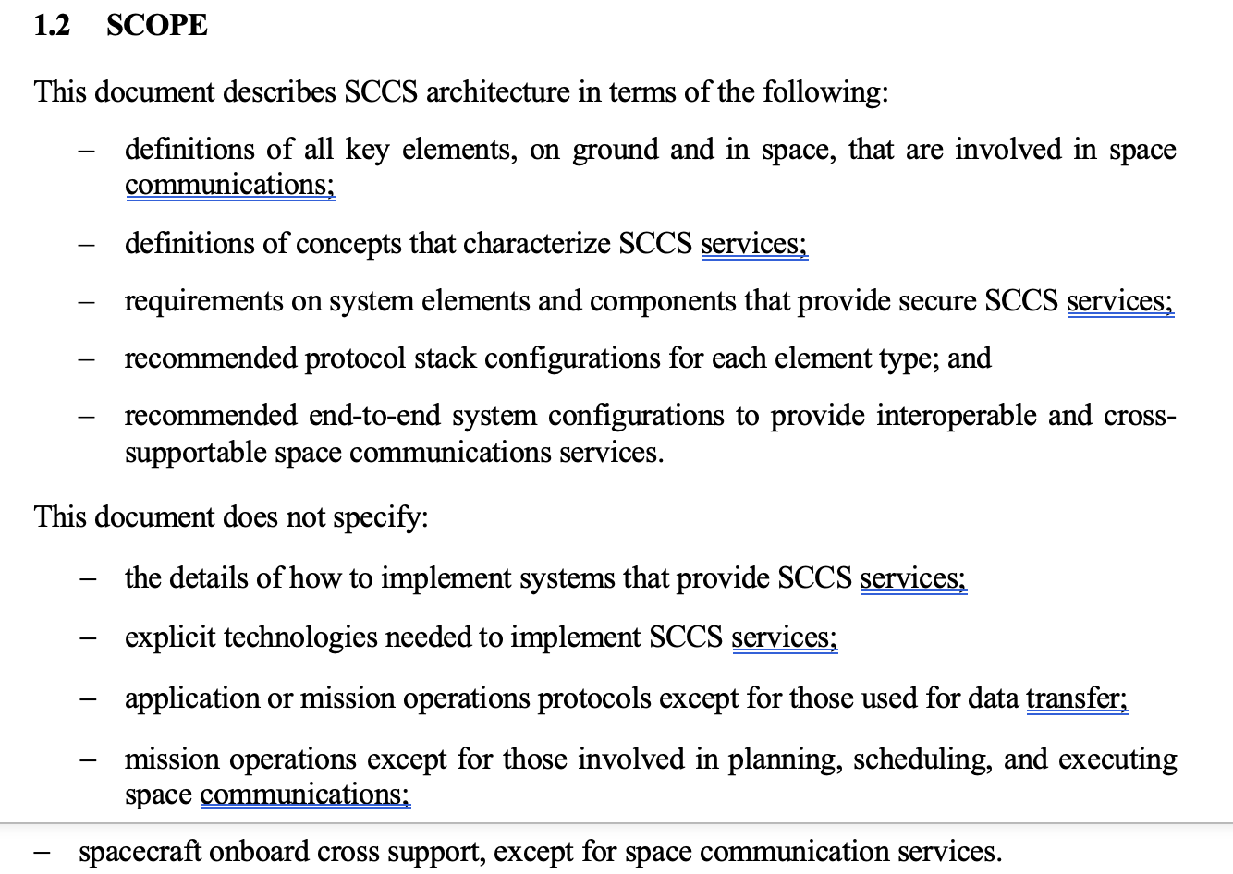
Discussion
What are the next steps for LunaNet Interop specification?
Should CCSDS integrate this document into any Sys Engineering Architecture documents?
What are other CCSDS WGs doing to address LunaNet?
  Develop E2E protocol stack for LunaNet?
  ABA/SSI Stages or SCCS-ARD terminology not addressed in LNIS
SCCS-ARD describes architecture and provides requirements for E2E deployments
  Decompose requirements from LunaNet Spec?

Slide 16
CCSDS SEA-SA WG:
CCSDS 901.1-P-1.11
Space Communications Cross Support – Architecture Requirements Document
(SCCS-ARD)
12-June 2024
AM Session
Magenta Book

Slide 17
SCCS-ARD Updates (throughout)
Section 1.0
  Iterative: Cleanup of references (work-in-progress) as CCSDS Books are being released.
  Iterative: Typos
Section 2.0
  OV-1 Addition for ABA and SSI Configuration
Section 3.0
  Administrative; added optical communications to the RF statements
Section 4.0
  Mostly cleanup to include fixing references; will need to revisit the use of collapsing various SSI sections.
Section 5.0
  Updated ABA and SSI Generic Building Blocks
  Modified Section # to be consistent CSSE Building Blocks
  Collapsed Sections specific for SSI related requirements
Section 6.0
  Updated linkages
  Collapsing Sections
Section 7.0
  Updated linkages
  Collapsing Sections
  Updating diagrams to include Optical considerations

Slide 18
Document Section Overview
Introduction
Overview
ABA and SSI Technical Architecture
Service View
Physical View
Communications Views
E2E Deployment view
Annexes

Slide 19
SSI DTN WG
Add reference for SSI architecture Magenta Book. Ask SSI DTN WG whether they will be identifying a standard for FUTURE requirement on security mgmt and whether we can add to our SCCS-ARD document.

Slide 20
2. Overview
SCCS
ABA/SSI
User
Applications
User
Applications
I
I
Need to formulate plan to update
Focus on Today
Describes
Specifies
Non-normative
Normative
Architecture
Description
What are the architectural elements?
Architecture
Requirements
How is the architecture constructed?
Services
Protocols
Nodes
Deployments
Services
Protocols
Nodes
Deployments

Slide 21




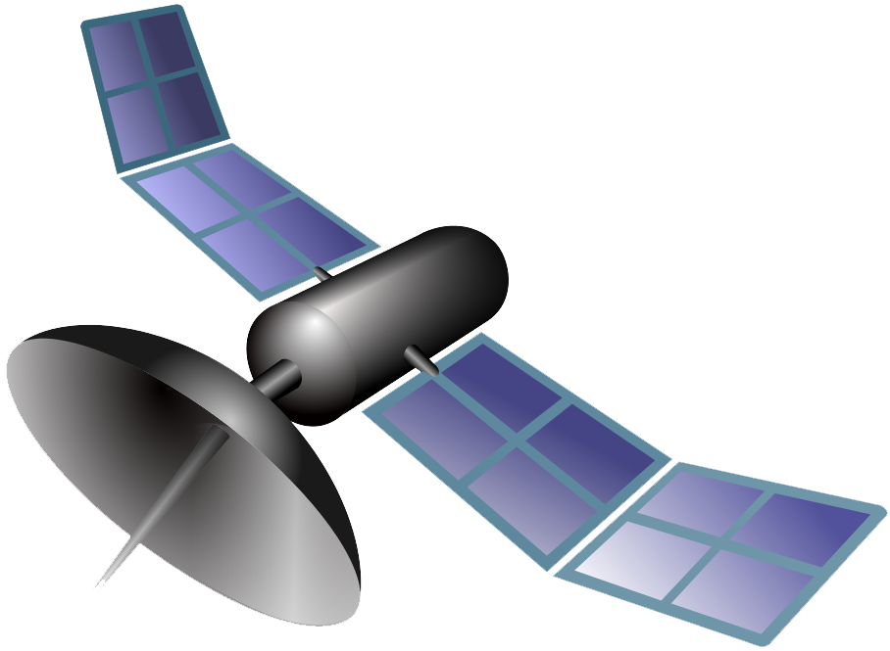



Figure 2-8: ABA Enterprise Overview (updated 5/22/2024)
User Assets in Space
User MOC
Service User
(Utilization
Management)
User Assets on the Earth
Spacecraft
ABA ESLT
Service Provider
(Provision Management)
Spacecraft
User Assets on Some Planetary Surface
OV-1 similar to many other architectures
Optical Communications
RF Communications
Terrestrial Communications
Notes:
Hugh mentioned in one of his comments that the lines should be changed to solid on the figures here b/c they didn’t represent organizations.
Changes here are mostly that I adjusted the planet so it didn’t hang off the edge of the slide, and I extended any line to its meeting point so there weren’t gaps at the end of the lines.

Slide 22
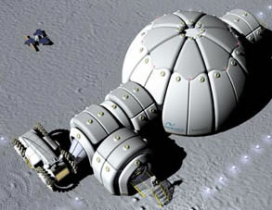


Figure 2-8: SSI Enterprise Overview (updated 6/12/2024)
OV-1 similar to many other architectures
Optical Communications
RF Communications
Terrestrial Communications
SSI Service User (UM)
Spacecraft
DTN
Spacecraft
User Assets on Planetary Surface
User Assets on the Earth
User Assets on Planetary Surface
DTN
Habitat
User MOC
User Assets in Space
User Assets in Space
DTN
Spacecraft
Routing
Spacecraft
Terrestrial WANs
Planetary
WANs
SSI Earth Terminal
SSI PSLT
DTN
DTN
Routing MOC
SSI Assets on Planetary Surface
SSI Assets on the Earth
SSI Assets on Planetary Surface
SSI Assets on the Earth
DTN
DTN
SSI Service Provider (PM)
Notes:
Hugh mentioned in one of his comments that the lines should be changed to solid on the figures here b/c they didn’t represent organizations.
Changes here are mostly that I adjusted the planet so it didn’t hang off the edge of the slide, and I extended any line to its meeting point so there weren’t gaps at the end of the lines.

Slide 23
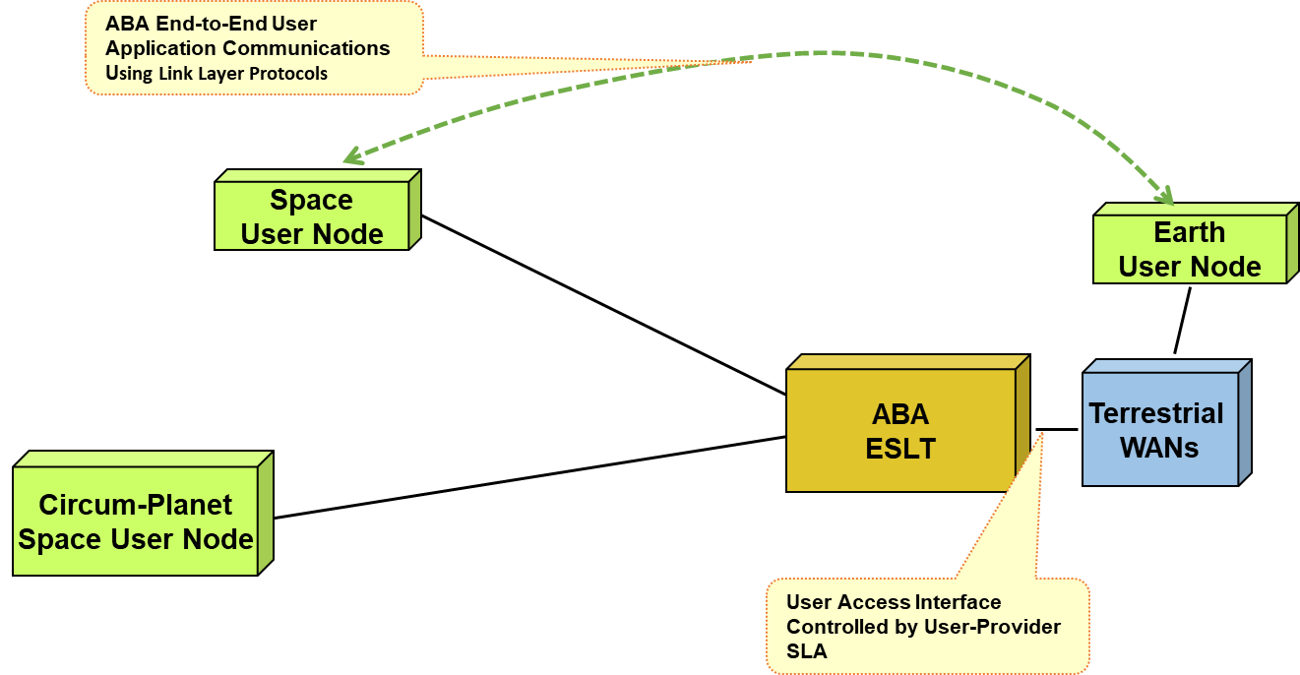
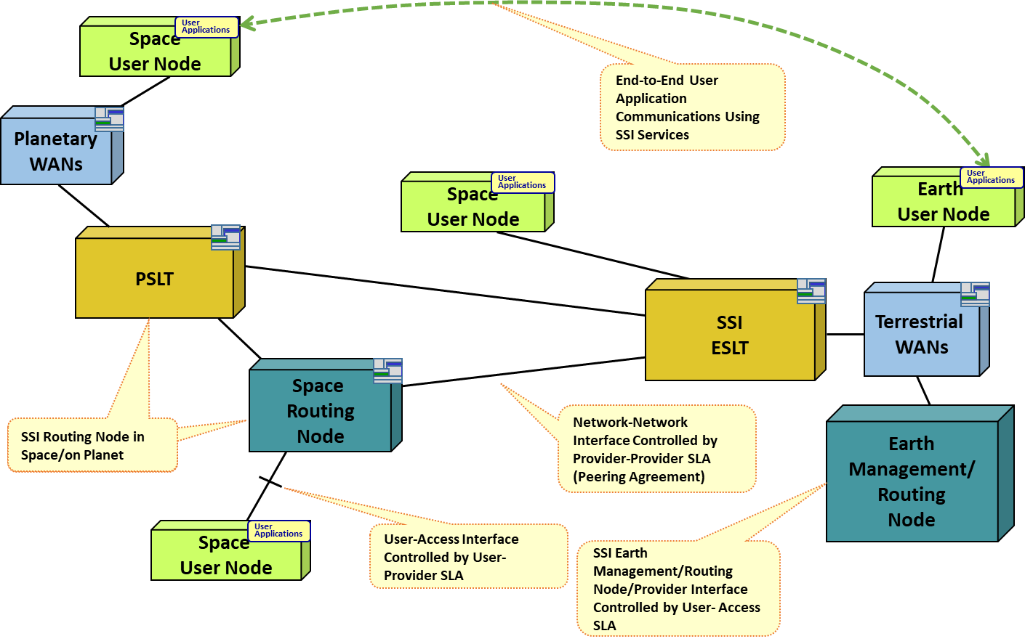
3. ABA and SSI Technical Arch
Action: Check with Lee/Natalya on modernizing the figures. Check with RASDS to determine if these diagrams are in compliance.
ABA Generic Deployment
SSI Generic Deployment
Section 3.0 provides Top-Level Requirements for EUN, SUN, ESLT, EMRN

Slide 24
4. Service View
Defines service interfaces (space and ground) for both ABA and SSI
  Methods for using services
  Cross-supported behavior for planning, scheduling, configuring, requesting, delivering, and reporting on services

Slide 25
4. Services View Requirements
Services Overview
ABA Services
SSI Services
Service User
Service User
Service Provider
Earth User Nodes
Earth Space Link Terminal
Service Provider
EUN/SUN
Earth Management Routing Nodes
ESLT
Space Routing Nodes
Security for Services
Security for Services

Slide 26
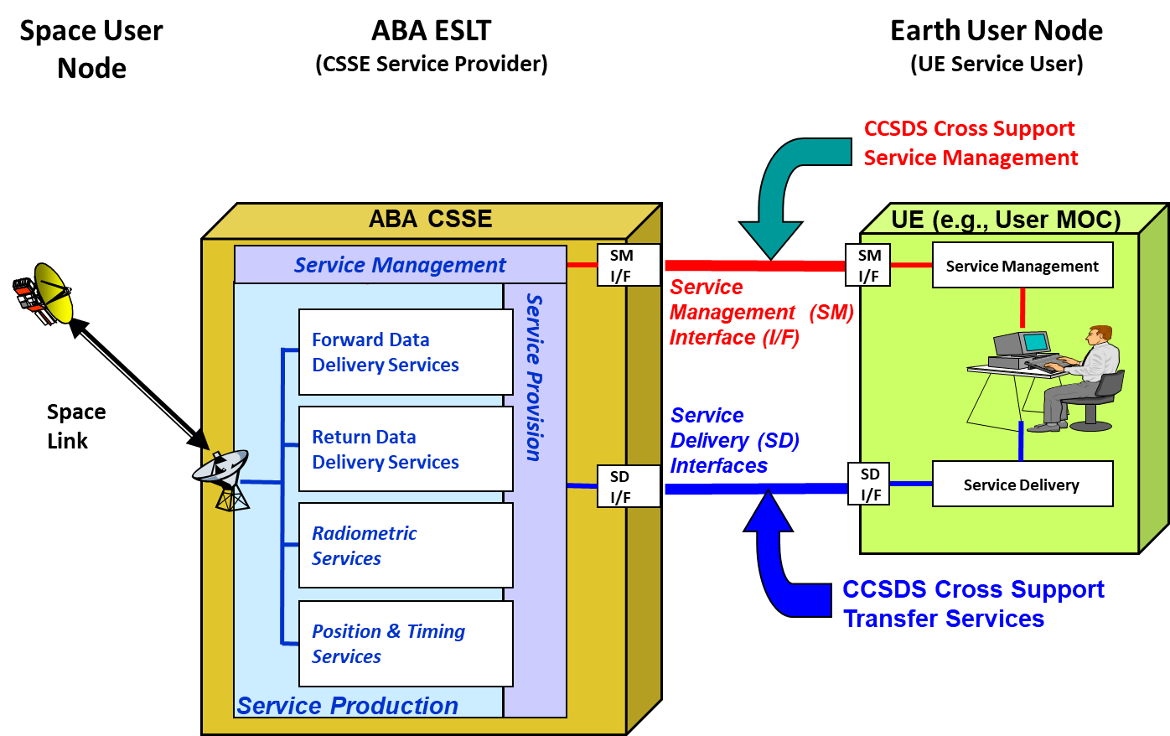
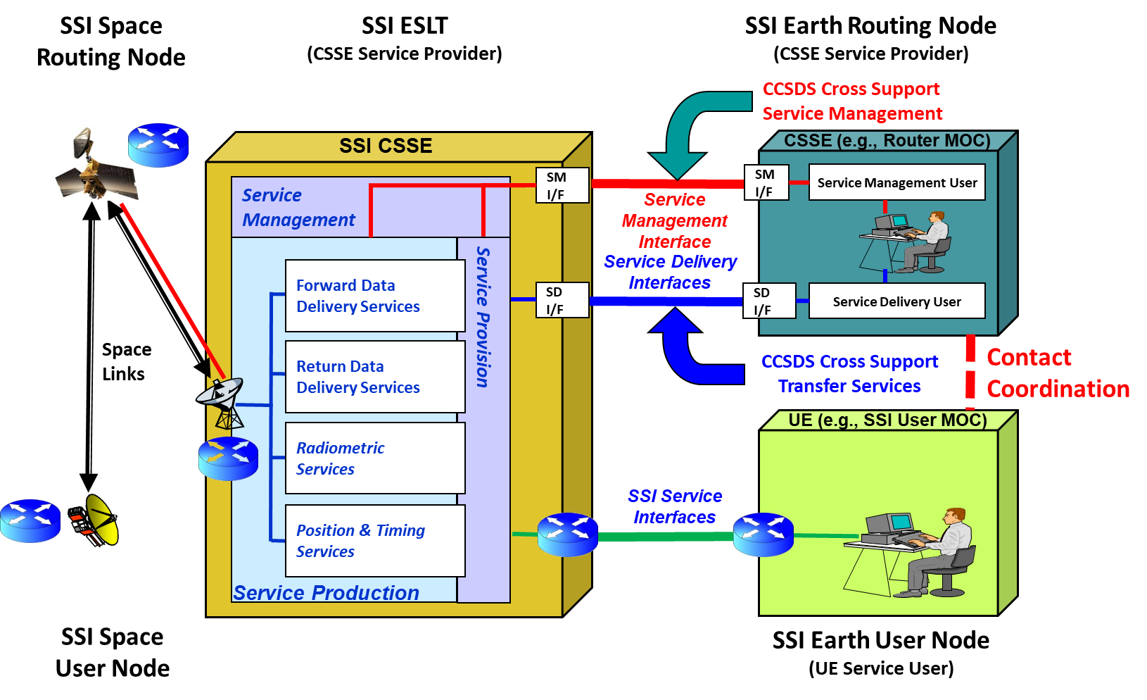
4. Service View
ABA Generic Deployment
SSI Generic Deployment
Drawings have been updated since previous release

Slide 27
SSI Table Differences Simplified
 | Stage 1 | Stage 2a | Stage 2b | Stage 3
Earth-Space Link Terminal | Link Layer Services | Network Layer Services | Network Layer Services | Network Layer Services
Routing Mgmt | Non-Standard | Non-Standard | Standard | Standard
Security Key Mgmt | Non-Standard | Non-Standard | Standard | Standard
Network Mgmt | Non-Standard | Non-Standard | Standard | Standard
Automation | None | None | None | Fully-Automated
Notes |  |  |  | Peering Agreements, NSAs, Standards across all aspects of communication
Non-Standard | Local or implementation specific

Slide 28
CSSS and CSSE
Cross Support Service Element (CSSE): A physical element involved in providing one or more cross support services (including functions for managing services).
Cross Support Service System (CSSS): A set of CSSEs or user elements that are managed by a single authority with a single set of management policies. These may be user or provider systems.

Slide 29
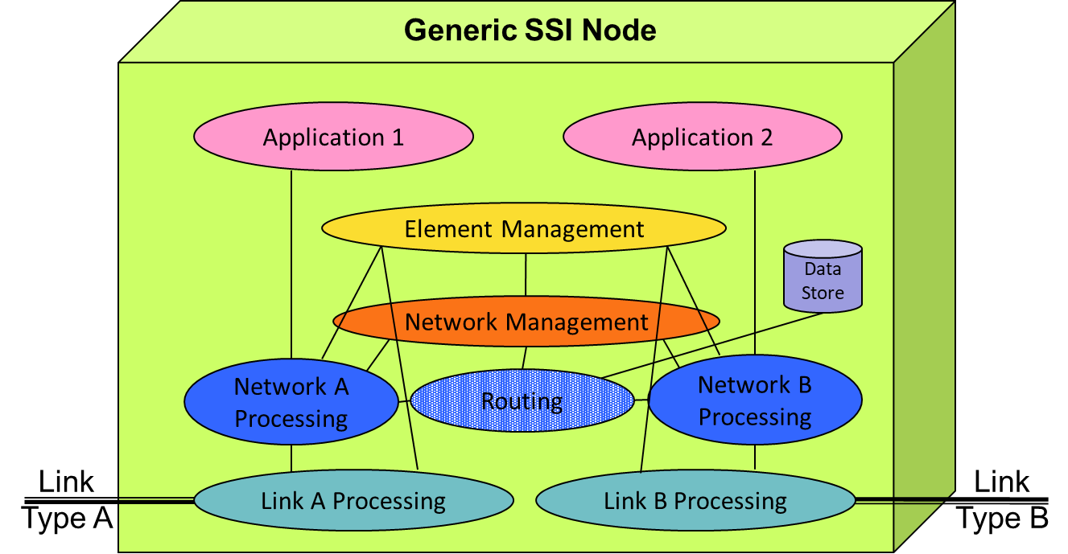
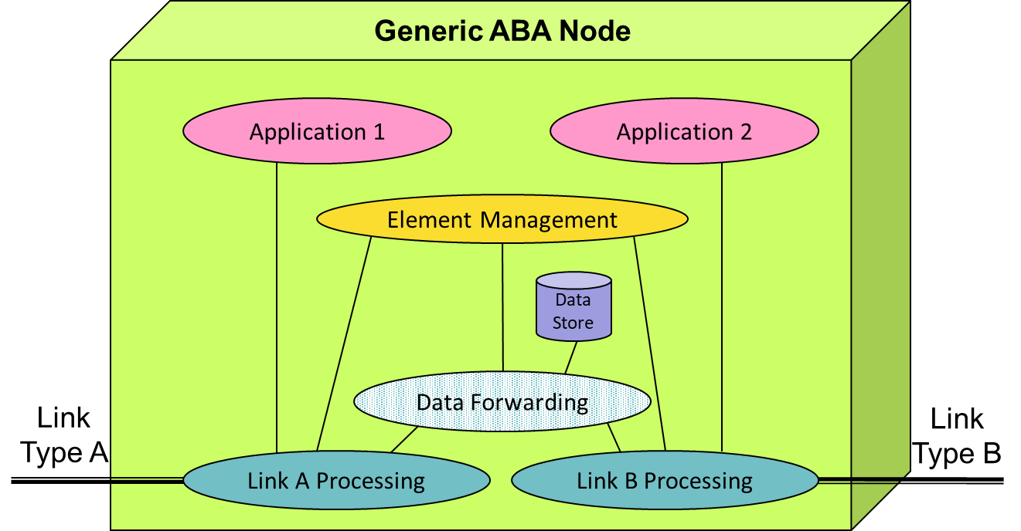
5. Physical View
Requirements definition for CSSEs
  ABA: SUN, ESLT, EUN
  SSI: SUN, ESLT, EUN, EMRN, SRN, PSLT, and Routing Nodes

Slide 30
5. Physical View Requirements
Physical Overview
ABA CSSEs
SSI CSSEs
ESLT
EUNs
EUN/SUN
EMRN
ESLT
SRN
Security for Physical
SUNs

Slide 31
6. Communications View
Focuses on the communications protocols used for accessing SCCS services
  Details of the communications protocol stacks that interface binding points between the CSSEs and UEs
Need to update to include optical definition (options in subsequent slides)
SSI Space User and Routing Node DTN Protocol Building Blocks
Single Example

Slide 32
Figure 6-24: Service Provider ABA CSTS Return-File Building Block (original)
Review WAS
D-DOR Correlation
Processing
Offline Radiometric
Processing
TDM File
CSTS Return-
File Processing
TDM File
CFDP
CSTS Transfer File
Encapsulation
TM/AOS Link Framing
SLE RCF
Delivery Service
(Frame De-Muxing)
SLE RCF
Frame Sync & De-Code
TCP
RF & De-Mod
IP
ABA CSTS Return-File Service Provider
Using CFDP File Delivery
over SPP and SLE RCF

Slide 33
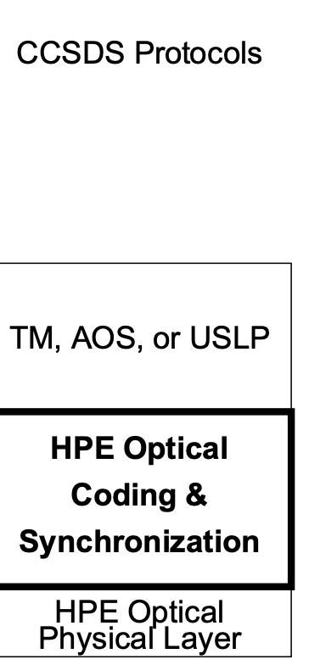
Figure 6-24: Service Provider ABA CSTS Return-File Building Block (original)
Review IS
D-DOR Correlation
Processing
Offline Radiometric
Processing
TDM File
CSTS Return-
File Processing
TDM File
CFDP
CSTS Transfer File
Encapsulation
TM/AOS Link Framing
SLE RCF
Delivery Service
(Frame De-Muxing)
SLE RCF
Optical C&S
Frame Sync & De-Code
TCP
Optical Physical
RF & De-Mod
IP
ABA CSTS Return-File Service Provider
Using CFDP File Delivery
over SPP and SLE RCF

Slide 34
Figure 6-24: Service Provider ABA CSTS Return-File Building Block (partial revision – 2022-01-12. Still needs work but it’s not clear that this will survive)
Review WAS
D-DOR Correlation
Processing
Offline Radiometric
Processing
TDM File
CSTS Return-
File Processing
TDM File
CFDP
Terrestrial Generic File Transfer
Encapsulation
TM/AOS Link Framing
SLE RCF
Delivery Service
(Frame De-Muxing)
MC & VC Demux
SLE RCF
Frame Sync & De-Code
TCP
RF & De-Mod
IP
ABA CSTS Return-File Service Provider
Using CFDP File Delivery
over EPP

Slide 35
Figure 6-24: Service Provider ABA CSTS Return-File Building Block (partial revision – 2022-01-12. Still needs work but it’s not clear that this will survive)
Review IS
D-DOR Correlation
Processing
Offline Radiometric
Processing
TDM File
CSTS Return-
File Processing
TDM File
CFDP
Terrestrial Generic File Transfer
Add text box explaining side by side for using Optical vs RF
Add USLP
Encapsulation
TM/AOS Link Framing
SLE RCF
Delivery Service
(Frame De-Muxing)
MC & VC Demux
SLE RCF
HPE Optical C&S
Frame Sync & De-Code
TCP
HPE Optical Physical
RF & De-Mod
IP
ABA CSTS Return-File Service Provider
Using CFDP File Delivery
over EPP

Slide 36
Review WAS
User Application
(Packet Processing)
User Application (CFDP Files)
Figure 6-36: Space User Node Comm Services Protocol Building Blocks – Forward Link (2022-01-12)
AMS, EPP, or SPP
CFDP
SPP or EPP
SDLP Receiving End Procedures – Packet
Extraction through All Frames Reception
COP FARM
SDLS
Sync & Decode
Physical Layer Reception & Demodulation
User Application
(Packet Processing)
User Application (CFDP Files)
User Application
(OCF Processing)
Figure 6-37: Space User Node Comm Services Protocol Building Blocks – Return Link (2022-01-12)
AMS, EPP, or SPP
CFDP
SPP or EPP
SDLP Sending End Procedures – Packet
Processing through All Frames Generation
COP FARM
SDLS
Code & Sync
Physical Layer Mod and Radiation

Slide 37
Review IS
User Application
(Packet Processing)
User Application (CFDP Files)
Figure 6-36: Space User Node Comm Services Protocol Building Blocks – Forward Link (2022-01-12)
AMS, EPP, or SPP
CFDP
SPP or EPP
SDLP Receiving End Procedures – Packet
Extraction through All Frames Reception
COP FARM
SDLS
Sync & Decode
Physical Layer Reception & Demodulation
User Application
(Packet Processing)
User Application (CFDP Files)
User Application
(OCF Processing)
Figure 6-37: Space User Node Comm Services Protocol Building Blocks – Return Link (2022-01-12)
AMS, EPP, or SPP
CFDP
SPP or EPP
SDLP Sending End Procedures – Packet
Processing through All Frames Generation
COP FARM
SDLS
HPE Optical C&S
Code & Sync
Physical Layer Mod and Radiation
HPE Optical Physical

Slide 38
Figure 7-1: Basic ABA End-to-End Forward CLTU Protocols (original – needs to be updated)
Review WAS
11 Dec 12 Updated version from Peter
ABA
ABA
ABA
ABA Space User Node
ABA Earth-Space
Link Terminal
ABA Earth User Node
User Frame
Application
Space F-Frame
Application
F-CLTU
Production
TC
VC X
VC X
C & S
To VC X
TC
F-CLTU
F-CLTU
C & S
TCP
TCP
RF & Mod
RF & Mod
IP
IP
Ground-Space
CCSDS Protocols
Terrestrial
WAN
C & S = Coding & Synchronization
Notes:
38

Slide 39
Figure 7-1: Basic ABA End-to-End Forward CLTU Protocols (original – needs to be updated)
Review IS
ABA
ABA
ABA
ABA Space User Node
ABA Earth-Space
Link Terminal
ABA Earth User Node
Add description for side by side physical layer.
User Frame
Application
Space F-Frame
Application
F-CLTU
Production
TC
VC X
VC X
C & S
To VC X
TC
F-CLTU
F-CLTU
C & S
Optical C&S
Optical C&S
TCP
TCP
RF & Mod
Optical Phy
Optical Phy
RF & Mod
IP
IP
Ground-Space
CCSDS Protocols
Terrestrial
WAN
C & S = Coding & Synchronization
Notes:
39

Slide 40
BACKUP

Slide 41
SSI Stage Differences
Stage 1:
SSI nodes implement the required standard SSI functions to provide communications services. Functions that have not been standardized yet, may be realized in a local and implementation specific fashion. In this stage, EUNs and EMRNs implement the SSI standards, but they use an ABA ESLT, which provides only link layer services, to communicate with other SSI nodes such as SRNs and SUNs, which also use SSI protocols. In Stage 1, many ancillary functions, like routing, security, and network management, must use non-standard or deployment specific implementations because there are no standards yet.
Stage 2:
This stage expands Stage 1 by the introduction of the SSI protocols into Earth station service providers (ESLT) to enable Network-Layer cross support. The SSI architecture supports this stage by providing internetwork functionality, which enables the SSI protocols to operate across multiple space flight missions, possibly managed by different organizations.
Stage 2 development occurs in two stages of 2a and 2b. Whereas Stage 2a uses local, or private, management of nodes, routing, and network management; Stage 2b uses standard management of nodes, routing, and network management. The nonstandard features may be realized in a local and implementation specific fashion.
Stage 3:
The automation of mission data communications occurs in this stage. Cross support communications between nodes owned by multiple organizations can be fully automated, including standard network service agreements, standard service providers peering agreement and standard service catalogs. Moreover, this stage provides management & governance using project, agency, or consortium standardized means for network and security keys management.

