Slide 1
SCaN MBSE Methodology & Framework
20 June, 2019

Slide 2
Agenda
MBSE Overview – 3 pillars to MBSE
  Modeling Language
  Modeling Method and Architectural Framework
  Modeling Tools
Methodology: Methods and Architectural Frameworks
  Overview
  SCaN Projected Network Architecture Methodology
    Object Oriented System Engineering Method (OOSEM)
    SCaN Abstract Architecture Model
  SCaN Integrated Network Architecture Framework
    CCSDS RASDS Framework

Slide 3
MBSE Overview
“MBSE is the formalized application of modeling to support system requirements, design, analysis, verification, test and validation activities beginning in the conceptual design phase and continuing through-out development and later lifecycle phases.”
— International Council on Systems Engineering (INCOSE), Systems Engineering Vision 2020, Sep 2007

Slide 4
Why Model?
To ensure that a comprehensive, consistent and optimized architecture is defined and documented
To create unambiguous architecture representation – far more precise than words
To facilitate dialog with all stakeholders, including the technically unsophisticated
To provide traceability from performance requirements to system elements; allows cost to be included in the trade space
To support effective system integration and test planning
To support clear definition of functions and system elements in each cycle of an incremental development
To create executable objects from which behavior can be computed before the expense of building components (this is the “Holy Grail”, but it is very hard to achieve)
Modeling Is the core method of architecture-centric MBSE
Notes:
Clarity
Tracing and mapping
System analysis

Slide 5
Three Pillars of MBSE
Modeling
Method & Framework
Modeling
Language
Modeling
Tool

Slide 6
Methodology
Methodology
  A methodology is loosely defined as the processes, methods, and tools used to accomplish our goals
  An Architectural Framework defines a set of Views that are required to describe an architecture
Why define our Methodology?
The aim is to develop a well-defined, documented, and structured MBSE approach. The goal is to build a model that represents SCaN as a whole: organizationally, architecturally, programmatically, and technologically.
Notes:
Governance and organization
well-documented and structurally sound (programs/project change)
Means to explore or constrain trade or design space

Slide 7
Three Pillars of MBSE
Modeling Languages:
  UML, SysML, ADL, SOMF
Modeling Methods and Frameworks:
  OOSEM, SYSMOD, Harmony-SE, CORE
  RASDS, DoDAF, EA framework, MODAF, NAF
Modeling tools:
  Magic Draw, Core, Genesis, Enterprise Architecture, Rhapsody, Innoslate, DOORS
Other tooling:
  Scripting, plugins, commercial MBSE enhancement/integration products

Slide 8
OOSEM Method
Object Oriented System Engineering Method (OOSEM): "OOSEM is a top-down, scenario-driven process that uses SysML to support the analysis, specification, design, and verification of systems.
The process leverages object-oriented concepts and other modeling techniques to help architect more flexible and extensible systems that can accommodate evolving technology and changing requirements.”
It’s a tool and vendor-neutral, model-based methodology created by INCOSE and adopted by many in the MBSE community.

Slide 9
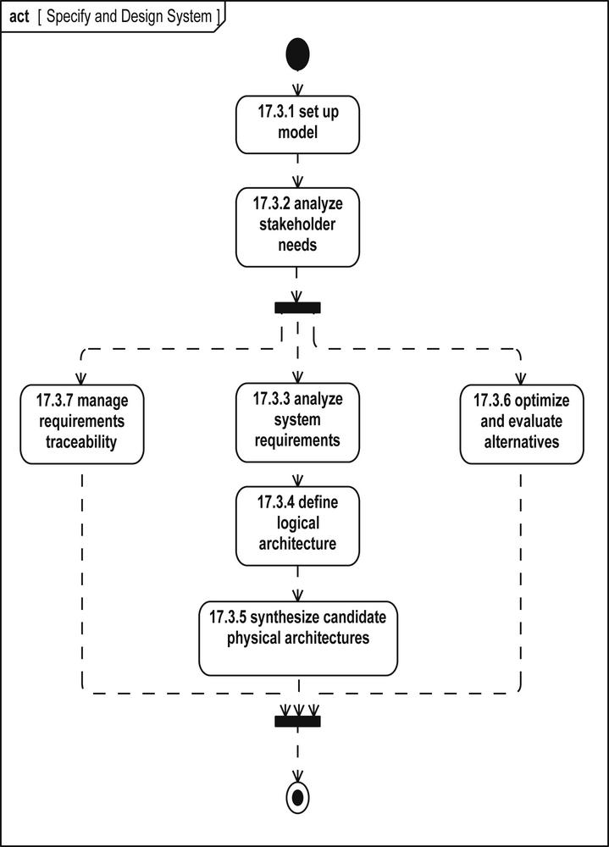

Slide 10
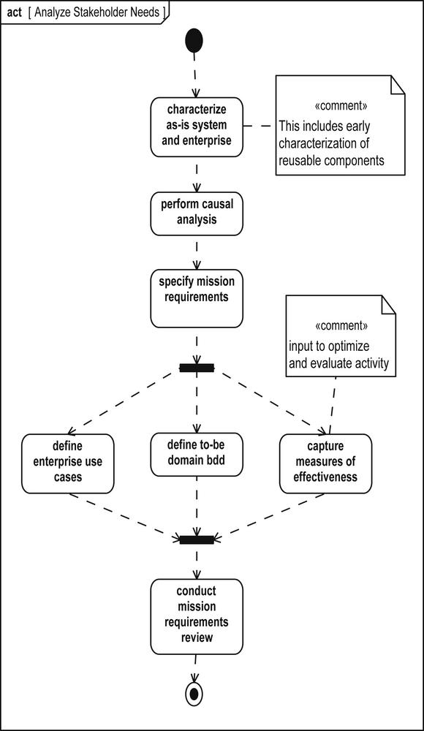

Slide 11
SCaN Abstract Architecture Model
The approach used to develop and describe the SCaN Network architecture is based on the U.S. Department of Defense Architecture Framework (DoDAF), the CCSDS Reference Architecture for Space Data Systems (RASDS), and (ANSI)/IEEE Standard 1471–2000, Recommended Practice for Architectural Description of Software-Intensive Systems. The SCaN Program will select views from these frameworks or define its own views as appropriate to the needs of the program.

Slide 12
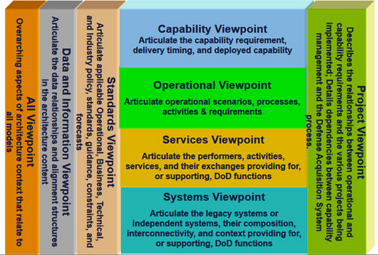
DoDAF Viewpoints Graphic View

Slide 13
DoD Architecture Framework (DoDAF)
DoDAF organizes the DoDAF-described Models into the following viewpoints:
The All Viewpoint describes the overarching aspects of architecture context that relate to all viewpoints.
The Capability Viewpoint articulates the capability requirements, the delivery timing, and the deployed capability.
The Data and Information Viewpoint articulates the data relationships and alignment structures in the architecture content for the capability and operational requirements, system engineering processes, and systems and services.
The Operational Viewpoint includes the operational scenarios, activities, and requirements that support capabilities.
The Project Viewpoint describes the relationships between operational and capability requirements and the various projects being implemented. The Project Viewpoint also details dependencies among capability and operational requirements, system engineering processes, systems design, and services design within the Defense Acquisition System process. An example is the Vcharts in Chapter 4 of the Defense Acquisition Guide.
The Services Viewpoint is the design for solutions articulating the Performers, Activities, Services, and their Exchanges, providing for or supporting operational and capability functions.
The Standards Viewpoint articulates the applicable operational, business, technical, and industry policies, standards, guidance, constraints, and forecasts that apply to capability and operational requirements, system engineering processes, and systems and services.
The Systems Viewpoint, for Legacy support, is the design for solutions articulating the systems, their composition, interconnectivity, and context providing for or supporting operational and capability functions.
https://dodcio.defense.gov/Library/DoD-Architecture-Framework/

Slide 14
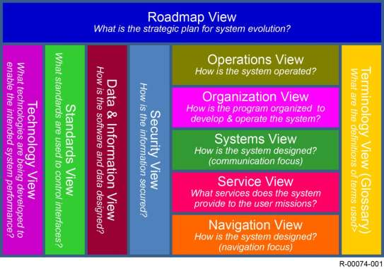
SCaN Abstract Architecture Model
Notes:
Mention “Increment View”

Slide 15
Methodology: Framework
The Roadmap View describes the long range plan for evolving the system integrating the results of the other Views. The Operations View includes the operational scenarios, activities, and requirements that support capabilities.
The Organization View describes the relationships between the various external organizations that interact with SCaN and the relationships between the various internal projects being implemented.
The Systems View is the design for solutions articulating the systems, their composition, interconnectivity, and context providing for or supporting communications operations as performed by the internal organizations.
The Navigation View is the design for solutions articulating the systems, their composition, interconnectivity, and context providing for or supporting navigation operations as performed by the internal organizations.
The Service View describes the variety of communication and navigation services that the system provides to the user missions.
The Technology View articulates the investments being made by SCaN to meet future needs or to take advantage of opportunities.
The Standards View articulates the applicable policies, technical standards, guidance, constraints, and forecasts that apply to requirements, system engineering processes, and systems and services.
The Data and Information View describes the data relationships and information structures in the architecture used to support the requirements, system engineering processes, and systems and services.
The Security View describes a representative set of security services, configurations, and common security standards that provide user missions end-to-end security of their data.
Terminology is defined with a glossary that captures both non-standard (legacy) definitions and standard (SCaN Network) definitions.

Slide 16
PSE Model
SCaN Program
NPR 7120.5
Roadmap
User Missions
Stakeholders
NPR 7123.1
ESC
PSE SCaN Model
Commercial satellites and service providers
Current Focus for PSE
SCaN Architecture Structure
SCaN Domain
Requirement
  Level 1
  Level 2
Architecture
  Functional Architecture
  Physical Architecture
  Information Architecture
ConOps
  Operational views – OV1s
  Ops Scenarios – Activity diagrams, use case diagrams
Verification & Validation (V&V)
Current Packaged Model
PSE model package Structure
How to use the model
SCaN Architecture
Documents
Roadmap
V&V
Program Docs
SCaN MBSE WG
SPTF
KDP’s
Glossary
Notes:
Snapshot
Show in a manner that isn’t sequential

Slide 17
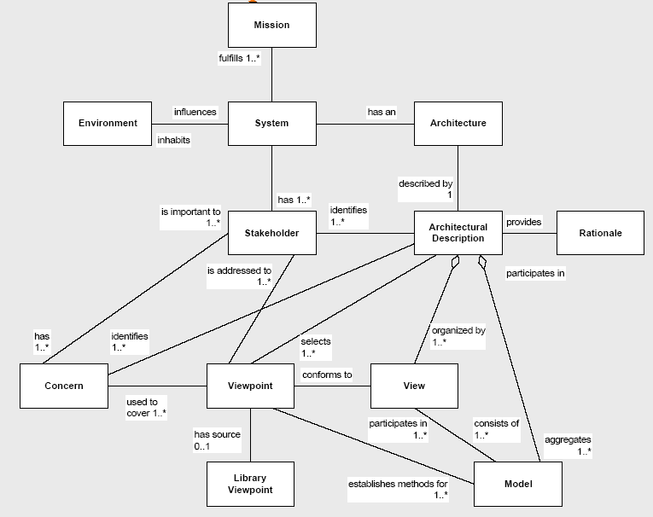
RASDS background – from the
IEEE-1471-2000
conceptual framework…
We formalize and adapt this generic conceptual
framework into one for
space data system design
2 Mar 2015
SC 13 / SC 14 RASDS & Ontologies
PS 17
Notes:
17

Slide 18
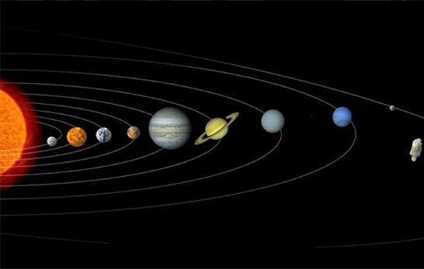
Reference Architecture
for Space Data Systems
Enterprise
Business Concerns
Organizational perspective
Physical Concerns
Node & Link perspective
Connectivity
Functional
Computational Concerns
Functional composition
Information
Data Concerns
Relationships and transformations
Communications
Protocol Concerns
Communications stack perspective
Derived from: RM-ODP, ISO 10746
Compliant with IEEE 1471 and ISO 42010
2 Mar 2015
SC 13 / SC 14 RASDS & Ontologies
PS 18
Notes:
18

Slide 19
Semantic Information Model
Development Process
RASDS as Architectural Framework *
Engineering Viewpoint
System Design & Construction
Functional allocation
Distribution of functions and trade-offs
Development
Validation & verification
Enterprise Viewpoint
Organizations
People
Use Case-Scenarios
Contracts/Agreements
Connectivity Viewpoint
Connectivity
Components & connectors
Physics of Motion
End to End View
External Forces
Performance
Functional Viewpoint
Functional Structure
Functional Behavior & interfaces
End to End View
Cross Support Service
Information Viewpoint
Information & information management
Scenarios
End to End View
Technology Viewpoint
Protocols & comm standards
End to end Information Transfer Mechanisms
Cross Support Services
Based on RMODP**
Augment to Capture:
Mission Design & Drivers
Requirements
Phases
Mission Assurance Viewpoint
Enterprise Risks
Cost
Validation & verification
Safety
Reliability & quality
Physical
Viewpoint
Structure
Power
Mass
Thermal
Orbit
Propulsion
Operational
Viewpoint
Processes
Procedures
Activities, tasks, actions
Events, scenarios
Modes & states
* Reference Architecture for Space Data Systems (RASDS)
** Reference Model Open Distributed Processing (RMODP, ISO 10746 spec)
2 Mar 2015
SC 13 / SC 14 RASDS & Ontologies
PS 19
Notes:
19

Slide 20
RASDS
Top Level Object Ontology
Composed Of
Organization
Perspective
(Viewpoint)
Mission
Defines Objects
Requirements
Defines Relations
FulfilledBy
Objectives
Defines Rules
Goals
Exposes Concerns
ComposedOf
Scenarios
Owns/Operates
Fulfills
Calls
Function
Produces
Information
Logical structure
Consumes
Data
Behavior
Metadata
Interfaces
IsAllocatedTo
ComposedOf
Rules
Constraints
ContainsInstances
Node
ProvidesService
Environment
Uses
Type
Affects
ImplementedOn
Attributes
ConnectVia
Physical Environs
Communication
Ports
Attributes
Location
ConnectToPort
Protocol stack
Link
Standards
AssociatedWith
Type
Attributes
2 Mar 2015
SC 13 / SC 14 RASDS & Ontologies
PS 20
Notes:
20

Slide 21
DoDAF and RASDS
Relationships
DoDAF (Notional)
RASDS (Notional)
Operational
Activity
Performs
Operational
Node
Enterprise
Object
Performs
Functional
Object
Is implemented by
Hosts
Owns
Owns
Interacts over
System
Function
Hosts
System
Node
Node
Connects
Link
Generates or consumes
System
Data
Is exchanged between
Generates or consumes
Is exchanged over
Information
Object
“RAS-DAF”
Operational
Activity
Performs
Ent Obj /
Ops Node
Performs
Functional
Object
Hosts
Is implemented by
Owns
Interacts over
System
Function
Hosts
(System)
Node
Connects
Link
Is exchanged between
Implemented by
Generates or consumes
Generates or consumes
Is exchanged over
System
Data
Information
Object
Protocols

Slide 22
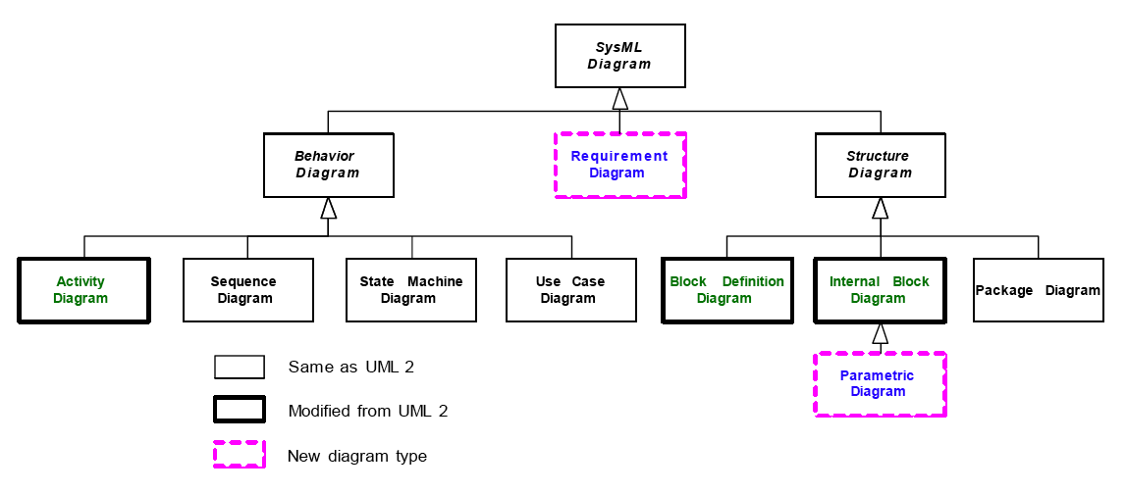
SysML Diagram Types
Source: SysML Partners

Slide 23
Mapping RASDS into SysML
No simple one for one mapping
RASDS uses Viewpoints to expose different concerns of a single system
SysML uses specific diagrams to capture system structure, behavior, parameters and requirements
Several SysML diagrams, focused on different object classes, may be usefully applied to any given RASDS Viewpoint
Extended SysML Views may be used to define the relationships between Viewpoints and Diagrams
SysML methods & tools will support more accurate fine grained modeling of structure, relationships and behavior than was expected of RASDS
The RASDS methodology may be used to select appropriate SysML diagram types and representations of complex systems architectures

Slide 24
Mapping RASDS into SysML
Enterprise
  Organizational structure & behavior diagrams
  Use case, activity, and sequence diagrams
  Requirements & constraints for rules, policies & agreements
Connectivity
  Physical structure, composition, behavior & class diagrams
  Parametric diagram for physical link & environment characterization
Functional
  Logical structure, behavior & class diagrams
  Activity, state chart, parametric, & timing diagrams
Informational
  Information class & parametric diagrams
Communication
  Protocol structure & behavior diagrams
  State machine, sequence, activity & timing diagrams

Slide 25
Proposed RASDS Extensions
(ISO TC20/SC 14 Cooperation)
Service Viewpoint
  Already introduced in CCSDS SCCS-ARD/ADD
  Covers system service interfaces and interface bindings
Physical viewpoint
  Extend present Connectivity Viewpoint
  Add support for physical elements, structures, power, thermal views (perhaps each their own Viewpoint)
Operational Viewpoint
  Extend present Enterprise Viewpoint
  Add support for organizational processes, procedures, and related behavior
  Possibly derived from DODAF OV’s
2 Mar 2015
SC 13 / SC 14 RASDS & Ontologies
PS 25

Slide 26
Connectivity (& Physical) Viewpoint -
Component / Connector (Node / Link)
Examples
Data System
  Components (CPU, instruments, SSR)
  Connectors (network, data bus, serial lines, backplane)
Telecomm
  Components (transmitter, receiver, antenna)
  Connectors (RF link, optical link, waveguide)
Structural
  Components (S/C bus, physical link, arm, struct attrib of other components)
  Connectors (joint, bolt (incl explosive), weld)
Power
  Components (solar panel, battery, RTG, switches, power attrib of other components)
  Connectors (power bus)
Thermal
  Components (cooler, heater, thermal attrib of other components)
  Connectors (heat pipe, duct, free space radiation)
Propulsion
  Components (motor, wheel, thruster)
  Connectors (contact patch, gravity )
2 Mar 2015
SC 13 / SC 14 RASDS & Ontologies
PS 26
Notes:
26

Slide 27
SCaN Integrated Network Architecture Framework - RASDS
Overview of the SCaN Integrated Network Architecture problem and the trade studies
Description of the methodology that was adapted for these System-of-systems trade studies
Overview of the conceptual elements and their representations
Examples of the different kinds of RASDS views used and their representation as SysML diagrams

Slide 28
SCaN INA Trade Study Process
Each of the ScaN Integrated Network Architecture (INA) trade study cycles was initiated by producing a guiding document that typically covered the following topics in a compact form:
An overall process flow for the trade study
A description of each of the separate parts of the study e.g., software, hardware, operations
Statement of the purpose and objectives of each part of the trade study
Any assumptions and constraints
The scope of the study, typically related to the baseline functional overview
Description of how the network and system elements mapped into the trade study
Definition of the trade space options to be considered
Description of the approach to be used for the trade study
Team composition, duration, and planned schedule for the effort

Slide 29
Integrated Network Architecture Trade Study Cycles 2-3
Based on conclusions of the Cycle 1 Study - Drill down into detailed analysis to refine the cost estimates for architecture selection during Cycles 2-3:
  Integrated Network Control Study
    Covers Network Control functions (minus Network Scheduling)
      Network Asset Configuration & Control
      Network Asset Monitoring
      Space Internetworking Management
  COOP Study
    Address Network Control aspect of the COOP
    Service Execution is no longer an issue for COOP after Cycle-1 decision
  Space Internetworking Study
    Any changes required to Service Execution and Network Control functions.

Slide 30
NCS-1 Common Network Control Framework
Service Execution
Network Control
Framework
MOC
EBRE
EBRE
Central Service
Management
I
/F
MOC
Service Execution
Network Control
Framework
NEE
NEE
I
/F
Service Execution
Network Control
Framework
DSE
DSE
NCS-2 Common Network Control Interface
Service Execution
Asset-specific
Network Control
MOC
EBRE
I/F
Central Service
Management
I
/F
MOC
Service Execution
Asset-specific
Network Control
NEE
I/F
I
/F
Service Execution
I/F
DSE
Asset-specific
Network Control
NCS-3 Central Gateway
Service Execution
Asset-specific
Network Control
Gateway
MOC
EBRE
Central Service
Management
I
/
F
MOC
Service Execution
Asset-specific
Network Control
NEE
I
/
F
Service Execution
Asset-specific
Network Control
DSE
NCS-4 Network Element Gateways
Service Execution
Asset-specific
Network Control
GW
MOC
EBRE
Central Service
Management
I
/
F
MOC
Service Execution
Asset-specific
Network Control
GW
NEE
I
/
F
Service Execution
Asset-specific
Network Control
GW
DSE

Slide 31
Modeling Approach
Initial Cycle 1 “modeling” was done using a combination of PowerPoint, Excel spreadsheets, and some analytical simulations of mission set loading and required network throughput
As we moved into software and system Trade Study cycles more accurate models were required
The team adopted Magic Draw / SysML and a Teamwork repository to coordinate the distributed effort
Two centers provided the modeling leads: JPL for system and software models, GRC for operational activity models
  JPL Team: Shames, Sindiy, Donahue, Levesque
  GRC team: Kunath, Reinert, Barnes
SMEs from GSFC and JPL provided the domain knowledge and reviewed the models
  GSFC SMEs: Wright, Anderson, Kowal
  JPL SMEs: Tai, Levesque, Barkley, Johnston, Wolgast
Experts from the network elements and HQ, and a Red Team with a mission focus, reviewed interim and final results of each cycle

Slide 32
System Modeling Methods
UML and SysML provide a series of diagram types, but it is up to the modeling team to determine which viewpoints and views best represent the system
For these models we used the following viewpoints - derived from CCSDS Reference Architecture for Space Data Systems (RASDS):
  System software structures and data / control flows (function BDD structure and IBD composition)
  System and software product line / variation points (function BDD generalization and specialization)
  System deployment across multiple sites (site and function BDD showing allocation)
  Software functional abstractions (abstract function activity and BDD generalization and specialization)
  Information models (information object BDD)
Use stereotypes and colors to make models readable and (more readily) interpretable, types, variations, specializations
Develop a “Guide for the Perplexed” to hand-hold novices in reviewing HTML browse models

Slide 33
Model Color Palette & System Stereotypes

Slide 34
EBRE PoD Architecture Model
The SN is doing a major upgrade called the Space Network Ground System Sustainment (SGSS) project
  This is assumed to provide the primary viable approach for implementing the whole of the next generation SCaN architecture
  Other options are also being studied
The SGSS design (pre-PDR) has the following characteristics:
  SGSS has the following elements: Space ground Link (SGL), User Services gateway (USG), Digital Signal Processor (DSP), Service Management (SM), Fleet Ground Management (FGM), Enterprise Infrastructure (EI)
  The SGSS architecture is a quite modern concept, using a pool of shared, programmable servers 9including blades and FPGAs), a high speed set of networks, and an message bus based enterprise infrastructure
  Service Management (SM) orchestrates the delivery of SGSS TT&C and User services. It provides the remote SN user service management interfaces and local SN operator interfaces for managing SN services.
  The Fleet Ground Management (FGM) element manages and controls the TDRS Fleet, and manages the Ground Segment. Management and Control is isolated from user or TTC bearer data wherever possible. The element provides distinct capabilities in an integrated element – Fleet Management, Fleet Control, Ground Management, and Ground Control.
  SGL, DSP & USG all have Control Test & Monitor functions. “Control, Test, & Monitor (CTM) functions manage, control and test each element. CTM functions accept service requests and provide service status on the control plane. CTM functions load software, load configurations, report detected faults, and provide performance information on the management plane.”
A primary purpose of the Cycle 2 studies is to assess whether the SGSS architecture is suitable for use in the other two network elements (DSE & NEE) or if some other alternatives are more functional, lower risk, or more cost effective

Slide 35
EBRE Level 2 Architecture

Slide 36
NCS-1 EBRE Level 2 System Composition Model

Slide 37
EBRE Level 3 Service Management (SM)
Software Architecture

Slide 38
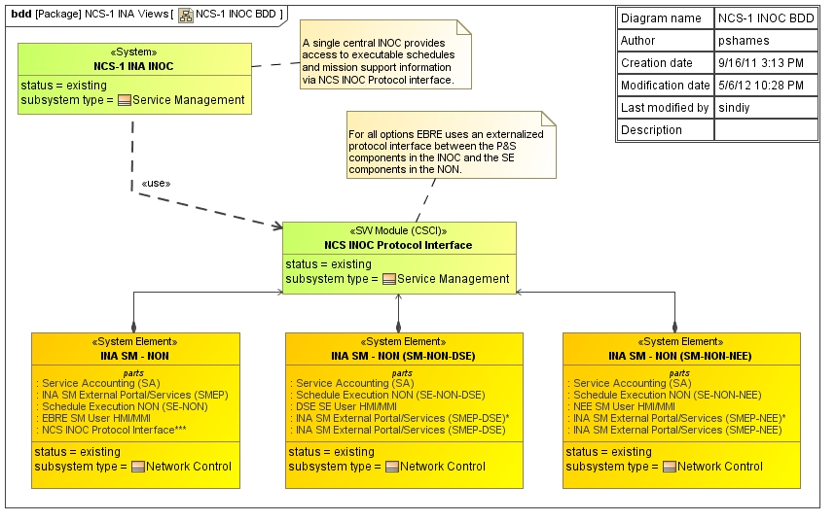
NCS-1 Integrated Overview

Slide 39
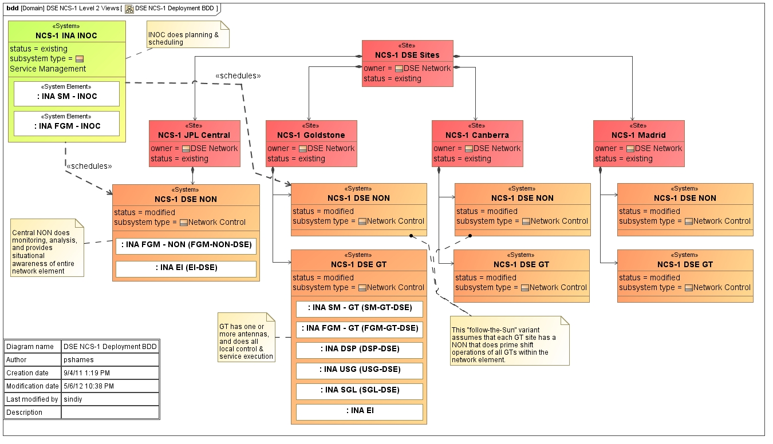
NCS-1 DSE Level 2 Deployment Model

Slide 40
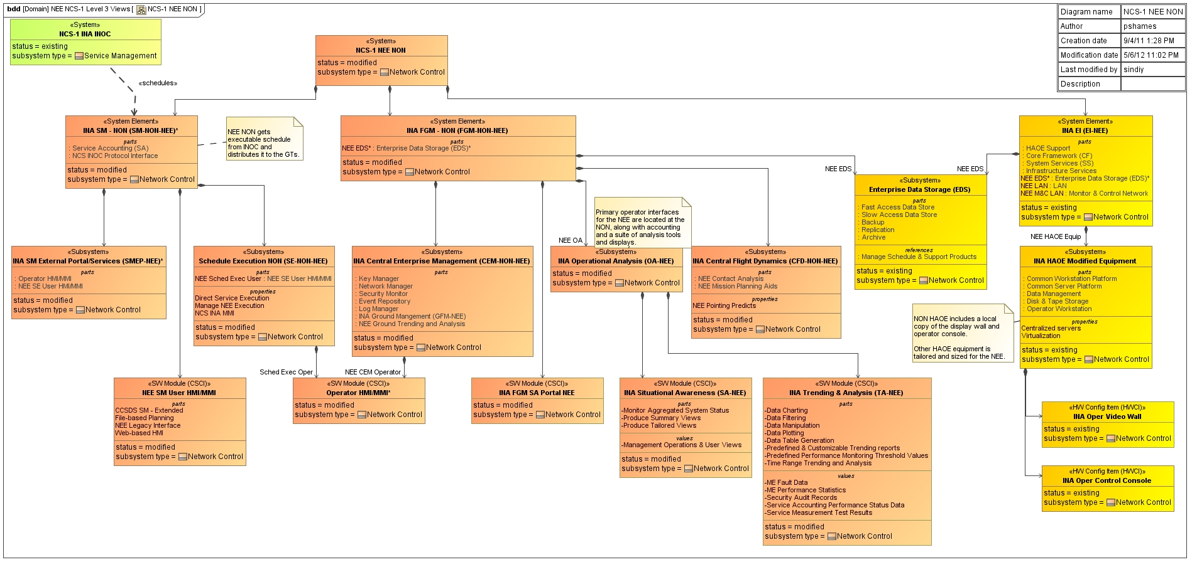
NCS-1 NEE Level 3 NON Network Control
Composition Model

Slide 41
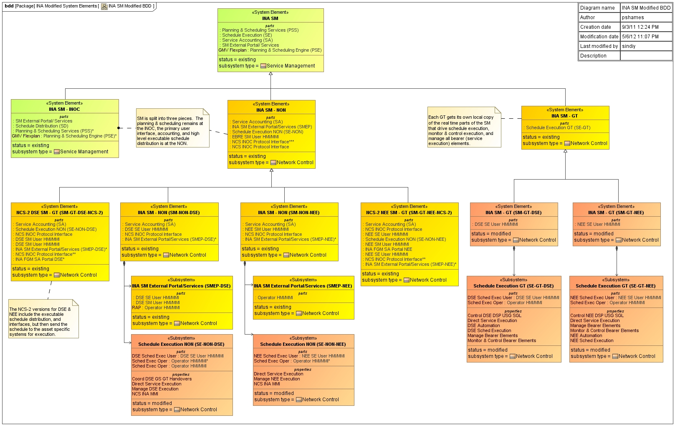
Service Management (SM) Specialization

Slide 42
Backup

Slide 43
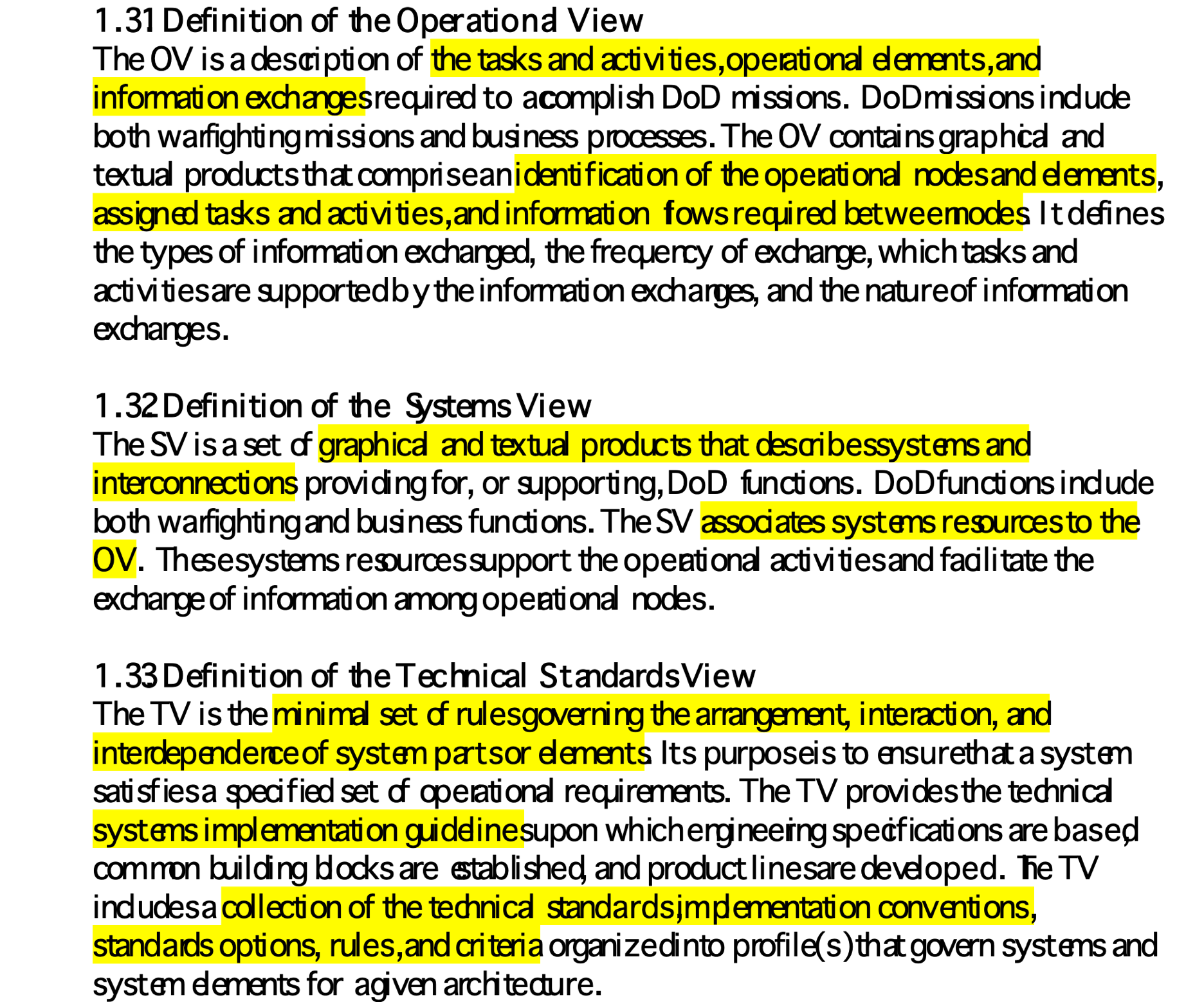
Definitions of DoDAF Views

Slide 44
Correspondence Between RASDS and DoDAF Elements
DoDAF Elements | RASDS Elements
Operational Nodes (OV-2) | Enterprise Objects (EV)
Needlines (OV-2) | Enterprise and Functional Interactions (EV and FV)
Information Elements (OV-3) | Information Objects (IV)
Operational Activities (OV-5) | Functional Objects (FV)
Systems Nodes (SV-1) | Nodes (CV)
Systems (SV-1) | Sub-nodes (CV)
System Interfaces (SV-1) | Links (CV)
Key Interface (SV-1) | Cross-support interface (CV)
System Functions (SV-4) | Functional Objects (FV)
System Data (SV-6) | Information Objects (IV)

Slide 45
Correspondence Between RASDS and DoDAF Views (1/2)
DODAF View | RASDS View
Overview and Summary Information (AV-1) | None
Integrated Dictionary (AV-2) | None
High-Level Operational Concept Graphic (OV-1) | None
Operational Node ConnectivityDescription (OV-2) | Enterprise View
Operational Information Exchange Matrix (OV-3) | Information View
Organizational Relationships Chart (OV-4) | Enterprise View
Operational Activity Model (OV-5) | Functional View
Operational Rules Model, etc (OV-6) | None
Logical Data Model (OV-7) | Information View
Systems Interface Description (SV-1) | Connectivity View
Systems Communications Description (SV-2) | Communications View
Systems-Systems Matrix (SV-3) | None

Slide 46
Correspondence Between RASDS and DoDAF Views (2/2)
DODAF View | RASDS View
Systems Functionality Description (SV-4) | Functional View
Operational Activity to Systems Functionality Traceability Matrix (SV-5) | None
Systems Data Exchange Matrix (SV-6) | Information View
Systems Performance Parameters Matrix (SV-7) | None
Systems Evolution Description (SV-8) | None
Systems Technology Forecasts (SV-9) | None
Systems Functionality and Timing Descriptions (SV-10) | None
Physical Schema (SV-11) | Information View
Technical Standards Profile (TV-1) | None (partially, Communications View)
Technical Standards Forecast (TV-2) | None

Slide 47
SCaN Model
Views and Perspectives
The Operational Viewpoint is the architecture repository for requirements and top-level system structure. It provides essential support to requirements analysis, e.g., by quantifying the operational, cost and technical risk consequences of alternative levels of capability.
The Logical/Functional Viewpoint evolves in lockstep with functional design and the early stages of detailed design; among the most important artifacts at this point are development or procurement specifications to be used to obtain various elements of the solution.
The Physical Viewpoint documents the point design and supports configuration management, test planning, and many other aspects of system implementation.
The entire architecture model is an important tool in timely and affordable incorporation of key Specialty Engineering requirements such Reliability, Maintainability, and Availability (RMA); security and information assurance; and system safety.

Slide 48
Definitions of DoDAF Views

