Slide 1
Solar Array in the Space Reference Architecture for Space Systems and Operations
Fred Slane
(impudent comments by Peter Shames)

Slide 2
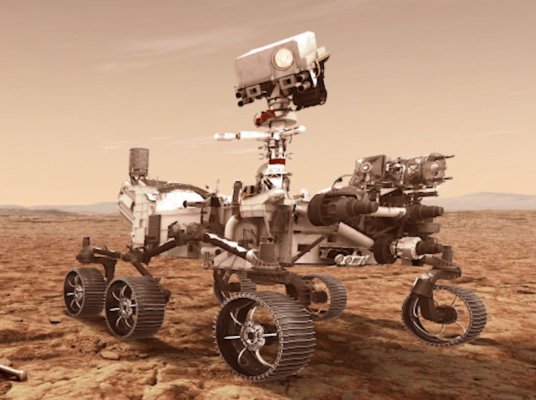
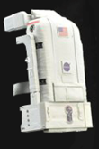
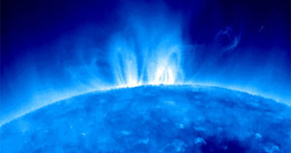
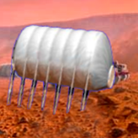
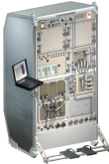
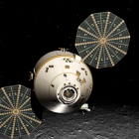
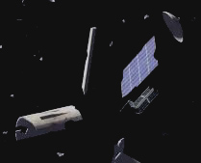
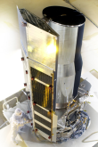
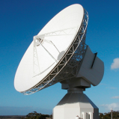
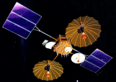
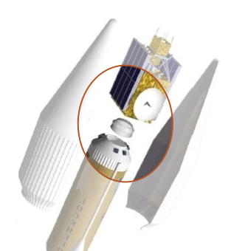
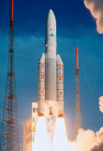
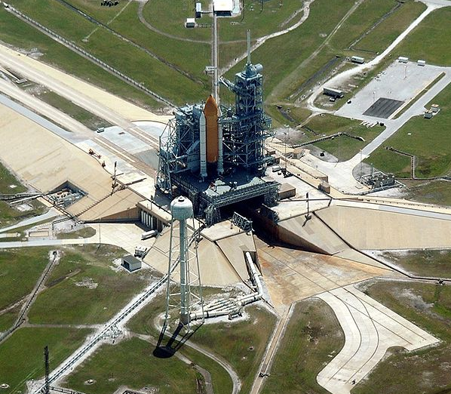
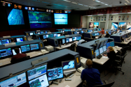
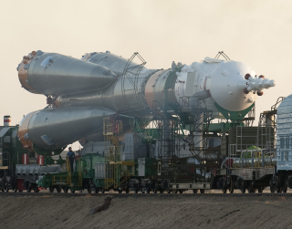
Reference Architecture for Space
1) Identify where the object “solar array” fits in this picture
Robotic
Explorers
EVAs
Constellations
Space
Environment
Habitats
Object is child of “Enterprise”
“Object is child of “Systems Engineering”
Spacecraft
Payloads
Planetary
Surfaces
Space
Debris
Human Spacecraft
Instruments
Robotic Spacecraft
Space-to-Ground
Comm
Mission Ops
and Support
Launch
Vehicles
Launch Ground Systems
Launch
Payloads
Vehicle Ground
Processing
In-Space
Comm &
Services
End-to-End
Networking
Space-to-Ground
Comm & Transport
Spacecraft
Development and test
Systems Engineering
Space Enterprise

Slide 3
RASDS Concept Model … and Proposed TC20/SC14 extensions
=RASDS++
Services Viewpoint
Tabular views of functions, operations, and related standards
Support system Design & Construction - realization
Correspondence to Protocol stacks and interface bindings
RASDS++ as Architectural Framework *
Functional allocation and distribution of functions and trade-offs (correspondence)
Engineering Viewpoint
System Design & Construction - realization
Functional allocation
Distribution of functions and trade-offs
Development
Validation & verification & engineering processes
Enterprise Viewpoint (15288)
Organizations
People
Use Case
Contracts Agreements (CONFERS)
Glossary
Connectivity / Deployment Viewpoint
Connectivity
Components & connectors
RF & optical
Physics of Motion
End to End Views
External Forces
Performance
Functional Viewpoint
Functional Structure - abstract
Functional Behavior & abstract interfaces
End to End View
Cross Support Services
Information Viewpoint
Information & information management
Data structures, syntax & semantics
Attributes & constraints (ASN, FRM, EDS)
Protocol Viewpoint
Protocols & comm standards
End to end Information Transfer Mechanisms
Cross Support Services
Service interface bindings
State & Sequence charts ?
Just use 15288 or agency specs
Mission Assurance Viewpoint ??
Enterprise Risks
Cost
Validation & verification
Safety
Reliability & quality
Augment to Capture:
Capabilities
Mission Design & Drivers (OV-1?)
Requirements
Phases
Physical Viewpoint -Structures:
Power
Mass
Thermal
Orbit
Propulsion
Operational Viewpoint
Processes
Procedures
Activities, tasks, actions
Scenarios, Events
Modes & states
New Viewpoint
Modified Viewpoint
Just use 15288 or agency specs
De-selected Viewpoint
* Reference Architecture for Space Data Systems (RASDS)
** Reference Model Open Distributed Processing (RMODP, ISO 10746 spec)
Notes:
3

Slide 4
Viewpoint Interconnects (Threads)
Composed Of
Operations
Enterprise
Meta-model
(each Viewpoint)
Scenarios
Performs
Processes
Mission
Defines Objects
Activities
Requirements
Defines Relations
Invoke
Tasks
Objectives
Defines Rules
Modes/states
Governance
Defines Correspondences
FulfilledBy
Use Cases
Exposes Concerns
ComposedOf
Resources
Develops / Owns
Meets
Calls
Function
Produces
Information
Offers
Logical structure
Consumes
Data
Behavior
IsImplementedBy
Metadata
Interfaces
ComposedOf
Rules
Service
Constraints
ContainsInstances
Component
(Node)
Svc Behavior
ProvidesService
Environment
Interface Sig
Uses
Type
Affects
Svc Constraints
ImplementedOn
Attributes
(comm, power,
thermal, prop,
other)
ConnectVia
Physical Environs
Defined by
Protocol
Attributes
Protocol stack
Attachment
Connector
(Link)
Standards
Location
AssociatedWith
Type
Flows
(comm, power,
thermal, prop,
other)

Slide 5
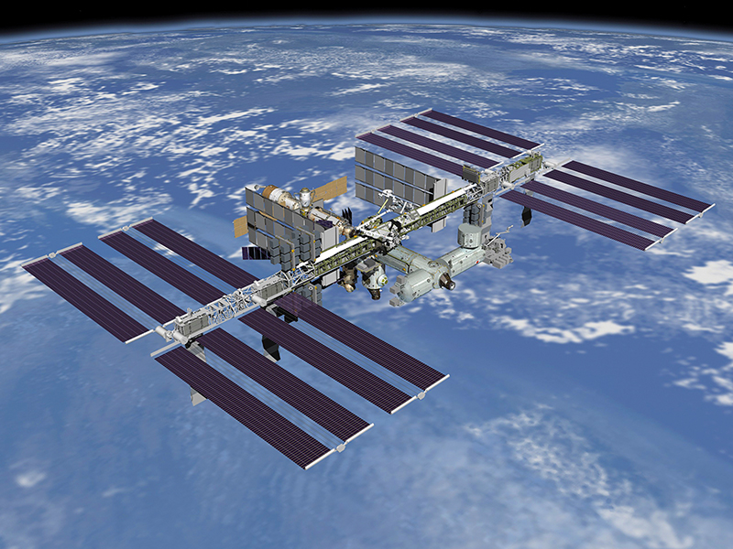
“Spacecraft” may have a “Solar Array” (Overview-1, an example)
1
2) A spacecraft has a power subsystem
3) Object “solar array” as a part of a “spacecraft power subsystem”
The “solar array” is a child of “spacecraft power subsystem”
The solar array has an interface to the spacecraft

Slide 6
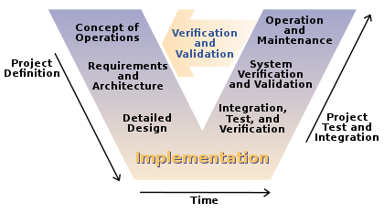
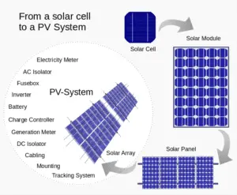
Systems Engineering for a Solar Array
Works as part of a Spacecraft (Reference Spacecraft Systems Engineering)
INCOSE reference
Show relationship of RASDS++ to the Vee
Include Arch <> Design triangles in middle

Slide 7
Solar Array Overview (OV-1) Environment and Operations Viewpoints are also relevant at the Spacecraft level

Slide 8
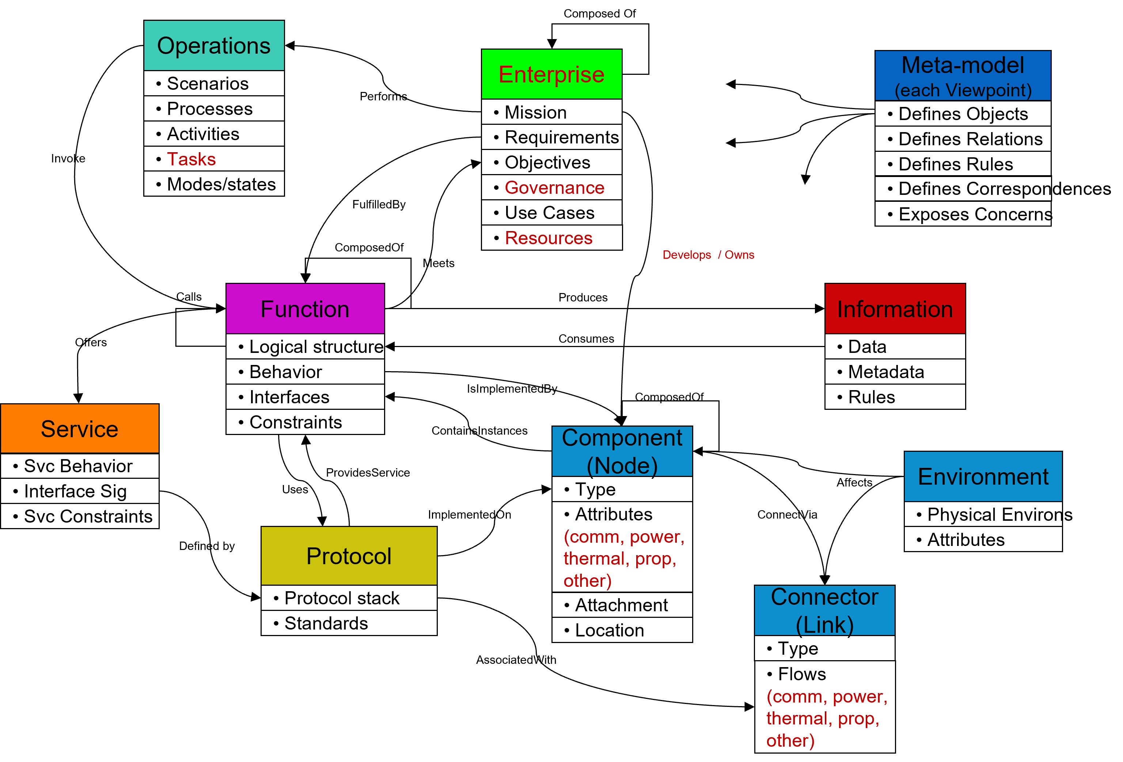

Slide 9
Refer to the RASDS++ Metamodel for MBSE links from the Solar Array (as an assembly of Components and Connectors or as a Component with Connections):
Enterprise develops/owns Solar Array
Environment affects Solar Array
Function is implemented by the Solar Array and the Solar Array contains instances of Function
Protocol controls Solar Array
Connector connects Solar Array component to Spacecraft component
Mission operates Solar Array and Spacecraft
Information describes Solar Array parameters

Slide 10
Solar Array (“OV-2” or Operational View)
Manufacture Solar Array (really Engineering viewpoint)
Integrate Solar Array with Spacecraft (likewise)
Verify Solar Array Function (likewise)
Pack Solar Array for Launch
Launch Spacecraft
Deploy Solar Array
Initiate Solar Array
Operate Solar Array
Dispose of Solar Array
Engineering VP

