Slide 1
How to use the Space Reference Architecture Fourth Draft (Comments by Peter Shames)

Slide 2
Help all participants understand modeling, articulating challenges and controlling risks Help coordinate serial and parallel process development across an organization/organizations Be consistent among the multitude of standards in the various Standards Development efforts: - Avoid superposition of subjects. - Identify cross issues in different standards. - reduce inclusion of requirements that we really do not need.
Some Reasons for a Reference Architecture

Slide 3
Step 1: Identify what is in the Transnational Space Reference Architecture

Slide 4
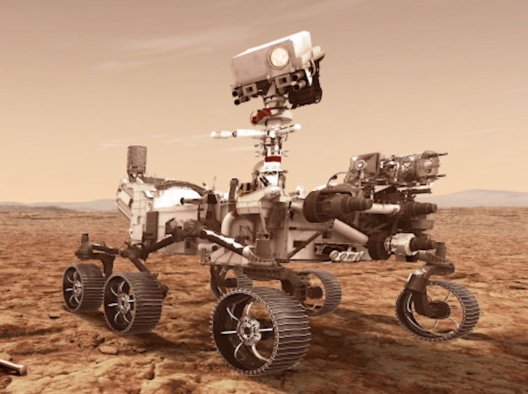
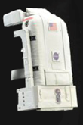
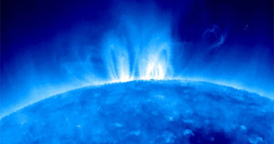
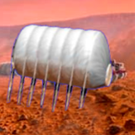
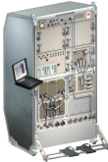
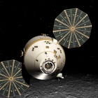
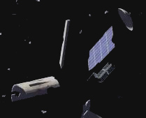
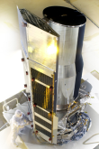
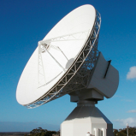
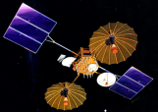
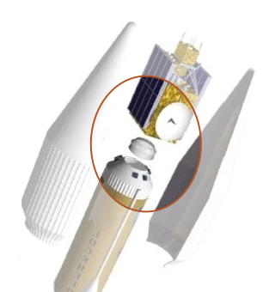
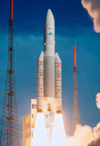
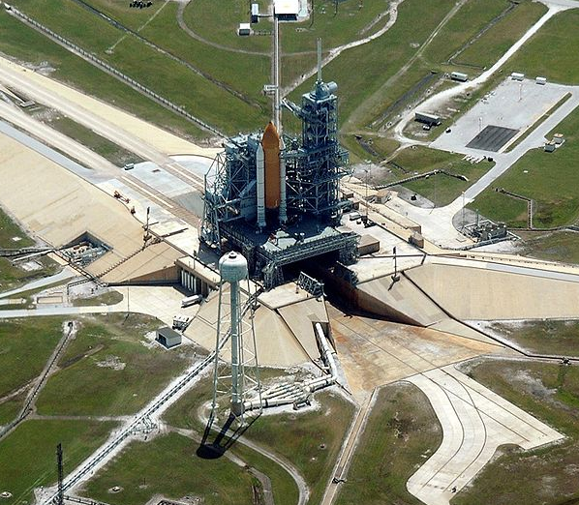
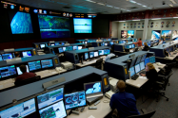
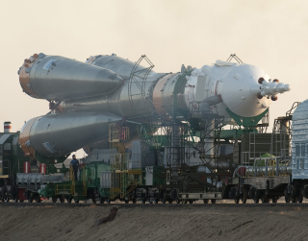
Transnational Space Architecture Framework
Robotic
Explorers
EVAs
Constellations
Space
Environment
Habitats
Spacecraft
Payloads
Planetary
Surfaces
Space
Debris
Human Spacecraft
Instruments
Robotic Spacecraft
Space-to-Ground
Comm
Mission Ops
and Support
Launch
Vehicles
Launch Ground Systems
Launch
Payloads
Vehicle Ground
Processing
In-Space
Comm &
Services
End-to-End
Networking
Space-to-Ground
Comm & Transport
Spacecraft
Development and test
Systems Engineering
Enterprise

Slide 5
Use RASDS++ to show “As is”
Viewpoints, Lifecycle, Scope Scale
Business
model
Enterprise
Connectivity
(Structure)
Wider
Spatial Scope
Function
RASDS/RASDS++
Interoperability viewpoints
Data model
Space
Information
Globe
Protocol
RF
Region
Communication
Scope
City
Venue
Operational
System
Component
Lifecycle
Environment
Disposal
Operations
Requirement
Verification
Architecture
Production
Design & Engineering
Service/Operation
Source: Koki Asari, Japan Space Systems
ISO TC 20/SC 14/WG8
Mission assurance

Slide 6
RASDS++ (DRAFT) Viewpoints
Composed Of
Operations
Enterprise
Meta-model
(each Viewpoint)
Scenarios
Performs
Processes
Mission
Defines Objects
Activities
Requirements
Defines Relations
Invoke
Tasks
Objectives
Defines Rules
Modes/states
Governance
Defines Correspondences
FulfilledBy
Use Cases
Exposes Concerns
ComposedOf
Resources
Develops / Owns
Meets
Calls
Function
Produces
Information
Offers
Logical structure
Consumes
Data
Behavior
IsImplementedBy
Metadata
Interfaces
ComposedOf
Rules
Service
Constraints
ContainsInstances
Component
(Node)
Svc Behavior
ProvidesService
Environment
Interface Sig
Uses
Type
Affects
Svc Constraints
ImplementedOn
Attributes
(comm, power,
thermal, prop,
other)
ConnectVia
Physical Environs
Defined by
Protocol
Attributes
Protocol stack
Attachment
Connector
(Link)
Standards
Location
AssociatedWith
Type
Flows
(comm, power,
thermal, prop,
other)

Slide 7
Step 2: Identify what is of specific interest or change in the Transnational Space Reference Architecture Example: On- Orbit Servicing

Slide 8
I would call this an OV-1, and I think it shows Operations Steps and activities, not functions, per se

Slide 9
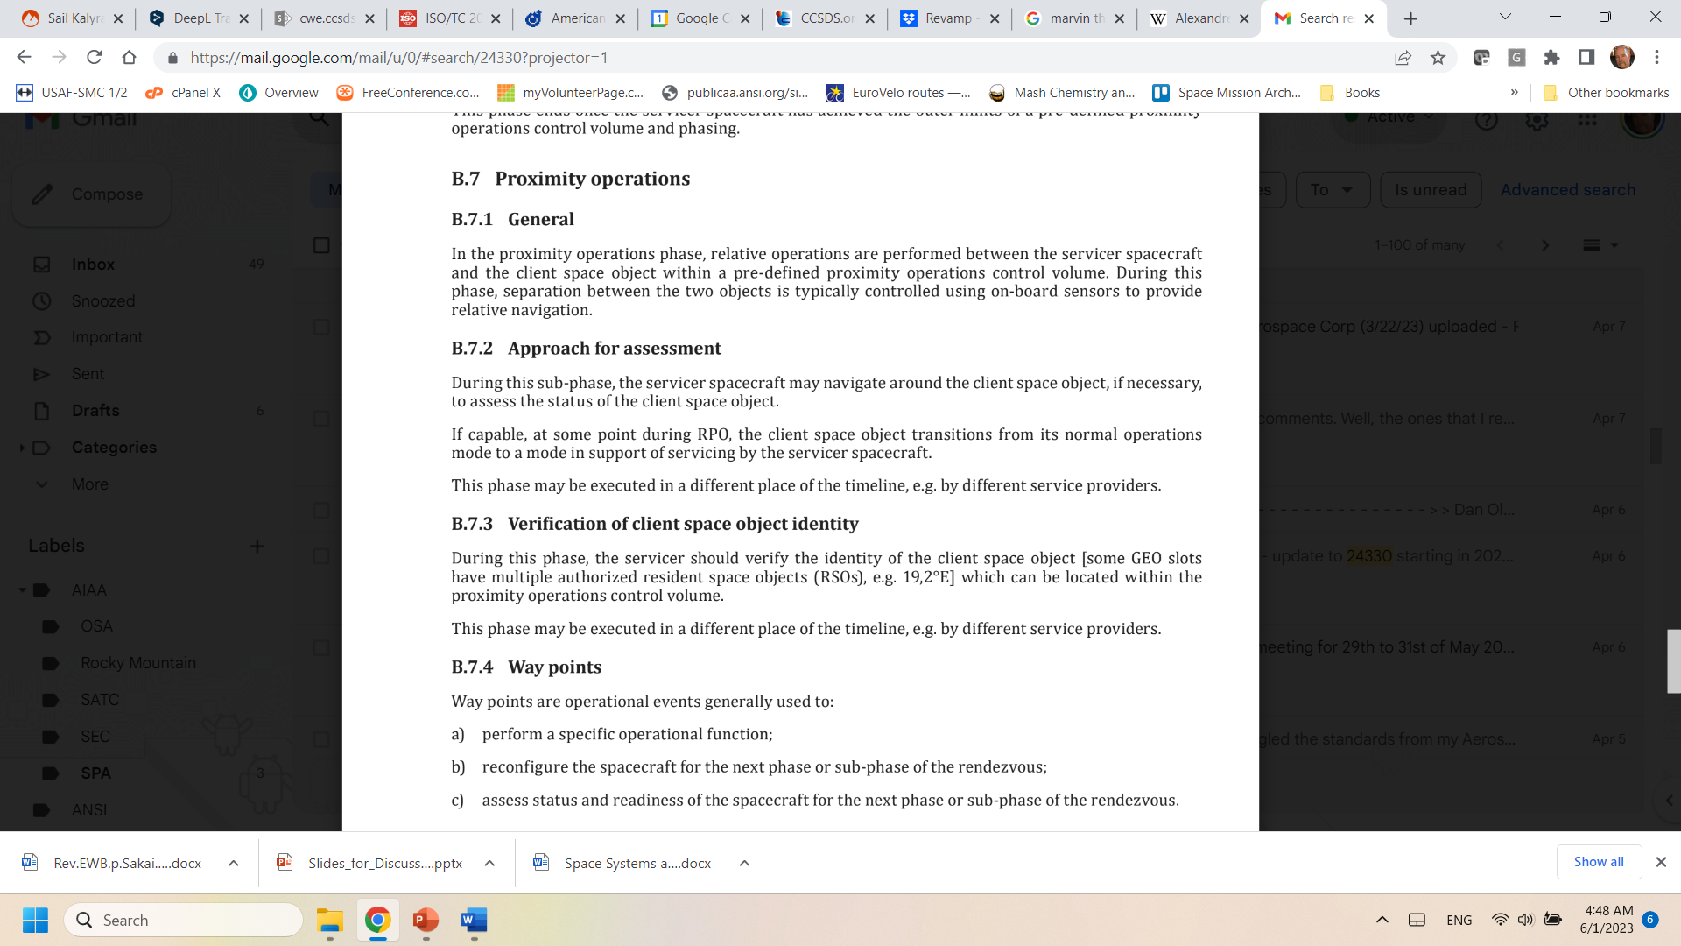
Prox Ops example
I think it shows Operations Steps and activities

Slide 10
Identify (OOS) Change Impact
I’m not sure just what point you are trying to make here? Is it that OOS can be represented from those viewpoints?
Composed Of
Operations
Enterprise
Scenarios
Performs
Processes
Mission
Activities
Requirements
Invoke
Tasks
Objectives
Modes/states
Governance
Defines Correspondences
FulfilledBy
Use Cases
ComposedOf
Resources
Develops / Owns
Meets
Calls
Function
Produces
Information
Offers
Logical structure
Consumes
Data
Behavior
IsImplementedBy
Metadata
Interfaces
ComposedOf
Rules
Service
Constraints
ContainsInstances
Component
(Node)
Svc Behavior
ProvidesService
Environment
Interface Sig
Uses
Type
Affects
Svc Constraints
ImplementedOn
Attributes
(comm, power,
thermal, prop,
other)
ConnectVia
Physical Environs
Defined by
Protocol
Attributes
Protocol stack
Attachment
Connector
(Link)
Standards
Location
AssociatedWith
Type
Flows
(comm, power,
thermal, prop,
other)

Slide 11
Step 3: Reestablish the Transnational Space Reference Architecture

Slide 12
Re-EstablishTransnational Space Architecture Framework
Robotic
Explorers
EVAs
Constellations
Space
Environment
Habitats
Spacecraft
Payloads
Planetary
Surfaces
Space
Debris
Human Spacecraft
Instruments
Robotic Spacecraft
Space-to-Ground
Comm
Mission Ops
and Support
Launch
Vehicles
Launch Ground Systems
Launch
Payloads
Vehicle Ground
Processing
In-Space
Comm &
Services
End-to-End
Networking
Space-to-Ground
Comm & Transport
Spacecraft
Development and test
Systems Engineering
Enterprise
I like this chart!!!

Slide 13
Step 4: Iterate the Transnational Space Reference Architecture from “As is” As Needed

Slide 14
Under the Hood
I’m not sure just what point you are trying to make here?
“Realized”
Services Viewpoint
Tabular views of functions, operations, and related standards
Support system Design & Construction - realization
Correspondence to Protocol stacks and interface bindings
RASDS++ as Architectural Framework *
Functional allocation and distribution of functions and trade-offs (correspondence)
Engineering Viewpoint
System Design & Construction - realization
Functional allocation
Distribution of functions and trade-offs
Development
Validation & verification & engineering processes
Enterprise Viewpoint (15288)
Organizations
People
Use Case
Contracts Agreements (CONFERS)
Glossary
Connectivity / Deployment Viewpoint
Connectivity
Components & connectors
RF & optical
Physics of Motion
End to End Views
External Forces
Performance
Functional Viewpoint
Functional Structure - abstract
Functional Behavior & abstract interfaces
End to End View
Cross Support Services
Information Viewpoint
Information & information management
Data structures, syntax & semantics
Attributes & constraints (ASN, FRM, EDS)
Protocol Viewpoint
Protocols & comm standards
End to end Information Transfer Mechanisms
Cross Support Services
Service interface bindings
State & Sequence charts ?
Just use 15288 or agency specs
Mission Assurance Viewpoint ??
Enterprise Risks
Cost
Validation & verification
Safety
Reliability & quality
Augment to Capture:
Capabilities
Mission Design & Drivers (OV-1?)
Requirements
Phases
Physical Viewpoint -Structures:
Power
Mass
Thermal
Orbit
Propulsion
Operational Viewpoint
Processes
Procedures
Activities, tasks, actions
Scenarios, Events
Modes & states
New Viewpoint
Modified Viewpoint
Just use 15288 or agency specs
De-selected Viewpoint
* Reference Architecture for Space Data Systems (RASDS)
** Reference Model Open Distributed Processing (RMODP, ISO 10746 spec)

Slide 15
Backgound

Slide 16
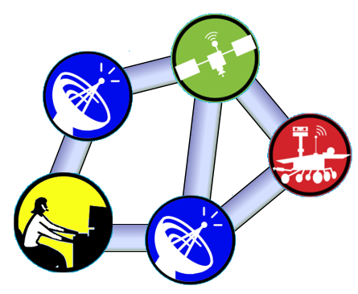
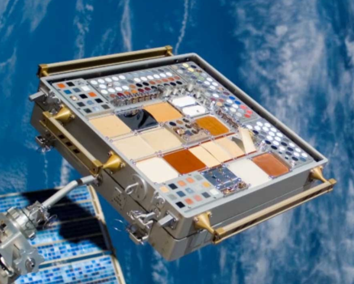
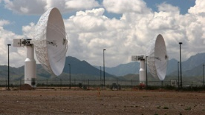
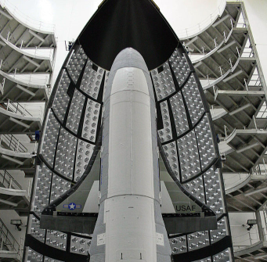
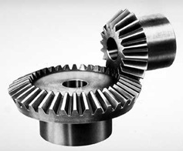
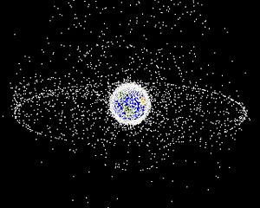
Space Standards Framework (v2)
Areas of coordination indicated by dotted lines
CCSDS Eng.
Steering Group
Cross-Cutting
Tech. Arch, etc.
Spacecraft Onboard
Interface Services
Space Internet
Services
Systems
Engineering
Space Link
Services
Materials and
Processes
CCSDS/SC13
ISO TC20/SC14
Cross Support
Services
Design Eng.
& Production
Ontologies
Mission Ops
Info Mgt Services
Interfaces,
Integration & Test
Navigation
Cross-Cutting
Mgt/Qual processes.
Space
Environment
Ops and Gnd
Support
SC14 Tech Mgt
Program Mgt
& Quality
Orbital Debris
Notes:
Minor change to V1 (recommended version). Arrows replace links between the areas.
Advantage: This shows flow within the architecture or between the processes of a typical mission.
Disadvantage: Adds visual complexity and may be somewhat “fabricated” rather than reflective of real processes.

Slide 17
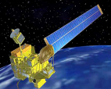
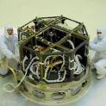
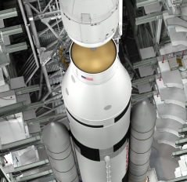
Space Standards Framework (v3)
I like this chart!!!
CCSDS (ISO TC20/SC13)
Space Data and Comm Systems
End Users
Cross-Cutting
Tech. Arch, etc.
MISSION OPS
CENTER
Tunnels Space Link to
Ground Faciliy/MCC
End-to-End Networking
Voice, Video
Appl. Layer Framework,
Control, Nav, Archive
System-wide Data Arch,
Security, Time, XML
Onboard Arch. and
Onboard Connectivity
Space-Space and
Space-Ground links
Spacecraft Onboard
Interface Services
Space Link
Services
Cross Support
Services
Space Internet
Services
Mission Ops &
Info Mgt Services
Systems
Engineering
ISO TC20/SC14
Space Systems and Operations
Processes and
Procedures for IV&T
Space Debris
prevention and
abatement
Space Vehicle
Materials standards
Cross-Cutting
Mgt/Qual processes.
MISSION OPS
CENTER
Space Weather
Vehicle Development
Standards
Ops Proccesses,
Nav, etc.
Overarching
Mission/program
processes
Orbital Debris
Space
Environment
Materials and
Processes
Design Eng.
& Production
Interfaces,
Integration & Test
Ops and Gnd
Support
Program Mgt
& Quality
7
4
6
1
2
3
5
Notes:
Version (option) 3 is another view of the CCSDS/SC13 and SC14 relationship.
Disadvantage: Not enough room to show areas of cooperation. More complex.
Advantages:
More compatible with CCSDS architecture illustrations… one-to-one mapping.
Has room for expansion of the content of an area/WG, providing a better understanding of each area/WG.
Better illustrates process flow in SC14 (but needs to be reviewed – may not be completely accurate and text for each SC14 WG should be reviewed/expanded)
Includes SC14 WG numbers (could be added to prior charts, too).
Explanation of CCSDS “flow”: Like CCSDS Architecture Graphic, Networking connects end-to-end and Applications (MOIMS) flows end-to-end across networking. Not enough room to illustrate tunnelling through Link and CSS services.
Explanation of SC14 “flow”
-- Orbital Debris is a subset of the space environment.
-- Space environment drives selection of materials and processes
-- Materials and processes feed design engineering and production (selection of materials feeds into design
-- Design Engineering and Production preceeds interfacing, integration and test.
-- Interfaces Integration and test preceeds Mission Ops
-- Program Mgt and Quality wraps around with cross-cutting processes.

