Slide 1
Cert
Cert
Cert
Cert
Proximity Link
Trunk Link
Terrestrial Link
Physical View
Rover
Lander
Ground Station
Mission Operations
Center
Cert
Authentication
Cert
Authentication
BP Network
Network and Users View
IP Network
IP Network
Mission Operations
Center
InterGovernmental Certification Authority / CA
Rover
Cert
App
Cert
Cert
Cert
App
Legend:
App: Application
BP: Bundle Protocol
BHP: Bundle Hop Protocol(s)
Bop: Bundle hop
IP: Internet Protocol
LNK: Link layer protocol
PHY: Physical layer
TCP: Transmission Control Protocol
TCPCL: TCP Convergence Layer Adapter
CA: Certificate Authority Trust Anchor
Cert: CCSDS Certificate
BP
BP
BP
BP
TCPCL
TCPCL
BHP
BHP
TCPCL
TCPCL
Protocol Stack View
TCP
TCP
TCP
TCP
IP
IP
IP
IP
LNK1
LNK1
LNK2
LNK2
LNK3
LNK3
PHY1
PHY1
PHY2
PHY2
PHY3
PHY3
Bop1
Bop2
Bop3
Non Security aware node

Slide 2
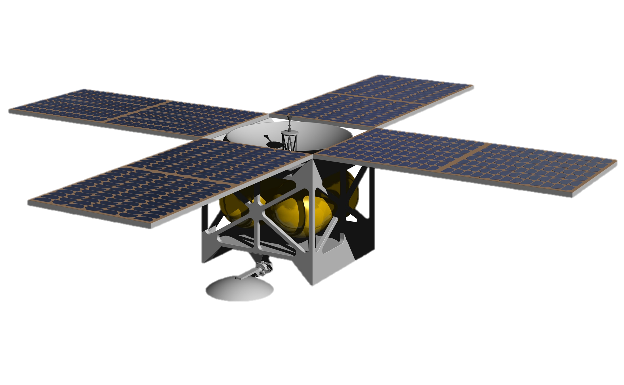

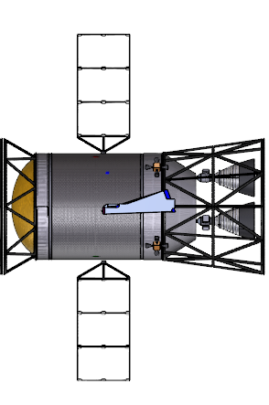



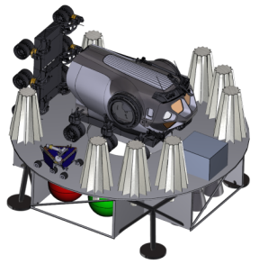



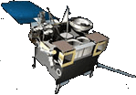


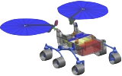

Lunar Network (LunaNet)
Earth Network
NME - CA mirror
Registration Authority
Lunar Relay
Earth Relay
High Lunar Orbit
High Earth Orbit
Proximity Links
Proximity Links
Near Rectilinear Halo Orbit
Trunk link
Trunk link
Gateway
Lander
Control System
InterGovernmental Certification Authority / CA
Surface Systems
Science/ Relay Orbiter
Direct With Earth
Science Orbiter
Low Lunar Orbit
Low Earth Orbit

Slide 3




Lunar Network (LunaNet)
Earth Network
Mars Network (MarsNet)
Lunar Relay
Earth Relay
Mars Relay
NME CA mirror
Registration Authority
High Lunar Orbit
High Earth Orbit
High Mars Orbit
NME CA mirror
Registration Authority
Proximity Links
Proximity Links
Proximity Links
Near Rectilinear Halo Orbit
Trunk link
Trunk link
Trunk link
Phobos Exploration Vehicle
Science Orbiter
Gateway
Lander
Control System and
IGCA
Lander
Science/ Relay Orbiter
Surface Systems
Science/ Relay Orbiter
Surface Systems
Direct With Earth
Science Orbiter
Deep Space Habitat
Low Lunar Orbit
Low Earth Orbit
Low Mars Orbit

Slide 4
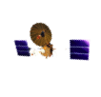




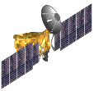

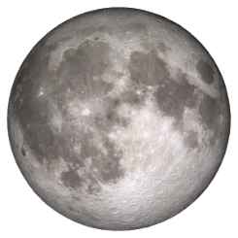
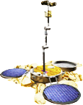



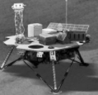
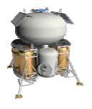

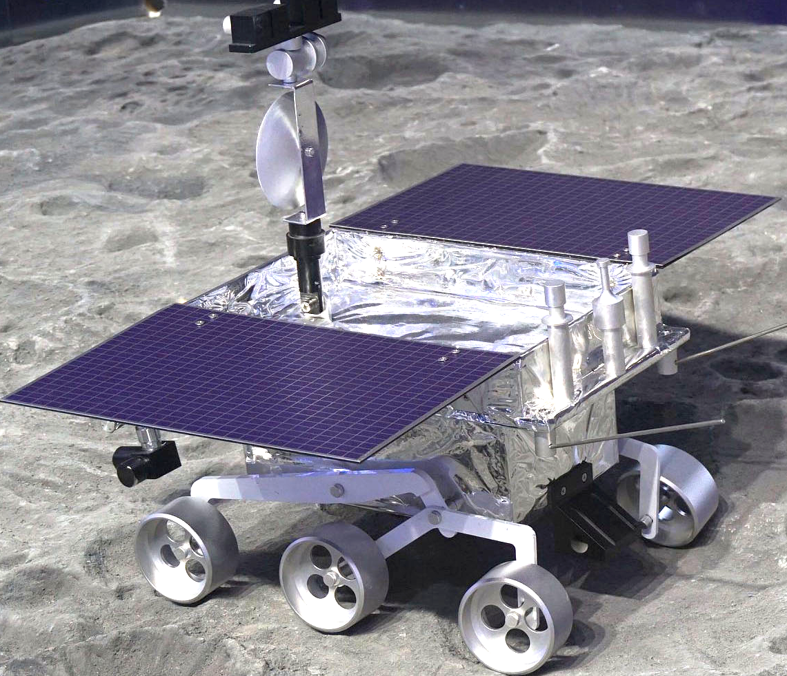


Lunar
CubeSat
Lunar
Relay Orbiter
Earth Stations
DTN nodes
DTN BP/LTP over AOS/USLP over
Trunk Link (X-band, Ka-band-22/26 GHz, Optical)
MOC
Lunar
Relay Orbiter
MOC
IGCA
Exploration Command Module
NME
DTN nodes
DTN BP/LTP over AOS/USLP
over Trunk Link (X-band,
Ka-band-22/26 GHz, Optical)
Earth Network
DTN BP/LTP over AOS/USLP over
Cross Link (Ka-band-22/26GHz,or Optical)
DTN nodes
Lunar Gateway
The IGCA will provide authentication and confidentiality services to all registered users.
DTN nodes
DTN BP/LTP over AOS/USLP over Proximity Link (S-band)
Science/Relay Orbiter
DTN BP/LTP over AOS/USLP
over Proximity Link (S-band, Ka-22/26 GHz, or optical)
DTN BP/LTP over AOS/USLP
over Proximity Link (S-band)
Low orbit
Science Orbiter
Lunar Relay Network
DTN nodes
DTN nodes
Geophysical Network Lander
Human Lander
Rover
Comm
Station
EVA Crew
Artemis
orbiter
ISRU platform
Exploration Zone
Lunar Surface Network
Wireless LAN
Habitat
Science Rover
DTN nodes
Mobile
Habitat
DTN BP/LTP over AOS/USLP over
Direct Earth Link (X-band, Ka-band 26 GHz)
CLPS Lander
To/from Earth Network
Surface Power
Moon-to/from-Earth trunk link:
Between relay orbiter and Earth station
Proximity link:
Between relay orbiter and landed vehicle/orbital vehicle
Lunar surface-to-surface link:
Wireless link between surface elements
Moon-to/from-Earth link:
Between Lunar orbiter/landed vehicle and Earth station
Cross link:
Between two relay orbiters
Lunar Relay Network;
Lunar Surface Network;
Earth Network

