Slide 1
2022-05-09
QOL Study on Application to
RASDS/RASDS++
Koki Asari, Japan Space Systems
ISO TC 20/SC 14/WG1
UNCLASSIFIED

Slide 2
Schedule Plan
QOL Space-based Services and RASDS/RASDS++ Application
 | 2022 | 2023 | 2024 | 2025
ISO 16215-1
ISO 13675
ISO 17459
ISO #####
････
WD
CD
DIS
IS/TS
WD
CD
DIS
IS/TS
NP
WD
CD
DIS
IS/TS
NP
WD
CD
DIS
IS/TS
Apply RASDS
(Existing ISO 13537)
Apply RASDS++
(After the completion)
FY: Fiscal Year, April to next year March
ID | Title | Last voting
WD 16215-1 | Space systems – Space-based positioning, navigation and timing (PNT) services | 2022-04-17 NWIP passed
WD 13675 | Space systems – Space-based services – Positioning information exchange service | 2022-03-20 NWIP passed
NP 17459 | Space systems – Pointing management for optical Earth observation | 2022-06-21 NWIP

Slide 3
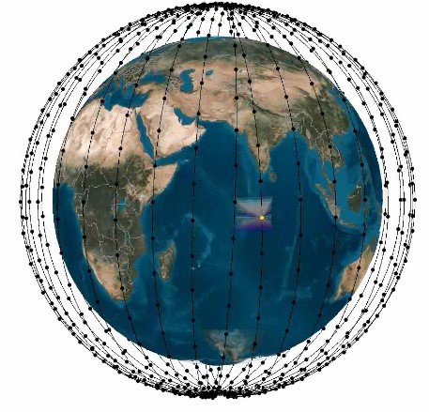
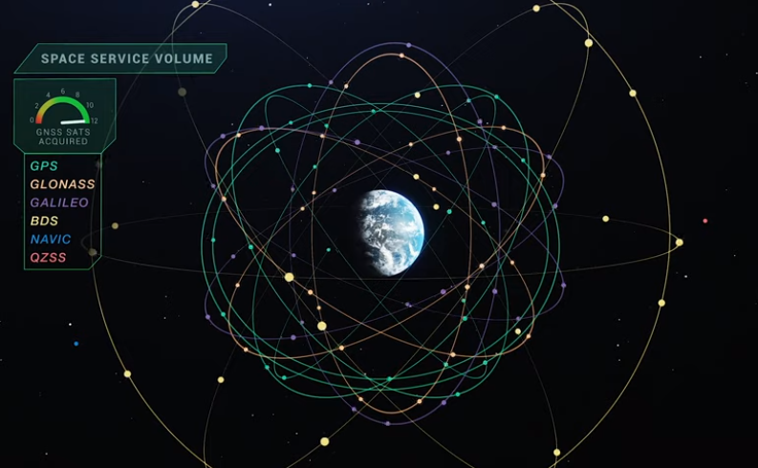
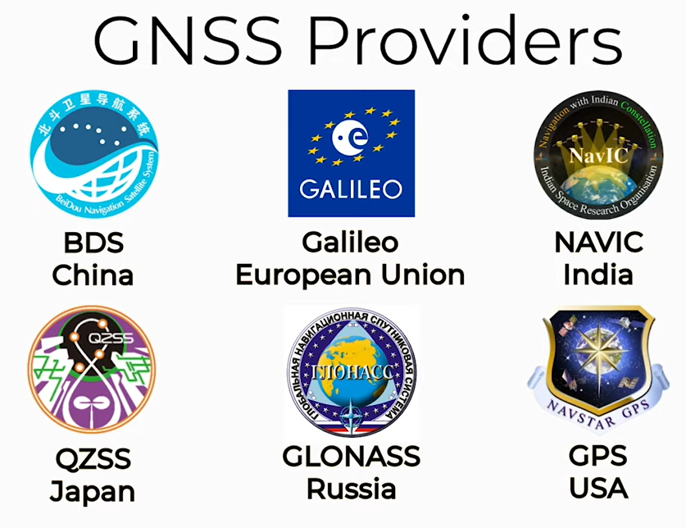
Space Systems Covering World
Space systems are covering the world. Earth Observation (EO), Global Navigation Satellite System (GNSS), communications and others become the infrastructure of the humanity.
For example, GNSS signals are received by 3 billion personal and enterprise devices.
LEO
Earth Observation
Communication
PNT/GNSS
Broadcast
Meteorology
GEO, IGSO, MEO
Reference https://www.youtube.com/watch?v=-1ngun6OfgQ

Slide 4
Quality of Life (QOL), the sustainable cycle
Space systems are working for the QOL of world citizens running through many disasters.
Sustainable
Development
Infrastructure: PNT, EO, Transport, Utility(Water/Elec/Gas), GIS
Entity: Government/Police, Carriers, Corporate(IT), Residents
Infrastructure: PNT, EO, Utility (Water/Elec/ Gas), Transport(Bus/Rail/etc), GIS
Entity: Government, Carriers, Corporate (IT/Construction/Insurance), NGO, Residents
Space / Planet
Life & Health
Dairy living
Reconstruct
Ordinary
Reconstruction
plan, budget,
and management
Rehabilitate
Health gain
Forest and check,
Contingency plan,
implementation
Equal justice
(Judiciary)
QOL
for
Humanity
Public
service
(Administration)
Accident/
Pathogeny
Legal
(Legislature)
Information gathering,
Restoration
management
Hospitalize
Catastrophe
Society of Trusty
Death
Disorder
Emergency response
Restore
Disaster
Evacuation path
and destination
Demolition
Infrastructure: PNT, EO, Utility(Water/Elec/ Gas), Transport(Bus/Rail/etc), GIS
Entity: Government, Carriers, Corporate (IT/ Construction/Insurance), NGO, Residents
Infrastructure: PNT, EO, Utility(Water/Elec/Gas), Shelter, GIS
Entity: Government/Police/Rescue, Carriers, Medical, Corporate(IT/ Construction), NGO, Residents

Slide 5
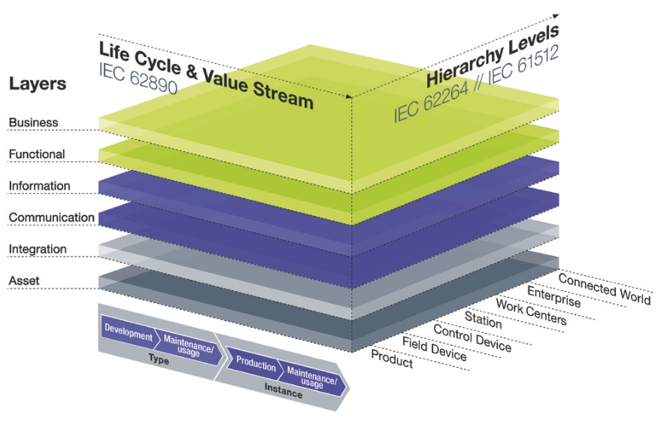
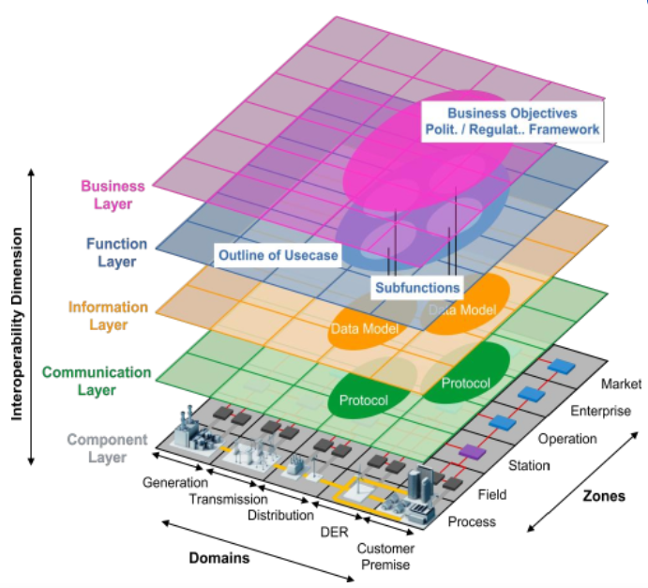
Space Leadership is Expected Now
Reference Architecture Framework Models are proposed by leading technological areas.
But these are not enough for coming space age, because spatial scope is limited and edge-technologies are less. RASDS and its extension is expected now.
Smart Grid Architecture Model
(SGAM) 2021
IEC SRD 63200
Reference Architecture Model Industry 4.0
(RAMI4.0) 2017
IEC 62890 / IEC 622264 / IEC 61512

Slide 6
Proposed model based on RASDS/RASDS++
If the model takes 3D-structure, isn’t it thought that our consensus is made easily ?
Business
model
Enterprise
Connectivity
(Structure)
Wider
Spatial Scope
Function
RASDS/RASDS++
Interoperability viewpoints
Data model
Space
Information
Globe
Protocol
RF
Region
Communication
Scope
City
Station
Operational
Machine
Component
Lifecycle
Environment
Disposal
Operation
Requirement
Validation
Production
Design & Engineering
Architecture
Service/Operation
Mission assurance

Slide 7
Interoperability using Reference Architecture
We want to make the interoperability using the reference architecture for space system.
This figure uses RASDS but it will be updating to RASDS++.
Spacecraft
Space port
Enterprise
Station
Enterprise
Connectivity
Enterprise
Connectivity
Functional
Connectivity
PNT
Functional
Information
Functional
Sensors
Enterprise
Information
Communication
Information
Enterprise
Connectivity
Communication
Communication
Connectivity
Functional
Functional
Information
Information
Communication
Interoperability
for safety, performance, and resilience
of systems
Communication
EO system
Machine
Enterprise
Enterprise
Connectivity
Connectivity
Functional
Robot
Component
Functional
Information
Information
Communication
Enterprise
Vehicle
Enterprise
Communication
Connectivity
Enterprise
Connectivity
Functional
Connectivity
Functional
Information
Functional
Information
Communication
Information
Communication
Communication

