Slide 1
Using a Reference Architecture for Space as an SC14 Standards Framework
ISO 42010 and Engineering by PowerPoint Version
SC14 RAS Working Committee?
12 June 2019
Comments to freds@spacestandards.org

Slide 2
Description Contents - Drivers
Missions – From SC14 Strategy and Market Needs (Enterprise/Mission Assurance) – Keywords: Telecommunications, Remote Sensing, etc. and Radiation Environment (Orbit)
Mission Systems – Level 1 – 7 – Keywords: Element, System, etc.
Mission Operations – Level 1 – 7 – Keywords: Element, System, etc.
Standards address corresponding services, systems and/or operations of Mission Systems and their life cycle (Design, Manufacturing, Verification (I&T), Launch, Initialization and Commissioning, Operations, Disposal)
  Correlate to WGs?)

Slide 3
Notional Levels (for Correspondence)
 | System Structure Decomposition |  | Requirements Levels |  |  | Example Organization Levels
 | System Level | Example | Requirements | Example | Approval
0 | N/A | N/A | Major Program/Goal | Heliophysics Mission | Agency/Center | NASA
1 | Mission System | MEME-X | Mission/Project | MEME-X | Program Office | SMD
2 | Segment | Flight Segment | Segment | Flight Segment | Project/MSE | Project Team
3 | System | Spacecraft Bus | System | Spacecraft Bus | MSE/PDL | PDL
4 | Subsystem | Propulsion | Subsystem | Propulsion | PDL | PDL
5 | Assembly | Propellant Distribution | Assembly | Propellant Handling | PDL | PDL
6 | Subassembly | Propellant Tank | (As required)
7 | Unit | Valve | (As required)
8 | (Lower levels) |  | (As required)

Slide 4
Level 1 System with Level 2 Services
(Mission Driven)

Slide 5
Architecture Description Construction
In building up the space mission architecture description there is an architecture process which establishes definitions and sets requirements evolution.
1) The starting point is to define the space mission functionally. There are many types of space missions, mostly identified in the SC14 Strategy
  The mission system will consist of a flight segment (one or more spacecraft), a ground segment (one or more operations centers) and a launch segment. A functional definition may be as simple as a functional diagram. It may include functional statements (Launch segment function –> place spacecraft in designated orbit. The Enterprise which owns the Mission will stipulate Mission Assurance needs
2) Within the segments, services such as data and information transfer are defined to meet functional requirements
3) Systems are designated to host the different services
4) The time sequence of operations is determined across the systems to satisfy direct and support mission needs

Slide 6
Concept for application on standards needs
Each standard should have a designation (diagram?) showing its primary placement in the space domain to include
  function, service, system and/or operation requirements
  and
  placement in the life cycle
Secondary considerations should be noted as they are understood

Slide 7
See A. Kato Adobe File

Slide 8
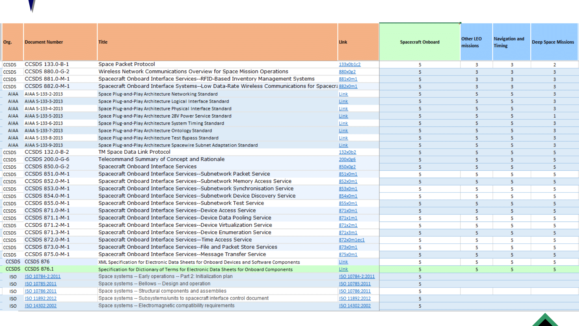
SIF Mission Applicability Guide
Sort data by Mission, Segment, Level, Viewpoint while identifying WG

Slide 9
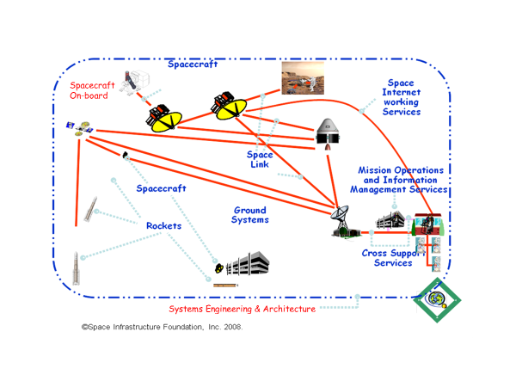
Top Functional View
(SC14 Common with SC13/CCSDS)

Slide 10
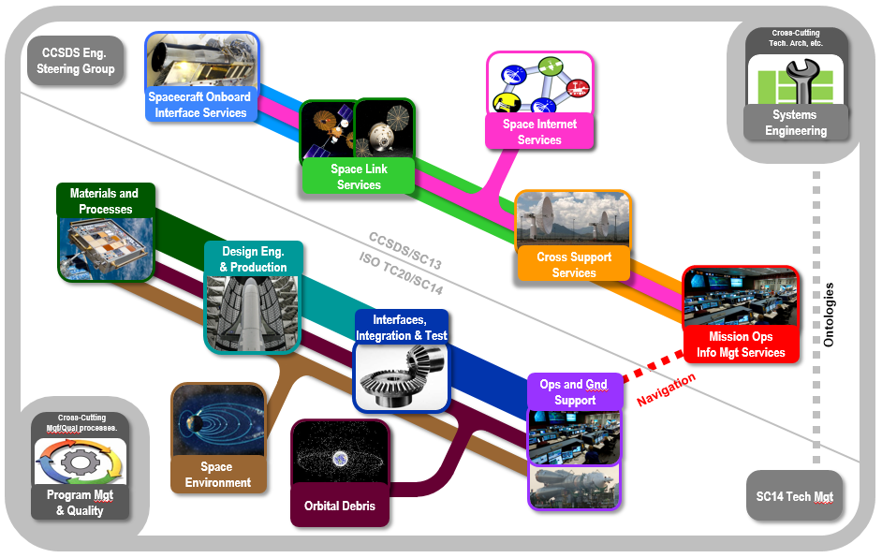
SDO Relative Scope and Cooperation

Slide 11
SC14 Perspectives/Viewpoints/Views
  Functional Viewpoint: The identification of various abstract functions and their allocation to space domain physical objects (Note: CCSDS RASDS Viewpoint)
  Connectivity Viewpoint: How space domain physical objects are deployed and are connected in a physical sense (RF, optical, cabling, mating, umbilicals) (Note: CCSDS RASDS Viewpoint)
  Enterprise Viewpoint: How organizations are structured to produce & operate space domain objects, requirements and agreements, governance including laws, regulations, policy, and industry guidance or rules for other Viewpoints
  Physical (Systems) Viewpoint: The space domain physical objects
  Operational Viewpoint: How space domain physical objects are operated, procedures & processes. This Viewpoint also includes end-of-life disposal.
  Communications Viewpoint: How space domain physical and software objects communicate, protocols and end-to-end views (Note: CCSDS RASDS Viewpoint)
  Hardware Development Viewpoint: The development and V&V processes for space domain physical objects
  Software Development Viewpoint: The development and V&V processes for space domain software and firmware objects (Note: CCSDS RASDS Viewpoint)
  Information Viewpoint: This Viewpoint includes information and data definitions, data structures and relationships, best practices, or a library of Voluntary Consensus Standards. (Note: CCSDS RASDS Viewpoint)

Slide 12
SC14 Concerns from the SC14 Strategy
Standards are relevant to market needs
  For a global space industry
    Established industry
    Entrant industry
  For global application of space capability to integrated market solutions
Needed standards are developed (determine if gaps exist in work programs)
  Performance-based standards
Properly organized to efficiently execute work program
  Working relationships with external organizations
  SC14 Leadership and Technical Management
  SC14 Working Groups

Slide 13
Background

Slide 14
Space Domain Objects
Necessary
  Space Object
    A physical object in space, it provides a service or product via an Earth Object or to/from another Space Object (examples: Spacecraft, Lunar Habitat, hybrid science/relay S/C).
  Earth Object
    A physical object on Earth (or even another planet), it provides or receives a service or product for a Space Object or a Launch Object and may also deliver space services to a non-space consumer of services (examples: Mission Control Center, Satellite TV ground station, Launch Complex)
  Launch Object
    A physical object that moves Space Objects as its primary service (example: Launch Vehicles) (SC14 really cares about these)
  Communications Object Class
    A physical object that provides communications services between Space Objects, Earth Objects, and Launch Objects (examples: DSN, TDRSS, Lunar Relay, Mars Relay) (SC13 really cares about these)
Other
  Natural Object Class
    A naturally occurring physical object that Space Objects interact with (example: Earth, Moon, Mars, asteroid)

Slide 15
Possible Perspectives/Viewpoints/Views
  Functional Viewpoint: The identification of various abstract functions and their allocation to space domain physical objects (Note: CCSDS RASDS Viewpoint)
  Connectivity Viewpoint: How space domain physical objects are deployed and are connected in a physical sense (RF, optical, cabling, mating, umbilicals) (Note: CCSDS RASDS Viewpoint)
  Enterprise Viewpoint: How organizations are structured to produce & operate space domain objects, requirements and agreements, governance including laws, regulations, policy, and industry guidance or rules for other Viewpoints
  Physical (Systems) Viewpoint: The space domain physical objects
  Operational Viewpoint: How space domain physical objects are operated, procedures & processes. This Viewpoint also includes end-of-life disposal.
  Communications Viewpoint: How space domain physical and software objects communicate, protocols and end-to-end views (Note: CCSDS RASDS Viewpoint)
  Hardware Development Viewpoint: The development and V&V processes for space domain physical objects
  Software Development Viewpoint: The development and V&V processes for space domain software and firmware objects (Note: CCSDS RASDS Viewpoint)
  Information Viewpoint: This Viewpoint includes information and data definitions, data structures and relationships, best practices, or a library of Voluntary Consensus Standards. (Note: CCSDS RASDS Viewpoint)

Slide 16
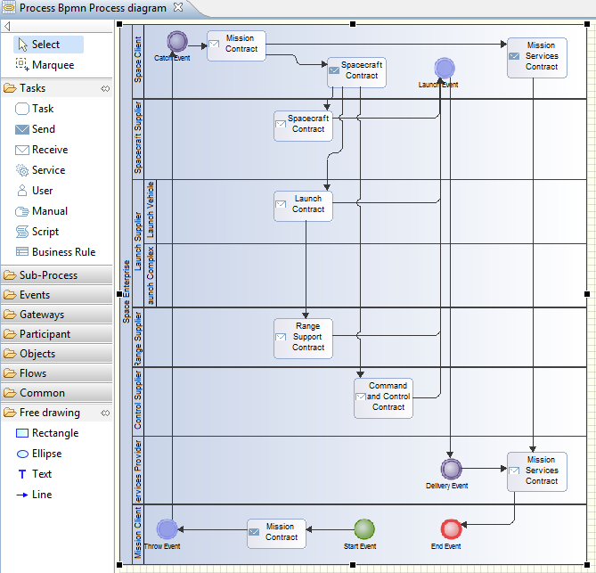
Enterprise View with Standards Information Objects
Many Program Management, Quality and ICD
Standards
Examples: 17666 Risk Management,
17401 Spacecraft to Launch Vehicle ICD,
27026 Project Breakdown Structures
SC14 initially focused on conventional spacecraft (1990s era).
In 2018 the SC14 Strategy concerns include variable program
size (small <-> large), program value ($<->$$$$) and
affordability to accommodate New Space Economy,
Conventional, Commercial Space Exploration and Human
Spaceflight

Slide 17
Space Domain Physical Object Attributes
Mass
Volume
Propulsion
Power (required / provided)
Sensor
Effectors
Physical interfaces
Location
Velocity
Trajectory/orbit
Environment
Interactions
Space Domain Natural objects typically do not include power, propulsion, sensors, effectors or physical interfaces, but they will have all of these other attributes.

Slide 18
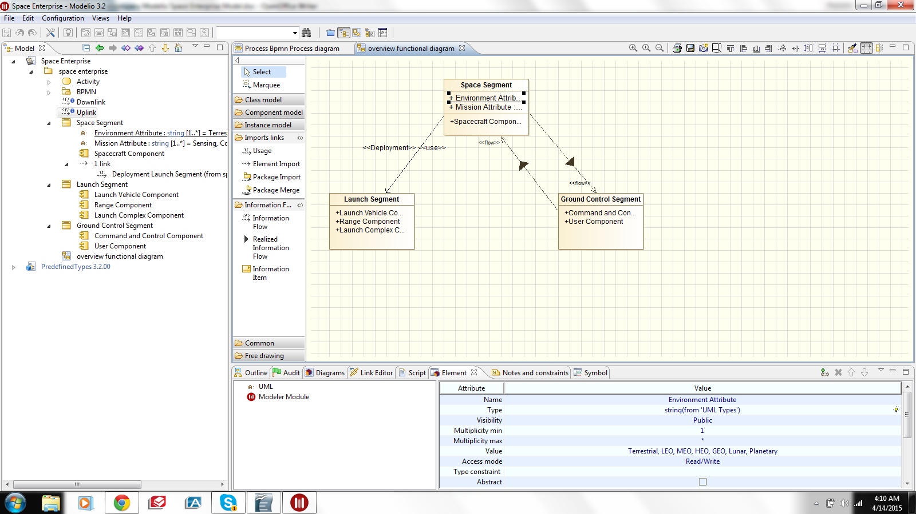
Physical Systems View with Standards Information Objects
Many Interface and Space Environment Standards
in this View
Example: 14303 Spacecraft Launch Vehicle Interfaces,
17761 Model of high energy radiation at low altitudes
(300-600 km)

Slide 19
Physical System: Launch Object View
Launch Objects have mass, propulsion and trajectory/orbit classes
Mass sub-classes are defined as
  Launch: Small
  Launch: Medium
  Launch: Heavy
  These correlate to historical value definitions used by launch providers and customers. For launch systems, value=mass to orbit/cost has simply broken down to small, medium and heavy launch vehicles
Trajectory/Orbit sub-classes are defined as
  Launch: Vertical
  Launch: Horizontal Aerodynamic
Propulsion sub-classes are defined as
  Launch: Chemical
  Launch: Electric
Example: The Launch Object for a Science mission to Mars will be Launch:Heavy;Vertical;Chemical
Example Standard: 24917 General test requirements for launch vehicles

Slide 20
Physical System: Space Object View
Within the Space Object Class there are sub-classes for mass, mission, human-rated/robotic.
  Mass sub-classes correlate to Launch: Mass sub-classes.
Mass sub-classes are defined as
  Space: Small (are there actual mass values that can be assigned, even if only at this point in time?)
    One or more Space:Small objects can be launched on a Launch:Small object, a Launch: Medium object or a Launch:Heavy object.
    Mass categories such as microsats or nanosats are Space:Small objects for the purposes of this Framework
  Space: Medium
    One or more Space:Medium objects can be launched on a Launch: Medium object or a Launch:Heavy object.
  Space:Heavy
    One or more Space:Heavy objects can be launched on a Launch:Heavy object.
Mission sub-classes are defined as:
  Human space flight:
    commercial,
    agency-sponsored;
  Earth observation (meteorological) satellites:
    Low Earth Orbit (LEO),
    GEO;
  Communications satellites:
    LEO constellations,
    GEO

Slide 21
Physical System: Space Object View (con’t)
  Science missions:
    near Earth/Earth orbit,
    lunar,
    interplanetary/deep-space; and
  Navigation satellites
  Space Research, Near Earth
  Space Research, Deep Space;
  Earth Exploration
  Space: Communications
  Space: Science
  Space: Habitat
  And so on
Human-rated/robotic Sub-classes are defined as
  Space:Human
  Space:Robotic
Example: The Space Object for a science mission to Mars will be stated as Space:Heavy;Science;Robotic.

Slide 22
RAS Working Rules
Architecture Assembly Rule 1: For any given program/project the program/project object will identified to the most descriptive class:sub-class;sub-class:sub-sub-class possible at each stage of development.
Architecture Assembly Rule 2: Relations to other class objects will be identified at least at the class level.
Architecture Assembly Rule 3: On the use of technical standards, standards apply at class:sub-class… levels. Some are very general (e.g., the class level) and some are more specific. More general standards apply automatically at lower specific levels. Different viewpoints will utilize different sets of technical standards: physical, information, enterprise/governance, protocols, etc.
Architecture Assembly Rule 4: During mission lifecycles the architecture and views will evolve. More abstract views (functional, enterprise, information) will be evolved and transform into more concrete views (physical, connectivity, communications), using processes (hardware and software development), until they can be made operational. Recursion operates at several levels, starting with systems of systems and drilling down to components that can be acquired (and even the parts that they are assembled out of).

Slide 23
Value in the RAS
Some class definitions appear arbitrary from a simple logical breakdown perspective. Take for example the small, medium and heavy subclasses of physical launch objects. The historical evolution here is based on the market determining value.
Similarly, spacecraft mass sub-classes are determined by launch objects.
Mission Assurance is a market value.
Value = (MA*performance)/cost.
It is a measure (not the only one, perhaps) of probable mission success. Standardization of Mission Assurance directs accepted measurement metrics from historical data to project future value.

