Slide 1
Common Mission Operations
Given a goal to enable common ground systems to perform mission operations across spacecraft
And spacecraft subsystem commands and telemetry are contained in CCSDS space packets
And Space packets are transported over several protocols with very different interaction patterns and timings
CCSDS AOS, COP-1, DTN, as files over CFDP
And Onboard application software must be targeted to the software and avionics architecture
Software framework, operating system, language (C, C++ …), real-time environment (threads, process, I/O), distributed across processors and/or partitions
Avionics architectures evolve (Software interfaces can remain )
Processors improve, multicore, distribution, Integrated Modular Avionics concepts…
Cubesats are very different than a deep space or human rated vehicle

Slide 2
Moving MO Onboard (?)
High frequency control loops need to be implemented onboard
Consequently MOIMS has always foreseen implementing services onboard as shown in the following chart 3

Slide 3
Mission Operations View of Spacecraft
Mission MO
Services
Ground Segment
Space Segment
Standard MO
Services
MCS
OBC
MO Applications
MO Applications
TM TC
MO Applications
AOCS
TM TC
Power
OBT Mgmt
SSMM mgmt
Power
Mode mgmt
…
…
MTL Services
Context mgmt
Thermal
FDIR
Message Abstraction Layer
Message Layer
TM/TC Device
MO Messages
Space Network
Protocols
(e.g. Space
Packet)
Space
Network
Protocols
(e.g. Space
Packet)
SOIS
Message
Transfer
Service
File and
Packet Store
Services
Command
and Data
Acquisition
Services
Time Access
Service
Device
Enumeration
Service
CCSDS Packet Router
CCSDS Packets
Spacecraft Transfer Layer
Space Data Link
Protocols
Space Data Link
Protocols
Subnetwork
Packet
Service
Subnetwork
Packet
Service
Subnetwork
Memory Access
Service
Subnetwork
Synchronisation
Service
Subnetwork
Device Discovery
Service
Subnetwork
Test
Service
Space Link
Onboard Subnetwork
Chart borrowed from Sam Cooper (SciSys), Mario Merri (ESA) presentation

Slide 4
Proposed CCSDS Layered Reference Model

Slide 5
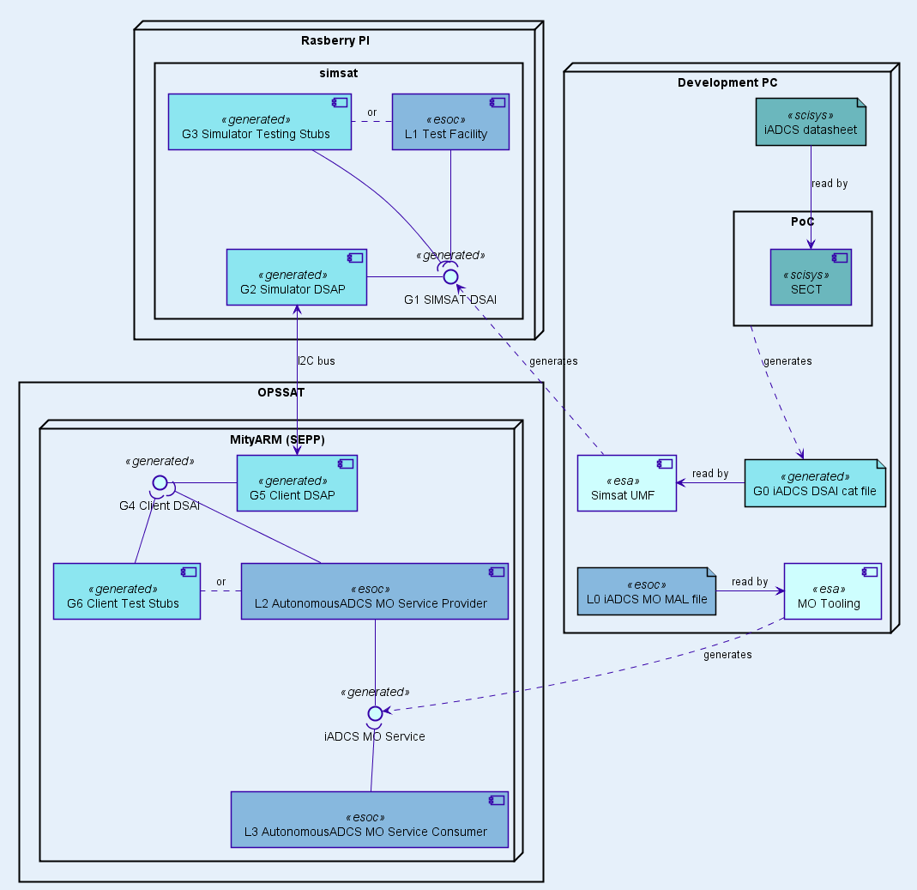
SVF Development Example of Proposed CCSDS Layered Reference Model
Parts of SVF code automatically
generated from datasheet by a
code generator based on SECT.

Slide 6
Moving MO Interfaces Onboard (?)
An alternative is to use the existing flight software and their respective scripting or procedural functions:
ESA/PUS uses OBCP,
NASA uses JAVA script, LUA, Store Command Procedure
CAST uses Store Command Procedure
These could be used by translating interaction patterns from MO to the specific scripting language used and uploading them
MO is common but the software and avionics architectures need not be

Slide 7
Common MO interfaces Instantiated Onboard
MO interface definitions
Spacecraft
Profile/configuration
MAL
translation tools
Ground Segment
MAL
XML File(s)
MCS
MO Applications
SOIS EDS
XML File(s)
Code
Generation tools
TM TC
Power
…
…
Message Abstraction Layer
PUS,
cFS,
CAST,
…
TM TC
TM/TC Device
OBT Mgmt
Space Network
Protocols
(e.g. Space
Packet)
MTL Services
CCSDS Packet Router
Scripting/
OBCP
SSMM mgmt
Context mgmt
AOCS
Message
Service
Power
Space
Packet
Space Data Link
Protocols
Space Data Link
Protocols
Subnetwork
Packet
Service
Avionics and Software
Architecture is independent
of MO architecture
Thermal
Mode mgmt
FDIR
Space Link
File and
Packet Store
Services
Command
and Data
Acquisition
Services
Device
Enumeration
Service

Slide 8
Common MO messages Transformed at the Operations Center
Spacecraft Configuration
Mission database (XTCE)
Onboard interface definitions
Ground Segment
MCS
SOIS EDS
XML File(s)
MO Applications
TM TC
Power
Code
Generation tools
…
…
Avionics and Software
Architecture Independent
Message Abstraction Layer
PUS,
cFS,
CAST,
…
TM TC
Translator/
Formatter
TM/TC Device
OBT Mgmt
MTL Services
Space Network
Protocols
(e.g. Space
Packet)
CCSDS Packet Router
Scripting/
OBCP
SSMM mgmt
Context mgmt
AOCS
Message
Service
Power
Space
Packet
Space Data Link
Protocols
Space Data Link
Protocols
Subnetwork
Packet
Service
Thermal
Mode mgmt
FDIR
Space Link
File and
Packet Store
Services
Command
and Data
Acquisition
Services
Device
Enumeration
Service
Avionics and Software Architecture is independent of MO and SOIS architecture

Slide 9
Backup

Slide 10
What is SEDS?
SEDS is: …
SOIS Electronic Data Sheet
An XML Schema
Based on the XTCE schema types – but extended and refactored to be more domain specific
That domain being flight software and devices attached through a subnetwork
A “FSW meta language” by which a tool will read SEDs XML files and autogenerate portions of the onboard flight software

Slide 11
Mission Use of SOIS
Current use of SEDS for software components is limited to command and telemetry interfaces over a message service
Device SEDS describes interface to flight software from a subnetworked connected device

Slide 12
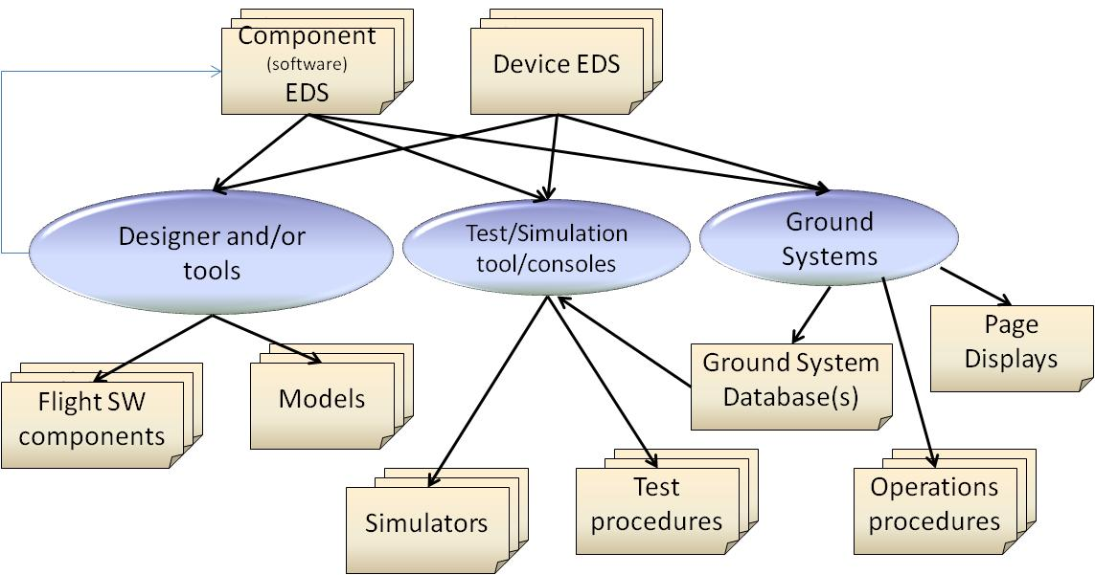
Current SOIS Focus: Definition and Use of EDS

Slide 13
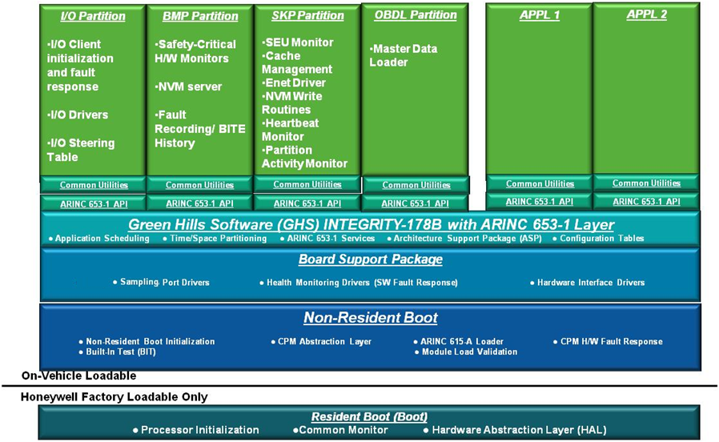
ARINC 653 System Architecture
Applications are partitioned into separate hardware protected memory
Applications are on fixed schedules with a fixed time allocation
Misbehaving applications cannot affect other applications
Can mix critical and non-critical applications an the same processor
System designers allocate processor MIPS, memory, and I/O to each application partition:

