Slide 1
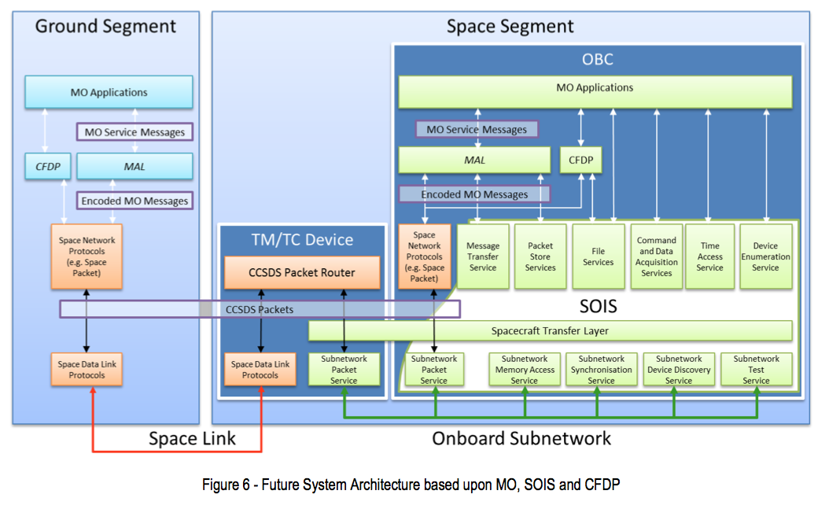
ESA SM&C / SOIS Future Architecture
(from EGOS-GEN-SMCSOIS-TN-1001 1)

Slide 2
ESA SM&C / SOIS Future Architecture
(from EGOS-GEN-SMCSOIS-TN-1001 1)
With Terra Incognita shown
Spacecraft & Device
Real-Time
Functions
SOIS
SOIS
CSS (SLE, CSTS, CSSM) and
SLS (link, coding, modulation) live in here

