Slide 1
MOIMS Comms Context: On-board Link
Space
User Node
MOIMS Information Exchange
MOIMS
User Application
MOIMS
User Application
MOIMS
SOIS
Communications Processing
SOIS
Communications Processing
SOIS Link
SOIS Compatible On-board Architecture

Slide 2
MOIMS Generic Protocol Stacks
MO Compliant Service
MOIMS File Exchange
MOIMS
User Application
MOIMS
User Application
MO Service
MOIMS File Format
Optional File Format Specification in terms of MAL
MO API
MO Language Binding
MAL
MAL
MALTechnology Binding
Encoding
MAL Encoding
Transport
Transfer Protocol
Messaging or File
File Transfer Protocol
Transport Protocol
Transport/Network Layer
Transport Protocol
Link Layer
Physical Link/Network
Link Layer
Blue layers correspond to Communications Layers:
Transfer (Application) Layer (e.g. FTP, HTTP or 0MQ) providing message exchange or file transfer
Transport and Network Layers combined (e.g. TCP/IP or UDP/IP)
Physical Link Layer or “Network” (e.g. RF Space Link, WAN, LAN or WLAN)
Protocol stacks must match between communicating User Applications
MO Language Binding can differ between communicating User Applications
For File Exchange, the transfer must be independently initiated at Communications Protocol level, either directly by the User Application or by a 3rd party.

Slide 3
MOIMS Generic Deployment Example
User Node
User Node
MOIMS
User Application (Provider)
MOIMS
User Application
(Consumer)
MOIMS
MO Service
MO Service
MO API
MO API
MAL
MAL
MAL Technology Binding
MAL Technology Binding
Transfer Protocol
Transfer Protocol
Transport Protocol
Transport Protocol
Link Layer
Link Layer

Slide 4
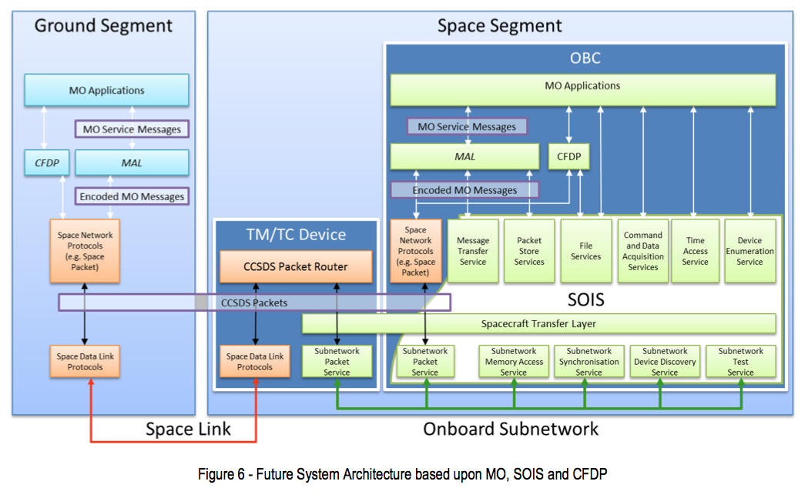
Reference Diagram
MO Servce Messages may be carried in files over CFDP.
Ground-Ground may be mapped over terrestrial protocols such as 0MQ/TCP or FTP
SLE may be used to extend space link. This is transparent to application level.
Need to generate RASDS Protocol Stack representation of this.

Slide 5
MOIMS Over On-board (SOIS)Link
MO Compliant Service over HTTP and/or FTP
MOIMS File Exchange
MOIMS
User Application
MOIMS
User Application
MO Service
MOIMS File Format
MO API
MAL
MAL AMS
MAL FAS
AMS
FAS
FAS
SOIS
SOIS
Link Layer
Link Layer
MO requires an exposed File Access Service (FAS) to interact with on-board file systems, and a Messaging Service to communicate with other on-board applications.
Although it previously identified a Message Transfer Service, Packet Store Service and File Services, SOIS currently does not include specification of such standard application support services. It does provide a standard means to declare such services.
CCSDS Asynchronous Messaging Service (AMS) may be used to provide a messaging service to on-board applications, but other/bespoke services may also be used, requiring a dedicated MAL transport binding.
If there is a distinct on-board Packet Store (rather than storing packets in files), then an additional binding may be required between the MAL and the Packet Store Service. Note: this is associated with the Space Link from an application perspective.
For File Exchange, the transfer must be independently initiated at Communications Protocol level, either directly by the User Application or by a 3rd party.

Slide 6
MOIMS Over On-board Link (Deployment Example)
Space User Node
MOIMS
User Application (Provider)
MOIMS
User Application
(Consumer)
MOIMS
MO Service
MO Service
MO API
MO API
MAL
MAL
MAL FAS
MAL AMS
MAL AMS
MAL FAS
FAS
AMS
AMS
FAS
SOIS
SOIS
Link Layer
Link Layer

