Slide 1
System Architecture WG (SAWG)
CURRENT STATUS Integration Views
Peter Shames (WG Chair)
16 May 2017
Notes:
1
1
1

Slide 2
System Architecture WG Executive Summary
Goals for this meeting cycle: Refine Application and Support Architecture materials, review with affected WGs, CESG, and CMC.
Working Group Status:
MOIMS and SOIS reference architecture (PPT) refined, covering: services, operations, interfaces, and information objects
Reviewed new analyses, including Richard Melvin’s EDS/MAL
Reviewed updated materials with affected WG
Added RASDS & SCCS-ADD Glossary terms
Problems and Issues:
Resources are constrained, but progress is being made
Key participants have multiple roles, and timing of meeting was an issue
Planning:
Cross area meetings with MOIMS & SOIS to review PPT materials
Plan to have draft Green Book by Fall 2017 meeting

Slide 3
Application and Support Architecture Approach
Create first phase (viewgraph) and second phase (document) materials for the Application and Support Architecture document
Develop viewgraph level materials first for MOIMS, SOIS, and joint deployments
include the use of services and interfaces identified in the SCCS-ADD/ARD (CSS, SLS, SIS & most of SEA), include security services as needed
Use a consistent set of viewpoints and views based on RASDS method and representations
Develop base materials adhering to the SOIS and MOIMS services and functions as they are defined
Propose extensions to the documented base as and where this seems advisable
Review base materials, proposed extensions, and evolving documents with the relevant MOIMS & SOIS groups

Slide 4
Application and Support Architecture Approach, contd
Adjust materials as needed and iterate if needed
Present to Areas / WGs, CESG and then CMC
Revise and augment as needed until there is an agreed set of PPT materials (diagrams and 1-page descriptions)
The above within 9 months (done Spring 2016)
Develop a document based on the agreed materials
Initial document to be Reference Architecture Magenta Green Book, including tables, figures and descriptive materials referencing all the other standards
Basic layout of the document will be similar to the RASDS and SCCS-ADD, with references to all the other standards in each section
All the above within the first 18 months

Slide 5
Reference Architecture Views
Service view, including service types:
Table with group name, functions, operations, stds reference
Nav is different, use group name, functions, data formats, stds reference
Functional views:
Top level black box (overview) and white box (at least 1 level, possibly 2)
Functions (with operations lists) & relationships
Specifically identify service interfaces & interactions
Protocol views, including service interface bindings:
Space transport & terrestrial transport,
Building block & end-to-end views,
Reference SCCS underpinnings,
Include MAL bridging, SOIS subnet bridging
Information views:
Identify all major data objects from functional views,
At abstract (key component) level, not at detail level,
Use UML structured or ER diagrams as needed (examples provided from RMP)

Slide 6
Reference Architecture Views, contd
Deployment views (both single link (ABA) & space internetworking (SSI)), these will just be representative examples:
Show relationship of the app layer functions to SCCS and below, and then abstract it away in most of the materials and focus on the upper layer stack
Show MOIMS and SOIS separately and also integrated,
Ground, flight, and also flight & ground,
S/C, relay S/C (packet, file, SSI),
Reference key application layer user node types: mission centers, science centers, satellite operators, as examples, these are not a focus

Slide 7
Current Status of MOIMS Analysis, Spring 2017
Several Views of MOIMS Architecture
Functional
Information
Service
Physical (nodes)
Deployment (multiple nodes and function or protocol allocations)
Protocol stacks
The following materials as a small subset, with focus on newer additions since Fall 2016
Review of Melvin’s EDS MAL analysis

Slide 8
MOIMS Data and Services - Functions
CSS-M&C
User Support
Planning & Scheduling
TT&C
MPS
CSS-SM
NAVT
MCS
MPS
MPS
NAVT
CSS-TS
TRM
MCS
NAVT
Mission Control
Navigation & Timing
MCS
NAVT
MCS
MCS
NAVT
OPD
MCS
MCS
MPS
NAVT
OPD
MPS
MPS
Data Storage and Archiving
Operations Preparation
NAVT
MDP
OPD
MDP
MCS
OPD
NAVT
Spacecraft Development & Maintenance
Mission Data Processing
MDP
MCS
NAVT
Functions and Data Colour Coded: Data in Rectangles; Services indicated at Provider End by Circle MDP = Mission Data Product
Notes:
The 5 MOIMS Areas are colour coded.
Each application level interaction is annotated with the Data exchanged. At this level all Data generated by each Function is grouped as a single type (the abbreviation reflects the function name).
Potential service interfaces identified by MO are indicated by a colour-coded circle representing the Service Provider
Data formats may be separately defined [NAV, MPS] or specified in the context of the service [MO M&C, MPS].
File Handling is a bit different – there are special services for File Management and File Transfer [the latter delegated to a lower level protocol, such as CFDP or FTP], but the file content my be associated with any of the other Functional Areas. It essentially provides the transport layer for bulk transfer of service messages or data formats. Mission Data Products may also be transferred as files.
Note Planning/Scheduling interactions with the GSTS are greyed out as they are outside the scope of MOIMS standardisation [CSS boundary agreement].

Slide 9
Mission Planning and Scheduling - Functions
Operations Preparation
User Support
Navigation & Timing
PDB
Mission Data Processing
PRQ
PRQ
PRQ
EVM
OSW
PRM
SMM
ODM
PLN
APD
PLN
PLN
CDM
PPM
PPM
PPM
Planning (Hierarchical or Distributed)
PRQ
Planning
TT&C
PLN
PPM
CSS-SM
PRQ
PLN
PPM
PPM
PEM
Plan Execution
EVM
M&C
M&C
PEM
AUT
Mission Control
EVM
SMM
Notes:
Planning Requests [PRQ]
Plans [PLN]
Planning Process Management [PPM]
Plan Execution Management [PEM]

Slide 10
Mission Planning (Alternative View of functions)
Planning
Plan
Execution
Hierarchical Planning:
PRQ
PLN
PPM
PRQ/PLN/PEM
M&C
ODM/EVM
CDM
CAR [PRQ/PLN]
FTM [PLN]
CSS-SM
PLN
PLC
M&C AUT
EVM
CAR [PEM]
FTM [PEM]
PRQ
PLN
PPM
PRQ
PLN
PEM
PRQ
PLN
PPM
PEM
M&C
AUT
ODM
EVM
CDM
CFG
CAR
FTM
CSS SM
PEM
PPM
PRQ [SMM]
PLN
PPM
PRQ [PRM]
PLN
PPM
M&C
AUT
PRQ
PLN
PEM
CAR
FTM
PRQ [OSW/APD]
ODM
CSS SM
EVM
CDM
Mission
Control
Data Storage and Archiving
Operations Preparation
Navigation & Timing
TT&C
User Support

Slide 11
Data Storage and Archiving - Functions
Operations Preparation
Mission Control
Planning & Scheduling
Navigation & Timing
OPD
MCS
MPS
MPS
NAVT
MO COM Service: Archive
NAVT
MCS
MO File Transfer & Management
Short term
Operations Archive
On-board File Store
MDP
MCS
MCS
MDP
NAVT
MPS
MO Data Product Distribution
Spacecraft Development & Maintenance
MDP
MCS
NAVT
MPS
MDP
NAVT
MDP
Long term
Mission Data Processing
[Archive Producer]
Data Archive [DAI]
Data Archive Ingestion
Data Archive Access
User Support
[Archive Consumer]
SIP
DIP
AIP
AIP
DAI: CAIS
DAI: PAIS
Data Archive Storage
Notes:
AIP: Archival Information Package
DIP: Dissemination Information Package
SIP: Submission Information Package
CAIS: Consumer Archive Interface Specification
PAIS: Producer Archive Interface Specification

Slide 12
MPS: Mission Planning & Scheduling Data - Information
COM Activity
Domain
Planning Request
Plan
Navigation Data
Predicted Event
Invokes
References
Planning Event
Contains
Invokes
Requests
Planning Activity
Contains
M&C Data
Initiates
Procedure
Invokes
Initiates
Action
Constrains
Invokes
Alert
References
Planning Resource
Contains
References
Requests
Planning Constraint
What is the relationship between these MPS Objects and the “SCCS” view of SM, SLE, CSTS?
COM State

Slide 13
Service View: Functions, Operations, Data
A | Group | Service | Functions | Operations | Data | Description | Standards | S | D
 | MO COM | Archiving | Ops. Archive <any function> | Store Update Query | <any COM obj> | Generic archive service for MO services defined in terms of the Common Object Model [COM]. | MO Common Object Model [CCSDS 521.1-B-1]
 |  | Activity Tracking | <any function> | Publish/Subscribe | <any Activity> | Activities are COM objects that have a limited duration. The service provides a mechanism to report progress/status and uses the COM Event service.
 |  | Event | <any function> | Publish/Subscribe | <any Event> | Events are COM objects that represent an occurrence at a point in time. Each service can define the Events it supports.
 | MO Common | Directory | Service Directory <any function> | Publish Provider Withdraw Provider Lookup Provider Get Service XML | Service Descriptor | Allows Providers to publish information about the services they provide; and Consumers to query the Service Directory and retrieve Service XML descriptors. | MO Common Services [CCSDS 522.0-R-n]
 |  | Login | Login and Authentication <any function> | Login Logout Report Available Roles Handover to other User | Authentication Credentials | Common login service for submission of authentication details to a deployment specific security system. Integrated with Access Control aspect of MO MAL.
 |  | Configuration | Configuration Management & Distribution <any function> | Activate List Get Current Get XML Add Remove Store Current Store XML | Configurations XML Configurations <any Config Data> | Configurations can be hard-coded, use bespoke configuration data, or a standard COM service configuration. Service consumers can activate predefined configurations of a service provder; and list, get, add, remove and store current configurations. It also defines a standardised XML representation for configurations.

Slide 14
Physical User Node Types
Space User Nodes:
Spacecraft
Lander/Rover
Relay
Habitat / Suit
Payload / instrument ?
Earth User Nodes:
Mission Operations Centre [MOC]
PI / Payload Operations Centre [POC]
Navigation Services Centre [NSC]
Data Processing Centre [DPC]
Data Archive Centre [DAC]
Spacecraft Manufacturer [SCM]
Launch / training site ?
Many kinds of users, external to the systems
Not clear that we need these Space User Node type distinctions for MO and SOIS. It does not appears that they are different from the MO point of view. Leave them in only to record that we are aware of these different classes of users.

Slide 15
Generic SSI Building Block and Functions - Physical
This generic SSI node type will be specialized as needed for different MO Node types
Generic SSI Node
Application 1
Application 2
Element Management
Data
Store
Network Management
Network A Processing
Routing
Network B Processing
Link Type A
Link A Processing
Link B Processing
Link Type B

Slide 16
Bespoke Deployment (Example: MOIMS on ground only) - Deployment
Spacecraft
Ground Station
Mission Control
User Node
TT&C
NAVT
CSS M&C
CSS-SM
Navigation & Timing
NAVT
Planning & Scheduling
User Support
MPS
MCS
MCS
NAVT
Mission Execution
Mission
Control
MPS
MDP
Bespoke
S/C Manufacturer
On-board
Configuration
Operations
Preparation
MCS
Satellite Dev. & Maint.
Bespoke
OPD
MCS
On-board Data Storage
Data Storage & Archiving
NAVT
Bespoke
OPD
MDP
Might change this one without the MOIMS svcs on board. Might also show a diagram (or two) of current agency / mission deployments.
Note: interaction between functions within a deployment node are omitted for clarity – see previous slide
Notes:
This is a generic deployment example. **Health Warning** : many other deployment architectures are possible.
The intention is to highlight potential areas of interoperability.
Note that interactions between functions within the same node [which can be any of those shown on the previous diagram] are omitted for clarity.

Slide 17
MOIMS Deployment (Example: MO Services on-board and on the ground) - Deployment
Spacecraft
Ground Station
Mission Control
User Node
TT&C
NAVT
Navigation & Timing
CSS M&C
CSS-SM
Navigation & Timing
NAVT
NAVT
Planning & Scheduling
Planning & Scheduling
User Support
MPS
MPS
MCS
MCS
NAVT
MDP
Mission Control
Mission
Control
MPS
MDP
MCS
S/C Manufacturer
On-board
Configuration
Operations
Preparation
MCS
Satellite Dev. & Maint.
OPD
OPD
MPS
MCS
On-board Data Storage
MCS
Data Storage & Archiving
NAVT
NAVT
OPD
OPD
MDP
MDP
Note: interaction between functions within a deployment node are omitted for clarity – see previous slide
Notes:
This is a generic deployment example. **Health Warning** : many other deployment architectures are possible.
The intention is to highlight potential areas of interoperability.
Note that interactions between functions within the same node [which can be any of those shown on the previous diagram] are omitted for clarity.

Slide 18
MOIMS Generic Protocol Stacks (clarified)
MO Compliant Service
MOIMS File Exchange
MOIMS
User Application
MOIMS
User Application
MO Service
MOIMS File Format
Optional File Format Specification in terms of MAL
MO API
MO Language Binding
MAL
MAL
MALTechnology Binding
Encoding
MAL Encoding
Transport
Transfer Protocol
Messaging or File
File Transfer Protocol
Transport Protocol
Transport/Network Layer
Transport Protocol
Link Layer
Physical Link/Network
Link Layer
Blue layers correspond to Communications Layers:
Transfer (Application) Layer (e.g. FTP, HTTP or 0MQ) providing message exchange or file transfer
Transport and Network Layers combined (e.g. TCP/IP or UDP/IP)
Physical Link Layer or “Network” (e.g. RF Space Link, WAN, LAN or WLAN)
Protocol stacks must match between communicating User Applications
MO Language Binding can differ between communicating User Applications
For File Exchange, the transfer must be independently initiated at Communications Protocol level, either directly by the User Application or by a 3rd party.

Slide 19
MOIMS Over Space Link (ABA Deployment Example)
Space User Node
ESLT (Ground Stn)
Earth User Node
MOIMS
User Application
MOIMS
User Application
MOIMS
MO Service
MO Service
MO API
MO API
MAL
MAL
MAL SPP
MAL CFDP
MAL SPP
MAL CFDP
Multiple service options, eg. R-AF + F-CLTU
CFDP
CFDP
CCSDS Space Packet
CCSDS Space Packet
Space Data Link
Space Data Link
SLE-SI
CCSDS CSTS/SLE
CCSDS CSTS/SLE
SLE-SI
Coding & Synch
C&S
TCP/IP
TCP/IP
RF & Mod
RF & Mod
Network
Network
Notes:
SLE Service Instance (SLE-SI) has to be known to both sides of the CSTS interface. This is managed either ad-hoc (as configuration data) or via SLE Service Management interactions.

Slide 20
Physical Model (SSI Example)
Spacecraft
Spacecraft
Lander/Rover
Inter-Satellite Link
Proximity Link
Space Link
SSI ESLT
Router/Store-and-Forward
TD-CSTS
Space Link Extension
Logical Link
NSC
MOC
DPC
DAC
SMC
PI / POC
User
Terrestrial Link/Network

Slide 21
Deployment on Physical Model (SSI Example)
Spacecraft
Spacecraft
Lander/Rover
MCS
MPS
MCS
MPS
MCS
MPS
DSA
NAVT
DSA
NAVT
DSA
NAVT
ESLT
Many of these deployments seem the same. Is that correct?
TT&C
NSC
MOC
DPC
DAC
NAVT
MCS
MPS
OPS
NAVT
DSA
MPS
DSA
DSA
NAVT
Mission Data Processing
SMC
PI/POC
User
Terrestrial Link/Network
Spacecraft Development & Maintenance
MCS
MPS
OPS
User Support
DSA
NAVT

Slide 22
DAI WG Standardized Archive System Architecture with Alternative View, Functions & RASIM Service Object Overlay
PAIS – Producer Archive Interface Specification
PAIP – Producer Archive Interface Protocol
CAIS – Consumer Archive Interface Spec
CAIP – Consumer Archive Interface Protocol
AAL – Archive Abstraction Layer
ADD – Archive Description Document
Producer Archive
Application
Consumer Archive
Application
SIP
DIP
PAIS
PAIP
CAIS
CAIP
RASIM Query Service
RASIM Query Service
Producer Archive I/F
Consumer Archive I/F
Access, submit, response I/F
Access, query, response I/F
AAL
Doesn’t bind to message
/comm systems, rather
Archive application layer
functions
RASIM Registry Service
SIP, DIP & AIP
RASIM Repository Service
RASIM Product Service
Archive Abstraction Layer
Query and AIP. SIP, DIP validation, transformation, processing
AIP => PSData
AIP => ESData
AIP => AData
ADD
Planetary Science
Data
Binding
Earth Science Data
Binding
Mission
Housekeeping
Binding
Astronomy
Data
Binding
RASIM Archive Service
AAL interface & function translations to domain specific interfaces & functions
Multiple Future
Bindings/plugins
For many various
Archive types.
Including domain
unique archives
or datastores.
Planetary Science Data
Archive I/F
Earth Science Data
Archive I/F
Mission
Housekeeping
Archive I/F
Astronomy Data
Archive I/F
PSD Archive
ESD Archive
MHK Archive
AD Archive
ARCHIVE(s) -- Long-term Data Preservation Archives (w/ Archive Information Packages, etc.)

Slide 23
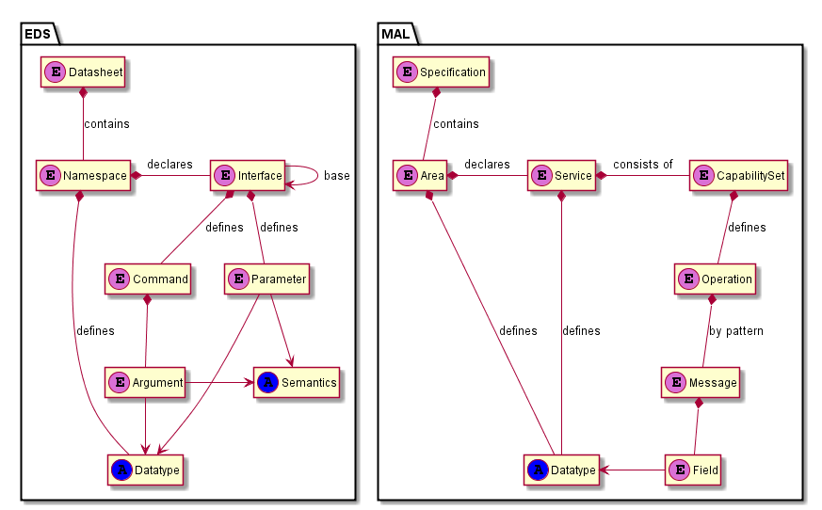
XML structure of EDS and MAL (Richard Melvin analysis & SAWG Updates)
HW & SW
SW Only
Patterns
Behavior
Logical
Topological
Messages
Provide
Specify
sets of

Slide 24
Richard Melvin Conclusions (Concurred by SAWG)
Overlap is limited to perhaps 15 to 20% of the scope of each specification
Analysis of a scenario where both MO services and SOIS EDS interfaces were in use shows there is no need to translate between the two, as they operate on different levels of abstraction.
Translating between the two representations (where they do intersect) in any case is straightforward.
Lessons learned from this analysis should be fed back into the corresponding specification development processes

Slide 25
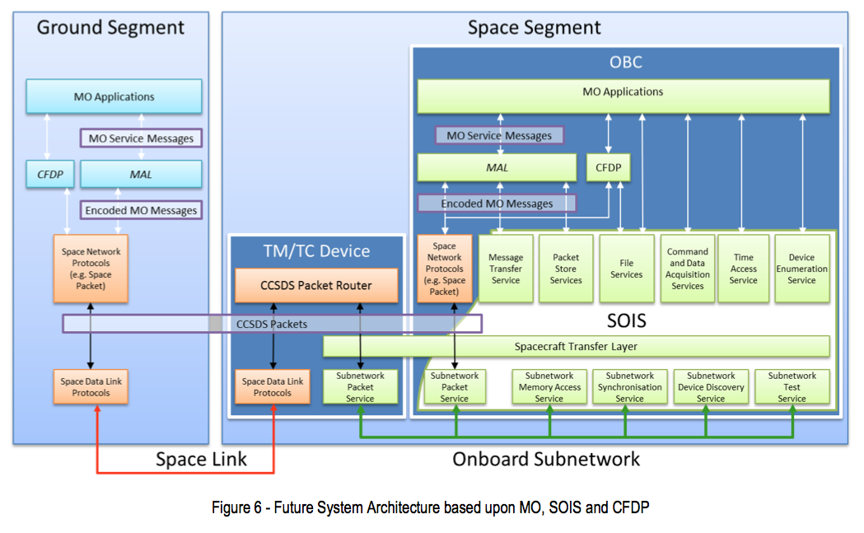
MOIMS / SOIS Reference Diagram (ESA)
MO Servce Messages may be carried in files over CFDP.
Ground-Ground may be mapped over terrestrial protocols such as 0MQ/TCP or FTP
SLE may be used to extend space link. This is transparent to application level.
Need to generate RASDS Protocol Stack representation of this.

Slide 26
Current Status of SOIS Analysis, Spring 2017
Several Views of SOIS Architecture
Functional
Information
Service
Physical (nodes)
Deployment (multiple nodes and function or protocol allocations)
Protocol stacks
The following materials are a small subset
Relationship to Melvin’s EDS MAL analysis

Slide 27
SOIS Architecture Overview
X
X
Sort of …
X
X
X
X
X
X
The SAWG believes that this is a very short-sighted approach, but it’s your call …

Slide 28
SEA SA WG: Remaining SOIS Services & Data Objects
X

Slide 29
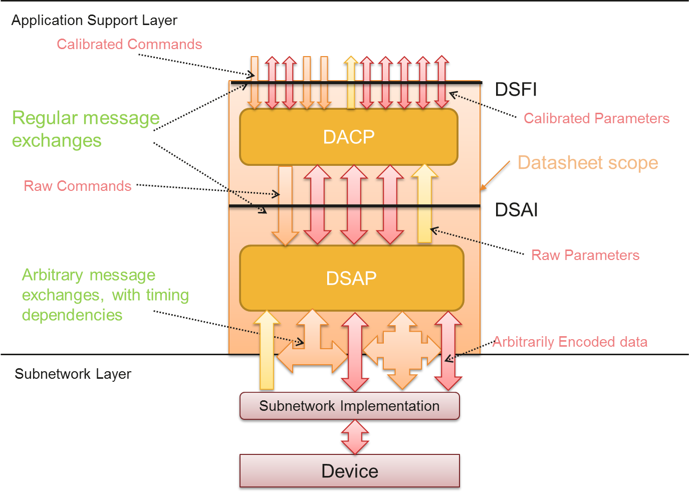
Example of EDS Device Specific Access Service Adopts many DAS & DVS concepts

Slide 30
SOIS New Layered View EDS describes components & interfaces
App Services (CDAS, MTS, and DES (plug and play)) have been deprecated.
Subnet Services (packet, memory, sync) are retained.
EDS descriptions of a variety of components and products are introduced.
The interfaces of applications may be defined in EDSs.
to facilitate automated adaptation of applications to services,
Optionally, to facilitate adaptation of applications to applications.
For example, MTS
can be replaced by a description of whatever subset of the AMS interface is appropriate for a specific mission.
Any other messaging service may be described in EDS and used to replace MTS.
Time Access Service and File and Packet Store Service interfaces will be described by EDS essentially as they are defined now in their magenta books.
EDS Descriptions of Interfaces
EDS Descriptions of Interfaces Required
EDS Descriptions of Interfaces
Device-specific
EDS Descriptions of Interfaces
EDS Descriptions of Interfaces
EDS Descriptions of Interfaces Provided

Slide 31
Process View: EDS in Tool Chain

Slide 32
EDS used to drive Avionics and MCS Software adaptation
Onboard component & interface definitions
Spacecraft Configuration
Mission database (XTCE)
Ground Segment
MCS
SOIS EDS
XML File(s)
MO Applications
TM TC
Power
Code
Generation tools
…
…
Avionics and Software
Architecture Independent
Message Abstraction Layer
PUS,
cFS,
CAST,
…
TM TC
Translator/
Formatter
TM/TC Device
OBT Mgmt
MTL Services
Space Network
Protocols
(e.g. Space
Packet)
CCSDS Packet Router
Scripting/
OBCP
SSMM mgmt
Context mgmt
AOCS
Message
Service
Power
Space
Packet
Space Data Link
Protocols
Space Data Link
Protocols
Subnetwork
Packet
Service
Thermal
Mode mgmt
FDIR
Space Link
File and
Packet Store
Services
Command
and Data
Acquisition
Services
Device
Enumeration
Service
Avionics and Software Architecture is independent of MO and SOIS architecture

Slide 33
SEA SA WG: Initial MOIMS / SOIS Deployment: MOIMS MO services on ground
User Support
Mission Data Processing
Data Archives
MOS
Spacecraft
Planning & Scheduling
Other “Be-spoke” Applications
MPS
MPS
Mission Control
MCS
NAVT
Navigation & Timing
ESLT
(Ground Station)
MCS
NAVT
Data Mgmt
Exec
MCS
GNC
TT&C
NAVT
Memory Access
Packet
Synchron-ization
MCS
MPS
NAVT
OPD
Data Storage and Archiving
Operations Preparation
OPD
Datalink Convergence
MAL - terrestrial
SpaceWire
Mil Bus
Can …
Electronic Data Sheet
Vehicle Manifest
GDS Dev &
SI&T
Satellite Dev. & Maint.

Slide 34
SEA SA WG: Intermediate Integrated MOIMS / SOIS Deployment, MO services on-board, Packet interface
User Support
Mission Data Processing
Data Archives
MOS
Spacecraft
Planning & Scheduling
Other “Be-spoke” Applications
Scheduling
Timing
MPS
MPS
Mission Control
MAL -Pkt
MCS
NAVT
ESLT
(Ground Station)
Mission Control
Navigation & Timing
MCS
NAVT
Data Mgmt
Exec
MCS
GNC
TT&C
NAVT
Memory Access
Packet
Synchron-ization
MCS
MPS
NAVT
OPD
Data Storage and Archiving
Operations Preparation
MAL -Pkt
OPD
Datalink Convergence
MAL - terrestrial
SpaceWire
Mil Bus
Can …
Electronic Data Sheet
Vehicle Manifest
GDS Dev &
SI&T
Satellite Dev. & Maint.

Slide 35
SEA SA WG: Future Integrated MOIMS / SOIS Deployment, MO services & MAL on-board
User Support
Mission Data Processing
Data Archives
MOS
Spacecraft
Planning & Scheduling
Other “Be-spoke” Applications
Planning & Scheduling
Navigation & Timing
MPS
MPS
Mission Control
MCS
NAVT
ESLT
(Ground Station)
Mission Control
Navigation & Timing
MAL -Space
MCS
NAVT
Data Mgmt
Exec
MCS
GNC
TT&C
NAVT
Memory Access
Packet
Synchron-ization
MCS
MPS
NAVT
OPD
Data Storage and Archiving
Operations Preparation
OPD
Datalink Convergence
MAL - terrestrial
SpaceWire
Mil Bus
Can …
Electronic Data Sheet
Vehicle Manifest
GDS Dev &
SI&T
Satellite Dev. & Maint.

Slide 36
SAWG Recommended Way Forward – Spring 2017
Adopt EDS and MAL analysis result (Richard Melvin & Sam Cooper), CESG concurrence.
Await development of the revised SOIS architecture vision, nominally Aug 2017.
What future looking features will it contain?
Analyze the info model of EDS and understand proposed standardization of “tool chains”.
Reach closure on a service spec: How is it defined? Does it include a description of the behavior?
Differentiate the “what” from the “how"
WG has agreed to only develop a Green Book
There does not appear to be a strong rationale for developing a normative Magenta Book because of the amount of Green / Magenta material

Slide 37
SAWG Terminology (drawn from RASDS [sec], SCCS-ADD, and MOIMS / SOIS - future)
ABA: A ‘single-hop’ space communications configuration that involves only a single direct to/from Earth space link. Term derives from the notion of an Agency ‘A’ using the ground station of an Agency ‘B’ to communicate between its MOC and its spacecraft, hence ABA.
Abstraction—A mechanism and practice to reduce and factor out details so that one can focus on few concepts at a time. It is the process of extracting the underlying essence of a concept, removing any dependence on real world objects with which it might originally have been connected, and generalizing it so that it has wider applications. [3.2.2]
Action—Something that happens within an object, either with or without participation of another object. An interaction is an action performed with participation of another object. [3.2.3]
Activity—A specification of behavior described as a sequence of actions. [3.2.3] Aggregation—Several things grouped together or considered as a whole; the act of gathering things together. [3.2.4]

Slide 38
SAWG Terminology (drawn from RASDS, SCCS-ADD, and MOIMS / SOIS)
Allocation—A mapping between one set of model elements and another. The mapping is often performed as part of the design process to refine the design. Typical examples of allocation include allocation of functions to nodes, logical to physical components, logical to physical links, and software to hardware. [6.3.4]
Application Layer: OSI Layer 7 contains all those functions that imply communication between open systems that are not already performed by the lower layers.
Application Programming Interface—A set of definitions of the ways one piece of computer software communicates with another; a method of achieving abstraction, usually (but not necessarily) between lower-level and higher-level software. [7.3.4]
Architecting—The process of defining, documenting, maintaining, improving, and certifying proper implementation of an architecture. Architecting is both a science and an art. [3.2.5]
Architecture—The concepts and rules that define the structure, semantic behavior, and relationships among the parts of a system; a plan of something to be constructed; includes the elements (entities) that make up the thing, the relationships among the elements, the constraints that affect those relationships, a focus on the parts of the thing, and a focus on the thing as a whole. [3.2.5]

Slide 39
SAWG Terminology (drawn from RASDS, SCCS-ADD, and MOIMS / SOIS)
Attribute—A characteristic of an object; a language construct that system designers use to add additional information to system elements (e.g., objects, modules, types) to define their functionality. [3.2.3]
Behavior—A set of actions performed by an object for some purpose. [3.2.3]
building block: The set of nodes, with specific defined characteristics, that are used to describe end-to-end system configurations in this document.
Communications Viewpoint—An engineering and technology view on a space data system that focuses on the protocols and mechanisms of information transfer performed by that system. [7.2]
Composition—A form of aggregation. Composition may be recursive. [3.2.4]
Configuration—A collection of objects able to interact at interfaces. A configuration determines the set of objects involved in each interaction along with constraints on their interactions. [3.2.3]
Connectivity Viewpoint—An engineering viewpoint on a space data system that focuses on the Node and Link view of a system, the physical connections among Nodes, their physical and environmental constraints, physical dynamics, and (optionally) the allocation of implemented functions to Nodes. [6.2]

Slide 40
SAWG Terminology (drawn from RASDS, SCCS-ADD, and MOIMS / SOIS)
Constraint—A limitation or implied requirement that limits the design solution or implementation, is not changeable by the enterprise, and is generally nonallocable. [3.2.3]
Correspondence—A function such that for elements in one viewpoint there is a related element in another viewpoint; the condition of being in conformity from elements in one viewpoint to elements in another. [3.2.5]
credential: A physical/tangible object, a piece of knowledge, or a facet of a person’s physical being, that enables an individual to have access to a given physical facility or computer-based information system.
cross support: An agreement between two or more organizations to exploit the technical capability of interoperability for mutual advantage, such as one organization offering support services to another in order to enhance or enable some aspect of a space mission.
cross support service: A function provided by one space agency to support operations of a space mission of another space agency.
Data Architecture—Models of the structure and relationships among the data elements used within a system. [8.3.4]

Slide 41
SAWG Terminology (drawn from RASDS, SCCS-ADD, and MOIMS / SOIS)
Data Link Layer: The OSI Layer (Layer 2, often referred to as ‘link layer’) that provides functional and procedural means for the establishment, maintenance, and release of data link connections among Network Layer entities (where they are used) and for the transfer of data link service data units.
Data Models—Schema and structure definitions. [8.3.4]
Data Objects—Information objects, either physical or digital. [8.3.4]
Domain—A Community that is under single organizational, administrative, or technical control (e.g., NASA Space Operations Mission Directorate). A domain may have resources, policies, access control, and possibly quality of service constraints. A Domain may be subdivided into Subdomains. Multiple Domains may be collected into a Federation. [4.3]
Element—A constituent part of something; any thing that is one of the individual parts of which a composite entity is made up; an identifiable component, process or entity of a system. [3.2.2]
Earth User Node: A physical element, located on the ground, that uses a cross support service provided by a CSSS.
encapsulation: A function that wraps a PDU in another PDU in order to transfer it to its destination.

Slide 42
SAWG Terminology (drawn from RASDS, SCCS-ADD, and MOIMS / SOIS)
Enterprise Object—An organizational entity that is governed by a single authority that has its own objectives and policies to operate the object. An Enterprise Object may be a component of another larger Enterprise Object. Enterprise Objects may participate wholly or in part in other Enterprise Objects. [4.2]
Enterprise Viewpoint—A view of a space data system that focuses on the community, purpose, scope, and policies for that system. This viewpoint includes organizations as well as the Enterprise Objects that have assigned roles, responsibilities, and interactions. [4.2]
Entity—Any concrete or abstract thing of interest. For example, an entity may be a physical instrument, a computer, a piece of software, or a set of functions performed by a system. While in general the word entity can be used to refer to anything, in the context of modeling it is reserved to refer to things in the universe of discourse being modeled. [3.2.2]
Environment—A complex of external factors that acts on a system and determines its course and form of existence. An environment may be thought of as a superset, of which the given system is a subset. An environment may have one or more parameters, physical or otherwise. The environment of some system or object consists of the substances, circumstances, objects, or conditions by which it is surrounded or in which it occurs. [3.2.4]

Slide 43
SAWG Terminology (drawn from RASDS, SCCS-ADD, and MOIMS / SOIS)
Facility—A physical infrastructure element that supports the use of services and other resources. [4.2]
Federation—A Community consisting of multiple Domains (e.g., CEOS or CCSDS) that come together to share resources while retaining their autonomy over those resources. Federations are bound by negotiated agreements. A Federation may include only some members of a Domain or Subdomain (e.g., a particular Earth Observing project). Members of a Federation agree to rules for sharing resources and for joining and/or leaving the Federation. [4.3]
Function—The set of actions or activities performed by some object to achieve a goal; the transformation of inputs to outputs that may include the creation, modification, monitoring, or destruction of elements. [3.2.4]
Functional Object—An object that performs Functions to achieve a goal of a space data system, or to support actions of another Functional Object, and to transfer, generate, or process data in performing those actions. [5.2]
Functional Viewpoint—A view on a space data system that focuses on the structure of the functions performed by that system and their behavior and on the interactions among the functions. This includes Functional Objects, the logical connections between them, their interactions, and logical interfaces. [5.2]

Slide 44
SAWG Terminology (drawn from RASDS, SCCS-ADD, and MOIMS / SOIS)
functional resource: The functions or capabilities that are provided by physical resources (e.g., transmitters and receivers) of a CSSE, but not those physical resources themselves. A functional resource is a logical construct not necessarily linked to any single system component.
gateway: A function that provides protocol translation between two different, but compatible, protocols at the same OSI Layer, e.g., IP to BP.
Goal—An aim or purpose; the end toward which effort is directed. Goals tend to be broad or abstract and to state general intentions. [3.2.4]
Information Management Functional Objects—Active functional elements that support the location, access, delivery, and management of passive Information Objects. These Information Management Functional Objects are a class of Functional Objects. [5.4.4]
Information Object—Data, along with the necessary structure and syntax to allow interpretation and use of that data; may also have associated metadata, including the relationships among Data Objects, rules for their use and transformation, and policies on access. [8.2]

Slide 45
SAWG Terminology (drawn from RASDS, SCCS-ADD, and MOIMS / SOIS)
Information Package—A primary Information Object, optional ancillary information, and associated supporting information that is needed to use the Information Object. The Information Package has associated Packaging Information used to delimit and identify the primary Information Object and Supporting Information. [8.2]
Information Viewpoint—A view of a space data system that focuses on the information used by that system. This includes structural (syntactic) and semantic views of the information, the relationships among information elements, and rules for their management and transformation. [8.2]
Instantiation—Creation of an instance of some abstract element, achieved by an action of an object in the model. Elements can be anything that can be instantiated, in particular objects and interfaces. Data Models must be instantiated as real information objects in order to participate in system activities. [8.3.4]
Interaction—An action performed by an object with participation of another object or with its environment. [3.2.3]
Interface—A set of interactions performed by an object for participation with another object for some purpose, along with constraints on how they can occur. An interface is therefore where the behavior of an object is exposed. Objects may have one or more interfaces. [3.2.3]

Slide 46
SAWG Terminology (drawn from RASDS, SCCS-ADD, and MOIMS / SOIS)
interface binding signature: A ‘signature’ that results from a service user and service provider implementing the proper stack of interface protocols in order to bind to service elements. This signature may involve Transmission Control Protocol/Internet Protocol (TCP/IP), Hypertext Transfer Protocol (HTTP), or some set of CCSDS space-communication protocols.
internetwork: A ‘network of networks’ (often shortened to internet), where two or more distinct computer networks are connected together using routing devices that allow traffic to flow back and forth between the networks.
internetworking: Practice of connecting two or more distinct computer networks or network segments together to form an internetwork, using devices which operate at OSI Layer 3 (Network Layer) to connect them together to allow traffic to flow back and forth between them.
interoperability: A property of protocols or systems whereby elements adopt a commonly defined and implemented set of protocols, data, and behaviors.
Location—A point or extent in space. [3.2.4]

Slide 47
SAWG Terminology (drawn from RASDS, SCCS-ADD, and MOIMS / SOIS)
Logical Link—The locus of relations among Logical Objects. It may be considered separately from any particular implementation or deployment and has no physical manifestation except as part of a model. [3.2.4]
logical link: A link that shows a relationship between various types of logical objects (e.g., functions, protocols, or organizations). It may be considered separately from any particular implementation or deployment and has no physical manifestation except as part of a model.
Logical Object—An abstract entity that may be considered separately from any particular implementation or deployment. A Logical Object has no physical manifestation except as part of a model, but it may have associated behaviors and interfaces. [3.2.4 Link—The locus of relations among Nodes. A Link provides interconnections between Nodes for communication and coordination. A Link may be implemented by a wired connection or with some RF or optical communications media. A Link may periodically become inactive because of the motion of a Node or the lack of availability of communications resources, for example. Links connect Nodes at a Port. [6.3.4]

Slide 48
SAWG Terminology (drawn from RASDS, SCCS-ADD, and MOIMS / SOIS)
Metadata—data about data; the information that describes content. Metadata is information about the meaning of data, as well as the relationships among Data Objects, rules for their use and transformation, and policies on access. [8.2]
Meta-model—An explicit model of the constructs and rules needed to build specific models within a domain of interest. [8.2]
Model—A formal specification of the structure and/or function of a system. All models are abstractions; abstraction is the suppression of irrelevant detail. [3.2.5]
(N)-layer—Any specific layer in a multi-layer protocol stack. The layer above is called the (N+1)-layer, the layer below is called the (N-1)-layer. This notation is also used in the model for other concepts that are related to these layers, for example, (N)-protocol, (N+1)- service. [7.3.4] .
network: One or more computers or other processing elements that are owned by a single organization, communicating using a single OSI Layer 3 protocol and sharing a single Layer-2 technology.
Network Layer: OSI Layer 3, which provides the means to establish, maintain, and terminate network connections between open systems and provides transport entities independence from routing and relay considerations.

Slide 49
SAWG Terminology (drawn from RASDS, SCCS-ADD, and MOIMS / SOIS)
node: A space data system physical entity operating in a physical environment. A node is a configuration of engineering objects forming a single unit for the purpose of location in space, and embodying a set of processing, storage, and communication functions. A node has some well-understood, possibly rapidly moving location, and it may be composed of two or more (sub-) nodes.
Object—An abstract model of an entity in the real world, containing information, having behavior, and offering services. A system is composed of interacting objects. An object is characterized by that which makes it distinct from other objects. [3.2.2]
Objective—Something to be done or achieved. Objectives tend to be precise, tangible, and concrete. [3.2.4]
Operations Concept—A verbal or graphic statement, in broad outline, of assumptions or intent in regard to the operation of the system. The concept of operations frequently is embodied in observing plans and operations plans. The concept is designed to give an overall picture of the operation of the system. [4.4.4]
Organization—A formal group of people with one or more shared goals. [4.3]

Slide 50
SAWG Terminology (drawn from RASDS, SCCS-ADD, and MOIMS / SOIS)
Ownership—Having administrative and fiscal responsibility for the owned element and the right to exclusively control and use that which is owned for one’s own purposes; the state or fact of having exclusive possession or control of some object, facility, intellectual property or some other kind of property. [4.2]
Perspective—In systems architecture, the choice of a context or a reference (or the result of this choice) from which to describe, categorize, explain, or codify system design, typically for comparing with another. [3.2.5]
Physical Layer: OSI Layer 1, which provides for the transparent transmission of bit streams between data-link entities across physical connections and the mechanical, electrical, functional, and procedural means to activate, maintain, and deactivate physical connections.
Policy—A set of guidelines and constraints on the behaviors exhibited by the objects in the system. [3.2.5]
Port—The physical element of a Node where a Link is connected. Nodes may have one or more Ports. [6.3.4]
Protocol—A set of rules and formats (semantic and syntactic) used to determine the communication behavior of (N-layer)-protocol-entities in the performance of (N-layer)- functions; the description of the state machines within a Protocol Entity and the PDUs that are exchanged between these entities. [7.3.4]

Slide 51
SAWG Terminology (drawn from RASDS, SCCS-ADD, and MOIMS / SOIS)
protocol data unit, PDU: A unit of data which is specified in a protocol of a given layer and which consists of protocol-control information, addressing information, and possibly user data for that layer (typically defined as a Service Data Unit [SDU]).
Protocol Entity—An active element within an (N-layer)-communications-subsystem embodying a set of capabilities defined for the (N-layer)-layer that corresponds to a specific (N-layer)-entity-type (without any extra capabilities being used). Protocol Entities implement protocols. [7.3.4]
Provenance—Documentation of the place of origin, proof of authenticity, or record of previous processing. These are valuable pieces of information in the history of an object. [8.3.4]
provider system: A CSSS that provides services to a user CSSS. A provider CSSS may also be a user of other CSSS services.
Proximity link: A communications link between an element in space and another nearby element in space or on the surface of a planetary body (<1 second Round-Trip Light Time [RTLT]).
Realization—The act or the condition of becoming real. Abstract data architecture elements must be realized as Data Models and stored in some sort of repository. [8.3.4]

Slide 52
SAWG Terminology (drawn from RASDS, SCCS-ADD, and MOIMS / SOIS)
Relationship—The way in which two or more entities can be associated with one another. [3.2.3] Representation—Some way of organizing, manipulating, presenting, and storing information; a visual or tangible rendering of something. [3.2.5]
relaying: A managed process for forwarding frame, packet, or physical data that involves no decision making.
Requirement—A formal statement of (1) an attribute to be possessed by the element or a function to be performed by the element; (2) the performance standard for the attribute or function; (3) the measuring process to be used in verifying that the standard has been met. [3.2.5]
Resource—Anything available to a system that can support the achievement of objectives; any physical or virtual element that may be of limited availability within a system. A resource may be shared by more than one activity. In the Enterprise Viewpoint a resource is an entity that has some role, offers services, and performs some action within a system. [3.2.4, 4.2]
router: A device that forwards Network Layer PDUs between computer networks, creating an Internetwork. A router is connected to two or more data links from different subnetworks and uses address information in the PDU and information in its routing table or routing policy to direct the PDU to the next subnetwork.
routing: The process of selecting paths from origins to destinations in a network.

Slide 53
SAWG Terminology (drawn from RASDS, SCCS-ADD, and MOIMS / SOIS)
Role—The way in which an entity participates in a relationship; an object’s set of behaviors and actions associated with the relationship of that object with other objects. [3.2.3]
Scenario—A specific sequence of activities illustrating behaviors. A scenario may be used to illustrate an interaction or an operations concept instance. [4.4.4]
Schema—An information model defined in a document or a database. The universe of objects that can be described is defined in the schema. For each object class, the schema defines what attributes an instance of the class must have, what additional attributes it may have, and what object class can be a parent of the current object base. [8.3.4]
Semantics—Rules by which syntactic expressions are assigned meaning. [3.2.3]
Service—A provision of an interface of an object to support actions of another object. [3.2.3]
Service Access Point—The point at which (N-layer)-services are provided by an (N-layer)- protocol-entity to an (N+l-layer)-protocol-entity. [7.3.4]

Slide 54
SAWG Terminology (drawn from RASDS, SCCS-ADD, and MOIMS / SOIS)
service management, SM: 1) The set of functions exposed by PM to utilization management for the purposes of acquiring and managing the services provided by the provider CSSS to the user CSSS. These functions include planning, scheduling, and managing the configuration of space communication service functions. 2) The specification for exchanging service management information.
service provider: The role played by a physical, functional, or organizational entity that provides a cross support service for a service user. (A single entity may play the roles of service provider and service user at the same time.)
service user: The role played by a physical, functional, or organizational entity that uses a cross support service provided by a service provider. (A single entity may play the roles of service provider and service user at the same time.)
Solar System Internetwork, SSI: A loose confederation of independent space communications networks that all share a single Network-Layer protocol that allows them to interoperate and exchange Network-Layer PDUs, each often owned and administered by a different space agency.

Slide 55
SAWG Terminology (drawn from RASDS, SCCS-ADD, and MOIMS / SOIS)
space communications protocol: A communications protocol designed to be used over a space link or in a network that contains one or multiple space links.
Space Enterprise—A top-level autonomous entity (e.g., NASA) that is dedicated to the exploration and/or exploitation of space. A Space Enterprise has its own objectives, resources, and policies, and it is not a component of any other Space Enterprise. [4.3]
space link: A communications link between a spacecraft and its associated ground system or between two spacecraft. A space link consists of one or more physical channels in one or both directions.
space link extension, SLE: A set of specific cross support services that provide reliable, access-controlled transfer of spaceflight mission-related data between ground cross support service providers and user elements. Each specific SLE service is defined separately for the kind of data it transfers (e.g., telemetry frames, telecommand, Communication Link Transmission Units [CLTUs], Operational Control Field [OCF]). CSTS is a generalization of the SLE concept.
space link interface: The interface of a CSSE that uses space link protocols.
space link layer processing: Processing at OSI Layers 1 and 2 for space communications, including any needed framing, coding, and modulation.

Slide 56
SAWG Terminology (drawn from RASDS, SCCS-ADD, and MOIMS / SOIS)
space routing node: A physical element located in space that provides space internetworking services.
Space User Node: A physical element located in space that uses a cross support service provided by a CSSS.
Specification—A set of requirements or other descriptive information for a system or classifier. [3.2.5]
Stakeholder—An individual, team, or organization (or classes thereof) with interests in, or concerns relative to, a system. [3.2.5]
Standard—A formal specification that defines and governs functions and protocols at interfaces of a data system. It describes in detail the technical capabilities of, and establishes the requirements to be met by interfacing subsystems to achieve compatibility and interoperability. [3.2.5]
State—A condition or situation during the life of some object; at a given instant in time, the condition of an object that determines the set of all sequences of actions in which the object can take part. [7.3.4]

Slide 57
SAWG Terminology (drawn from RASDS, SCCS-ADD, and MOIMS / SOIS)
State Machine—The description of the discrete sequence of states that an object or interaction goes through during its life in response to events, together with its responses and actions. A State Table is an alternative tabular representation of the same information. [7.3.4]
store and forward (S&F): The process of holding data (store) until a path is available to send it to its destination (forward).
Structure—The relationship between a set of elements, contributing to the properties of the whole and enabling them to interact. [3.2.3]
supported agency: A space agency that uses cross support services. supporting agency: A space agency that provides cross support services.
supporting agency: A space agency that provides cross support services.
Syntax—The grammar defining the valid set of symbols and well-formed linguistic constructs of a language. [3.2.3]
System—A set of elements (people, products [hardware and software], facilities, equipment, material, and processes [automated as well as manual procedures]) that are related and whose behavior satisfies customer and/or operational needs. [3.2.5]

Slide 58
SAWG Terminology (drawn from RASDS, SCCS-ADD, and MOIMS / SOIS)
terrestrial-link interface: The interface of a CSSE that uses terrestrial link (and networking) protocols.
Transport Layer: OSI Layer 4, which has end-to-end significance, where the ends are defined as transport entities having transport associations. The Transport Layer provides transparent transfer of data between applications and relieves them from any concern with subnetwork topologies or the detailed way in which transfer of data is achieved.
Type—Specification of the set of values allowed and the primitive operations that an object can provide. Types are grouped into classes, which share the same primitive operations. [3.2.3]
View—A representation of a whole system from the perspective of a set of concerns. Views are themselves modular and well formed, and each View is intended to correspond to exactly one Viewpoint. A View may include representations or correspondences to elements defined in other Viewpoints. [3.2.5]
Viewpoint Specification—A form of abstraction achieved using a selected set of architectural concepts and structuring rules in order to focus on particular concerns within a space data system. A Viewpoint Specification defines a pattern or template from which to construct individual views, and it establishes the rules, techniques, and methods employed in constructing a View. [3.2.5]

Slide 59
SAWG Terminology (drawn from RASDS, SCCS-ADD, and MOIMS / SOIS)
user applications: OSI Layer 8 functions that use other communications services.
user system: A CSSS that uses the services of a provider CSSS. A user CSSS may also be a provider CSSS for other CSSSes.

Slide 60
BACKUP

Slide 61
SEA SA WG: Integrated Services Deployment - Initial
User Support
Mission Data Processing
Data Archives
MOS
Spacecraft
Planning & Scheduling
“Be-spoke” Applications
MPS
MPS
MCS
NAVT
ESLT
Mission Control
Navigation & Timing
TT&C
Exec
GNC
Data Mgmt
MCS
NAVT
MCS
NAVT
Memory Access
Packet
Synchron-ization
MCS
MPS
NAVT
OPD
Data Storage and Archiving
Operations Preparation
Datalink Convergence
OPD
SpaceWire
Mil Bus
Can …
Electronic Data Sheet
Vehicle Manifest
GDS Dev &
SI&T
Satellite Dev. & Maint.

