Slide 1
MOIMS Protocol Viewpoint
Inputs to SEA Reference Architecture
Roger Thompson ESA

Slide 2
RASDS Graphical Conventions
Data
Store
Data Store
Physical Node
Organizational Element
Organizational Domain
Service Consumer
Service Provider
DATA
Physical or
Functional Connection
Logical Link
between Elements
Link Layer User
Service Access Point
Peering
Arrangement
Functional Element
Physical, Logical, & Service Connectors
Communications Protocol
Router
Color Keys:
As all Functions are Application Layer – overload by Functional Group
User Node
Application
Link Layer function
Earth Routing Node
Element Management
Routing function
Space Routing Node
Network Management
Forwarding function
WAN Node
Network Layer function
Data Store

Slide 3
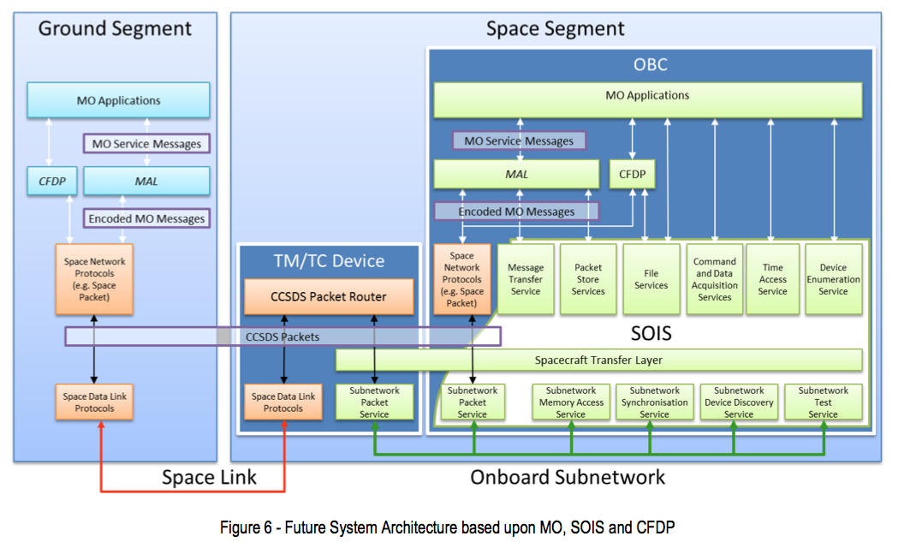
Reference Diagram
MO Servce Messages may be carried in files over CFDP.
Ground-Ground may be mapped over terrestrial protocols such as 0MQ/TCP or FTP
SLE may be used to extend space link. This is transparent to application level.
Need to generate RASDS Protocol Stack representation of this.

Slide 4
SCCS Context
SCCS
ABA/SSI
User
Applications
User
Applications
I
I
Space Communications Cross Support (SCCS) Architecture
Describes Communications Architecture for two primary cases:
ABA: a ‘single-hop’ space communications configuration that involves only a single direct to/from Earth space link. Term derives from the notion of an Agency ‘A’ using the ground station of an Agency ‘B’ to communicate between its MOC and its spacecraft, hence ABA.
SSI: A loose confederation of independent space communications networks that all share a single Network-Layer protocol that allows them to interoperate and exchange Network-Layer PDUs, each often owned and administered by a different space agency.

Slide 5
SCCS Basic ABA Configuration
Service
Management
Interface
Space User
Node
ABA
ESLT
Earth User
Node
Space-Link Service Provider Interface
Terrestrial Service Provider Interface

Slide 6
SCCS SSI Core Configuration
Space Link
Interfaces
Terrestrial-Link
Interfaces
Space-Link
Interfaces
Space User
Node
SSI
ESLT
Terrestrial
WANs
Earth User
Node
Space
Routing
Node
Service
Management
Interface
Earth
Routing
Node

Slide 7
MOIMS Services Protocol Binding
MOIMS Concerns Application Level Services, end to end
MOIMS Standards are defined in terms of two principle information exchange paradigms:
Message Based Interaction
File Transfer
In terms of Communications Architecture, MOIMS Services may be deployed in 3 principle contexts:
Across a Space Link, using CCSDS SCCS ARD compliant communications protocol stacks. It should be noted that this includes the use of Space Link Extension services, or SSI protocols deployed over terrestrial networks.
Across a Terrestrial Network, using industry standard communications protocol stacks
Within a Spacecraft, using CCSDS SOIS services [TBC]
Bridging between these contexts is performed at application level. Where the MO MAL is used, a generic MAL bridge can provide this as an application independent service

Slide 8
MOIMS Comms Context: Space Link
Space
User Node
Space or Earth
User Node
MOIMS Information Exchange
MOIMS
User Application
MOIMS
User Application
MOIMS
Space Link
Communications Processing
Space Link
Communications Processing
Space Link
Any SCCS Architecture
(ABA/SSI)

Slide 9
MOIMS Comms Context: Terrestrial Link
Earth
User Node
Earth
User Node
MOIMS Information Exchange
MOIMS
User Application
MOIMS
User Application
MOIMS
Terrestrial Link
Communications Processing
Terrestrial Link
Communications Processing
Terrestrial Link
Any Terrestrial Network Architecture

Slide 10
MOIMS Comms Context: On-board Link
Space
User Node
MOIMS Information Exchange
MOIMS
User Application
MOIMS
User Application
MOIMS
SOIS
Communications Processing
SOIS
Communications Processing
SOIS Link
SOIS Compatible On-board Architecture

Slide 11
MOIMS Generic Protocol Stacks
MO Compliant Service
MOIMS File Exchange
MOIMS
User Application
MOIMS
User Application
MO Language Binding
API Transform
MO Service
MOIMS File Format
Optional File Format Specification in terms of MAL
MAL
MAL
MALTechnology Binding
Transport and Encoding
MAL Encoding
Application Protocol
Messaging or File
File Transfer Protocol
Transport Protocol
Transport/Network Layer
Transport Protocol
Network
Link Layer
Network
Blue layers correspond to Internet/DOD 4 Layer model :
Application Layer (e.g. FTP or ZeroMQ)
Transport and Network Layers combined (e.g. TCP/IP or UDP/IP)
Physical Link Layer or “Network” (e.g. WAN, LAN or WLAN)
Protocol stacks must match between communicating User Applications
MO Language Binding can differ between communicating User Applications
For File Exchange, the transfer must be independently initiated at Communications Protocol level, either directly by the User Application or by a 3rd party.

Slide 12
MOIMS Over Space Link
MO Compliant Service over Space Packet and/or CFDP
MOIMS File Exchange
MOIMS
User Application
MOIMS
User Application
MO Language Binding
Entire Service or Single Message
MO Service
MOIMS File Format
MAL
MAL SPP
MAL CFDP
Bidirectional:
TM and TC Packets
CFDP
CFDP
CCSDS Space Packet
CCSDS Space Packet
Communications Processing
Communications Processing
Any SCCS Architecture
(ABA/SSI)
Any SCCS Architecture
(ABA/SSI)

Slide 13
MOIMS Over Space Link (ABA Deployment Example)
Space User Node
ESLT (Ground Stn)
Earth User Node
MOIMS
User Application
MOIMS
User Application
MOIMS
MO Language Binding
MO Language Binding
MO Service
MO Service
MAL
MAL
MAL SPP
MAL CFDP
MAL SPP
MAL CFDP
Multiple service options, eg. R-AF + F-CLTU
CFDP
CFDP
CCSDS Space Packet
CCSDS Space Packet
Space Data Link
Space Data Link
CCSDS CSTS/SLE
CCSDS CSTS/SLE
Coding & Synch
C&S
TCP/IP
TCP/IP
RF Link
RF Link
Network
Network

Slide 14
MOIMS Over Terrestrial Link
MO Compliant Service over ZeroMQ and/or FTP
MOIMS File Exchange
MOIMS
User Application
MOIMS
User Application
MO Language Binding
MO Service
MOIMS File Format
MAL
MAL 0MQ
MAL FTP
0MQ
FTP
FTP
TCP/IP
TCP/IP
Network
Network
Note that 0MQ and FTP are example protocols – others may be used if MAL binding exists
MO Language Binding can differ between communicating User Applications
For File Exchange, the transfer must be independently initiated at Communications Protocol level, either directly by the User Application or by a 3rd party.

Slide 15
MOIMS Over Terrestrial Link (Deployment Example)
Earth User Node
Earth User Node
MOIMS
User Application (Provider)
MOIMS
User Application
(Consumer)
MOIMS
MO Language Binding
MO Language Binding
MO Service
MO Service
MAL
MAL
MAL FTP
MAL 0MQ
MAL FTP
FTP
0MQ
0MQ
FTP
TCP/IP
TCP/IP
Network
Network
WAN, LAN or WLAN

Slide 16
MAL Bridging
User Node
MAL Bridge
User Node
MOIMS
User Application (Provider)
MOIMS
User Application
(Consumer)
MOIMS
MO Language Binding
MO Language Binding
MO Service
MO Service
MAL
MAL
MAL
MAL MTA
MAL MTA
MAL MTB
MAL MTB
Messaging Tech A
MTA
MTB
Messaging Tech B
Transport A
Trans A
Trans B
Transport B
Network A
Net A
Net B
Network B
MAL Bridge supports two technology bindings and translates between them
Example above is for two Messaging Technologies (A and B)
All MO Services defined in terms of MAL can be transferred across the same generic MAL Bridge
Can be used to link different Communications contexts (Space-Ground or Ground-Ground)

