Slide 1
MOIMS Services
Inputs to SEA Reference Architecture
Roger Thompson ESA

Slide 2
Background
SEA System Architecture WG has a CCSDS Communication Systems Reference Architecture covering SLS, CSS and SIS Areas
Has been tasked to define Reference Architecture for CCSDS Application and Support Layer Services: MOIMS and SOIS Areas
SEA SA WG Project to do this supported by:
NASA: Peter Shames; Ramon Krosley [SOIS]
CNSA: Yonghui Huang [SOIS]
ESA: Roger Thompson [MOIMS]
Work scheduled in 2 Phases
Powerpoint “Cartoon” Version, using RASDS Representation
Magenta/Green Book Production
Model Views: Functional, Service, Information, Protocol and Deployment

Slide 3
MOIMS Services Overview
This version covers standardisation areas covered by the following working groups:
Spacecraft Monitoring and Control
Navigation
Mission Planning and Scheduling
Data Archives
Primarily Functional View: Diagrams illustrate MOIMS Standards in terms of
Service Interfaces
Data Formats
Extend RASDS representation to show these

Slide 4
RASDS Graphical Conventions
Data
Store
Data Store
Physical Node
Organizational Element
Organizational Domain
Service Consumer
Service Provider
DATA
Physical or
Functional Connection
Logical Link
between Elements
Link Layer User
Service Access Point
Peering
Arrangement
Functional Element
Physical, Logical, & Service Connectors
Communications Protocol
Router
Color Keys:
As all Functions are Application Layer – overload by Functional Group
User Node
Application
Link Layer function
Earth Routing Node
Element Management
Routing function
Space Routing Node
Network Management
Forwarding function
WAN Node
Network Layer function
Data Store

Slide 5
MOIMS Data and Services
CSS-M&C
User Support
Planning & Scheduling
TT&C
MPS
CSS-SM
NAVT
MCS
MPS
MPS
NAVT
CSS-TS
TRM
MCS
NAVT
Mission Control
Navigation & Timing
MCS
NAVT
MCS
MCS
NAVT
OPD
MCS
MCS
MPS
NAVT
OPD
MPS
MPS
Data Storage and Archiving
Operations Preparation
NAVT
MDP
OPD
MDP
MCS
OPD
NAVT
Spacecraft Development & Maintenance
Mission Data Processing
MDP
MCS
NAVT
Functions and Data Colour Coded: Data in Rectangles; Services indicated at Provider End by Circle MDP = Mission Data Product
Notes:
The 5 MOIMS Areas are colour coded.
Each application level interaction is annotated with the Data exchanged. At this level all Data generated by each Function is grouped as a single type (the abbreviation reflects the function name).
Potential service interfaces identified by MO are indicated by a colour-coded circle representing the Service Provider
Data formats may be separately defined [NAV, MPS] or specified in the context of the service [MO M&C, MPS].
File Handling is a bit different – there are special services for File Management and File Transfer [the latter delegated to a lower level protocol, such as CFDP or FTP], but the file content my be associated with any of the other Functional Areas. It essentially provides the transport layer for bulk transfer of service messages or data formats. Mission Data Products may also be transferred as files.
Note Planning/Scheduling interactions with the GSTS are greyed out as they are outside the scope of MOIMS standardisation [CSS boundary agreement].

Slide 6
Common Services
Data Storage and Archiving
Operations Preparation
MO COM Service: Archive
Any Data
Any Config
MO Common Service: Configuration
Any Function
MO Common Service: Directory
SDIR
LAC
MO Common Service: Login
Service
Directory
Login & Authentication
Notes:
SDIR: Service Directory
LAC: Login and Authentication Credentials

Slide 7
Mission Control
Operations Preparation
Planning & Scheduling
OSW
APD
AUT
M&C
OSM
APD
OPM
SDB
Automation
On-board ConfigurationManagement
OSM
OPM
M&C
M&C
ODM
AUT
EVM
AUT
ADM
TT&C
Monitoring and Control
Navigation Interface
SMM
Navigation & Timing
CSS-M&C
M&C
PRM
NHM
M&C
TCM
User Support
OSM
OPM
Mission Data Processing
AUT
M&C
Data Storage and Archiving
Spacecraft Development & Maintenance
Notes:
M&C: Monitoring & Control
AUT: Automation
OSM: On-board Software Management
OPM: On-board Procedure Management

Slide 8
Mission Control (Alternative View)
Monitoring & Control
Automation
On-board
Configuration
Management
Navigation Interface
CSS-M&C
OPD[SDB]
TCM
CAR [M&C]
FTM [M&C]
M&C
OSM
OPD
OPD[APD]
CAR [AUT]
FTM [AUT]
M&C
OPD[OSW/APD]
CAR [OSM/OPM]
FTM [OSM/OPM]
M&C
AUT
ODM
EVM
ADM
SMM
PRM
M&C
AUT
OSM
OPM
NHM
M&C
AUT
OSM
OPM
NDM*
NHM
TCM
OPD
CAR
FTM
CSS M&C
M&C
AUT
OSM
OPM
OPD[PDB]
M&C
AUT
OSM
OPM
CAR
FTM
OSW
NDM*
TCM
CSS M&C
M&C
SDB
APD
PDB
NHM
Planning & Scheduling
Data Storage and Archiving
Operations Preparation
Navigation & Timing
TT&C
User Support/
Mission Data Proc/
Spacecraft Dev
Mission Data Processing
Mission Data Processing
*NDM: Navigation Data Message includes ODM, EVM, ADM, SMM and PRM
Notes:
CFG: Configuration (MO Common Service)
CAR: Common Archive (MO COM Service)
FTM: File Transfer and Management (MO Service)

Slide 9
Updated input from NAV WG
CCSDS Navigation Working Group Technical Program
S/C
NOTE: Exchanges may be predicted future data or
reconstructed actual data, depending on the message type
Messages
ADM = Attitude Data Message
CDM = Conjunction Data Message
EVM = Events Message
NHM = Navigation H/W Message
ODM = Orbit Data Message
PRM = Pointing Request Message
SMM = Spacecraft Maneuver Message
TDM = Tracking Data Message
Functions
Att Det = Attitude Determination function
Cmd Gen = Command Generation function
Mission S/C Team = Spacecraft Team function
Mnvr = Maneuver Design function
Orbit Det = Orbit Determination function
S/C = Spacecraft
Sched = Scheduling function
Science = Science function
Trk Stn = Tracking Station
Conjunction
Assessment
CDM
SMM
Navigation
ODM
Trk Stn
ODM
SMM
TDM
Orbit
Det
CDM
Mnvr
Commands
TLM Data
CDM
EVM
EVM, SMM
SMM,
ADM,
PRM
ADM
NHM
SMM
Att
Det
Mission
S/C Team
ODM, EVM
Sched
ODM
PRM
SMM, ADM, ODM
Commands
ADM
Science
Cmd Gen
PRM

Slide 10
Navigation and Timing
Planning & Scheduling
TT&C
ODM
Time/Position Determination
EVM
MPS
CDM
ODM
TDM
TRM
TDM
Conjunction Assessment
TIM
Orbit Determination & Propagation
ODM
ODM
ODM
ADM
ODM
User Support
CDM
EVM
SMM
PRM
ADM
Manoeuvre Planning
SMM
Attitude Determination
SMM
PRM
PRM
ADM
ODM
PRM
ADM
ODM
SMM
EVM
Time
Correlation
SMM
Mission Data Processing
TCM
TDM
Mission Control
TCM
NHM
PRM
Notes:
ADM Attitude Data Message
CDM Conjunction Data Message
EVM Event Message
NHM Network Hardware Message
ODM Orbit Data Message
PRM Pointing Request Message
SMM Spacecraft Manoeuvre Message
TDM Tracking Data Message
TIM Time Report
TRM Time Reception Message
TCM Time Correlation Message
Currently showing M&C interacting with NAV Messages – not convinced this happens directly. NAV WG Identified a “Command Generation” function as part of Mission Ops Processes. Not consistent with many MOC architectures. NAV specific Command Generation could be considered a NAV function – this might receive PRM and SSM and generate MO M&C; conversely use MO M&C to generate NHM.

Slide 11
Navigation and Timing (Alternative View)
Conjunction Assessment
Manoeuvre Planning
Orbit Determination & Propagation
Attitude Determination
Time/Position Determination
Time
Correlation
ODM
SMM
CDM
MPS
ODM
ADM
CDM
NHM
SMM
PRM
TDM
ADM
SMM
NHM
ODM
EVM
ODM
EVM
PRM
NHM
ADM
TIM
TDM
TIM
TRM
TCM
TDM
ODM
EVM
ADM
SMM
PRM
CDM
NHM
TIM
TRM
TCM
MPS
ODM
EVM
SMM
CDM
ODM
ODM
EVM
ADM
SMM
PRM
TCM
ODM
ADM
SMM
TCM
ODM
ADM
MPS
TDM
TRM
NHM
TDM
ADM
PRM
PRM
Planning & Scheduling
TT&C
Mission
Control
Mission Data Processing
User Support

Slide 12
Mission Planning and Scheduling
Operations Preparation
User Support
Navigation & Timing
PDB
Mission Data Processing
PRQ
PRQ
PRQ
EVM
OSW
PRM
SMM
ODM
PLN
APD
PLN
PLN
CDM
PPM
PPM
PPM
Planning (Hierarchical or Distributed)
PRQ
Planning
TT&C
PLN
PPM
CSS-SM
PRQ
PLN
PPM
PPM
PEM
Plan Execution
EVM
M&C
M&C
PEM
AUT
Mission Control
EVM
SMM
Notes:
Planning Requests [PRQ]
Plans [PLN]
Planning Process Management [PPM]
Plan Execution Management [PEM]

Slide 13
Mission Planning (Alternative View)
Planning
Plan
Execution
Hierarchical Planning:
PRQ
PLN
PPM
PRQ/PLN/PEM
M&C
ODM/EVM
CDM
CAR [PRQ/PLN]
FTM [PLN]
CSS-SM
PLN
PLC
M&C AUT
EVM
CAR [PEM]
FTM [PEM]
PRQ
PLN
PPM
PRQ
PLN
PEM
PRQ
PLN
PPM
PEM
M&C
AUT
ODM
EVM
CDM
CFG
CAR
FTM
CSS SM
PEM
PPM
PRQ [SMM]
PLN
PPM
PRQ [PRM]
PLN
PPM
M&C
AUT
PRQ
PLN
PEM
CAR
FTM
PRQ [OSW/APD]
ODM
CSS SM
EVM
CDM
Mission
Control
Data Storage and Archiving
Operations Preparation
Navigation & Timing
TT&C
User Support

Slide 14
Hierarchical and Distributed Planning
PRQ
OSW
APD
EVM
PRM
ODM
PPM
PLN
SMM
CDM
M&C
Planning
Long-Term Planning
PRQ
Distributed Long-Term Planning
PLN
PPM
PRQ
PLN
PPM
Medium-Term Planning
PRQ
Distributed
Medium-Term Planning
PLN
CSS-SM
PPM
PRQ
PLN
PPM
Short-Term Planning
PLN
Distributed
Short-Term Planning
PLM
PRQ
PRQ
PLN
PEM
Plan Execution
PEM

Slide 15
Operations Preparation
Spacecraft Development & Maintenance
Planning & Scheduling
PRQ
PRQ
SDB
APD
OSW
APD
OSW
XTCE
Satellite DB Definition
Automated Procedure Definition
On-board Software Definition
Planning Data
Definition
MO Common Service: Configuration
Configuration management operations (add/remove/activate)
Configuration Management & Distribution
PDB
OSW
OSW
APD
APD
SDB
SDB
Data Storage and Archiving
Mission Control
MO Common Service: Configuration
Configuration distribution operations (list/get)
Notes:
SDB: Satellite Database
OSW: On-board Software
APD: Automated Procedure Definition
PDB: Planning Database

Slide 16
Operations Preparation (Alternative View)
Satellite DB Definition
Automated Procedure Definition
On-board
Software
Definition
Planning Data Definition
Configuration
Management & Distribution
CFG-M [SDB]
XTCE
CFG-M [APD]
PRQ [APD]
CFG-M [OSW]
PRQ [OSW]
CFG-M [PDB]
PDB
CAR [OSW/SDB/APD]
CFG-M
CFG-D
SDB
APD
OSW
CFG-X
CFG-M
CFG-D
CAR
PRQ
SDB [XTCE]
OSW
APD
PDB
PRQ
CAR
SDB
OSW
APD
Spacecraft Development & Maintenance
Planning & Scheduling
Data Storage and Archiving
Mission Control
Notes:
CFG: Configuration (MO Common Service)
CFG-M: Configuration Management (Add/Remove/Activate)
CFG-D: Configuration Distribution (List/Get)
CFG-X: Configuration Exchange (Import/Export)
CAR: Common Archive (MO COM Service)

Slide 17
Data Storage and Archiving
Operations Preparation
Mission Control
Planning & Scheduling
Navigation & Timing
OPD
MCS
MPS
MPS
NAVT
NAVT
MCS
MO COM Service: Archive
MO File Transfer & Management
Operations Archive
On-board File Store
MDP
MCS
MCS
NAVT
MPS
MO Data Product Distribution
MDP
NAVT
Spacecraft Development & Maintenance
MDP
MCS
Data Archive
MPS
MDP
NAVT
MDP
XFDU
XFDU
User Support
[Archive Consumer]
DAI: CAIS
DAI: PAIS
Mission Data Processing
[Archive Producer]

Slide 18
Data Storage/Archiving (Alternative View)
On-board
File Store
Operations Archive
Data Archive
FTM
MCS
NAVT
MPS
FTM[MDP]
CFG [SDB/APD/OSW]
CAR
XFDU
XFDU
CAR
FTM
PAIS
CAIS
MCS
NAVT
MPS
CFG
CAR[MCS]
CAR[NAVT]
CAR[MDP]
CAR[MCS]
FTM[MCS]
CAR[NAVT]
FTM[NAVT]
CAR[MPS]
FTM[MPS]
CAR[SDB]
CAR[APD]
CAR[OSW]
CAR[MCS]
CAR[NAVT]
CAR[MPS]
CAR[MDP]
FTM[MDP]
XFDU
XFDU
CAR[MCS]
CAR[NAVT]
CAR[MPS]
CAR[MDP]
MCS
NAVT
MPS
OSW
SDB
APD
Spacecraft Development & Maintenance
Mission
Control
Navigation & Timing
Planning & Scheduling
Operations Preparation
Mission Data Processing
User Support
Notes:
CAR: Common Archive (MO COM Service)
FTM: File Transfer and Management (MO Service)
CAIS: Consumer Archive Interface Specification
PAIS: Producer Archive Interface Specification

Slide 19
MOIMS Deployment (Example)
Spacecraft
Ground Station
Mission Control
User Node
TT&C
NAVT
Navigation & Timing
CSS M&C
CSS-SM
Navigation & Timing
NAVT
NAVT
Planning & Scheduling
Planning & Scheduling
User Support
MPS
MPS
MCS
MCS
NAVT
MDP
Mission Control
Mission
Control
MPS
MDP
MCS
S/C Manufacturer
On-board
Configuration
Operations
Preparation
MCS
Satellite Dev. & Maint.
OPD
OPD
MPS
MCS
On-board Data Storage
MCS
Data Storage & Archiving
NAVT
NAVT
OPD
OPD
MDP
MDP
Note: interaction between functions within a deployment node are omitted for clarity – see previous slide
Notes:
This is a generic deployment example. **Health Warning** : many other deployment architectures are possible.
The intention is to highlight potential areas of interoperability.
Note that interactions between functions within the same node [which can be any of those shown on the previous diagram] are omitted for clarity.

Slide 20
MOIMS Deployment (Example)
Spacecraft
Ground Station
Mission Control
User Node
TT&C
NAVT
Navigation & Timing
CSS M&C
CSS-SM
Navigation & Timing
Bespoke
NAVT
Planning & Scheduling
Planning & Scheduling
User Support
Bespoke
MPS
MCS
MCS
NAVT
Mission Control
Mission
Control
MPS
MDP
Bespoke
S/C Manufacturer
On-board
Configuration
Operations
Preparation
MCS
Satellite Dev. & Maint.
Bespoke
OPD
MCS
On-board Data Storage
Data Storage & Archiving
NAVT
Bespoke
OPD
MDP
Bespoke
Note: interaction between functions within a deployment node are omitted for clarity – see previous slide
Notes:
This is a generic deployment example. **Health Warning** : many other deployment architectures are possible.
The intention is to highlight potential areas of interoperability.
Note that interactions between functions within the same node [which can be any of those shown on the previous diagram] are omitted for clarity.

Slide 21
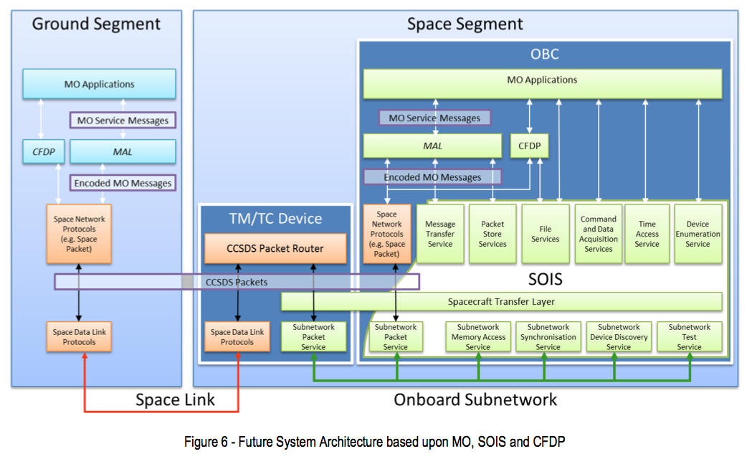
Protocol Stack
MO Servce Messages may be carried in files over CFDP.
Ground-Ground may be mapped over terrestrial protocols such as 0MQ/TCP or FTP
SLE may be used to extend space link. This is transparent to application level.
Need to generate RASDS Protocol Stack representation of this.

Slide 22
Future Work
Add additional views:
Functional/Service: diagrams complete
Add Functional Descriptions / summary of contained Functions
Service: abstract operations set [as table] – in progress
Data: abstract data model
Protocol: show MO Framework layers and File Transfer mappings
Deployment: example deployment cases
Last two views build on existing material in Communications Architecture

