Slide 1
System Architecture WG (SAWG)
Working Group Report
Peter Shames (WG Chair)
Notes:
1
1
1

Slide 2
System Architecture WG Executive Summary
Goals for this meeting cycle: Finalize initial Application and Support Architecture materials, review with affected WG, CESG, and CMC. Get approval for formal document projects.
Working Group Status:
MOIMS and SOIS initial reference architecture (PPT) formulated, covering: services, operations, interfaces, and information objects
Reviewed initial materials with affected WG
Problems and Issues:
Resources are constrained, but progress is being made
Formal approval, and adequate resources, are required for work to progress.
Planning:
Cross area meeting with MOIMS & SOIS to review PPT materials
Request CMC approval to proceed with formal document projects

Slide 3
System Architecture WG Executive Summary
Area and WG name | CCSDS Ref Nr | Activity (RB, Pink, Draft. Update) | Document Title | Status | Start and / or Target Publication Date | Comments
SEA SA | 320.0 | MB | CCSDS Global Spacecraft Identifier Field: Code Assignment Control Procedures (Issue 7) | Queued for CMC approval to release for agency review | Start date 5/1/2015 End date 02/15/2017 | Update to align with RMP, convert to MB from BB.
SEA SA | 311.0 | MB | Reference Architecture for Space Data Systems (Issue 2) | Not yet started, waiting completion of CCSDS Application & Support Architecture | Start date dd/mm/year End date dd/mm/year
SEA SA | 311.0 | MB | Reference Architecture for Space Data Systems (Issue 1) | Re-confirmed for 5 years | Start date Apr 2015 End date Apr 2016
SEA SA | 313.1 | YB | Registry Management Policy | Published | Start date Apr 2015 End date June 2016
SEA SA | 313.2 | YB | Procedures for SANA Registry Specification | Published | Start date Apr 2015 End date May 2016
Interaction with other WGs
MOIMS: DAI, Nav, SM&C, (MP)
SOIS: APP, Subnet, (WIR)
CSS, SEA as needed
Resolutions
SEA-R-2016-10-001: Request CMC approval of SEA Application & Support Architecture document project

Slide 4
SEA SA WG: MOIMS Services & Data Objects
CSS-M&C
User Support
Planning & Scheduling
TT&C
MPS
CSS-SM
NAVT
MCS
MPS
MPS
NAVT
MCS
NAVT
Mission Control
Navigation & Timing
MCS
NAVT
MCS
MCS
NAVT
MCS
MCS
MPS
NAVT
OPD
MPS
MPS
Data Storage and Archiving
Operations Preparation
NAVT
MDP
OPD
MDP
MCS
OPD
NAVT
Satellite Dev. & Maint.
Mission Data Processing
MDP
MCS
NAVT
Functions and Data Colour Coded: Data in Rectangles; Services indicated at Provider End by Circle MDP = Mission Data Product
Notes:
The 6 MOIMS Areas are colour coded.
Each application level interaction is annotated with the Data exchanged. At this level all Data generated by each Function is grouped as a single type (the abbreviation reflects the function name).
Potential service interfaces identified by MO are indicated by a colour-coded circle representing the Service Provider
Data formats may be separately defined [NAV, MPS] or specified in the context of the service [MO M&C, MPS].
File Handling is a bit different – there are special services for File Management and File Transfer [the latter delegated to a lower level protocol, such as CFDP or FTP], but the file content my be associated with any of the other Functional Areas. It essentially provides the transport layer for bulk transfer of service messages or data formats. Mission Data Products may also be transferred as files.
Note Planning/Scheduling interactions with the CSTS are greyed out as they are outside the scope of MOIMS standardisation [CSS boundary agreement].

Slide 5
SOIS Functional View
SEA SA WG:
SOIS Services & Data Objects
Applications
The applications served by SOIS appear as a functional unit at the top of the diagram.
The message categories depicted by rectangles are the subject matter of SOIS magenta books.
The SOIS Electronic Data Sheet (EDS), now in development, provides means to describe in an interoperable way, all of the services, interfaces, and components.
CMD
FILE
ACQ
PKT
TIME
LIST
Device Access, Device Virtualization, Message Transfer
File and Packet Store
Time Access
Device Enumeration
MEM
PKT
SYNC
DEV
STAT
Memory Access
Packet
Synchron-ization
Device Discovery
Test

Slide 6
MOIMS Deployment (Example)
Spacecraft
Ground Station
Mission Control
User Node
TT&C
NAVT
Navigation & Timing
CSS M&C
CSS-SM
Navigation & Timing
NAVT
NAVT
Planning & Scheduling
Planning & Scheduling
User Support
MPS
MPS
MCS
MCS
NAVT
MDP
Mission Control
Mission
Control
MPS
MDP
MCS
S/C Manufacturer
On-board
Configuration
Operations
Preparation
MCS
Satellite Dev. & Maint.
OPD
OPD
MPS
MCS
On-board Data Storage
MCS
Data Storage & Archiving
NAVT
NAVT
OPD
OPD
MDP
MDP
Note: interaction between functions within a deployment node are omitted for clarity – see previous slide
Notes:
This is a generic deployment example. **Health Warning** : many other deployment architectures are possible.
The intention is to highlight potential areas of interoperability.
Note that interactions between functions within the same node [which can be any of those shown on the previous diagram] are omitted for clarity.

Slide 7
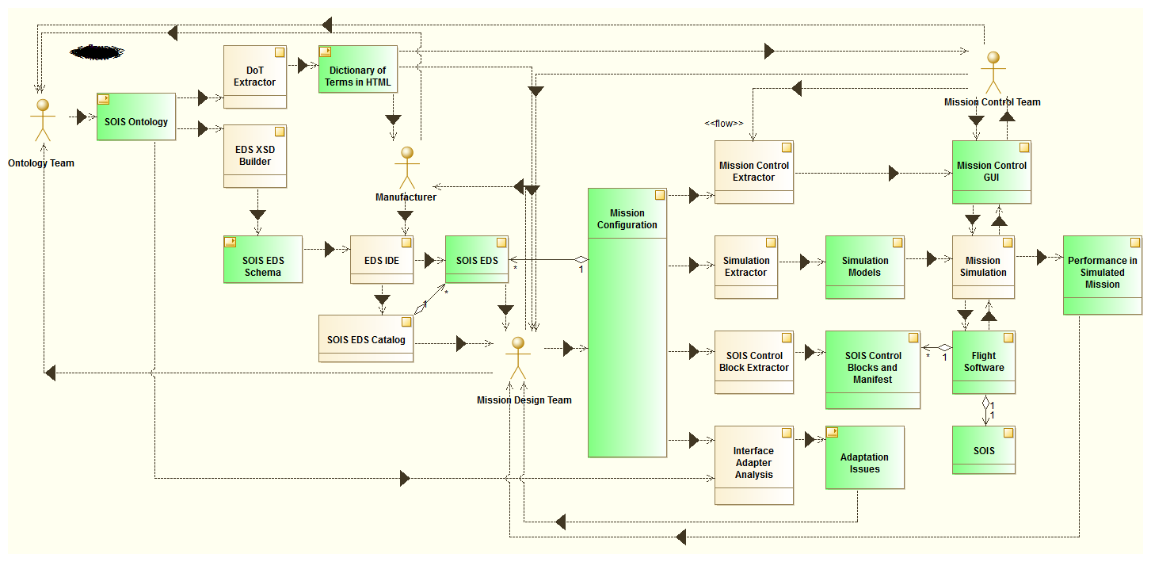
SOIS EDS Use Case
Some Use Cases for Electronic Data Sheets. The processes are rendered as beige blocks, while the data artifacts are green blocks.

Slide 8
SEA SA WG: Integrated Services Deployment - Initial
User Support
Mission Data Processing
Data Archives
MOS
Spacecraft
Planning & Scheduling
“Be-spoke” Applications
MPS
MPS
MCS
NAVT
ESLT
Mission Control
Navigation & Timing
TT&C
Exec
GNC
Data Mgmt
MCS
NAVT
MCS
NAVT
Memory Access
Packet
Synchron-ization
MCS
MPS
NAVT
OPD
Data Storage and Archiving
Operations Preparation
Datalink Convergence
OPD
SpaceWire
Mil Bus
Can …
Electronic Data Sheet
Vehicle Manifest
GDS Dev &
SI&T
Satellite Dev. & Maint.

Slide 9
SEA SA WG: Integrated Services Deployment - Advanced
User Support
Mission Data Processing
Data Archives
MOS
Spacecraft
Planning & Scheduling
“Be-spoke” Applications
Planning & Scheduling
Navigation & Timing
MPS
Mission Control
MPS
ESLT
Mission Control
MCS
NAVT
Navigation & Timing
MCS
NAVT
TT&C
Exec
GNC
Data Mgmt
MCS
NAVT
Memory Access
Packet
Synchron-ization
MCS
MPS
NAVT
OPD
Data Storage and Archiving
Operations Preparation
Datalink Convergence
OPD
SpaceWire
Mil Bus
Can …
Electronic Data Sheet
Vehicle Manifest
GDS Dev &
SI&T
Satellite Dev. & Maint.

Slide 10
SEA-SA Resource Issues for Approved Projects
Area and WG name | CCSDS Ref Nr | Activity (RB, Pink, Draft. Update) | Document Title | Target Publication Date | Missing Resources for Prototype 2 | Comments
 | N/A |  | N/A

Slide 11
SEA-SA Upcoming New Work Items
Area and WG name | CCSDS Ref Nr | Activity (RB, Pink, Draft. Update) | Document Title | Target Start / Publication Date | Resources Needed (total, Editor, Proto 1, Proto 2) |  |  |  | Comments Rationale What if not started?
SEA-SA | MB - TBS | WB - PPT form | CCSDS Application & Support Architecture MB | Start Nov 2016 End Nov 2018 | 2017 | 3 WMs for MB | N/A | N/A | Requested by CMC as "CCSDS Reference Architecture". Companion to published SCCS-ARD MB.
 |  |  |  |  | 2018 | 3 WMs for MB
 |  |  |  |  | 2019
SEA-SA | GB-TBS |  | CCSDS Application & Support Architecture GB | Start Nov 2016 End Nov 2019 | 2017 | 1 WMs for GB | N/A | N/A | Requested by CMC as "CCSDS Reference Architecture". Companion to published SCCS-ARD MB.
 |  |  |  |  | 2018 | 3 WMs for GB
 |  |  |  |  | 2019 | 3 WMs for GB
Notes:
11
11
11

Slide 12
Fall 2016 Meeting Agenda
Agenda review, Tues AM
SOIS Materials focus – RK & YH, Tues AM
MOIMS Materials focus – RT, Tues PM
Integration session, explore common topics / integration points, Wed AM
Joint meeting with SM&C and MOIMS, Wed, 19 Oct, early afternoon
Wrap-up & future planning, late afternoon

