Slide 1
SOIS Services
Version 6, for discussion in 2016 August 17 Teleconference

Slide 2
Summary of Changes from Version 5
Separate Layered Functional View into two diagrams.
Slide 5 in this deck shows relationships between function implementations and elements of design.
Slide 6 shows messaging relations between function implementations.
Move API table from end to position 7.
Added slide 8 to show subset relationship of MTS in AMS.
Added slides 9, 10, and 11 to summarize MTS API. The operational view is suitable for mapping to MOIMS MAL patterns.
Remove wire frame processor boundaries from protocol diagrams in slides 12, 13, and 14.
Note: The criterion for choosing system engineering material here is that the material should integrate domains of knowledge, or at least provide common handles to span them.

Slide 3
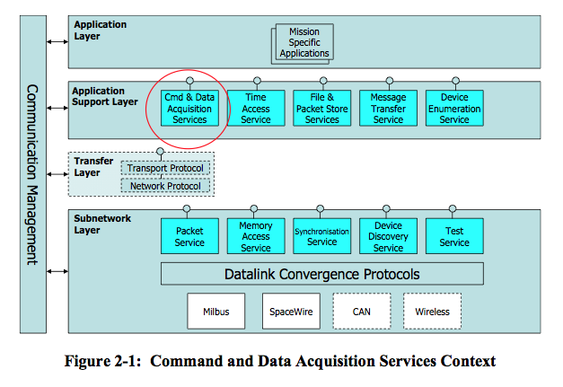
Layered View
This is the traditional diagram that summarizes SOIS services in layers of a protocol stack.

Slide 4
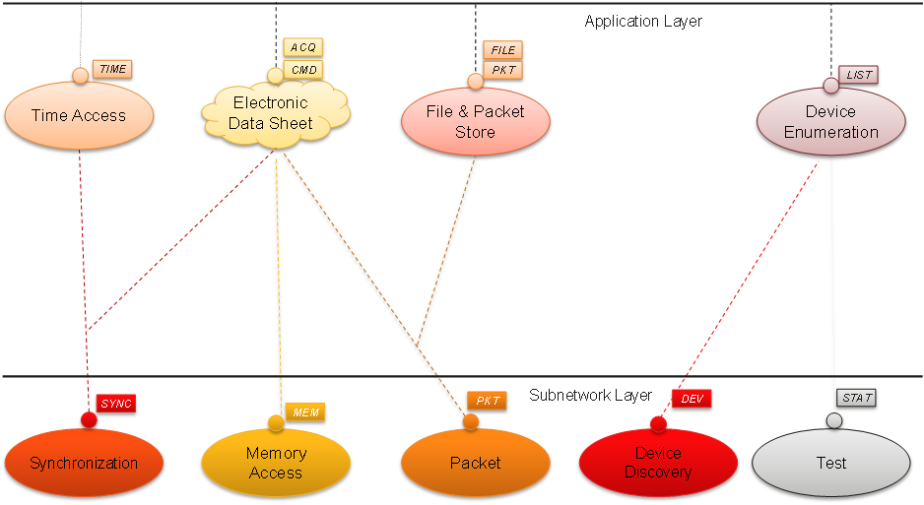
Layered View (with special symbols)
This diagram has been proposed as a replacement for the traditional layered view of SOIS services. Special interpretations enable an elegant presentation.
This diagram represents a revision of SOIS services, which eliminates some obsolete concepts. Two layers remain visible; other layers remain unspecified. The solid line in the Application Layer requires special interpretation.
The cloud symbol for Electronic Data Sheet (EDS) indicates that it requires a special interpretation. An EDS describes a service, but it is not a service.

Slide 5
Layered Functional View
Electronic Data Sheet
Applications
Vehicle Manifest
describes
uses
uses
uses
uses
uses
The applications served by SOIS appear as a functional unit.
The Electronic Data Sheet is shown as something to be realized, and its realization is shown as a service.
The Electronic Data Sheet is also shown as an aggregant of Device Enumeration.
(The end symbols of the aggregation and realization associations should be hollow, but this drawing tool does not support that.)
realizes
updates
aggregates
Device Access, Device Virtualization, Message Transfer
File and Packet Store
Time Access
Device Enumeration
uses
uses
uses
uses
uses
uses
Memory Access
Packet
Synchron-ization
Device Discovery
Test

Slide 6
Data View
Applications
CMD
FILE
The applications served by SOIS appear as a functional unit at the top of the diagram.
The message categories depicted by rectangles are the subject matter of SOIS magenta books.
ACQ
PKT
TIME
LIST
Device Access, Device Virtualization, Message Transfer
File and Packet Store
Time Access
Device Enumeration
MEM
PKT
SYNC
DEV
STAT
Memory Access
Packet
Synchron-ization
Device Discovery
Test

Slide 7
Service | Function | Interface/Primitive | Parameter
Device Enumeration Service (DES) | provides table of device names and virtual / physical identifiers – Management of existing devices – Management and user notification of added devices – Management and user notification of removed devices | DEVICE_FOUND DEVICE_LOST ENUMERATE_DEVICES ADD_DEVICE REMOVE_DEVICE QUERY_DEVICES | Transaction Identifier, Result Metadata, Virtual Device Identifier, Physical Device Identifier, Device Serial Number, Device Type, Spacecraft Network Address
Device Discovery Service (DDS) | searches sub-net(s) for devices, recognizes changes to device and sub-net accessibility, provides notifications -discovers initial topology -detects changes to topology -informs management with discovery information -provides notification | DEVICE_DISCOVERY DEVICE_DISCOVERY_LOSS | DDSAP Address, Device Address, Device Metadata
Device Virtualization Service (DVS) | provides virtual device interface, hides physical device mapping – Commanding – Data Acquisition | ACQUIRE_FROM_DEVICE COMMAND_DEVICE | Transaction Identifier, Result Metadata, Virtual Device Identifier, Value Identifier, Value, Timestamp
Device Access Service (DAS) | provides direct physical device access when needed – Acquire value from device – Command a device | ACQUIRE_FROM_DEVICE COMMAND_DEVICE | Transaction Identifier, Result Metadata, Physical Device Identifier, Value Identifier, Value, Timestamp
Packet Service (PS) | provides means to read / write packets to devices providing packet delivery over a single subnetwork | PACKET_SEND PACKET_RECEIVE PACKET_FAILURE | Data, PSSAP, PDSAP, Service Class, Channel, Priority, Failure Metadata
Memory Access Service (MAS) | provides means to read write data to memory providing direct access to device memory | READ, WRITE, READ/MODIFY/WRITE, MEMORY_ACCESS_RESULT | MASAP Address, Destination Address, Transaction ID, Memory ID, Start Memory Address, Size, Mask, Data, Channel, Priority, Acknowledge, Authorization, Verification, Result Metadata
Message Transfer Service (MTS) | provides a standard service for mediating the transfer of discrete data (messages) between onboard software users in a distributed onboard system – send a discrete message; – receive the next queued discrete message; – send a query message and receive a reply message back. – multicast a discrete message (publish-subscribe); – broadcast a discrete message (announce). | SEND, QUERY, REPLY, MESSAGE, FAULT, REGISTER, UNREGISTER, ASSERT_INVITATION, CANCEL_INVITATION, ASSERT_SUBSCRIPTION, CANCEL_SUBSCRIPTION PUBLISH, ANNOUNCE, MODULE_IS_DEAD | Continuum ID, Application Name, Authority Name, Unit ID, Role ID, Meta-AMS Delivery Point (MADP) Specification, Module Number, Subject ID, Delivery Specification, Service Mode, Priority, Flow Label, Context, Application Data Length, Application Data, Term, Fault Expression
Management Information Base (MIB) | stores data about devices in a common format

Slide 8
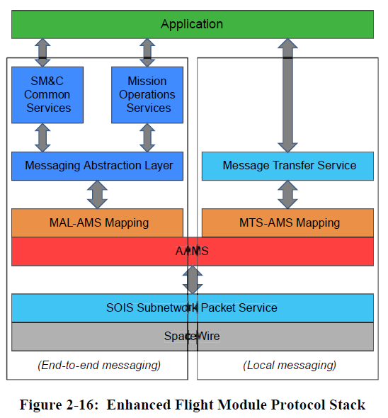
Relationship of AMS and MTS
Application
(End-to-end messaging)
(Local messaging)
The AMS book shows MTS as a layer separate from AMS on board spacecraft.
Recent discussions have modified this view to show an alternative that does not require putting the entire AMS implementation on board.
Instead, MTS stands as the subset implementation of AMS that is on board.
SM&C
Common
MOS
MAL
MAL-MTS Map
MTS
SOIS PS
SpaceWire
MTS ⊂ AMS

Slide 9
Operational View of MTS API 1/3
The MTS API is a subset of the AMS API.
It is shown here and in the next two slides in the form of sequence diagrams, which show how to apply the interface operationally.
This first diagram shows the pattern that is expected to be the most commonly used.
This pattern maps well to the message bus of NASA’s cFS, in which modules subscribe to topics published by other modules.
The subscriber is decoupled from the server, unless the designer decides that an Assert_Subscription.Indication should be passed to the publisher from its local MTS.
A Cancel_subscription.Request closes the window in time during which the subscriber receives messages published by the publisher.

Slide 10
Operational View of MTS API 2/3
This second diagram shows the most primitive pattern.
This pattern resembles UDP,
except that its access is predicated upon a prior invitation from the receiver to the sender, by means of which the sender obtains the address of the receiver.
A Cancel_invitation.Request closes the window in time for sending to the receiver.

Slide 11
Operational View of MTS API 3/3
This third diagram shows a synchronous pattern.
This pattern applies where the designer of the client sees little that can be done while awaiting the response from the server.
Access begins after an invitation from the server to receive queries from the client.
An invitation from the client to the server may be required to complete the contract for sending replies. Optionally, the server can simply send its reply to the address in the query.
A Cancel_invitation.Request closes the window in time for sending to the client.

Slide 12
Connecting a Device to an Application through a Software Bus
Device
Application
PDU
Device Proxy
CMD
This diagram shows a communication path between a device and an application across a software bus.
The software bus is shown here as a virtual entity; it might be subsumed in the Message Transfer implementation.
The EDS for the device may be different from the EDS for the device proxy, or the proxy may simply implement the same interfaces.
The device is shown communicating through the subnet packet service, but memory access could be used depending on the device.
ACQ
CMD
CMD
ACQ
ACQ
Device Access, Device Virtualization
Message Transfer
Message Transfer
Software Bus
PKT
Packet
Device Physical Link

Slide 13
Connecting a Device to an Application through a Physical Message Bus
Device
Application
PDU
Device Proxy
CMD
This diagram shows a communication path between a device and an application across a physical communication bus.
The processor containing the Device Proxy might be any of the following.
an adapter for the device
a remote interface unit
a time/space partition (The message bus could then be an inter-partition communication channel.)
a processor peer of the processor containing the application
The device is shown communicating through the subnet packet service, but memory access could be used depending on the device.
ACQ
CMD
CMD
ACQ
ACQ
Device Access, Device Virtualization
Message Transfer
Message Transfer
PKT
PKT
PKT
Packet
Packet
Message Bus
Packet
Device Physical Link

Slide 14
Connecting Two Applications through a Physical Message Bus
Application
Application
PDU
CMD
CMD
ACQ
ACQ
This diagram shows a communication path between two applications across a physical communication bus.
The applications could be MOIMS SM&C components, for example
The processors containing the applications might be any of the following.
time/space partitions (The message bus could then be an inter-partition communication channel.)
peer processors
Message Transfer
Message Transfer
PKT
PKT
Message Bus
Packet
Packet

Slide 16
Adding/Removing Devices

