Slide 1
MOIMS Services
Inputs to SEA Reference Architecture
Roger Thompson ESA

Slide 2
Background
SEA System Architecture WG has a CCSDS Communication Systems Reference Architecture covering SLS, CSS and SIS Areas
Has been tasked to define Reference Architecture for CCSDS Application and Support Layer Services: MOIMS and SOIS Areas
SEA SA WG Project to do this supported by:
NASA: Peter Shames; Ramon Krosley [SOIS]
CNSA: Yonghui Huang [SOIS]
ESA: Roger Thompson [MOIMS]
Work scheduled in 2 Phases
Powerpoint “Cartoon” Version, using RASDS Representation
Magenta/Green Book Production
Model Views: Functional, Service, Information, Protocol and Deployment

Slide 3
MOIMS Services Overview
Initial version covers standardisation areas covered by the following working groups:
Spacecraft Monitoring and Control
Navigation
Mission Planning and Scheduling
It does not yet address
Data Archives
MO Common Services
Primarily Functional View: Diagrams illustrate MOIMS Standards in terms of
Service Interfaces
Data Formats
Extend RASDS representation to show these

Slide 4
RASDS Graphical Conventions
Data
Store
Data Store
Physical Node
Organizational Element
Organizational Domain
Service Consumer
Service Provider
DATA
Physical or
Functional Connection
Logical Link
between Elements
Link Layer User
Service Access Point
Peering
Arrangement
Functional Element
Physical, Logical, & Service Connectors
Communications Protocol
Router
Color Keys:
As all Functions are Application Layer – overload by Functional Group
User Node
Application
Link Layer function
Earth Routing Node
Element Management
Routing function
Space Routing Node
Network Management
Forwarding function
WAN Node
Network Layer function
Data Store

Slide 5
MOIMS Data and Services
CSS-M&C
User Support
Planning & Scheduling
TT&C
MPS
CSS-SM
NAVT
MPS
NAVT
AUT
MPS
NAVT
M&C
Automation
Navigation & Timing
M&C
NAVT
MPS
NAVT
MDP
NAVT
M&C
M&C
M&C
SWM
Monitoring & Control
Software Management
M&C
M&C
AUT
MPS
NAVT
SWM
SWM
Need to Add:
Data Segment as External Function
Data Archiving
Extend FH to Data Management
Extend SWM to Config Management
File Handling
M&C
Satellite Dev. & Maint.
AUT
NAVT
SWM
MDP
M&C
AUT
Functions and Data Colour Coded: Data in Rectangles; Services indicated at Provider End by Circle MDP = Mission Data Product
Notes:
The 6 MOIMS Areas are colour coded.
Each application level interaction is annotated with the Data exchanged. At this level all Data generated by each Function is grouped as a single type (the abbreviation reflects the function name).
Potential service interfaces identified by MO are indicated by a colour-coded circle representing the Service Provider
Data formats may be separately defined [NAV, MPS] or specified in the context of the service [MO M&C, MPS].
File Handling is a bit different – there are special services for File Management and File Transfer [the latter delegated to a lower level protocol, such as CFDP or FTP], but the file content my be associated with any of the other Functional Areas. It essentially provides the transport layer for bulk transfer of service messages or data formats. Mission Data Products may also be transferred as files.
Note Planning/Scheduling interactions with the GSTS are greyed out as they are outside the scope of MOIMS standardisation [CSS boundary agreement].

Slide 6
MOIMS Data and Services
CSS-M&C
User Support
Planning & Scheduling
TT&C
MPS
CSS-SM
NAVT
MCS
MPS
MPS
NAVT
MCS
NAVT
Mission Control
Navigation & Timing
MCS
NAVT
MCS
MCS
NAVT
MCS
MCS
MPS
NAVT
OPD
MPS
MPS
Data Storage and Archiving
Operations Preparation
NAVT
MDP
OPD
MDP
MCS
OPD
NAVT
Satellite Dev. & Maint.
Mission Data Processing
MDP
MCS
NAVT
Functions and Data Colour Coded: Data in Rectangles; Services indicated at Provider End by Circle MDP = Mission Data Product
Notes:
The 6 MOIMS Areas are colour coded.
Each application level interaction is annotated with the Data exchanged. At this level all Data generated by each Function is grouped as a single type (the abbreviation reflects the function name).
Potential service interfaces identified by MO are indicated by a colour-coded circle representing the Service Provider
Data formats may be separately defined [NAV, MPS] or specified in the context of the service [MO M&C, MPS].
File Handling is a bit different – there are special services for File Management and File Transfer [the latter delegated to a lower level protocol, such as CFDP or FTP], but the file content my be associated with any of the other Functional Areas. It essentially provides the transport layer for bulk transfer of service messages or data formats. Mission Data Products may also be transferred as files.
Note Planning/Scheduling interactions with the GSTS are greyed out as they are outside the scope of MOIMS standardisation [CSS boundary agreement].

Slide 7
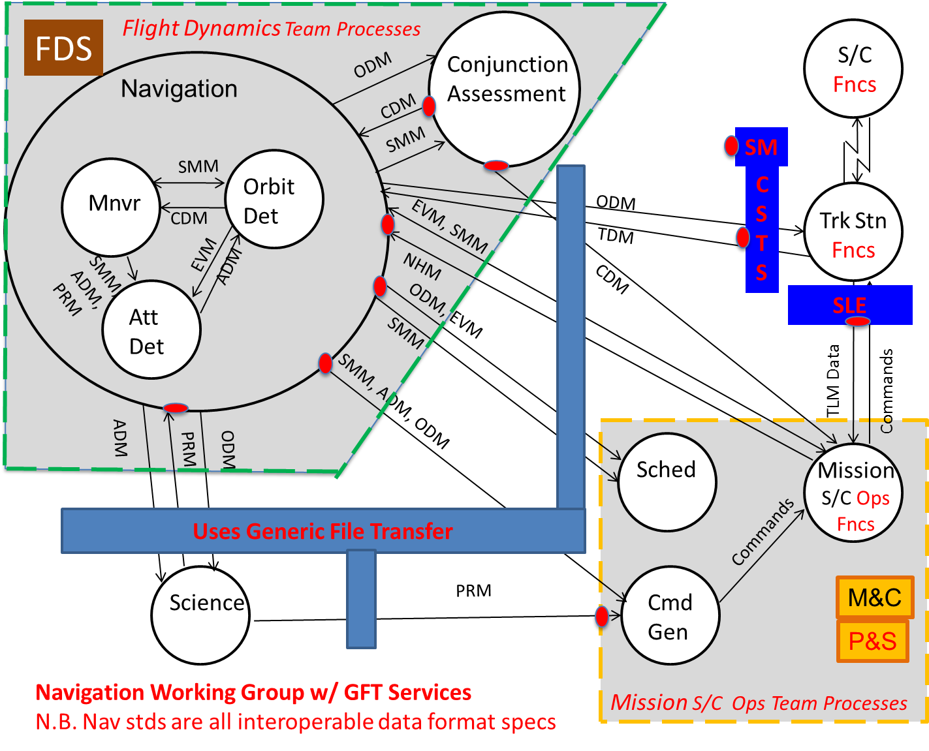
NAV WG Input

Slide 8
Updated input from NAV WG
CCSDS Navigation Working Group Technical Program
S/C
NOTE: Exchanges may be predicted future data or
reconstructed actual data, depending on the message type
Messages
ADM = Attitude Data Message
CDM = Conjunction Data Message
EVM = Events Message
NHM = Navigation H/W Message
ODM = Orbit Data Message
PRM = Pointing Request Message
SMM = Spacecraft Maneuver Message
TDM = Tracking Data Message
Functions
Att Det = Attitude Determination function
Cmd Gen = Command Generation function
Mission S/C Team = Spacecraft Team function
Mnvr = Maneuver Design function
Orbit Det = Orbit Determination function
S/C = Spacecraft
Sched = Scheduling function
Science = Science function
Trk Stn = Tracking Station
Conjunction
Assessment
CDM
SMM
Navigation
ODM
Trk Stn
ODM
SMM
TDM
Orbit
Det
CDM
Mnvr
Commands
TLM Data
CDM
EVM
EVM, SMM
SMM,
ADM,
PRM
ADM
NHM
SMM
Att
Det
Mission
S/C Team
ODM, EVM
Sched
ODM
PRM
SMM, ADM, ODM
Commands
ADM
Science
Cmd Gen
PRM

Slide 9
Navigation and Timing (Old)
Planning & Scheduling
TT&C
ODM
Time/Position Determination
EVM
MPS
CDM
ODM
TDM
TRM
TDM
Conjunction Assessment
TIM
Orbit Determination & Propagation
ODM
EVM
ODM
ODM
Automation
ADM
ODM
User Support
CDM
EVM
SMM
PRM
Manoeuvre Planning
SMM
Attitude Determination
ADM
SMM
PRM
PRM
ADM
Monitoring & Control
ODM
SMM
NHM
EVM
NHM
Need to Resolve:
Where NAV M&C Mapping lives
Usage of ODM/EVM/ADM by M&C
TRM (Reception Time) currently supported by CSS-SLE
Time
Correlation
ADM
M&C
TCM
NAV M&C Mapping
Notes:
ADM Attitude Data Message
CDM Conjunction Data Message
EVM Event Message
NHM Network Hardware Message
ODM Orbit Data Message
PRM Pointing Request Message
SMM Spacecraft Manoeuvre Message
TDM Tracking Data Message
TIM Time Report
TRM Time Reception Message
TCM Time Correlation Message
Currently showing M&C interacting with NAV Messages – not convinced this happens directly. NAV WG Identified a “Command Generation” function as part of Mission Ops Processes. Not consistent with many MOC architectures. NAV specific Command Generation could be considered a NAV function – this might receive PRM and SSM and generate MO M&C; conversely use MO M&C to generate NHM.

Slide 10
Navigation and Timing
Planning & Scheduling
TT&C
ODM
Time/Position Determination
EVM
MPS
CDM
ODM
TDM
TRM
TDM
Conjunction Assessment
TIM
Orbit Determination & Propagation
ODM
ODM
ODM
ADM
ODM
User Support
CDM
EVM
SMM
PRM
ADM
Manoeuvre Planning
SMM
Attitude Determination
SMM
PRM
PRM
ADM
ODM
PRM
ADM
ODM
SMM
NHM
EVM
NHM
Time
Correlation
SMM
Mission Data Processing
ADM
TCM
TDM
TCM
Mission Control
PRM
Notes:
ADM Attitude Data Message
CDM Conjunction Data Message
EVM Event Message
NHM Network Hardware Message
ODM Orbit Data Message
PRM Pointing Request Message
SMM Spacecraft Manoeuvre Message
TDM Tracking Data Message
TIM Time Report
TRM Time Reception Message
TCM Time Correlation Message
Currently showing M&C interacting with NAV Messages – not convinced this happens directly. NAV WG Identified a “Command Generation” function as part of Mission Ops Processes. Not consistent with many MOC architectures. NAV specific Command Generation could be considered a NAV function – this might receive PRM and SSM and generate MO M&C; conversely use MO M&C to generate NHM.

Slide 11
Navigation and Timing (Alternative View)
Conjunction Assessment
Manoeuvre Planning
Orbit Determination & Propagation
Attitude Determination
Time/Position Determination
Time
Correlation
MPS
ODM
ADM
CDM
NHM
SMM
PRM
TDM
ADM
ODM
ODM
EVM
CDM
SMM
TDM
ODM
EVM
ADM
SMM
PRM
CDM
NHM
TIM
TRM
TCM
MPS
Planning & Scheduling
TT&C
Monitoring & Control
Mission Data Processing
User Support

Slide 12
Mission Planning and Scheduling (Old)
User Support
Software Management
Navigation & Timing
PRQ
PRQ
PRQ
EVM
EVM
EVM
PRM
SWM
SMM
ODM
SMM
CDM
Planning & Scheduling
TT&C
CSS-SM
PRQ
Hierarchical
Planning
PLN
PLN
PLN
Plan Execution
M&C
AUT
Need to add service for Plan retrieval.
Refactor the hierarchical planning to represent federated and abstracted planning (2 dimensions: LTP/MTP/STP and distributed planning)
M&C goes to Planning
Monitoring & Control
Automation

Slide 13
Mission Planning and Scheduling
Operations Preparation
User Support
Navigation & Timing
PRQ
PRQ
PRQ
EVM
OSW
PRM
SMM
ODM
APD
PLN
PLN
CDM
PLC
PLC
Planning (Hierarchical or Distributed)
PRQ
Planning
TT&C
PLN
PLC
CSS-SM
PLC
PLN
PEC
PLC
Plan Execution
EVM
M&C
M&C
AUT
Mission Control
EVM
SMM

Slide 14
Hierarchical and Distributed Planning
PRQ
OSW
APD
EVM
PRM
ODM
PLC
SMM
CDM
M&C
Mission Planning
Long-Term Planning
PLN
Distributed Long-Term Planning
PLC
PRQ
PLN
PLC
PRQ
Medium-Term Planning
PLN
Distributed
Medium-Term Planning
PLC
CSS-SM
PRQ
PLN
PLC
PRQ
Short-Term Planning
PLN
Distributed
Short-Term Planning
PLC
PRQ
PLN
PEC
Plan Execution

Slide 15
Monitoring and Control
Operations Preparation
Planning & Scheduling
OSW
APD
AUT
M&C
OSM
APD
OPM
SDB
Automation
On-board ConfigurationManagement
OSM
OPM
M&C
M&C
ODM
AUT
EVM
AUT
ADM
TT&C
Monitoring and Control
Navigation Interface
SMM
Navigation & Timing
CSS-M&C
M&C
PRM
NHM
M&C
TCM
User Support
OSM
OPM
Mission Data Processing
AUT
M&C
Data Storage and Archiving
Satellite Dev. & Maint.

Slide 16
Operations Preparation
Satellite Dev. & Maint.
Planning & Scheduling
PRQ
PRQ
SDB
APD
OSW
APD
OSW
XTCE
Satellite DB Definition
Automated Procedure Definition
On-board Software Definition
Configuration Management
Configuration Distribution
OSW
OSW
APD
APD
SDB
SDB
Data Storage and Archiving
Mission Control

Slide 17
Data Storage and Archiving
On-board File Store
Data Archive

Slide 18
MOIMS Deployment (Example)
Spacecraft
Ground Station
Mission Control
User Node
TT&C
NAVT
Navigation & Timing
CSS M&C
CSS-SM
Navigation & Timing
NAVT
NAVT
Planning & Scheduling
Planning & Scheduling
User Support
MPS
MPS
Automation
Automation
M&C
NAVT
MDP
MPS
MDP
AUT
M&C
S/C Manufacturer
Monitoring & Control
M&C
Monitoring & Control
AUT
M&C
Software Management
Software Management
Satellite Dev. & Maint.
SWM
SWM
MPS
File Handling
M&C
File Handling
M&C
AUT
AUT
NAVT
NAVT
SWM
SWM
MDP
MDP
Note: interaction between functions within a deployment node are omitted for clarity – see previous slide
Notes:
This is a generic deployment example. **Health Warning** : many other deployment architectures are possible.
The intention is to highlight potential areas of interoperability.
Note that interactions between functions within the same node [which can be any of those shown on the previous diagram] are omitted for clarity.

Slide 19
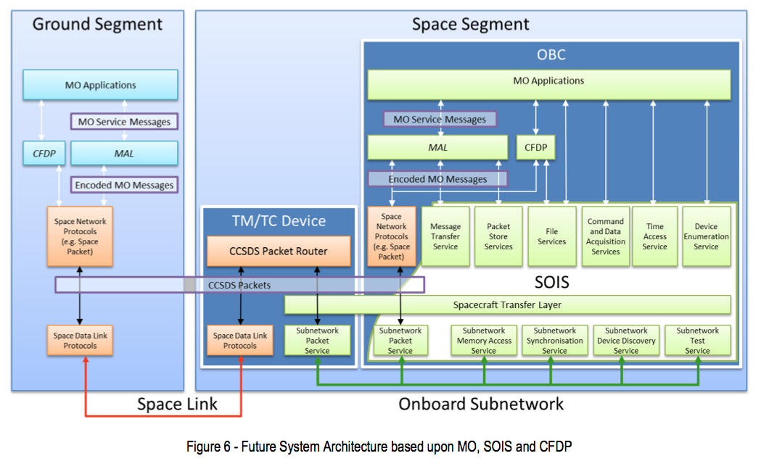
Protocol Stack
MO Servce Messages may be carried in files over CFDP.
Ground-Ground may be mapped over terrestrial protocols such as 0MQ/TCP or FTP
SLE may be used to extend space link. This is transparent to application level.
Need to generate RASDS Protocol Stack representation of this.

Slide 20
Future Work
Resolve open Issues / Nomenclature
Address Data Archiving/DAI standards
Address MO Common Services
Service Directory
Configuration …
Add additional views:
Functional/Service: largely covered
Add Functional Descriptions / summary of contained Functions
Service [TBD]: abstract operations set
Protocol: show MO Framework layers and File Transfer mappings
Data: abstract data model
Deployment: example deployment cases

