Slide 1
SOIS Services
Version 5, for discussion in 2016 June 22 Teleconference

Slide 2
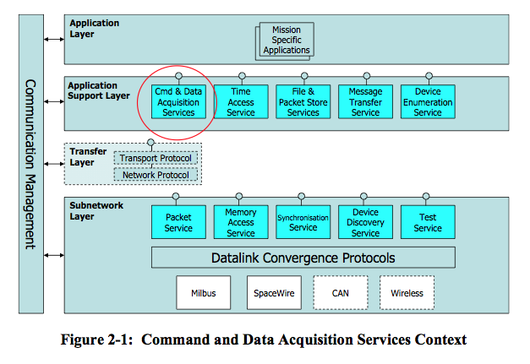
Layered View
This is the traditional diagram that summarizes SOIS services in layers of a protocol stack.

Slide 3
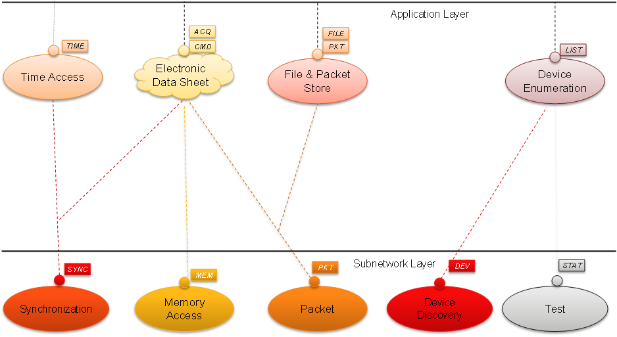
Layered View (with special symbols)
This diagram has been proposed as a replacement for the traditional layered view of SOIS services. Special interpretations enable an elegant presentation.
This diagram represents a revision of SOIS services, which eliminates some obsolete concepts. Two layers remain visible; other layers remain unspecified. The solid line in the Application Layer requires special interpretation.
The cloud symbol for Electronic Data Sheet (EDS) indicates that it requires a special interpretation. An EDS describes a service, but it is not a service.

Slide 4
Layered Functional View
Electronic Data Sheet
Applications
realizes
CMD
FILE
The applications served by SOIS appear as a functional unit.
The Electronic Data Sheet is shown as something to be realized, and its realization is shown as a service.
The Electronic Data Sheet is also shown as an aggregant of Device Enumeration.
(The end symbols of the aggregation and realization associations should be hollow, but this drawing tool does not support that.)
The message categories depicted by rectangles are the subject matter of SOIS magenta books.
ACQ
PKT
TIME
aggregates
LIST
Device Access, Device Virtualization, Message Transfer
File and Packet Store
Time Access
Device Enumeration
MEM
PKT
SYNC
DEV
STAT
Memory Access
Packet
Synchron-ization
Device Discovery
Test

Slide 5
Connecting a Device to an Application through a Software Bus
Device
Application
PDU
Device Proxy
CMD
This diagram shows a communication path between a device and an application across a software bus.
The software bus is shown here as a virtual entity; it might be subsumed in the Message Transfer implementation.
The EDS for the device may be different from the EDS for the device proxy, or the proxy may simply implement the same interfaces.
The device is shown communicating through the subnet packet service, but memory access could be used depending on the device.
ACQ
CMD
CMD
ACQ
ACQ
Device Access, Device Virtualization
Message Transfer
Message Transfer
Software Bus
PKT
Packet
Device Physical Link

Slide 6
Connecting a Device to an Application through a Physical Message Bus
Device
Application
PDU
Device Proxy
CMD
This diagram shows a communication path between a device and an application across a physical communication bus.
The processor containing the Device Proxy might be any of the following.
an adapter for the device
a remote interface unit
a time/space partition (The message bus could then be an inter-partition communication channel.)
a processor peer of the processor containing the application
The device is shown communicating through the subnet packet service, but memory access could be used depending on the device.
ACQ
CMD
CMD
ACQ
ACQ
Device Access, Device Virtualization
Message Transfer
Message Transfer
PKT
PKT
PKT
Packet
Packet
Message Bus
Packet
Device Physical Link

Slide 7
Connecting Two Applications through a Physical Message Bus
Application
Application
PDU
CMD
CMD
ACQ
ACQ
This diagram shows a communication path between two applications across a physical communication bus.
The applications could be MOIMS SM&C components, for example
The processors containing the applications might be any of the following.
time/space partitions (The message bus could then be an inter-partition communication channel.)
peer processors
Message Transfer
Message Transfer
PKT
PKT
Message Bus
Packet
Packet

Slide 9
Adding/Removing Devices

Slide 10
Service | Function | Interface/Primitive | Parameter
Device Enumeration Service (DES) | provides table of device names and virtual / physical identifiers – Management of existing devices – Management and user notification of added devices – Management and user notification of removed devices | DEVICE_FOUND DEVICE_LOST ENUMERATE_DEVICES ADD_DEVICE REMOVE_DEVICE QUERY_DEVICES | Transaction Identifier, Result Metadata, Virtual Device Identifier, Physical Device Identifier, Device Serial Number, Device Type, Spacecraft Network Address
Device Discovery Service (DDS) | searches sub-net(s) for devices, recognizes changes to device and sub-net accessibility, provides notifications -discovers initial topology -detects changes to topology -informs management with discovery information -provides notification | DEVICE_DISCOVERY DEVICE_DISCOVERY_LOSS | DDSAP Address, Device Address, Device Metadata
Device Virtualization Service (DVS) | provides virtual device interface, hides physical device mapping – Commanding – Data Acquisition | ACQUIRE_FROM_DEVICE COMMAND_DEVICE | Transaction Identifier, Result Metadata, Virtual Device Identifier, Value Identifier, Value, Timestamp
Device Access Service (DAS) | provides direct physical device access when needed – Acquire value from device – Command a device | ACQUIRE_FROM_DEVICE COMMAND_DEVICE | Transaction Identifier, Result Metadata, Physical Device Identifier, Value Identifier, Value, Timestamp
Packet Service (PS) | provides means to read / write packets to devices providing packet delivery over a single subnetwork | PACKET_SEND PACKET_RECEIVE PACKET_FAILURE | Data, PSSAP, PDSAP, Service Class, Channel, Priority, Failure Metadata
Memory Access Service (MAS) | provides means to read write data to memory providing direct access to device memory | READ, WRITE, READ/MODIFY/WRITE, MEMORY_ACCESS_RESULT | MASAP Address, Destination Address, Transaction ID, Memory ID, Start Memory Address, Size, Mask, Data, Channel, Priority, Acknowledge, Authorization, Verification, Result Metadata
Message Transfer Service (MTS) | provides a standard service for mediating the transfer of discrete data (messages) between onboard software users in a distributed onboard system – send a discrete message; – receive the next queued discrete message; – send a query message and receive a reply message back. – multicast a discrete message (publish-subscribe); – broadcast a discrete message (announce). | SEND, QUERY, REPLY, MESSAGE, FAULT, REGISTER, UNREGISTER, ASSERT_INVITATION, CANCEL_INVITATION, ASSERT_SUBSCRIPTION, CANCEL_SUBSCRIPTION PUBLISH, ANNOUNCE, MODULE_IS_DEAD | Continuum ID, Application Name, Authority Name, Unit ID, Role ID, Meta-AMS Delivery Point (MADP) Specification, Module Number, Subject ID, Delivery Specification, Service Mode, Priority, Flow Label, Context, Application Data Length, Application Data, Term, Fault Expression
Management Information Base (MIB) | stores data about devices in a common format

