Slide 1
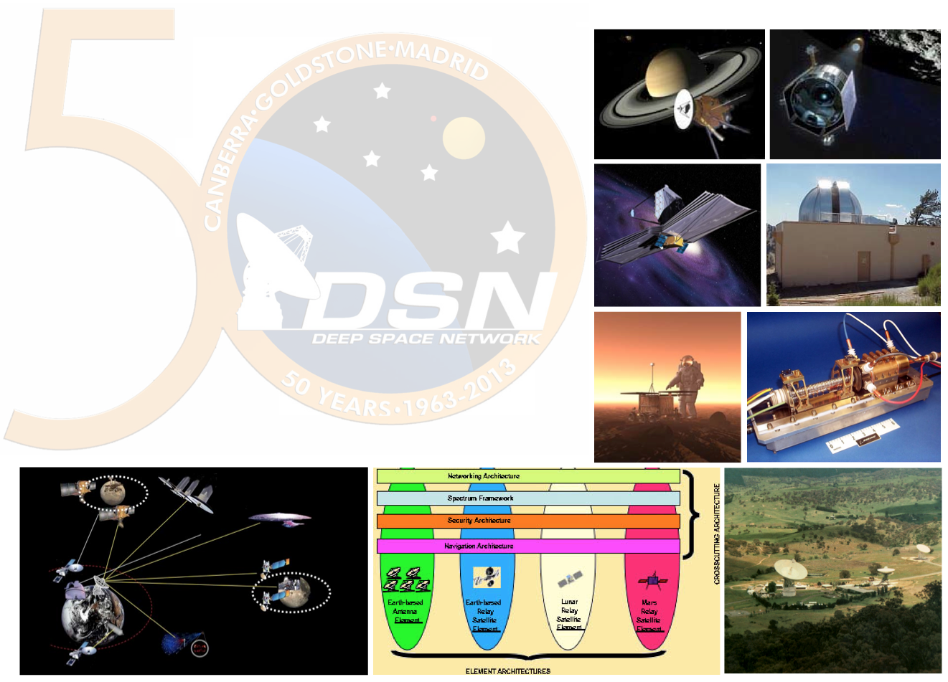
Interoperable End-to-End Space Communications Architectures Using CCSDS Building Blocks
Peter Shames
Jet Propulsion Laboratory, California Institute of Technology
SpaceOps 2016, 16-20 May 2016
Daejeon, Korea
© 2016 California Institute of Technology. Government sponsorship acknowledged.

Slide 2
Introduction – Interoperable End-To-End
Space Data Systems
End-to-End space data systems are inherently systems of systems
Typically composed of:
  Spacecraft and mission operations systems (MOS) that belong to one (or more) organizations
  Multi-mission communication assets that belong to another organization.
Interoperability and cross support are essential to:
  Take advantage of expensive, shared, multi-mission assets (DSN, ESTRACK, commercial, …)
  Provide interoperability within and among spacecraft owned by different agencies (e.g. Mars and Lunar exploration)
  Move toward Solar System Internetworking (SSI)
What standard building blocks are available to build such systems?

Slide 3
Service and Interface Interoperability
Considerations
CCSDS has developed a large suite of interoperable, and cross-supportable, protocols and other standards.
Each of these defines a specific “layer” of functionality, such as: RF modulation, space link, error coding, cross support frame delivery, or network layer routing.
What had not been provided was an end-to-end view of how all of these many parts fit together to provide a solution for different missions.
Missions may be “traditional” single space link (called ABA) or may use a relay or network approach (SSI).
The Space Communication Cross Support Architecture document (CCSDS 901.1-M-1) describes best practices for service, system, and protocol building blocks based on more than 80 CCSDS standards.
16-20 May 2016

Slide 4
Generic End-to-End Space Data System (ABA)
“ABA” configuration
  Agency A develops the spacecraft (Space User Node) and the MOS (Earth User Node).
  Agency B owns/operates the ground station (Earth Space Link Terminal).
Interfaces
  Service interfaces between EUN and ESLT.
  Space Link interfaces between ESLT and SUN
Each of these system building blocks has defined interfaces and component behaviors
Each of these interfaces has an associated set of protocols and protocol behaviors
Service
Management
Interface
Space
User
Node
ABA
ESLT
Earth
User
Node
Space-Link Service Provider Interface
Terrestrial Service Provider Interface
16-20 May 2016

Slide 5
Generic End-to-End Space Internetworking Data System (SSI)
Space Link
Interfaces
Terrestrial-Link
Interfaces
Space-Link
Interfaces
Space
User
Node
SSI
ESLT
Terrestrial
WANs
Earth
User
Node
Space
Routing
Node
Service
Management
Interface
Earth
Routing
Node
“SSI” configuration
  Agency A develops the spacecraft (Space User Node) and the MOS (Earth User Node).
  Agency B owns/operates the Earth and Space Routing nodes.
  Agency C owns/operates the SSI capable ground station (SSI Earth Space Link Terminal).
Interfaces
  Service interfaces between ERN and ESLT.
  Space Link interfaces between ESLT to SRN and SRN to SUN.
  Space internetworking (network layer) interfaces end-to-end,
Each of these system building blocks has defined interfaces and component behaviors.
Each of these interfaces has an associated set of protocols and protocol behaviors.

Slide 6
Overall Building Block Approach
Service Interfaces
  Describes how missions may plan, schedule, configure, use, and monitor cross supported service interfaces
Component (Physical) Building Blocks
  Shows the major physical elements that are used to compose end-to-end systems
  Describes their typical functions and interfaces
  Supports development of a coarse grained composition of the major system elements
  Shows the nature of the connections and the high level data flows
Protocol (Communications) Building Blocks
  Shows the primary protocol stack assemblies for ABA and SSI configurations
  Shows the protocol configurations as they are intended to be used
  Describes appropriate assemblies for different kinds of services: link layer, radiometric, network layer, application layer, and security
End-to-end Diagrams
  Use the component and protocol building blocks to demonstrate how to construct typical end-to-end ABA and SSI system deployments
The focus is on data transport and related communications services, all user applications, using whatever protocols, are constructed upon these services
16-20 May 2016

Slide 7
ABA Service Interface View
Space User
Node
ABA ESLT
(CSSE Service Provider)
Earth User Node
(Service User)
CCSDS Cross Support
Service Management
ABA CSSE
EUN (e.g., User MOC)
Service Management
SM
I/F
SM
I/F
Service
Management (SM)
Interface (I/F)
Forward Data
Delivery Services
Space
Link
Service
Delivery (SD)
Interfaces
Return Data
Delivery Services
SD
I/F
SD
I/F
Service Provision
Radiometric
Services
CCSDS Cross Support
Transfer Services
Position & Timing
Services
Service Production
16-20 May 2016

Slide 8
ABA Service Interface Types
Service Management Interfaces (SM)
  Used by the EUN to plan, schedule, configure, use, and monitor cross supported service interfaces
  Defined by a related set of interfaces for exchange of requests and responses between the EUN and the ESLT
Service Delivery Interfaces (SLE & CSTS)
  Two related sets of data delivery interfaces, SLE and CSTS
  SLE includes: forward CLTU, return all frames, and return channel frames
  CSTS includes: a framework and services for radiometric data, monitor data, service control of forward frames built on that framework
16-20 May 2016

Slide 9
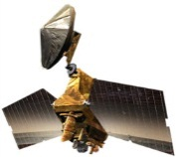

SSI ERN & EUN Service Request and Delivery
SSI Space
Routing Node
SSI ESLT
(CSSE Service Provider)
SSI Earth Routing Node
(CSSE Service Provider)
CCSDS Cross Support
Service Management
CSSE (e.g., Router MOC)
SSI CSSE
Service
Management
Interface
SM
I/F
Service Management
SM
I/F
Forward Data
Delivery Services
Service Delivery
Interfaces
SD
I/F
Space
Links
SD
I/F
Return Data
Delivery Services
CCSDS Cross Support
Transfer Services
Service Provision
EUN (e.g., SSI User MOC)
Radiometric
Services
SSI Service
Interfaces
Position & Timing
Services
Service Production
SSI Space
User Node
SSI Earth User Node
(UE Service User)

Slide 10
SIS Service Interface Types
Service Management Interfaces (SM)
  Used by the ERN to plan, schedule, configure, use, and monitor cross supported service interfaces
  In the SSI the ERN “owns” the SM interfaces to the ESLT, and the space link interfaces from ESLT to SRN
Service Delivery Interfaces (SLE, CSTS, and SSI)
  The ERN uses the data delivery interfaces, SLE and CSTS when it requires link layer access to the SRN
  At the link layer the ERN to SRN connections look like an ABA mission
  At the network layer the EUN and ERN use SSI services end-to-end to route data through the SSI ESLT and SRN, all may operate as SSI nodes
16-20 May 2016

Slide 11
Component Building Blocks
ABA Component Building Blocks
  ABA Earth Space Link terminal
  ABA Earth User Node
  ABA Space User Node
SSI Component Building Blocks
  SSI Earth Space Link terminal
  SSI Earth Routing Node
  SSI Earth User Node
  SSI Space Routing Node
  SSI Space User Node
  Wide Area Network (WAN) Routing Node
  Planet Space Link Terminal
  Hybrid Science / Routing Node
16-20 May 2016

Slide 12
Generic ABA Building Block and Functions
Generic ABA Node
Application 1
Application 2
Element Management
Data
Store
Link Type A
Data Forwarding
Link Type B
Link A Processing
Link B Processing
16-20 May 2016

Slide 13
Generic ABA Building Block Notes
Not all ABA building blocks will include all functions, user building blocks are often “one-sided”
The functions for link layer processing are well specified in the relevant link layer and related standards
The data forwarding and data storage functions are defined, but typically not in a fully specified form
Some functions, like element management, will be present, but not specified and use interfaces that are not standardized
16-20 May 2016

Slide 14
Generic SSI Building Block and Functions
Generic SSI Node
Application 1
Application 2
Element Management
Data
Store
Network Management
Network A Processing
Routing
Network B Processing
Link
Type A
Link A Processing
Link B Processing
Link
Type B
16-20 May 2016

Slide 15
Generic SSI Building Block Notes
Not all SSI building blocks will include all functions, user building blocks are often “one-sided”
The link layer functions are essentially the same as for ABA configurations, with the exception of the ESLT frame creation, merging, and encoding functions
The SSI networking and routing functions are specified in the relevant SSI standards, some of which are still in development (marked as [Future] in the SCCS-ARD)
Network management functions are identified, but they are not yet in a fully specified form
Some functions, like element management and cross-domain coordination, will be present, but are presently specified only in the SSI conceptual architecture
16-20 May 2016

Slide 16
ABA Protocol Building Blocks
Describe CCSDS ABA protocol configurations as they are intended to be used
Describe appropriate assemblies for different kinds of services: physical, link layer, radiometric, application layer, and security
Are designed to be used as the interface bindings for the different services and functions within components
The following diagrams include:
  ABA Earth user protocol stacks, forward and return (may be asymmetric)
  ABA ESLT protocol stacks
  ABA Space user protocol stacks
  Specialized “round trip” protocol stacks such as radiometric processing
  An example security protocol deployment
  Many other examples, including security, are in the SCCS-ARD
16-20 May 2016

Slide 17
ESLT Fwd / Ret Service Provider Protocol Stack Building Blocks
SLE F-CLTU
Processing
CSTS F-Frame
Processing
(Frame Muxing)
SLE F-CLTU
CSTS F-Frame
TCP
Code & Sync
TCP
RF & Mod
IP
RF & Mod
IP
a) SLE F-CLTU
c) CSTS F-Frame
(multiplex)
SLE RAF
Processing
SLE RCF
Processing
(Frame De-Muxing)
SLE RAF
SLE RCF
Frame Sync & De-Code
TCP
Frame Sync & De-Code
TCP
RF & De-Mod
IP
RF & De-Mod
IP
b) SLE RAFs
d) SLE RCFs
(de-multiplex)
16-20 May 2016

Slide 18
ABA Service-User CLTU & F-Frame Building Blocks
User Application
(Packet Processing)
User Application
(Packet Processing)
TC Frame
Code & Sync
AOS/TC Frame
User F-CLTU
Application
(CLTU Processing)
User F-Frame
Application
(Frame Processing)
SLE F-CLTU
CSTS F-Frame
TCP
TCP
IP
IP
a) ABA User SLE F-CLTU
b) ABA User CSTS F-Frame
16-20 May 2016

Slide 19
ABA Service-User Service Management Building Blocks
NDM or ODM
ESLT Service Management Processing
(Planning & Scheduling)
User Service Management Application
(Planning & Scheduling)
SCCS-SM
SCCS-SM
HTTPS
HTTPS
TCP
TCP
IP
IP
a) ABA ESLT Service Management
b) ABA User Service Management
16-20 May 2016

Slide 20
ESLT Radiometric Service Provider Protocol Stack Building Blocks
CSTS F-Frame
Processing
(Frame Muxing)
CSTS F-Frame
Ranging Sequence Generation
Code & Sync
TCP
RF & Mod
IP
Ranging Data
TD-CSTS
Processing
(Real-time Radiometric Data)
Ranging
Signal
Doppler Data
SLE RCF
Processing
(Frame De-Muxing)
TD-CSTS
TCP
SLE RCF
Ranging Sequence Recovery
Frame Sync & De-Code
IP
TCP
RF & De-Mod
IP
TD-CSTS Ranging & Radiometric Data
16-20 May 2016

Slide 21
ABA Earth User Secure Forward-Frame / File Building Blocks
Earth User Secure File
Application
Earth User Secure Forward-
Frame Application
(Packet Processing)
Earth User Secure Forward-
Frame Application
(Packet Processing)
File Validate/Decrypt
SDLS Auth./Encrypt
SDLS Auth./Encrypt
CFDP
AOS/TC Frame
AOS/TC Frame
Encapsulation
CSTS Forward-Frame
CSTS Forward-Frame
TCP
TCP
IP
IP
a) ABA Secure CSTS
Forward-Frame User
b) ABA Secure CDFP file & CSTS
Forward-Frame User
16-20 May 2016

Slide 22
SSI Protocol Building Blocks
Describe CCSDS SSI protocol configurations as they are intended to be used
Describe appropriate assemblies for different kinds of services: network layer, application layer, using underlying link layer protocols
Are designed to be used as the interface bindings for the different SSI services and functions within components
The following diagrams include:
  SSI Earth user and relay protocol stacks, forward and return
  SSI ESLT protocol stacks
  SSI Space user and relay protocol stacks
  Many other examples, including security, are in the SCCS-ARD
16-20 May 2016

Slide 23
SSI Earth Service User / Provider Building Blocks
Bundle Agent
(Routing, Store-and-Forward Processing)
BP
BP
LTP
ENCAP
TC/AOS Link Framing
User CFDP Forward-
File Application
CSTS F-Frame
Processing
(Frame Muxing)
CFDP
CSTS F-Frame
BP
Code & Sync
TCP
TCP
RF & Mod
IP
IP
a) SSI Earth Bundle Routing
with Frame Multiplexing
b) SSI User CFDP File Delivery
Directly over BP
16-20 May 2016

Slide 24
SSI Space User / Service Provider Building Blocks
Bundle Agent
(Routing, Store-and-Forward Processing)
Bundle Agent
(Routing, Store-and-Forward Processing)
BP
BP
BP
LTP
ENCAP
ENCAP
ENCAP
Prox-1 Link
Prox-1 Link
TC/AOS Link
Prox-1 Sync & De-Code
Prox-1 Code & Sync
Frame Sync & De-Code
Prox-1 RF & De-Mod
Prox-1 RF & Mod
RF & De-Mod
a) SSI Space User Relay Link with Bundle Routing
b) SSI Space Bundle Routing
Long-Haul and Proximity Links
16-20 May 2016

Slide 25
End-to-End Deployments
Both ABA and SSI examples are provided in the SCCS-ARD and the companion SCCS Architecture Description Document (911.0-G-1)
The following two examples show the Component building blocks and a typical protocol stack building block configuration
The ABA example shows a very “traditional” forward TC deployment
  Similar examples for return flows, radiometric processing, file delivery, and secured services are possible
The SSI example shows both forward command and forward file using a SSI ESLT and Earth and Space Routing Nodes
  Similar examples for return flows and secured services are possible
16-20 May 2016

Slide 26
Basic ABA End-to-End Forward CLTU Protocols
ABA
ABA
ABA
ABA Space User Node
ABA Earth-Space
Link Terminal
ABA Earth User Node
User F-CLTU
Application
Space F-Frame
Application
F-CLTU
Production
TC
VC X
C & S
To VC X
VC X
TC
F-CLTU
F-CLTU
C & S
TCP
TCP
RF & Mod
RF & Mod
IP
IP
Ground-Space
CCSDS Protocols
Terrestrial
WAN
C & S = Coding & Synchronization
16-20 May 2016
Notes:
26

Slide 27
SSI End-to-End Forward: All DTN
SSI
SSI
SSI
SSI
SSI
Space
User Node
Space
Routing Node
Earth-Space
Link Terminal
Space
Routing Node MOC
Earth
User Node
Space File Application
CMD
VC X
CMD
CFDP
Space Pkt
Application
Bundle Agent
(Router/S&F)
Space File Application
BP
BP
User Pkt
Application
Bundle Agent
(Router/S&F)
LTP
To
VC X
CFDP
ENCAP
To
VC Y
BP
BP
BP
AOS/TC
User File Application
User File Application
To
VC Z
VC Z
LTP
VC Y
Mux F-Frame
Production
EP or SP
ENCAP
ENCAP
ENCAP
EP or SP
VC X,
Y, & Z
CFDP
AOS/TC
CFDP
Prox-1
Prox-1
AOS/TC
F-Frame
BP
F-Frame
BP
C & S
C & S
C & S
C & S
TCP
TCP
TCP
UHF
UHF
RF & Mod
RF & Mod
IP
IP
IP
Proximity Space
CCSDS Protocols
Ground-Space
CCSDS Protocols
Terrestrial
WAN
16-20 May 2016
Notes:
27

Slide 28
A word about the figures
All of the figures use the viewpoints and methods documented in the Reference Architecture for Space Data Systems (RASDS, CCSDS 311.0-M-1)
These figures use simple Powerpoint drawings and agreed conventions for representing function, components, links, protocols, and other objects
These same viewpoints and the fundamentals of the methods may also be represented using SysML or similar approaches
See a related SpaceOps 2016 paper by Shames, Sarrel, and Friedenthal, 2307501, for a description of this modeling approach
16-20 May 2016

Slide 29
End-to-End Protocol View using SysML
Shows major communications systems from the End-to-End view
  Shows End-to-End high level protocol flows
  Shows typical CCSDS Standards in relationship to major system elements
Interface Specification
  Shows only the top level ports, types, and data flows
  Does not show interface details nor protocol stacks
16-20 May 2016

Slide 30
End-to-End Building Block Benefits
The building-block approach presented here provides the means for specifying, analyzing, and designing interoperable, cross-supportable, end-to-end space communications systems.
This approach enhances reuse, consistency, conformance to standards, and provides guidance for adopting CCSDS service, data link, and space internetworking interfaces.
Adopting standard component interfaces and services, complying to CCSDS standards, will support high levels of interoperability and cross support
Using these building blocks supports system connectivity and composition, and will enable re-use of expensive ground communications assets
These building blocks, used appropriately, will support multi-mission and multi-agency space deployments and the development of a Solar System Internet (SSI)
Not all systems deployments require all of these viewpoints
16-20 May 2016

Slide 31
References
Space Communications Cross Support Architecture Requirements Document (SCCS-ARD, CCSDS 901.1-M-1)
Space Communications Cross Support Architecture Description Document (SCCS-ADD, CCSDS 901.0-G-1)
Reference Architecture for Space Data Systems (RASDS), CCSDS 311.0-M-1, Sept 2008
Shames, Peter M, Sarrel, Marc A, Freidenthal, Sanford A, A Representative Application of a Layered Interface Modeling Pattern, to be published 26th Annual INCOSE International Symposium (IS 2016), Edinburgh, Scotland, UK, July 18-21, 2016
Shames, Peter M, Sarrel, Marc A, A modeling pattern for layered system interfaces, 25th Annual INCOSE International Symposium (IS2015), Seattle, WA, July 13 – 16, 2015
Information technology - Open Systems, Basic Reference Model, ISO/IEC 7498-1, revised June, 1996
Systems and software engineering — Recommended practice for architectural description of software-intensive systems, ISO/IEC 42010, July 2007, revised 2011
And eighty other CCSDS standards as documented in Sec 1.7 References of CCSDS 901.1-M-1
16-20 May 2016

