Slide 1
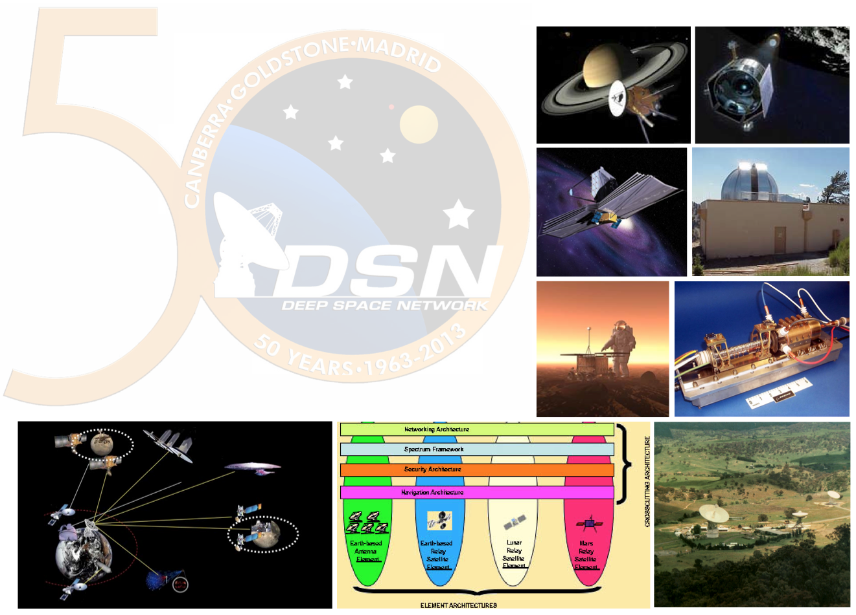
Modeling Systems-of-Systems Interfaces with SysML
Peter Shames, Marc Sarrel,
Jet Propulsion Laboratory, California Institute of Technology
Sandy Friedenthal, SAF Consulting
SpaceOps 2016, 16-20 May 2016
Daejeon, Korea
© 2016 California Institute of Technology. Government sponsorship acknowledged.

Slide 2
Introduction – End-To-End Space Data Systems
End-to-End space data systems are inherently systems of systems
Typically composed of spacecraft and mission operations systems (MOS) that belong to one (or more) organizations, and multi-mission communication assets that belong to another organization.
  “The greatest leverage in system architecting is at the interfaces. The greatest dangers are also at the interfaces.” Maier, 1998
So … how to accurately describe, model, and characterize these systems and their interfaces?

Slide 3
System-of-Systems Interfaces
Considerations
Each major system has interfaces
The elements within each system have interfaces
Interfaces include the connection points on the interacting elements, the items that are exchanged, the constraints and/or rules that govern the exchange, and the medium for the exchange (i.e. link)
Multi-layered communications interfaces include application layer to physical layer
  For some interfaces the link aspects can drive performance (e.g. atmospheric affects of various signals)
  For other interfaces protocol behavior and data transformations can drive performance (e.g. end-to-end throughput)

Slide 4
System-of-Systems Interfaces
Considerations, contd
Different views may be used to address different concerns
  Different interface abstractions from logical flows to complete protocol stacks
  End-to-end data flows, connectivity, and data transformations
  Physical connections
  Protocol specifications
  Message definitions
  Complete interface specifications that span discipline concerns
The type and detail of interface information for each view must be consistent

Slide 5
A Simple Example of Interface Stack Specification
The simple view is “boxes and lines”
  What are the interfaces?
  What are the protocols?
End-to-End simple view
  Send a PDF file from A to B.
  This is the requirement, what the user sees.
Interface Specification
  Implemented with HTTP, TCP, IP and Ethernet.
  Each component is connected both horizontally and vertically.
Simple lists of interface protocols are just not sufficient to understand the architecture
Notes:
Ask Marc for elaboration of last bullet;
Examples: gradient coloring, constraint layout,

Slide 6
A Simple Example of Interface Stack Specification - Details
The simple view is “boxes and lines”
  What are the interfaces?
  What are the protocols?
End-to-End simple view
  Send a PDF file from A to B.
  This is the requirement, what the user sees.
Interface Specification
  Implemented with HTTP, TCP, IP and Ethernet.
  The protocol stacks in each component are connected both horizontally and vertically..
Simple lists of interface protocols are just not sufficient to understand the architecture
Notes:
Ask Marc for elaboration of last bullet;
Examples: gradient coloring, constraint layout,

Slide 7
Focus May be on the Protocol at a Layer or on the Interface Stack
Different views enforce separation of concerns.
We can focus on just the TCP layer.
  How it is connected (horizontally).
  How it behaves (horizontally).
We can focus on just the stack.
  How it is connected (vertically).
  How it behaves (vertically).
Data logically flows across the horizontal layers, the TCP spec describes the behavior of the peer protocol entities.
Data actually flows “down the stack” through each successive layer until it gets to the physical layer where the “real” connections occurs.
“On the wire” the whole stack is visible.
Notes:
Ask mark to elaborate “has implications…”

Slide 8
Notes on the System Interface Modeling Method
The method is intended to allow complete modeling of systems components, their interfaces, protocols, and protocol behaviors.
  Supports evolution of detail as design progresses
Several different views of these interfaces are presented.
Only selected views need to be used to address specific concerns (e.g., logical data flow, protocol stacks and behavior, message definition, physical interconnection).
Appropriate use of the method, starting with the basic views, allows other views and details to be added when and where they are required.

Slide 9
End-to-End Space Data System Example

Slide 10
Overall Mission Model Context
Provides an End-to-End view of the whole context
Shows the major physical elements that are being modeled
Shows a coarse grained decomposition of the major system elements
Shows the nature of the connections and the high level data flows
Does not show organizations, ownership, or operational details, but views based on this could be developed to address these concerns
Does not show interface or protocol details (yet…)

Slide 11
End-to-End Protocol View
Major communications systems from the End-to-End view
  Shows End-to-End high level protocol flows
  Shows typical CCSDS space communications standards in relationship to major system elements
Interface Specification
  Shows only the top level ports, protocol types, and data flows
  Does not show interface nor protocol stack details

Slide 12
End-to-end Space Data System Flows and Connectivity
Unlike terrestrial systems, space data systems use a variety of different protocols in order to communicate end-to-end.
Often these are asymmetric, with different protocols used for forward and return data paths.
These protocols may be locally developed and used within a single organization, or standard, interoperable, ones like CCSDS.
Terrestrial space communication assets are usually multi-mission and typically offer standard cross support interfaces like SLE or CSTS.

Slide 13
Modeling the Spacecraft System Decomposition – “Black Box” View
Shows one of the systems from the End-to-End view
  Shows a partial decomposition and component relationships
  Shows hardware and software relationships
Interface Specification
  Shows only the top level ports and data flows and type of data
  Does not show interface details nor protocol stacks

Slide 14
Modeling the Interface – Protocol Stack Details ”White Box” View

Slide 15
Interface Model – Protocol Stack Details
Shows the details of the interface protocol stack
Defines the Interface Binding Signature
  Application layer: packet transfer protocol, manages exchange of packet data between applications.
  Transport layer: Transmission Control Protocol (TCP), provides end-to-end, once only, in order, complete delivery of data.
  Network layer: Internet Protocol (IP), provides network layer routing over any number of intermediate network nodes.
  Data link layer: 1 Gb Ethernet, provides data link layer services that may involve a fabric of switches and hubs.
  Physical layer: twisted pair cable (Cat-5) and RJ-45 plug terminations.
Distinguishes which components own the physical layers and which the data layers

Slide 16
Protocol Entity Interfaces
Every protocol entity has three ports: the interface that provides services to the upper (N+1) layer; the interface that requires services of the lower (N-1) layer; and the interface with the peer protocol entity at the same layer
There may also be a management interface, which can be in-line or separate

Slide 17
Protocol Entity Port Details
Description of protocol entity ports:
  Provided service port: the services offered to any upper layer (N+1) protocol, defined as an abstract service and using a layer N Service Data Unit (passes SDUs)
  Required service port: the services required from any lower layer (N-1) protocol, defined as an abstract service and using a layer N-1 Service Data Unit (passes SDUs)
  Peer protocol port: the port that enables the protocol entity to interact with its peer entity at the same layer, defined by the protocol specification and using the layer N Protocol Data Units (exchanges PDUs)
  Protocol management may be in-line with the protocol, via a MIB, or a separate interface

Slide 18
Protocol Behavior Specification - TCP Protocol
State Machine Example
Protocol behavior specification
Might be described as:
  State machine
  or …
  State tables
  Sequence diagrams
  Simple English text
State machines are clear, formalized, and integrated with the rest of the model

Slide 19
Protocol Behavior Description
Describes how a protocol entity behaves when receiving a Protocol Data Unit (PDU) from a peer entity
Describes the exchange(s) of PDUs between peers
May describe the behavior at the required and provided interfaces, such as start-up, connection establishment, and SDU transformation into PDUs
Typically involves describing the dynamics of PDU exchanges, including nominal and error conditions

Slide 20
Interface Compliance Specification Example TCP, RFC 793

Slide 21
Interface Compliance Specification Details
Where necessary, interfaces may be defined by a full stack specification and by tying the details of each layer not just to a whole standard, but to specific sub-sections of a standard
Compliance includes interface data, PDU structures, and behavior as illustrated by a state machine or by activity, and sequence diagrams.
Compliance is captured explicitly in the model by the “Satisfies” notation shown on the diagram.
If the protocol at any given layer is fully specified in a published standard, just using “Satisfies” for these layers may be adequate

Slide 22
Modeling Flexibility – Re-use of Components and Views
Models may contain multiple views, from top level context, to composition and components, and down to low level interface and protocol details
Appropriate use of carefully chosen stereotypes and views allows different levels of abstraction to be expressed clearly
Development of libraries of components and of protocol entities allows them to be re-used and combined as needed in different views
Different views allow the systems, and systems-of-systems, to be understood from different perspectives and at different levels of detail, as needed

Slide 23
Systems-of-Systems Interface Modeling Benefits
The method permits space data systems, and systems-of-systems, their structure and interfaces, to be modeled with a high degree of fidelity
Not all systems require all of these layers of details
Adopting a principled approach to component and interface modeling allows successive levels of detail to be added as and when needed
A well constructed partial model can document systems, interfaces, and behavior at a much deeper level of specificity than is typical in an ICD “protocol list” or “boxes and lines” diagrams
Inclusion of clear descriptions of connectivity and composition, and mapping to specifications and behaviors, supports analysis of flow and continuity, and design of interfaces
Further parametrization of the interfaces can be used to support analysis of end-to-end behavior and performance

Slide 24
References
[1] Object Management Group. OMG Systems Modeling Language (OMG SysML™). V1.4. Available at: http://www.omg.org/spec/SysML/.
[2] A Practical Guide to SysML, The Systems Modeling Language, Third Edition by Sanford Friedenthal, Alan Moore, and Rick Steiner, Morgan Kaufmann, 2014
[3] Shames, Peter M, Sarrel, Marc A, Freidenthal, Sanford A, A Representative Application of a Layered Interface Modeling Pattern, to be published 26th Annual INCOSE International Symposium (IS 2016), Edinburgh, Scotland, UK, July 18-21, 2016
[4] Shames, Peter M, Sarrel, Marc A, A modeling pattern for layered system interfaces, 25th Annual INCOSE International Symposium (IS2015), Seattle, WA, July 13 – 16, 2015
[5] Postel J., “Transmission Control Protocol,” RFC 793, September 1981.
[6] Zaghal, R, Khan, J, EFSM/SDL modeling of the original TCP standard (RFC793) and the Congestion Control Mechanism of TCP Reno, Kent State University report, TR2005-07-22-tcp-EFSM.pdf, 2005
[7] Information technology - Open Systems, Basic Reference Model, ISO/IEC 7498-1, revised June, 1996
[8] Systems and software engineering — Recommended practice for architectural description of software-intensive systems, ISO/IEC 42010, July 2007, revised 2011
[9] Reference Architecture for Space Data Systems (RASDS), CCSDS 311.0-M-1, Sept 2008
[10] Consultative Committee for Space Data Systems, CCSDS Space Packet Protocol, CCSDS 133.0-B-1c2, Sept 2010
[11] Jackson, et al., “Architecting the Human Space Flight Program with Systems Modeling Language (SysML)”, Infotech 2012, AIAA 2012-2556.
[12] Karban, et al., “MBSE Initiative – SE2 Challenge Team, Cookbook for MBSE with SysML, Issue 1, INCOSE, 2011.

